Slide 1
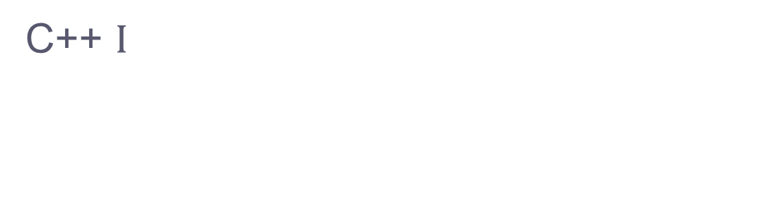
CSE 333 – SECTION 4
C++ $Ι$

Slide 2
Overview
Pointers vs. references
Const
Classes, constructors, new, delete, etc.
More operator overloading

Slide 3
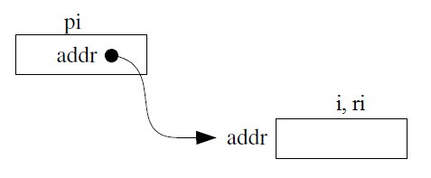
This or That?
Consider the following code:
Pointers: References:
int i; int i;
int *pi = &i; int &ri = i;
They are used differently in expressions:
*pi = 4; ri = 4;

Slide 4
Pointers and References
Once a reference is created, it cannot be later made to reference another object.
Compare to pointers, which are often reassigned.
References cannot be null, whereas pointers can.
References can never be uninitialized. It is also impossible to reinitialize a reference.

Slide 5
When to Use?
Function parameter types and return types and functions that declare overloaded operators.
Pointers: may point to many different objects during its lifetime. Pointer arithmetic (++ or --) enables moving from one address to another. (Arrays, for e.g.)
References: can refer to only one object during its lifetime.
Style Guide Tip:
use const reference parameters to pass input
use pointers to pass output parameters
input parameters first, then output parameters last

Slide 6
C++ const Declaration
As a declaration specifier, const changes the type to make the data bits unmodifiable.
const int m = 255;
Pointer/Reference to constant integer:
int n = 100;
const int *pi = &n; //*pi is read only
const int &ri = n; //ri is read only

Slide 7
C++ Classes
/* Note: This code is unfinished! Beware! */
class Point {
public:
Point(const int x, const int y); // constructor
int get_x() { return x_; } // inline member function
int get_y() { return y_; } // inline member function
double distance(const Point &p); // member function
void setLocation(const int x, const int y); //member function
private:
int x_; // data member
int y_; // data member
}; // class Point

Slide 8
C++ Classes
Encapsulation and Abstraction
Access specifiers:
Public: anything outside the class can access it
Protected: only this class and derived classes can access it
Private: only this class can access it
Polymorphism
Multiple Inheritance

Slide 9
Constructors and Destructors
Function called when an object of a class is created
Initializes the data members of a class
Has the same name as the class
Types –
Default – also called the empty constructor
Parameterized – Has arguments
Copy – Pass another already constructed object of the same class
Destructors are invoked implicitly when a class instance is deleted / goes out of scope

Slide 10
new and delete
new is used to allocate objects and primitive data types on the heap
delete is used to deallocate these heap allocated objects
Use “delete [ ] array” on an array
Unlike malloc() and free(), new and delete are operators

Slide 11
Initialization vs Assignment
#define MAXSIZE 3
class IntArrayList {
public:
IntArrayList() : array_(new int[MAXSIZE]), len_(0), maxsize_(MAXSIZE) { }
IntArrayList(const int *const arr, size_t len) : len_(len), maxsize_(len_*2) {
array_ = new int[maxsize_];
memcopy(array_, arr, len * sizeof(int));
}
IntArrayList(const IntArrayList &rhs) {
len_ = rhs.len_;
maxsize_ = rhs.maxsize_;
array_ = new int[maxsize_];
memcopy(array_, rhs.array_, maxsize_ * sizeof(int));
}
...
private:
int *array_;
size_t len_;
size_t maxsize_;
};
Notes:
1. For objects of built-in types like long and int, there is no difference in cost between initialization and assignment
2. For user-defined classes, it will often be more efficient. The assignment-based version first called default constructors to initialize the fields, then promptly assigned new values on top of the default-constructed ones.
3.When you have a variable of a class with no default constructor, initialization list is required.

Slide 12
Operator Overloading
A form of polymorphism.
Give special meanings to operators in user-defined classes
Special member functions in classes with a particular naming convention
For E.g., for overloading the ‘+’ operator, define a member function named operator+

Slide 13
Common Operators
The most commonly overloaded operators are
= (assignment operator)
+ - * (binary arithmetic operators)
+= -= *= (compound assignment operators)
== != (comparison operators)

