Slide 1
Flush-Based Attacks

Slide 2
Today
Flush+Reload
Recovering missing bits from RSA keys
Performance degradation attacks
Flush+Flush

Slide 3
Bridging the gap
Cache utilises locality to bridge the gap
Divides memory into lines
Stores recently used lines
In a cache hit, data is retrieved from the cache
In a cache miss, data is retrieved from memory and inserted to the cache
Processor
Cache
Memory
Notes:
Another thing that changed since my Apple // days is the processor speed. My apple 2 ran at 1 MHz. My mac runs at 2GHz. Memory speed, however, has not fared so well. The memory on my apple needed half a clock cycle to produce data, whereas modern computers require about 200. When the processor reads from memory it needs to wait. <click> and if it needs to read from the same location again it needs to wait again. <click>. So, we have a speed gap between the processor and the memory.
The cache is the part of the processor that bridges this gap. It is a small memory that is included within the processor. Being small, being closer to the execution core and using more expensive technologies than the main memory mean that the cache is much faster than the memory. On intel the spead ranges from 4 to 50 cycles, depending on the level of cache.
Yada yada

Slide 4
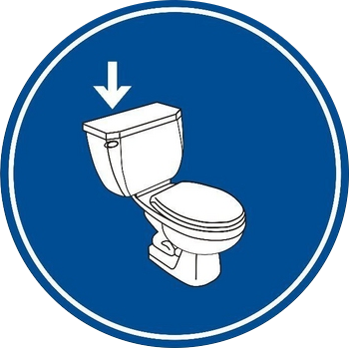
Cache Consistency
Memory and cache can be in inconsistent states
Rare, but possible
Solution: Flushing the cache contents
Ensures that the next load is served from the memory
Processor
Cache
Memory

Slide 5


The Flush+Reload Attack
Processor
Flush a memory line from the cache
Wait a bit
Measure time to load line
slow-> no access
fast-> access
Repeat
Cache
Memory
Notes:
Reminder: Fast 50 cycles. Slow 200. Measurement adds about 30 cycles.
Wrap-up – the weakness is that the spy can monitor access to shared memory lines and consequently infer information about the data the victim processes

Slide 6
Flush+Reload
flush
wait wait wait wait
Reload
flush
wait wait wait wait
Reload
flush
wait wait wait
Time

Slide 7
Flush+Reload
Victim
working working
access
working working
Spy
flush
wait wait wait wait
Reload
flush
wait wait wait wait
flush
wait wait wait
Time

Slide 8
Detour - Virtual Memory
Processes execute within a virtual address space
Virtual pages map to physical frames

Slide 9
Sharing
Frames can be shared by multiple processes
Read only sharing maintains functional isolation
Protection using Copy-on-write

Slide 10
Causes of sharing
Content-aware sharing
Pages from the same file have identical content
Shared program or library code
Can also share constant data
Shared images in PaaS clouds
Content-based sharing (a.k.a. page deduplication)
The system identifies and coalesces identical pages
Implemented in many hypervisors and in most modern operating systems

Slide 11
Demo

Slide 12


The RSA Encryption System
The RSA encryption is a public key cryptographic scheme
M
M = C^{d} mod N
C
C = Me mod N
Key Generation:
Select random primes p and q
Calculate N = pq
Select a public exponent e(=65537)
Compute d=e⁻¹ mod φ(N)
(N, e) is the public key
(p, q, d) is the private key

Slide 13
Square and Multiply Exponentiation
x ⟵1
for i ⟵|d|-1 downto 0 do
x ⟵x² mod n
if (d_{i} = 1) then
x = xC mod n
endif
done
return x
Operation | x | i | d_{i}
 | 1 | 2 | 101
Square | 1 | 2 | 101
reduce | 1 | 2 | 101
Multiply | 11 | 2 | 101
reduce | 11 | 2 | 101
Square | 121 | 1 | 101
reduce | 21 | 1 | 101
Square | 441 | 0 | 101
reduce | 41 | 0 | 101
Multiply | 451 | 0 | 101
reduce | 51 | 0 | 101
The private key is encoded in the sequence of operations !!!
Example:
11⁵ mod 100 =
161,051 mod 100 = 51
Notes:
Old implementation – not in use

Slide 14
Demo

Slide 15
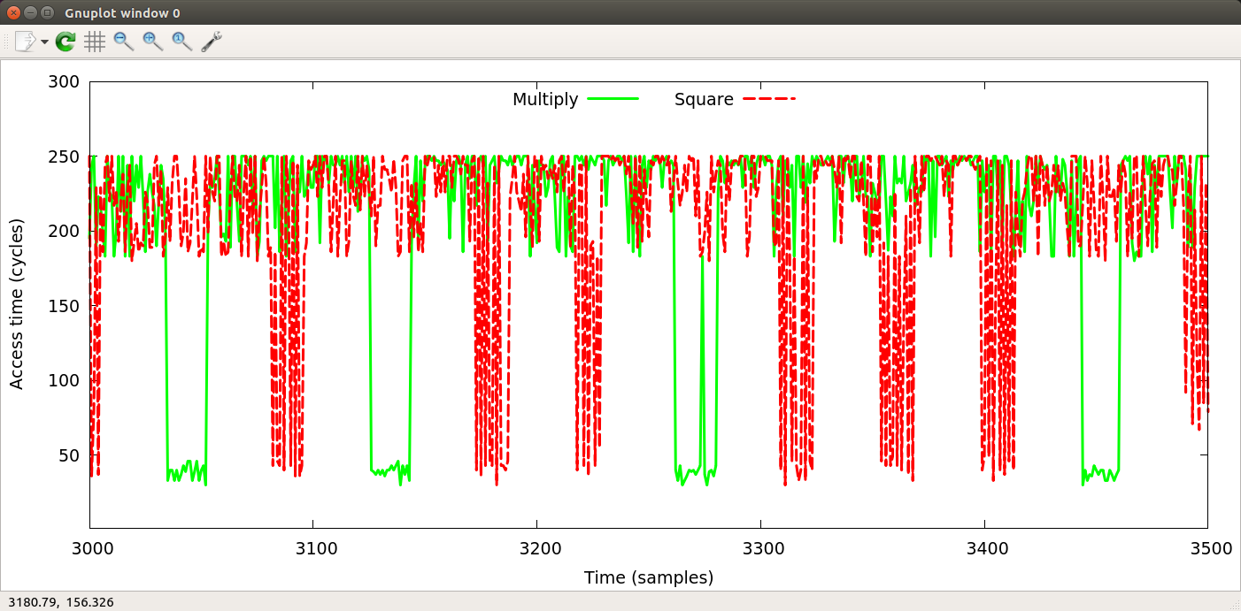
Flush+Reload on Square-and-Multiply

Slide 16
Why not AMD?
Multilevel cache hierarchy
Inclusive LLC: stores copies of all data in higher level caches
Exclusive LLC: does not store data cached in higher level caches
Non-inclusive LLC: not strictly inclusive. (Can be exclusive.)
Core 0
Core 1
L1-I
L1-D
L1-I
L1-D
L2
L2
LLC

Slide 17
Defences

Slide 18
Performance Degradation
Allan et al. “Amplifying Side Channel Through Performance Degradation” ACSAC 2016
See also: Cabrera Aldaya and Brumley. “HyperDegrade: From GHz to MHz Effective CPU Frequencies”, USENIX Security 2022

Slide 19
Flush+Reload
Victim
working working
access
working working
Spy
flush
wait wait wait wait
Reload
flush
wait wait wait wait
flush
wait wait wait
Time

Slide 20
Timing matters
Victim
working working
access
working working
Spy
flush
wait wait wait wait
Reload
flush
wait wait wait wait
Reload
flush
wait wait wait
Time
Access missed due to temporal overlap

Slide 21
Probability of a probe miss
Ratio of probe time to slot length

Slide 22
Probing OpenSSL ECDSA
For secp256k1, operation times are:
Addition: 2,892 cycles
Doubling: 3,086 cycles
Everything else: negligible
To avoid aliasing errors, need to probe at least once every 1,450 cycles
Limitations on probing
Each probe takes 450 cycles.
At the required probe rate, we can expect a 37% miss rate

Slide 23
Solution: slow the victim down
Flushing data or code forces the victim to retrieve it from the memory
Performance degradation attack:
Find frequently used code lines
For example, usingprofiling information
Repeatedly flush them from the cache
Processor
Cache
Memory
Notes:
Reminder: Fast 20ns. Slow 80ns including a 10ns measurement overhead
Note that the attack works across cores.

Slide 24
SPEC Results

Slide 25
Attacking OpenSSL
Use two threads to flush three addresses spanning the inner loop in the bignum multiplication code
Add slowed by a factor of 53 (153,709 cycles)
Double slowed by a factor of 41 (126,282 cycles)
Monitor four memory locations: one in add, one in double and two in the call chain of invert
Probe each monitored location once every 17,000 cycles

Slide 26
Flush+Flush
Gruss et al. “Flush+Flush: A Fast and Stealthy Cache Attack”, DIMVA 2016

Slide 27
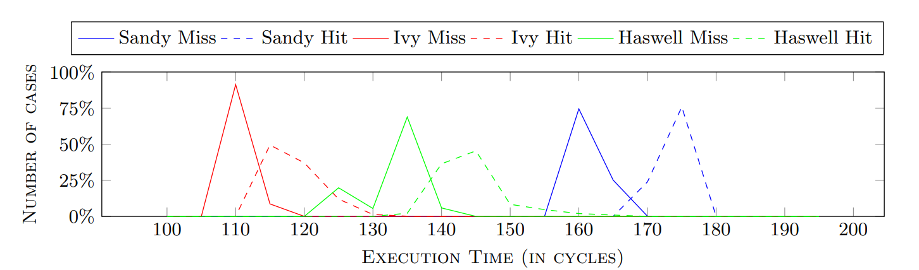
Flush+Flush
Flush time depends on cache residency
Small differences, variable baseline

Slide 28
Improvements
Timing depends on core and slice. Can improve accuracy through calibration
Didier and Maurice, “Calibration Done Right: Noiseless Flush+Flush Attacks.”, DIMVA 2021
Avoiding fences increases difference between hit and miss
Ding et al., “A Cross-Platform Cache Timing Attack Framework via Deep Learning”, DATE 2022

Slide 29
Summary
Flush+Reload and related attacks
Amplification through performance degradation
Next: Prime+Probe Attacks
Read: Osvik, Shamir, and Tromer, “Cache attacks and Countermeasures: The Case of AES”, CT-RSA 2006

