Slide 1
Prime+Probe

Slide 2



Cache Attacks
Program
History
Cache
State
Execution
Time

Slide 3
Cache Attacks
Program
History
Cache
State
Execution
Time

Slide 4
Bridging the gap
Cache utilises locality to bridge the gap
Divides memory into lines
Stores recently used lines
In a cache hit, data is retrieved from the cache
In a cache miss, data is retrieved from memory and inserted to the cache
Processor
Cache
Memory
Notes:
Another thing that changed since my Apple // days is the processor speed. My apple 2 ran at 1 MHz. My mac runs at 2GHz. Memory speed, however, has not fared so well. The memory on my apple needed half a clock cycle to produce data, whereas modern computers require about 200. When the processor reads from memory it needs to wait. <click> and if it needs to read from the same location again it needs to wait again. <click>. So, we have a speed gap between the processor and the memory.
The cache is the part of the processor that bridges this gap. It is a small memory that is included within the processor. Being small, being closer to the execution core and using more expensive technologies than the main memory mean that the cache is much faster than the memory. On intel the spead ranges from 4 to 50 cycles, depending on the level of cache.
Yada yada

Slide 5
Set Associative Caches
Memory lines map to cache sets. Multiple lines map to the same set.
Sets consist of ways. A memory line can be stored in any of the ways of the set it maps to.
When a cache miss occurs, one of the lines in the set is evicted.
Sets
Ways
Memory

Slide 6


The Prime+Probe Attack [OST06]
Allocate a cache-sized memory buffer
Prime: fills the cache with the contents of the buffer
Probe: measure the time to access each cache set
Slow access indicates victim access to the set
The probe phase primes the cache for the next round
Memory

Slide 7
Demo

Slide 8
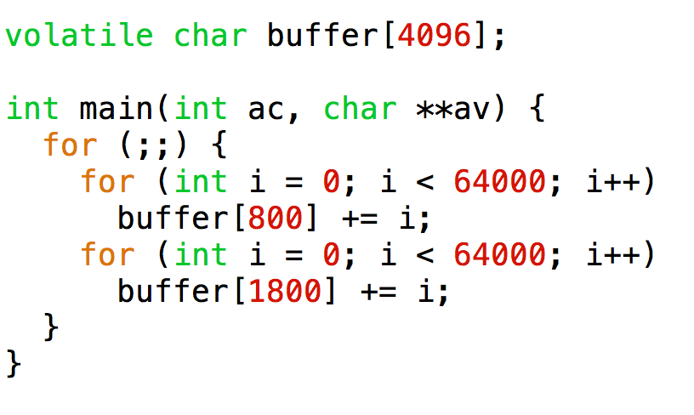
Sample Victim: Data Rattle

Slide 9
Cache Fingerprint of the Rattle Program

Slide 10
Finding Eviction Sets
0 | 1 | 2 |  | 63
64B | 64B | 64B | · · · | 64B
64B | 64B | 64B | · · · | 64B
· · · | · · · | · · · | · · · · · · · · · | · · ·
64B | 64B | 64B | · · · | 64B
12
11
6
5
0
Address
Tag
Set
Offset

Slide 11
Out-of-Order Execution
RTDSCP
MOV ESI, RAX
LFENCE
MOV RBX, [RDI]
MOV RBX, [RDI + 4096]
…
MOV RBX, [RDI + 28672]
RDTSCP
SUB EAX, ESI
RDTSC
(hit)
RDTSC
(miss)
Out-of-Order Execution can mask cache misses

Slide 12
Controlling Execution Order
RDTSC
(hit)
RDTSC
(miss)

Slide 13
Creating Dependencies
XOR ECX, ECX
RTDSCP
MOV ESI, RAX
ADD ECX, [RDI + ECX]
ADD ECX, [RDI + ECX + 4096]
…
ADD ECX, [RDI + ECX + 28672]
RDTSCP
SUB EAX, ESI
RTDSCP
MOV ESI, RAX
MOV RDI, [RDI]
MOV RDI, [RDI]
…
MOV RDI, [RDI]
RDTSCP
SUB EAX, ESI
Percival (2005)
Set memory to zero
Use arithmetic to force dependencies
Osvik, Shamir, Tromer (2006)
Follow a linked list
Also known as Pointer chasing

Slide 14
Fighting the Prefetcher
Prefetchers try to pre-emptively load data into caches to serve identified access patterns.
A common pattern is accessing memory at fixed steps.
Scanning an array.
Prefetching in Prime+Probe may kill the attack
Solution: Randomize probe order
75
77
79
81
A
A+s
A+2s
A+3s
A+4s
0 | 1 | 2 |  | 63

Slide 15
Attacking AES
Plaintext
$$plaintex ⊕roundkey$$
AddRoundKey
SubBytes
ShiftRows
MixColums
AddRoundKey
Lookup table
x9
SubBytes
ShiftRows
AddRoundKey
Ciphertext

Slide 16
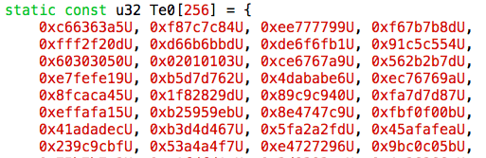
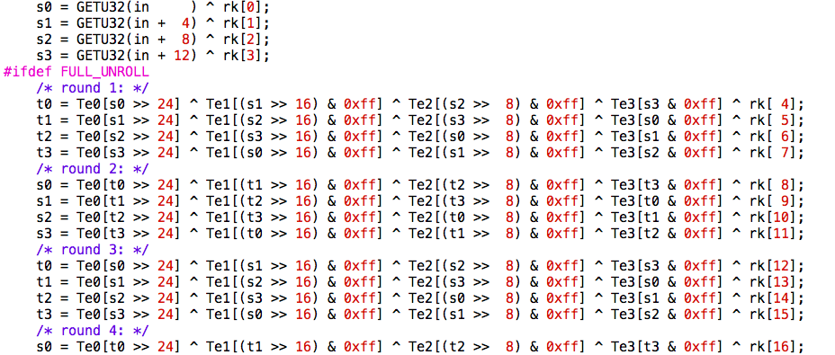
Attacking AES

Slide 17
AES T-table access
s0 = plaintext ^ key
t0 = Te0[s0>>24]
Assume we know the plaintext and the index (s0>>24)
We can recover the most significant byte of the key

Slide 18
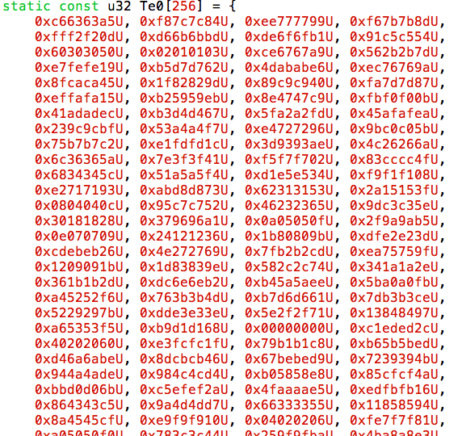
Spatial Resolution
s0 = plaintext ^ key
t0 = Te0[s0>>24]
Prime+Probe detects access to cache sets
Can only get the four MSBs of the index
Aliasing is not a problem
For this attack!
Cache Line 0
Cache Line 1
Cache Line 2
Cache Line 3
Cache Line 4
Cache Line 5

Slide 19
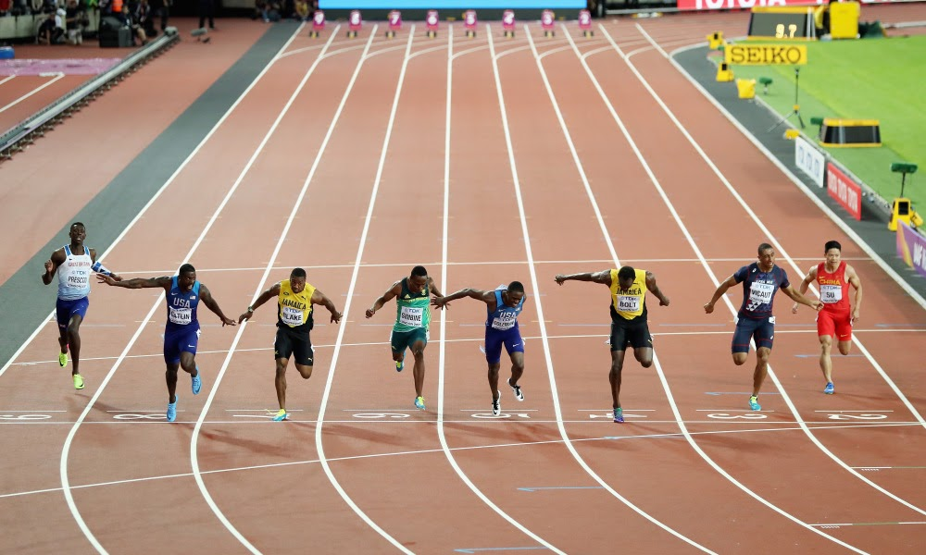
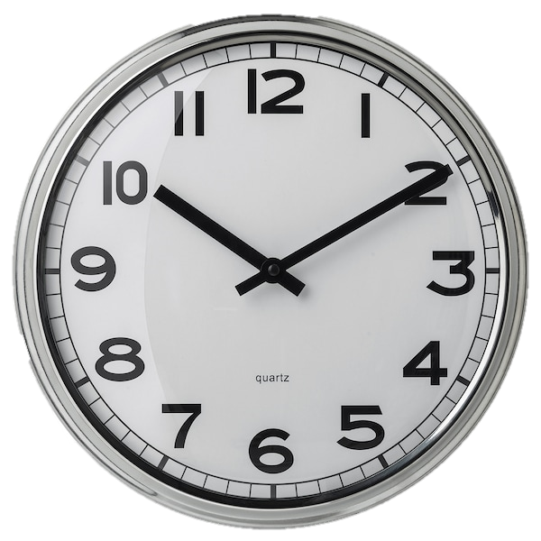

Temporal Resolution
Probing 64 cache sets takes a minimum of $∼20⋅64=1280$ cycles
AES encryption takes about 112 cycles
How do we measure only the first access?
Measure this
With this

Slide 20
Synchronous Attack
s0 = plaintext ^ key
t0 = Te0[s0>>24]
Plaintext
Attack: Prime, AES, Probe
A table has 256 entries of 4 bytes each → 16 cache lines
Probability of no access to a cache set: (15/16)⁴⁰ or approx. 7.6%
On average ~5 cache lines not accessed during encryption
Eliminate impossible keys
$$plaintex ⊕roundkey$$
AddRoundKey
SubBytes
ShiftRows
MixColums
AddRoundKey
Lookup table
x9
SubBytes
ShiftRows
AddRoundKey
Ciphertext

Slide 21

Handling Noise
General strategy
Average
OS Activity
Remove outliers
Spy activity
Normalize

Slide 22
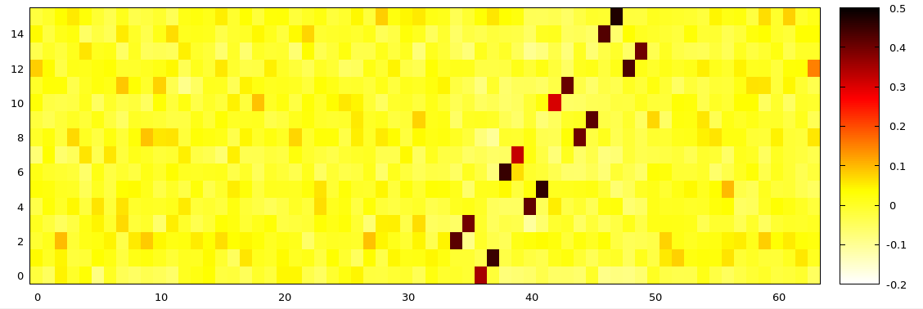
PP Attack on AES - Results

Slide 23
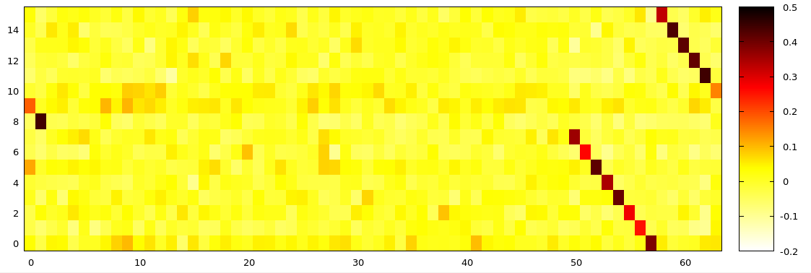
PP Attack on AES – More Results

Slide 24
Another look at the data
Given plaintext and a guess of a key byte, we can predict the probability that a cache line is accessed:
Cache line of p^key: 100%
Other lines in same table: 1-(15/16)³⁹ = 91.9%
Probe time correlates with cache misses

Slide 25
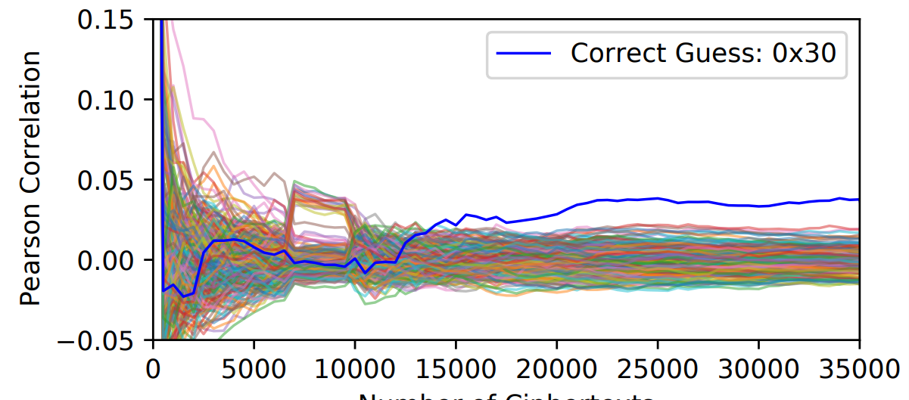

Correlation Attack
Pick a cache set in the table
For a sequence of plaintext do PP on the cache set (filter outliers)
For each key guess, determine probability of access to cache set
Compute the Pearson correlation between each key and measurements
Pearson correlation $r=\frac{\sum{(x_{i}−\overline{x})(y_{i}−\overline{y})}}{\sqrt{\sum{{(x_{i}−\overline{x})}^{2}}\sum{{(y_{i}−\overline{y})}^{2}}}}$

Slide 26
Final round attack
Plaintext
Given ciphertext and (last round) key guess, determine cache access
Correlation attack breaks the full key
AddRoundKey
SubBytes
ShiftRows
MixColums
AddRoundKey
x9
SubBytes
ShiftRows
AddRoundKey
Table Lookup
Ciphertext

Slide 27
L1-Instruction Cache
So far we targeted the L1 Data cache.
But there are other caches. Can we target them?
L1-I – caches program code.
Why do we need a separate cache?
Need to have code in specific memory location.
Core 0
Core 1
L1-I
L1-D
L1-I
L1-D
L2
L2
LLC
JMP .+4096
JMP .+4096
RET

Slide 28
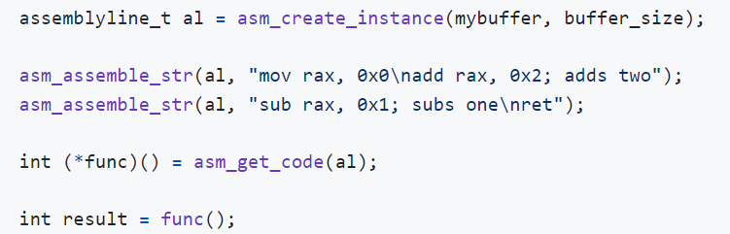

AssemblyLine
A library for generating assembly code
In active development – ask if interested

Slide 29
Summary
Prime+Probe
Attack theory
… and practice
Attacking AES
Ideal scenario
Basic noise handling
Correlation attacks
Next lecture
Recovering partial RSA keys
Read: Heninger and Shacham, “Recovering RSA Private Keys from Random Key Bits”, CRYPTO 2009

