Slide 1

MSDS610 Week 2 Jennifer Steiner

Slide 2

US Chronic Disease Indicators https://catalog.data.gov/dataset/u-s-chronic-disease-indicators
High level Overview
“CDI provides valuable surveillance data that public health professionals, researchers, and policymakers can use to track chronic diseases and their risk factors at the national and state level. It compiles estimates from various data sources, including surveys, vital records, and administrative data. It uses standardized definitions to allow comparisons at national and state levels.”
https://www.cdc.gov/cdi/about/?CDC_AAref_Val=https://www.cdc.gov/cdi/overview.html

Slide 3
Available data fields
Field | description | datatype | Relevance
YearStart | Value between 2016 and 2024 | discrete | can be used for time frames
YearEnd | Value between 2016 and 2024 | discrete | can be used for time frames
LocationAbbr | State abbreviation | nominal | can be used for state to state or national comparisons
LocationDesc | state name | nominal | can be used for state to state or national comparisons
DataSource | Where the data was collected from | nominal | can be used to filter data out from certain data sources or for certain data sources, depending on what results the ML yieldsd
Topic | Type of illness | nominal | can be used to filter the data to a specific illness
Question | Question being answered | nominal | can be used to narrow down the responses by illnesses
Response | Numeric value for anser | Continuous | This should be valuable when manipulating the data
DataValueUnit | Unit measurement unit | nominal | This makes a difference when looking at the populatin (i.e. per 100k, all, etc)
DataValueType | Unit measurement type | discrete | This explains if it is crude, age adjusted, etc.
DataValue | value of data unit (i.e. 44/yrs) | discrete | This is the value for the prevoius 2 fields--so 44 years old kind of thing. Field will be used for age range, and population calcs
DataValueAlt | alternate value of data unit | discrete | same as previous field
DataValueFootnoteSymbol | This is either null or * | nominal | not sure yet
DataValueFootnote | The actual footnote | nominal | not sure yet
LowConfidenceLimit | Unclear
HighConfidenceLimit | Unclear
StratificationCategory1 | First grouping category | discrete | Defines the grouping being used for the record
Stratification1 | Value of the group | nominal | the value of the group
StratificationCategory2 | Second grouping category | discrete | Defines the grouping being used for the record
Stratification2 | value of group | nominal | the value of the group
StratificationCategory3 | Third grouping category | discrete | Defines the grouping being used for the record
Stratification3 | Value of Group | nominal | the value of the group
Geolocation | The geo location id | Continuous | I don't think I'll use this field. It appears to be a true geo location and not useful in terms of what we're doing
LocationID | Location id as int | Continuous | I'm sure there is a correlation between this and the state abbreviation
TopicID | The CDI topic (i.e. DIA, AST…etc) | discrete | This is an abbreviation for the topic--I am not sure if I'll use it or not
QuestionID | This is the CDI topic with the id of the question | nominal | this is the abbreviation plus question #--it may be useful in the manipulations, as it means I won't have to do dummies
ResponseID | The response id | nominal | same as previous field
DataValueTypeID | The data value type (i.e. "AGEADJRATE" or CRD) | discrete | this is also an abbreviation for a previous field
StratificationCategoryID1 | What stratification was used | discrete | this is the abbreviation for the grouping
StratificationID1 | The value of the stratification | nominal | abbreviation for the grouping category
StratificationCategoryID2 | What stratification was used | discrete | this is the abbreviation for the grouping
StratificationID2 | The value of the stratification | nominal | abbreviation for the grouping category
StratificationCategoryID3 | What stratification was used | discrete | this is the abbreviation for the grouping
StratificationID3 | The value of the stratification | nominal | abbreviation for the grouping category

Slide 4

Is it possible to predict which illness(es) are the most prevalent based on the data collected by the CDI web tool and based on the categories used by each data source? Can this be done using time series (start year/end year) analysis?
ML Goal

Slide 5
ML Plan?
Iterative process to determine which diseases should bee looked at along with which categories.
Data Collection: CDI Import
Model Training
SQL DB
ETL/Data Processing/Cleanup
Deploy
Time Series data to predict which illnesses are most prevalent in the various targets.
Review outcome/maintenance adjust model as needed

Slide 6
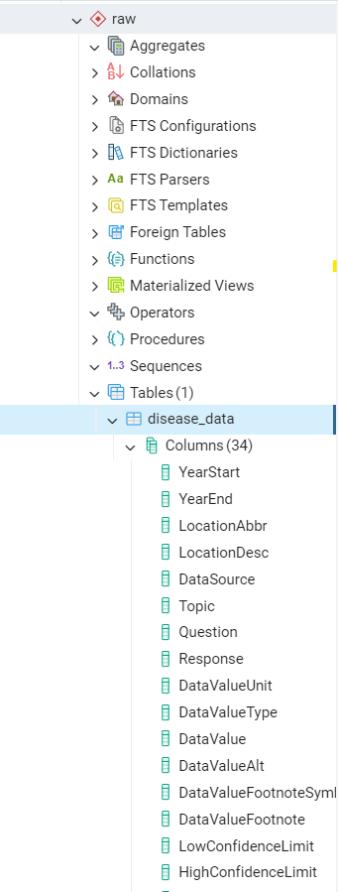
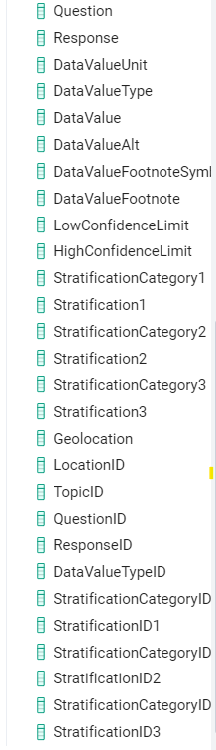
pgAdmin

