Slide 1
COMP4449-Capstone Final Project
Jesse St. John

Slide 2
General Guidance
This project analyzed the impact of climate factors and how they relate to bridge performance.
Currently bridges are evaluated using a Sufficiency Rating which is obtained from components that relate to structural adequacy and safety, serviceability and functional obsolescence, and essentiality for public use. No climate information is included in this rating.
This study brought in climate data from a period of 1992-2023 to supplement already available metrics and improve prediction of bridge condition.

Slide 3
STAR Summary
We can show across several algorithms, the addition of climate data into bridge condition modeling increased the overall performance of the model. Amongst the data utilized, we found that minimum temperature, max temperature, prevailing wind direction, average temperature, and average relative humidity were the most impactful climate features.
After consideration of multiple potential algorithms, an XGBoost Regressor was selected at the most optimal methodology.
Details of the project and model pipeline development are detailed within this document.

Slide 4
Situation
Original Question of Interest:
Does climate impact bridge deck joints and superstructure bearings, in particular the NBE condition states?
Blocked by Data
Availability is hit or miss
Data is messy and inconsistent
Zoom out and Refocus
Big Picture Question
Does climate impact overall bridge performance?

Slide 5
Task
How: Regression problem with bridge performance rating as target.
Motivation: If climate is found to be impactful in terms of predicting overall bridge performance, then arguments can be made for pushing for better data collection standards and/or overhaul of current modeling procedures.

Slide 6
Action
Data was pulled in from two different sources, which resulted in a bridges data set and a climate data set.
Each set was cleaned independently before merging on year and structure number of the individual bridge.
A new target was created from five measured bridge conditions to get an overall average bridge condition.
Three models were considered:
Model 1: no climate data, includes Sufficiency Rating
Model 2: no climate data, does not include Sufficiency Rating
Model 3: includes climate data, does not include Sufficiency Rating

Slide 7
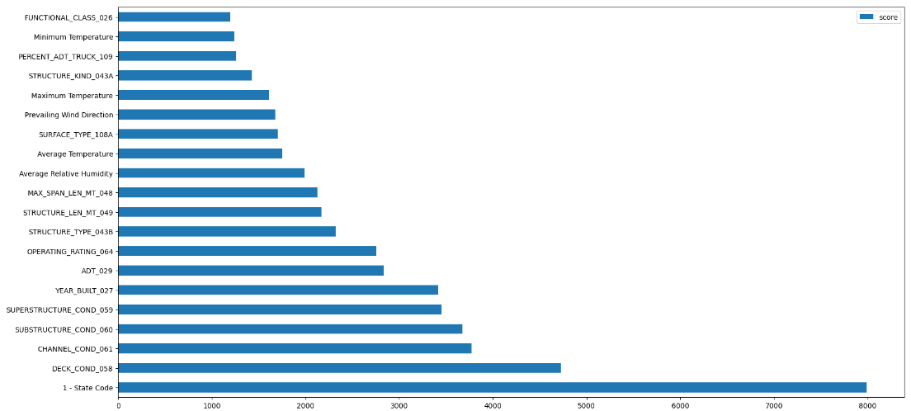
Results
We were able to show for 3 out of the 4 models that adding climate data greatly improved model performance when it came to predicting overall bridge condition.
Model 3 XGBoost Feature Importance

Slide 8
Model Pipeline
Raw Data
Input Layer
Predictions
…
Data Acquisition
Data Prep &
Feature Engineering
Model M
Working with a large set of tabular data.
Climate data is annual for each individual bridge.

Slide 9
Data Acquisition
Data was acquired from the following warehouses and tables:
Bridge Data
US Dept of Transportation Federal Highway Administration
Climate Data
LTBP InfoBridge

Slide 10
Data Preparation
Data was assessed and prepared with the following criteria:
Identification and removal of missing values
Most rows w/nulls were dropped
Imputation of 0 was used for Year of Reconstruction
Imputation of mean based off Year and Functional Class was used for Percent ADT Truck
Transformations
Several columns had to encoded for use (binary flags or encoded categories)
Skewness of ADT, Year Built, Traffic Lanes columns was handled using IQR approach
Feature Selection
Features used or like types used in existing deterioration models
Correlation analysis (Removal of redundancy)
Partitioning
Train-Test splits: 80-20 split
Scaling
Standardization of numerical features

Slide 11
Model Selection
Data requirements allowed the following algorithms to be considered:
Linear Regression
Elastic Net Regression
Decision Tree Regression
XGBoost Regression
Each model was evaluated using Adjusted R2 Criteria:
 | Model 1 | Model 2 | Model 3
LInear Regression | .4826 | .4177 | .9162
Elastic Net | .0753 | .0514 | .0514
Decision Tree | .5541 | .4979 | .9935
XGBoost | .8093 | .7733 | .9963

Slide 12
Model Interpretability
While the XGBoost Regressor was the champion model, the key take away is the overall improvement between variations.
The increase in the adjusted R2 score from .81 to .99 shows clearly that including climate features is important to modeling bridge performance. This is backed up by the feature importance breakdown of the model.

Slide 13
Future Opportunities
Now that we have shown that climate does have an impact on modeling bridge performance, if I had more time, I would revisit my original question and proceed with modeling with the data available.
Original question: Does climate impact bridge deck joints and superstructure bearings, in particular the NBE condition states?

Slide 14
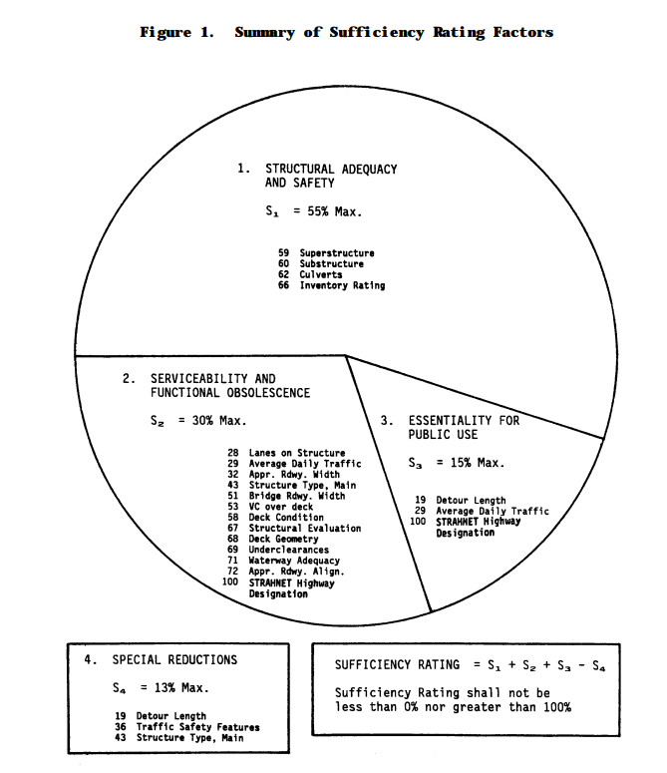
Appendix
Additional Explanation of Sufficiency Rating, as provided by USDOT
It is important to note, that this study focuses on the structural integrity of bridges. Thus, the following columns were initially selected as features.
STATE_CODE_001
STRUCTURE_NUMBER
SERVICE_LEVEL_005C
DIRECTION_005E
LAT_016
LONG_017
FUNCTIONAL_CLASS_026
YEAR_BUILT_027
TRAFFIC_LANES_ON_028A
TRAFFIC_LANES_UND_028B
ADT_029
MEDIAN_CODE_033
DEGREES_SKEW_034
STRUCTURE_FLARED_035
OPEN_CLOSED_POSTED_041
SERVICE_ON_042A
SERVICE_UND_042B
STRUCTURE_KIND_043A
STRUCTURE_TYPE_043B
APPR_KIND_044A
APPR_TYPE_044B
MAIN_UNIT_SPANS_045
APPR_SPANS_046
MAX_SPAN_LEN_MT_048
STRUCTURE_LEN_MT_049
DECK_COND_058
SUPERSTRUCTURE_COND_059
SUBSTRUCTURE_COND_060
CHANNEL_COND_061
CULVERT_COND_062
OPERATING_RATING_064
INVENTORY_RATING_066
STRUCTURAL_EVAL_067
DECK_GEOMETRY_EVAL_068
UNDCLRENCE_EVAL_069
WATERWAY_EVAL_071
APPR_ROAD_EVAL_072
DATE_OF_INSPECT_090
INSPECT_FREQ_MONTHS_091
FRACTURE_092A
UNDWATER_LOOK_SEE_092B
SPEC_INSPECT_092C
TEMP_STRUCTURE_103
YEAR_RECONSTRUCTED_106
DECK_STRUCTURE_TYPE_107
SURFACE_TYPE_108A
MEMBRANE_TYPE_108B
DECK_PROTECTION_108C
PERCENT_ADT_TRUCK_109
SCOUR_CRITICAL_113
SUFFICIENCY_RATING

Slide 15
Appendix
Columns w/Imputed Values in place of nulls:
Functional Class 026 → imputed as 0, other existing codes are scalers indicating a functional level of service (i.e. Rural Principal Arterial Interstate), 0 was used to aggregate this group of unknowns
Open Closed Posted → imputed as 0 (come back to this)
Year Reconstructed → imputed as 0, this column was then used to assist in creating a feature column called Relative Bridge Age which was ultimately not used, however, a year of 0 would be used to indicate the bridge has not been reconstructed
Percent ADT Truck → a mean value of percent ADT truck for each bridge was imputed based off the year and the functional class of the bridge
Inspect Freq Months → missing values were filled in using the ffill method, since due to current regulations bridges should be inspected at a minimum of every 24 months depending on condition, if the value is less, it should be carried forward

Slide 16
Appendix
Columns converted to binary flags:
Fracture, Underwater Look See, Spec Inspect → new flag feature columns were created from these columns based on whether there was a ‘Y/y’ or ‘N/n’ present in their value that would indicate additional concerns with bridge performance during the inspection
Date of Inspect → new feature column was created to indicate whether the bridge had been inspected that year or not instead of focusing on the specific date of inspection

Slide 17
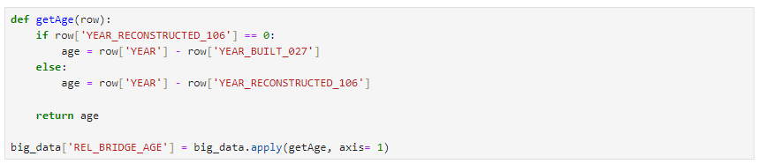
Appendix
Other important encodings:
DECK COND, SUPERSTRUCTURE COND, SUBSTRUCTURE COND, CHANNEL COND, CULVERT COND, STRUCTURAL EVAL, DECK GEOMETRY EVAL, UNDCLRENCE EVAL, WATERWAY EVAL, APPR ROAD EVAL, DECK STRUCTURE TYPE, SURFACE TYPE, MEMBRANE TYPE, DECK PROTECTION → all these features had ‘N’ for not applicable, this was replaced by ‘-1’ for consistency with coding of other features which are scalers and additionally came into play for easily identifying which features/condition evaluations to not include when creating target feature
Rel Bridge Age
This feature was created as follows:

Slide 18
Appendix
Distributions were checked for features and the most concerning ones were found to be for ADT, Year Built, Traffic Lanes On, and Traffic Lanes Und.
These distributions contained outliers that were eliminated using the IQR approach.
Rel Bridge Age also allowed for revealing inconsistent data in the Year Reconstructed feature (such as showing a year being built of 64). Bridges with a Rel Bridge Age of greater than 115 years were removed.

Slide 19
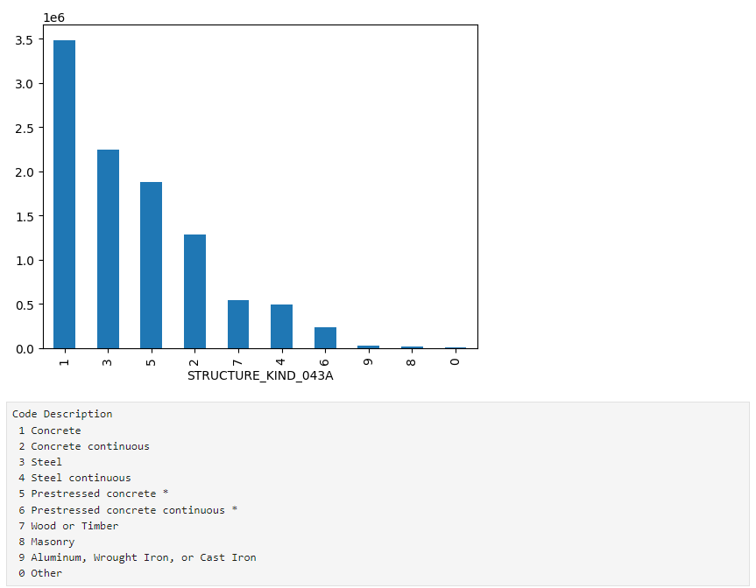
Appendix
Below is the distribution of the type of structure material over the bridge dataset (before combined with the climate data).
Due to the small representation of the latter types within the data set, we chose to focus only on the various types of steel and concrete bridges.

Slide 20
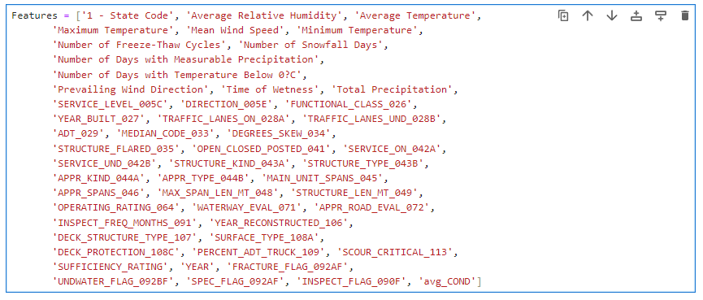
Appendix
After checking correlations, additional features were removed before merging the bridge data with the cleaned climate data. The resulting features can be seen below.

Slide 21
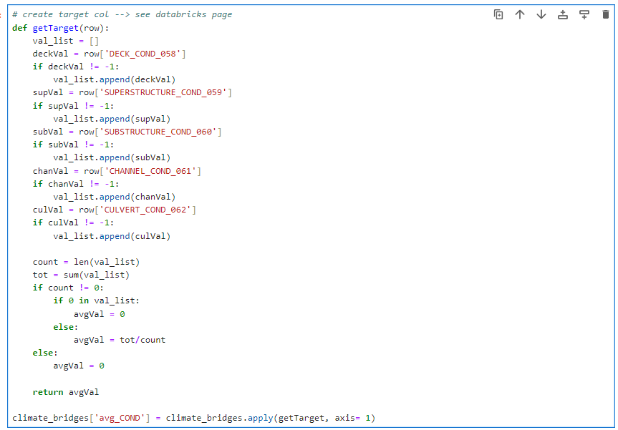
Appendix
Target Feature of Avg Cond (average condition) was created as follows:

Slide 22
Appendix
Model Setup Choice:
Model 1: Bridge Data w/Sufficiency Rating, w/out Climate Data → this was done to get a baseline while still including some of the information USDOT uses when calculating their Sufficiency Rating
Model 2: Bridge Data w/out Sufficiency Rating w/out Climate Data → this was done to get a separate baseline model that only focused on structural information
Model 3: Bridge Data w/out Sufficiency Rating w/Climate Data → this was done to show whether climate features had an impact on modeling prediction
Algorithm Choice:
Linear Regression: Easy to implement, straightforward to interpret
Elastic Net: Easy to implement, can handle multicollinearity, can help with feature selection
Decision Tree Regressor: Can handle more complex relationships between the features and target variables.
XGBoost Regressor: Like the decision tree, can model non-linear relationships that may be present in the data. Can help reduce overfitting by introducing randomness.

Slide 23
References
Summary Report: LTBP Program Data Collection Workshop. https://infobridge.fhwa.dot.gov/Content/Documents/Publications/LTBP_Data_Collection_Workshop_Summary_Report_Number_FHWA-HRT-22-015.pdf
Condition Rating Forecast of Bridge Components—MLM by Heng Lie, Ph.D, et al. https://infobridge.fhwa.dot.gov/Content/Documents/Models/Condition_Rating_Forecast_of_Bridge_Components_Machine_Learning_Models.pdf
Recording and Coding Guide for the Structure and Inventor and Appraisal of the Nation’s Bridges. https://rosap.ntl.bts.gov/view/dot/38886
National Bridge Inspection Standards. https://www.federalregister.gov/documents/2022/05/06/2022-09512/national-bridge-inspection-standards

