Slide 1
Build & Deployment

Slide 2


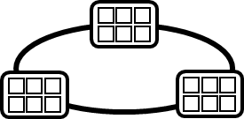

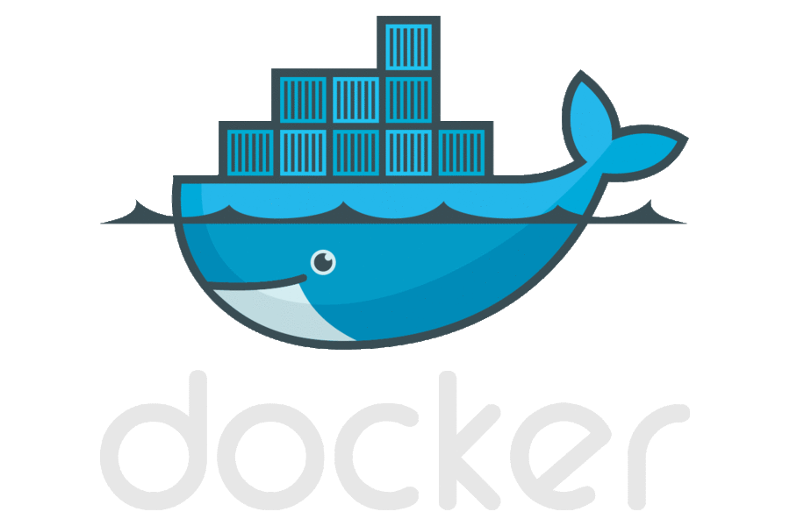




Containerized Workflow
2.
3.
4.
5.
Source Code Control
(SCC)
Build/CI,
Integrate,
Test
Run, Manage
CD, Deploy
Production
environments
Container Registry
Push
Code
Inner-Loop
6.
1.
Run
Code
Validate
Debug

Slide 3
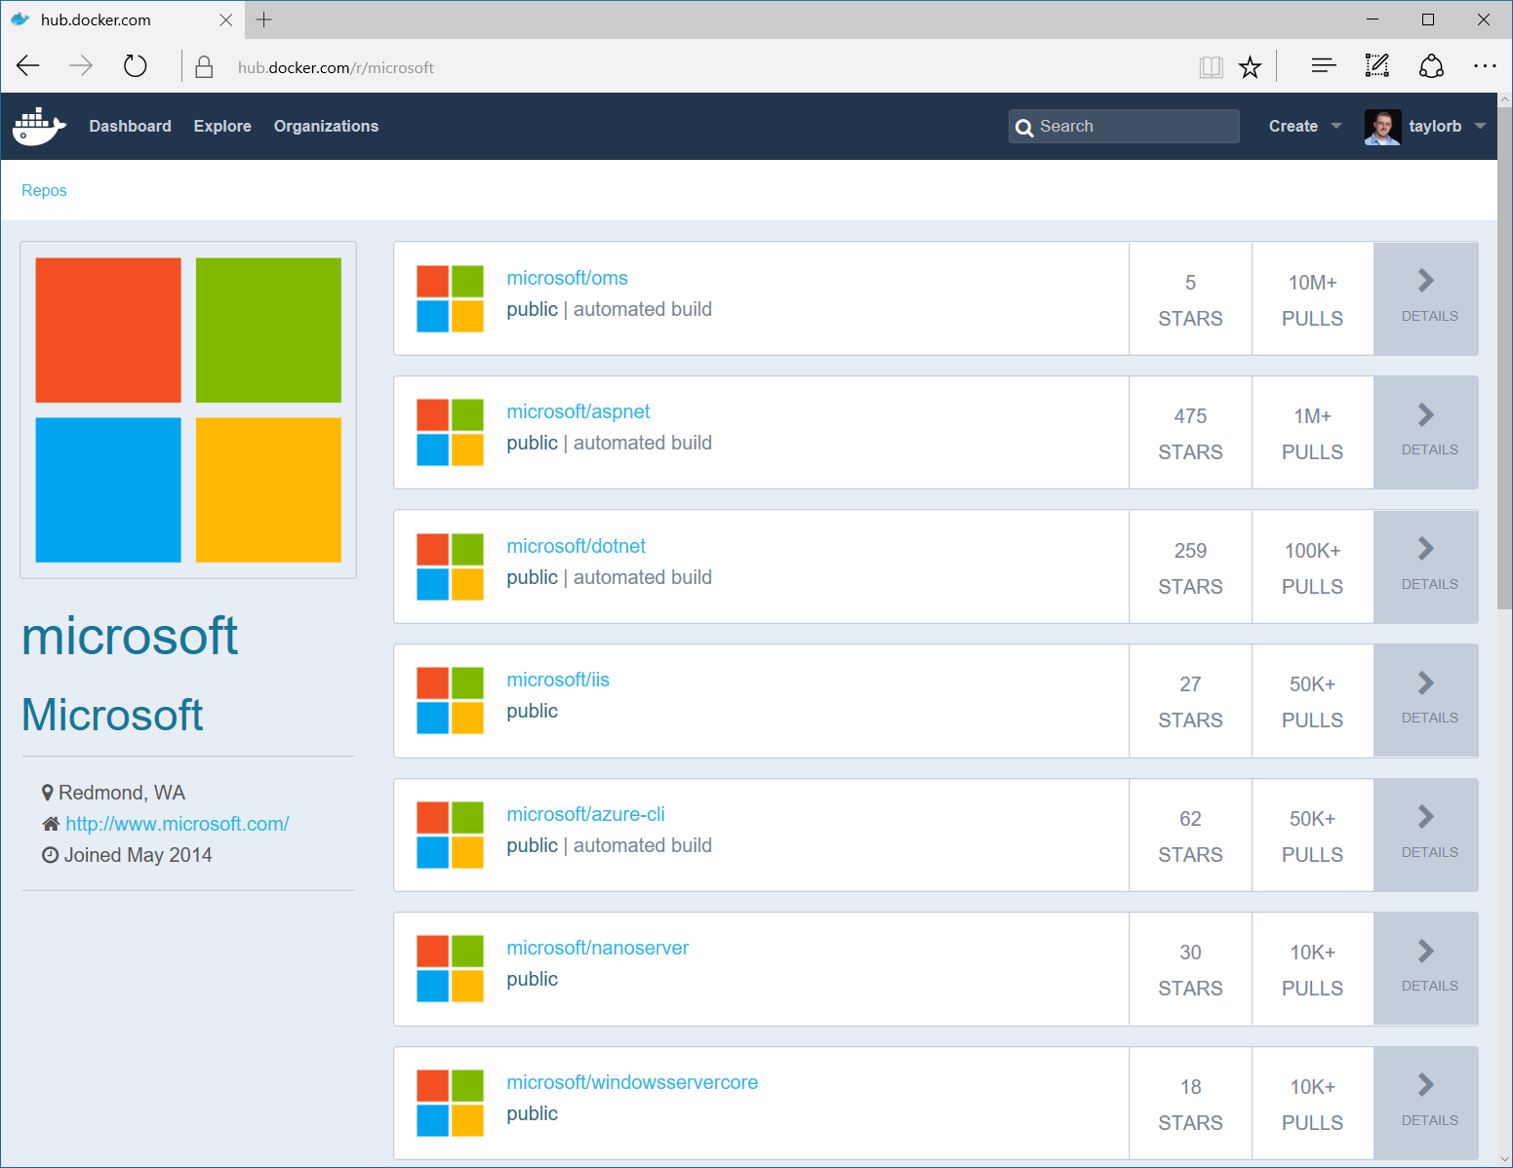
Image Registries
Docker Hub and Docker Store
Public, Official and Private image repositories
Docker Trusted Registry
Enterprise Grade Private Registries
Docker Registry
Open source foundation of Hub and DTR
Azure Container Registry
Store your container image in local, network-close storage on Azure
Notes:
Docker Hub and Docker Store
Public, Official and Private image repositories
Granular access controls with organization support
Automated image build support
Docker Trusted Registry
Enterprise Grade Private Registries
Runs on your infrastructure (on-prem or cloud)
Active Directory and Role Based Access Controls
Docker Registry
Open source foundation of Hub and DTR
Runs on your infrastructure (on-prem or cloud) as a container
https://docs.docker.com/registry and or https://github.com/docker/distribution
Azure Container Registry
Currently in Preview
Store your container image in local, network-close storage on Azure
Use Azure Active Directory to manage access
Manage Windows and Linux container images in a single registry

Slide 4
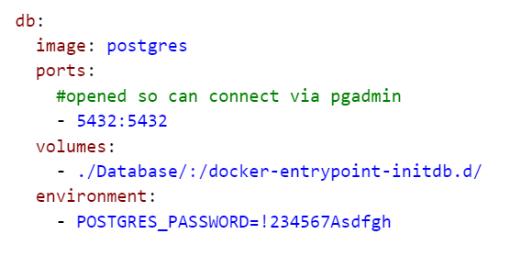
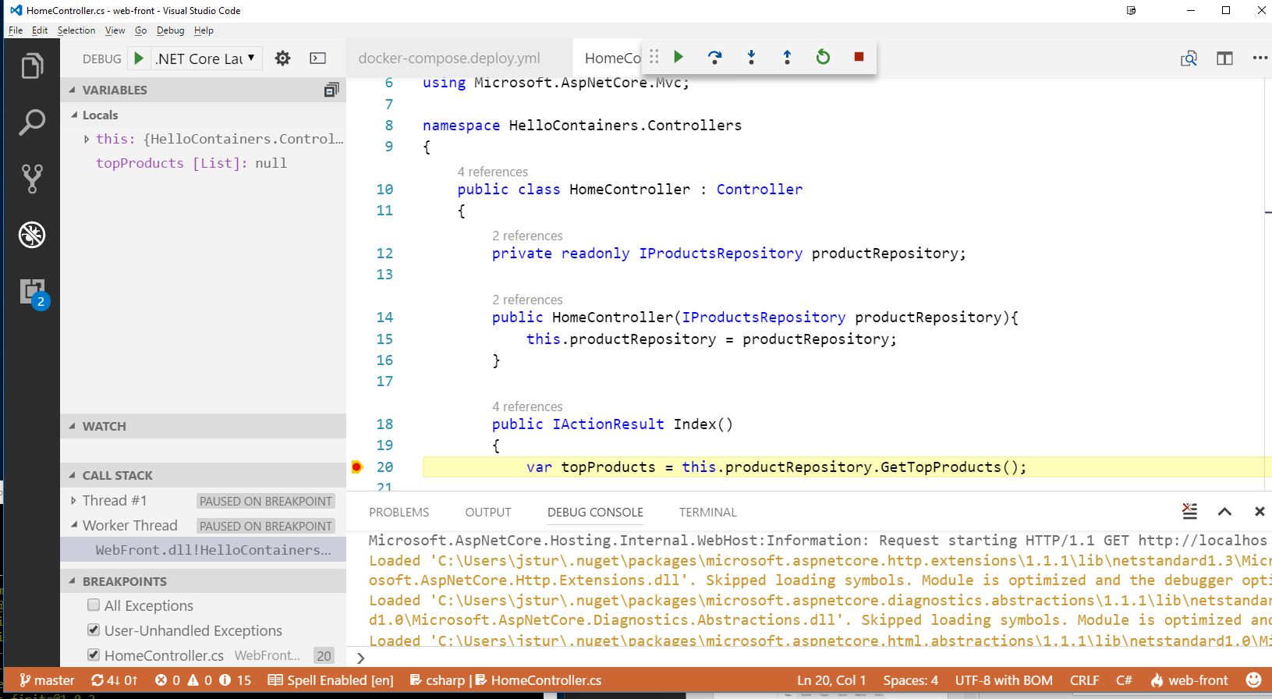
Step 1,2: Develop locally and commit
docker-compose -f docker-compose.build.yml up -d db
2.
Source Code Control
(SCC)
Push
Code
Inner-Loop
1.
Run
Code
Validate
Debug

Slide 5
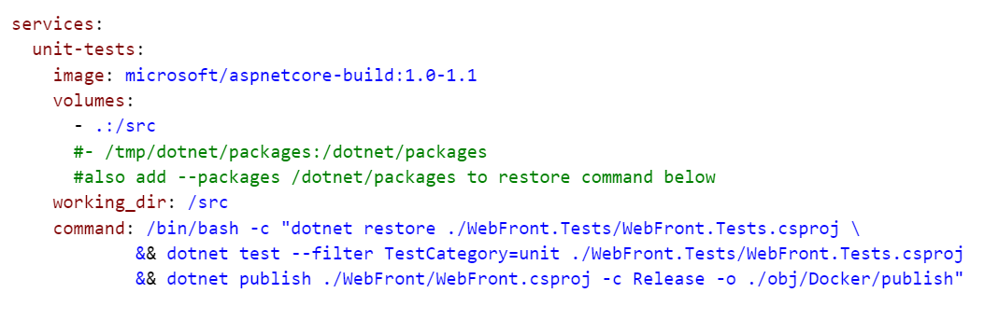
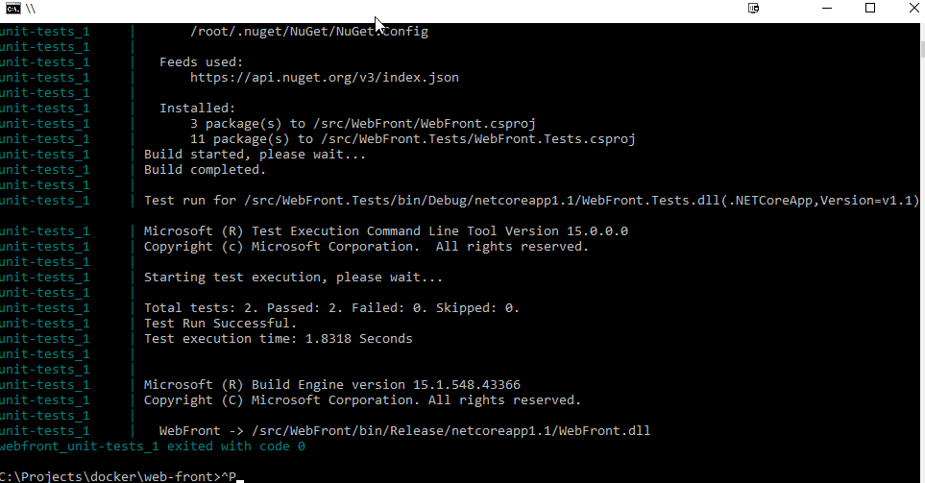
Step 3a: Build and Test
3.
Build/CI,
Integrate,
Test
docker-compose -f docker-compose.build.yml up unit-tests

Slide 6
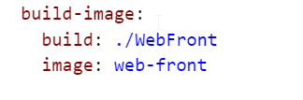
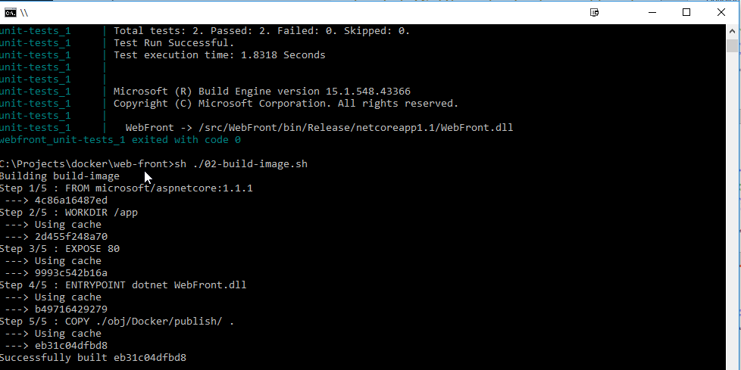
Step 3b: Build Docker image
3.
Build/CI,
Integrate,
Test
docker-compose -f docker-compose.build.yml build build-image

Slide 7
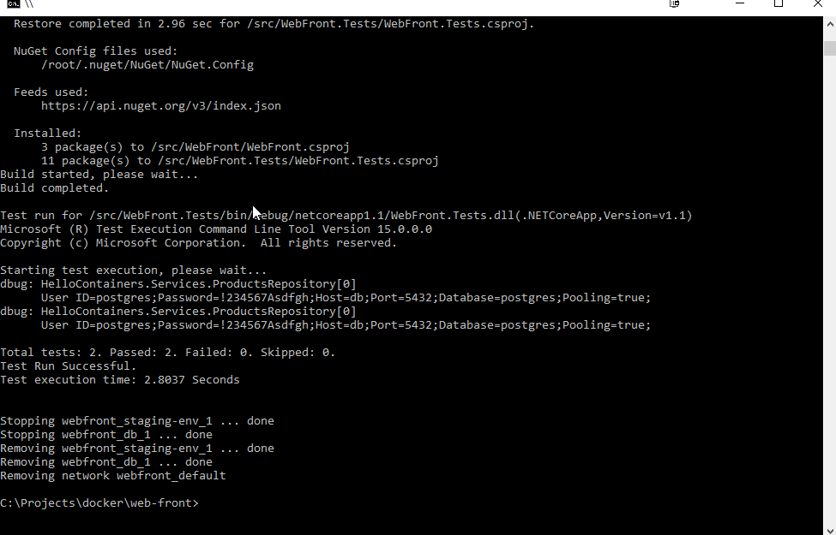
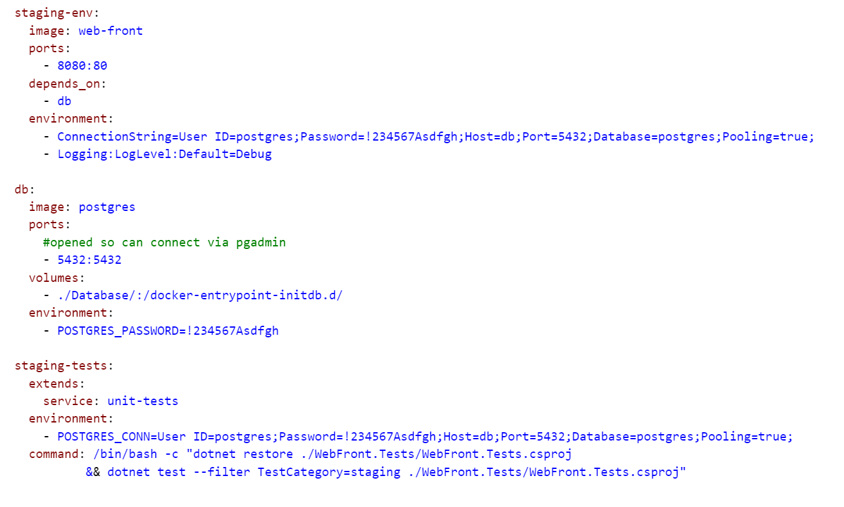
Step 3c: Staging tests
3.
Build/CI,
Integrate,
Test
docker-compose -f docker-compose.build.yml up -d staging-env
docker-compose -f docker-compose.build.yml run --rm staging-tests
docker-compose -f docker-compose.build.yml down

Slide 8
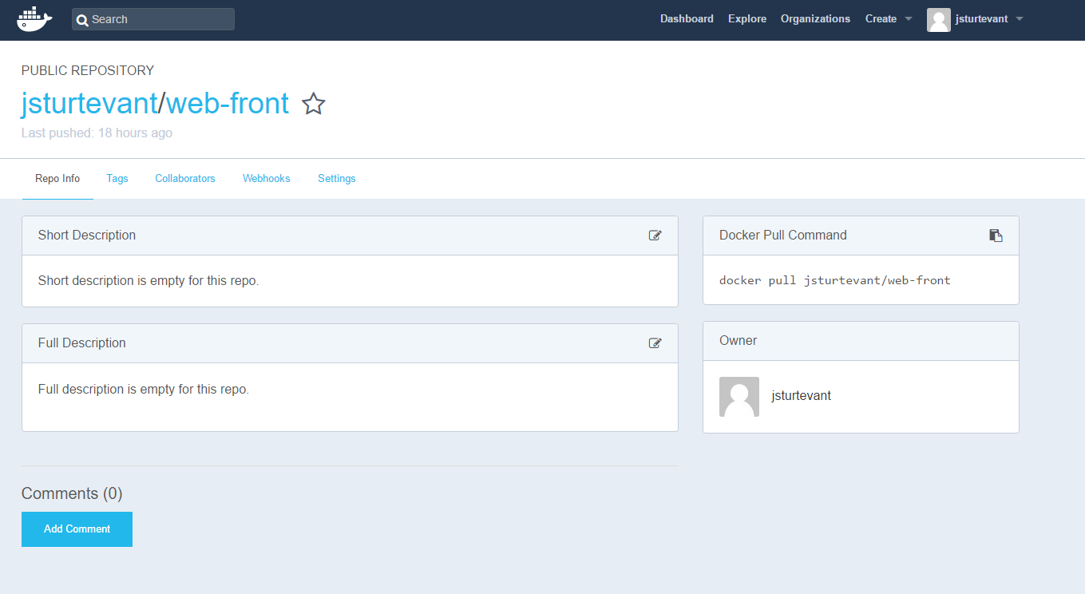
Step 3d: Publish
Container Registry
docker tag web-front jsturtevant/web-front:$1
docker push jsturtevant/web-front:$1

Slide 9
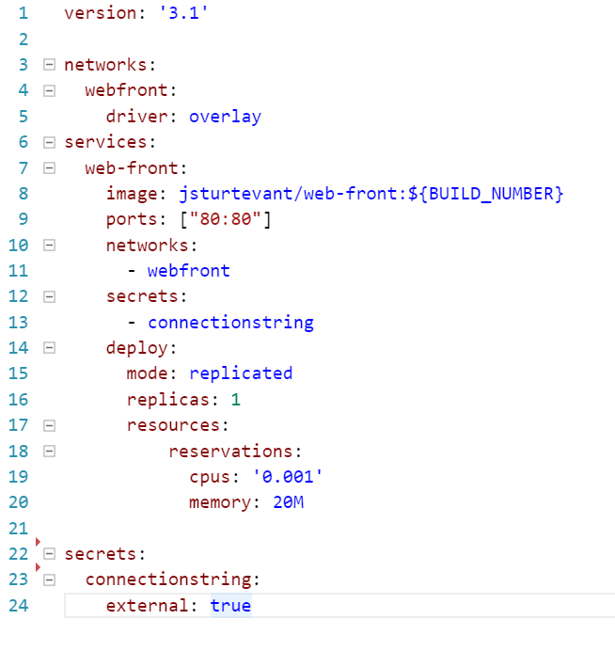
Step 4a: Deploy To QA
4.
CD, Deploy
docker stack deploy -c docker-compose.deploy.yml webfront
Notes:
Not this is the only step that is Swarm Specific.

Slide 10
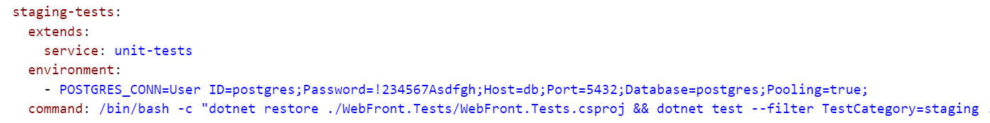
Step 4b: QA tests
3.
Build/CI,
Integrate,
Test
docker-compose -f docker-compose.build.yml run --rm staging-tests
docker-compose -f docker-compose.build.yml down

Slide 11
Step 4c: Deploy To Production
4.
CD, Deploy
docker stack deploy -c docker-compose.deploy.yml webfront
Notes:
Not this is the only step that is Swarm Specific.

Slide 12
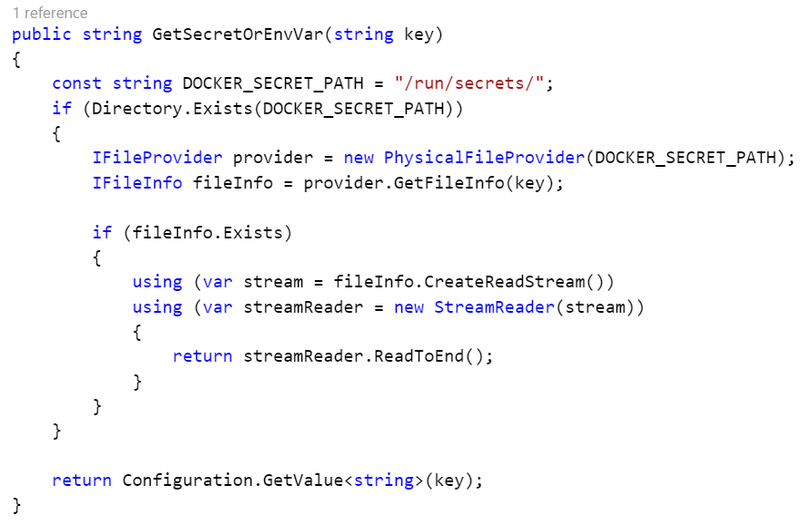
Reading secrets in .NET

Slide 13
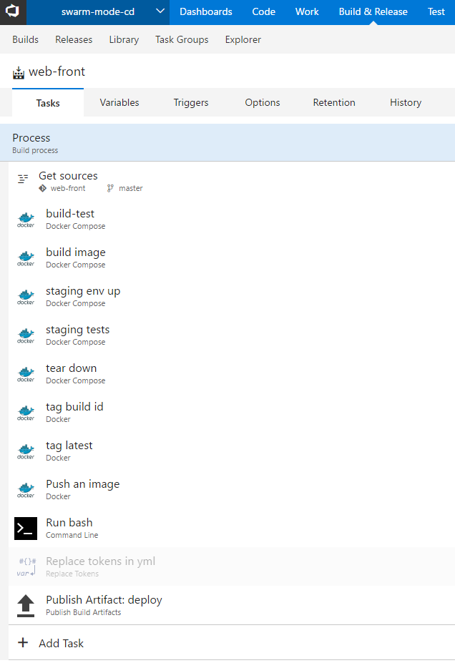
VSTS: Build

Slide 14
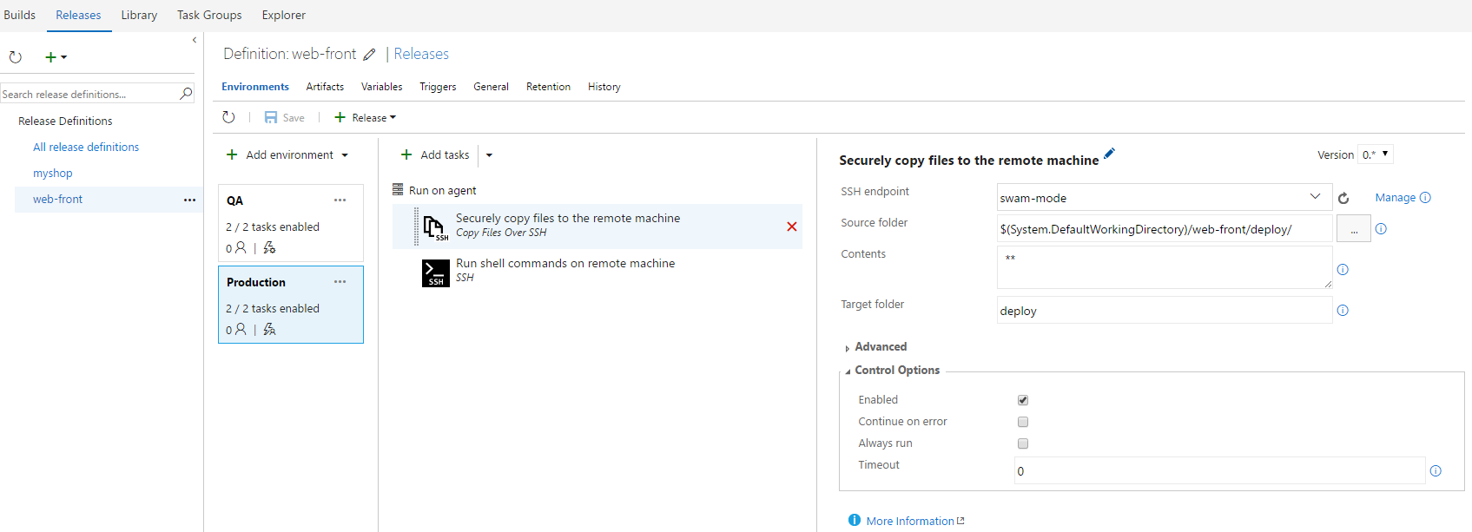
VSTS: Release

