Slide 1
Multiple Services

Slide 2
Deploying Docker
Docker VM
Demands:
Demand for you app grows (Scale & Redundancy)
You add another external app (Multiple Services)
You need internal app (More Services/ Independent Scale)
You love this container thing (Batch processing)
Machine failures (Redundancy/ Coordination)
Service 1
Service 2
Service 3
Service 4
Docker VM
Docker VM
Docker VM
Notes:
So you love docker and it’s doing great for you but now your ready to scale and start adding services:
You have
First you add machines and scale your app
add examples likes
Next you have a new service
Then you have a service but doesn’t need the scale so you only
this is your first sign of trouble (how do you know where things are?
You start to realize you really create these containers for all sorts of things including batch processing (Azure functions anyone?)
Next you have a tasks that needs to scale but not just at the service level but 300 hundred to do some serious processing (image processing maybe?)
this is you next issue (how do you determine where to run them given resource consumptions (memory/cpu/etc)
Finally now that you have everything running what do you do when a machine goes down? Where do those containers go? Do they go anywhere? Do you even know that they are not running?

Slide 3


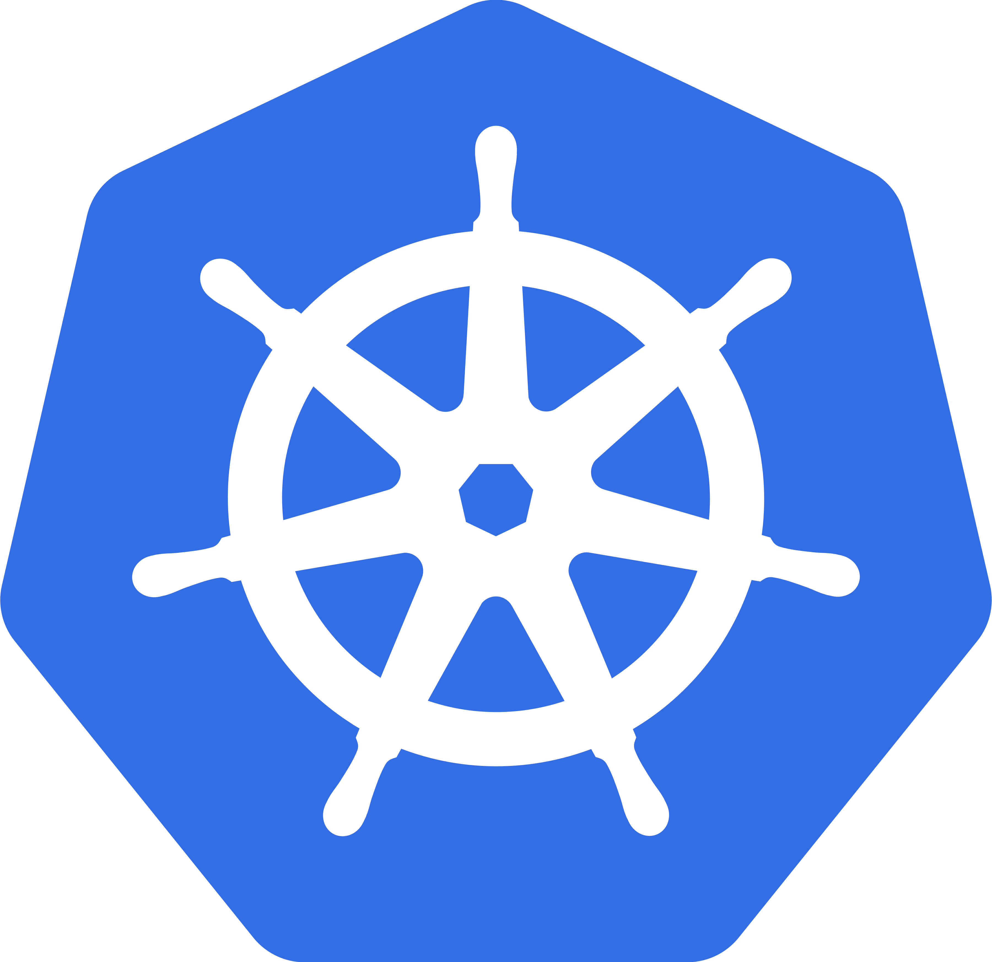
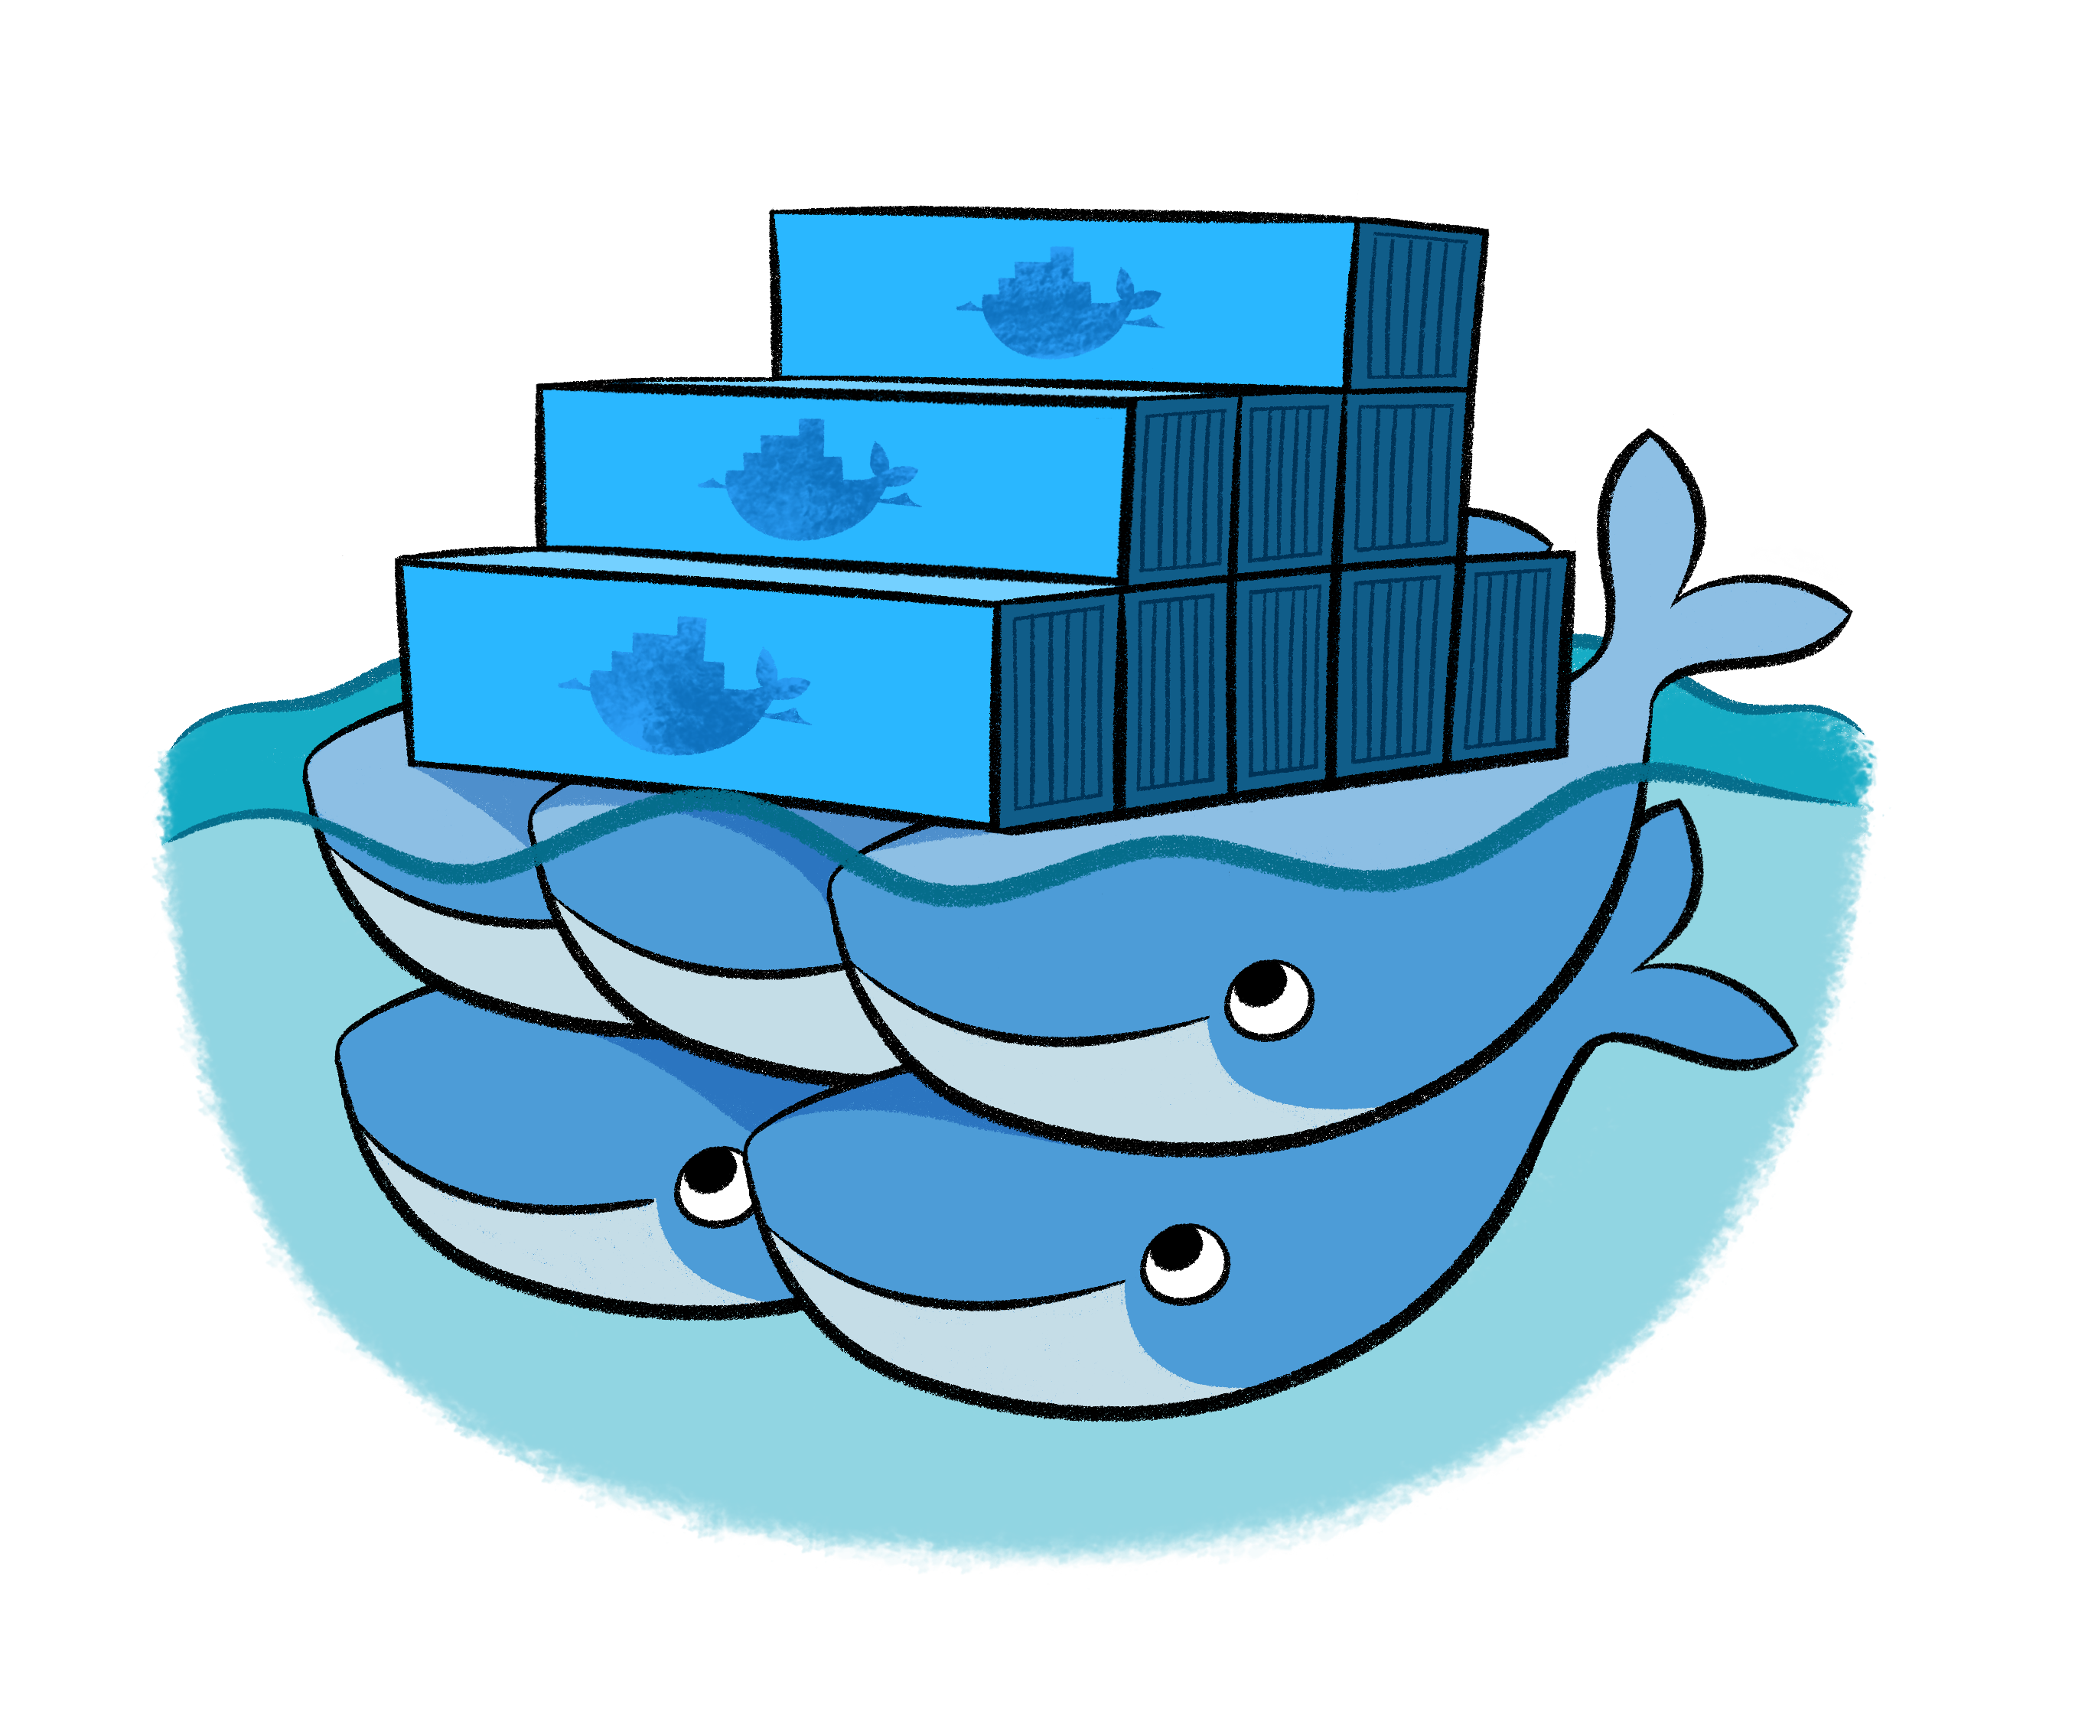
Orchestration Solutions
Containers typically hosted across a cluster of nodes. Orchestration is the automated arrangement, coordination, and management of computer systems, middleware, and services.
Notes:
Resources contraints on multiple servers
Reliability/ scalling/ fault taulernace.
Apache Mesos abstracts CPU, memory,
storage, and other compute resources away from machines (physical or virtual), enabling fault-tolerant and elastic distributed systems to easily be built and run effectively.
Docker Swarm is native clustering for Docker. It turns a pool of Docker hosts into a single, virtual Docker host.

Slide 4
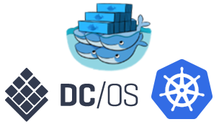

Azure Container Services
Manager Node
Worker Node
App1
Worker Node
Worker Node
App2

Slide 5
Handling machine failures
Manager Node
Worker Node
App1
Worker Node
Worker Node
App2

Slide 6
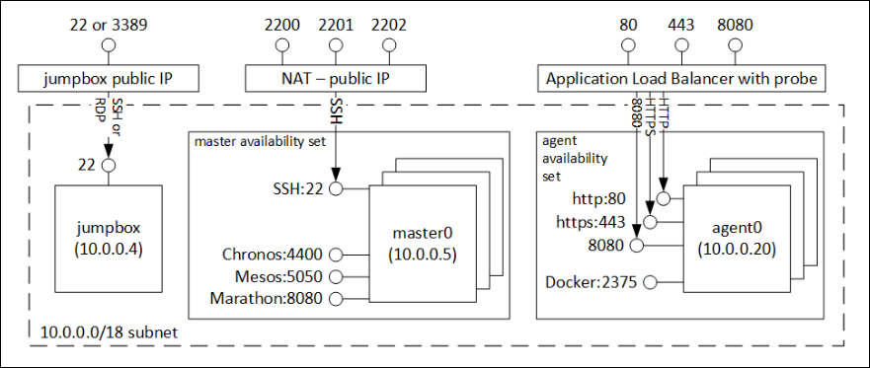
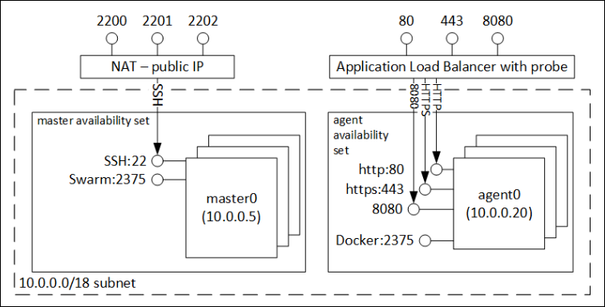
Typical Architectures
Notes:
Setting up the orchestrators so they are in VM scale sets, have security setup, subnets, load balaneer, etc, can get complicated.

Slide 7
Azure Container Service
Application
Orchestrator
ARM
Template
Infrastructure

Slide 8
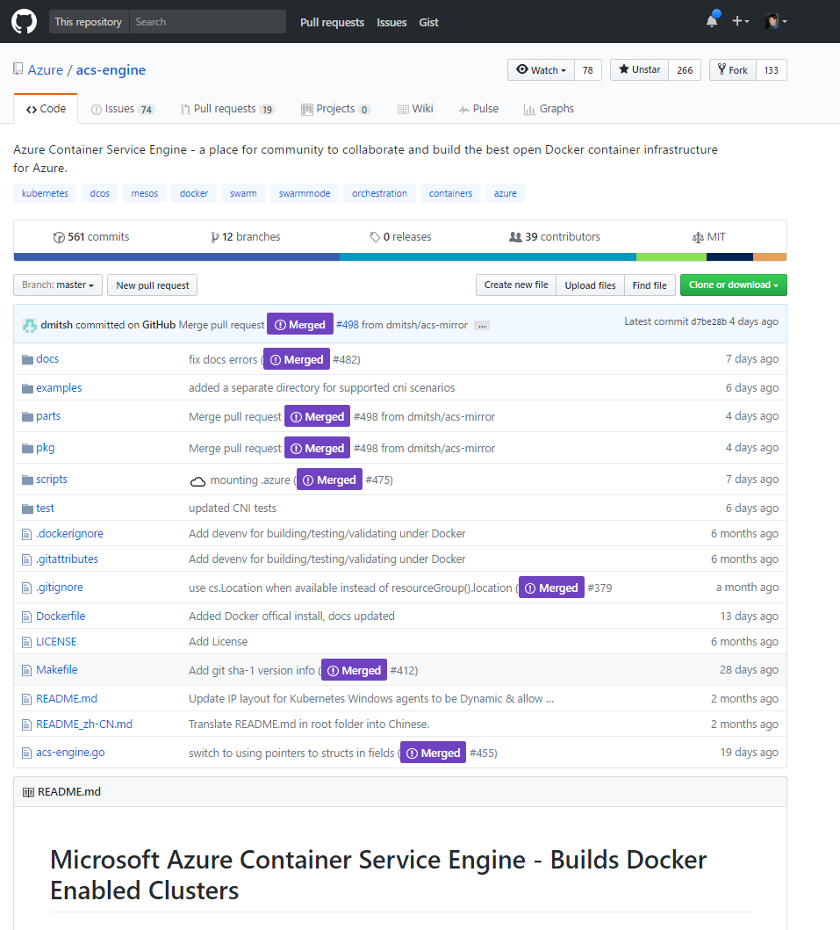

Slide 9
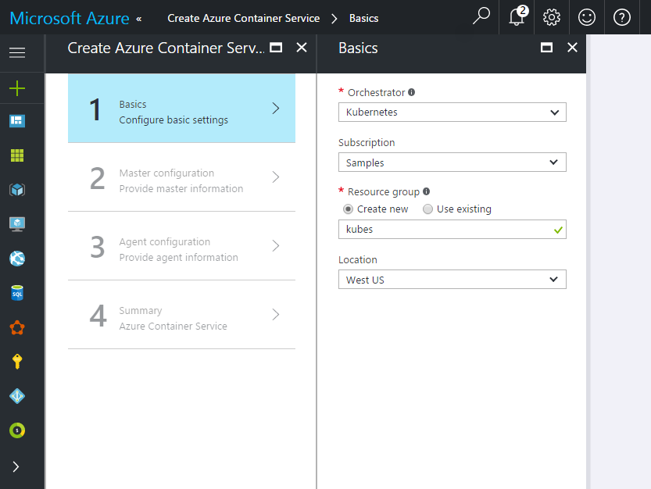

Slide 10
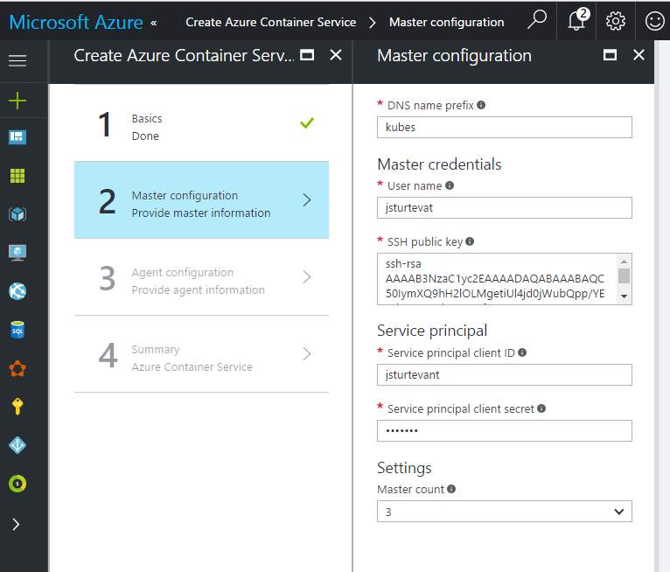

Slide 11
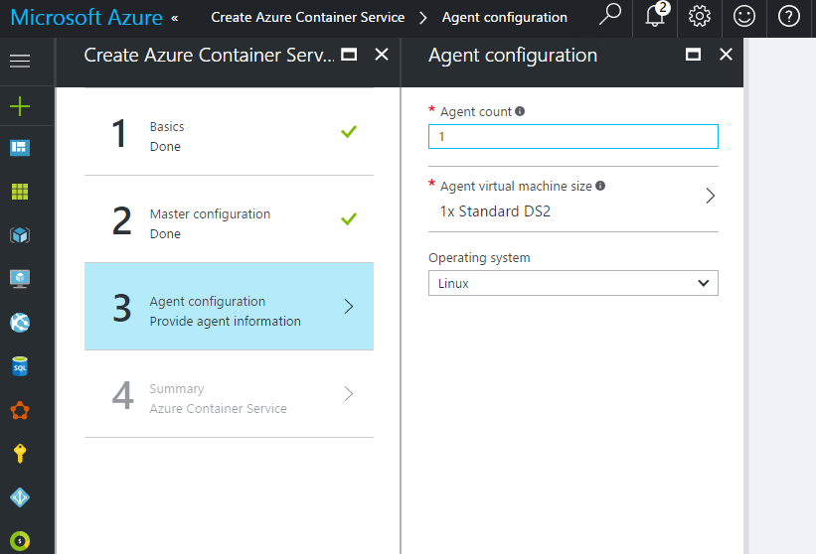

Slide 12
Swarm Mode
Not currently support in ACS. Options are:
Docker Machine using Azure Driver
Docker for Azure
Use ACS Engine to generate template
Notes:
Quick Aside….

Slide 13
Swarm setup
Manager Node
Manager Node
Worker Node
Worker Node
Worker Node

Slide 14
Create Service
Manager Node
Manager Node
Worker Node
Worker Node
Worker Node
docker service create --replicas 1 --name my_web nginx

Slide 15
Scale Service
Manager Node
Manager Node
Worker Node
Worker Node
Worker Node
docker service scale helloworld=3

Slide 16
Task (Container) – nginx:1.0
Service - Proxy
Task (Container) – nginx:1.0
Task (Container) – nginx:1.0
docker service scale proxy=3

Slide 17
Task (Container) – nginx:1.0
Service - Proxy
Task (Container) – nginx:1.0
Task (Container) – nginx:1.0
Stack – MyApp
Task (Container) – dotnetapp:1.0
Service - Front
Task (Container) – dotenetapp:1.0
Task (Container) – dotnetapp:1.0
docker service scale proxy=3
docker service scale front=3

Slide 18
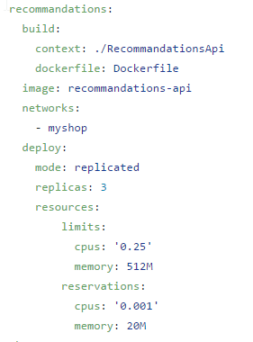
Docker Compose
docker stack deploy -c deploy/docker-compose.yml myshop

