Slide 1
KDI :
Construction of visual knowledge map of diet and medical treatment
Reporter ：刘慕
Notes:
饮食与医疗的可视化知识图谱构建

Slide 2

First Section
01

Slide 3
1 - Team Members and Distribution
ID Name Role
2023532043 刘慕 Knowledge Engineer
2023532074 王硕 Domain Expert
2023534045 马世旋 Data Scientist

Slide 4
Second Section
02

Slide 5
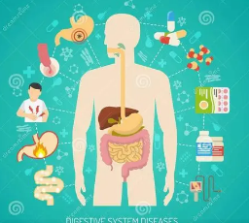
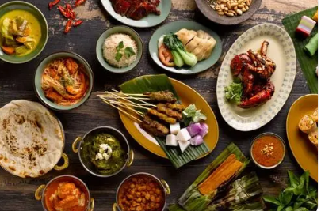
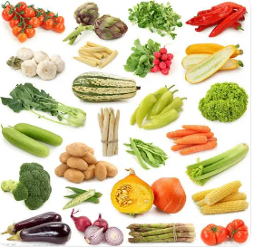
2.1 - Domain of Interest
The Knowledge and Data Integration (KDI) project provides users with disease and food centric medical dietary solutions in the medical field. We take into account the characteristics of various diseases and food, their interrelationships, treatment options, food information.
Disease
Ingredients
Food
Notes:
Domain 这个图谱设计的主要原因

Slide 6
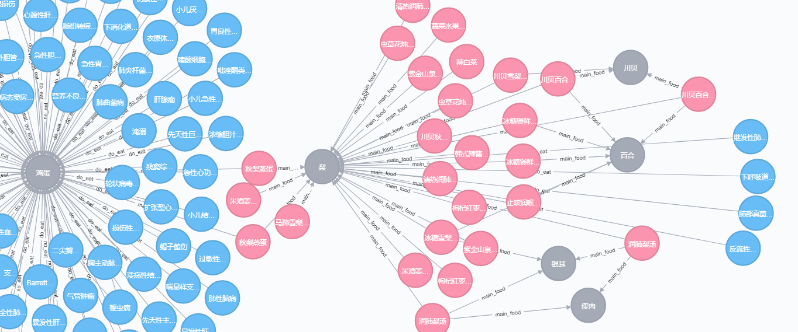
2.2 - Scenarios
In the program, users can search for foods to eat, recommend recipes and avoid foods based on their single or multiple medical conditions.
Notes:
这是最后的程序生成图 进行展示

Slide 7
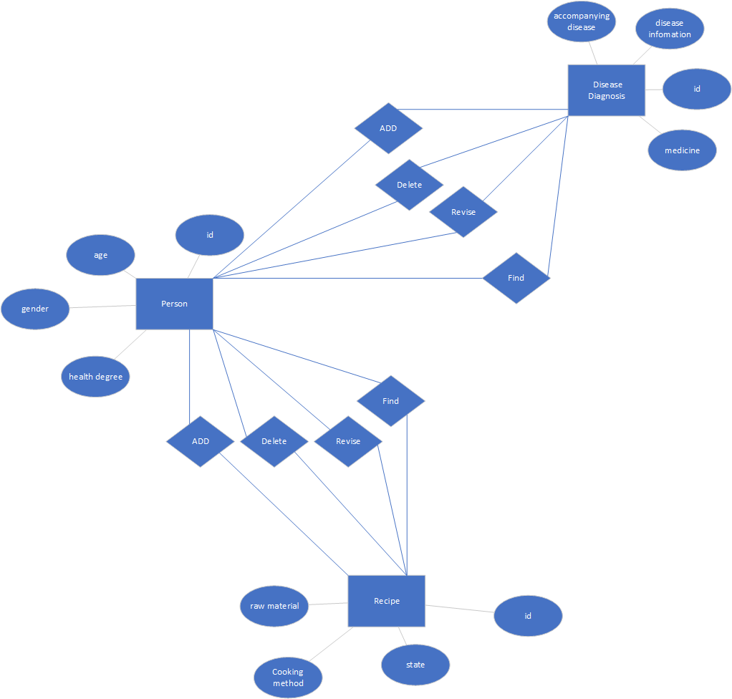
2.3 - ER
Notes:
这个图是整体的结构主要包括菜品和疾病节点 中间通过菜品连接起来

Slide 8
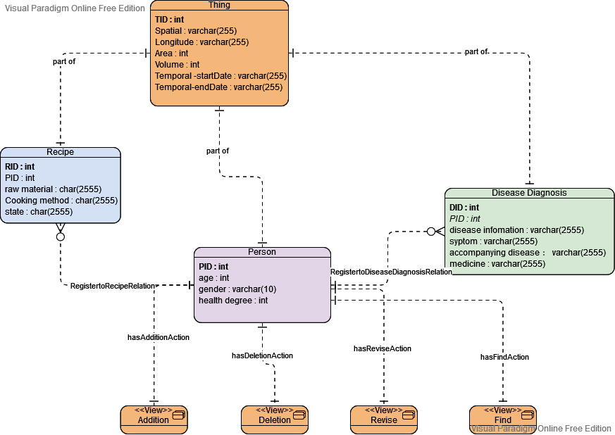
2.4 - EER
Notes:
这个图是整体的结构主要包括菜品和疾病节点 中间通过菜品连接起来

Slide 9
Third Section
03
Notes:
这个 cq问题 我确实不太会整

Slide 10
3 – Purpose
3.1 Competency Questions
The patient is looking up the recommended diet and foods for his condition.
CQ1: What recipe does fracture patient recommend?
CQ2:What should old asthma patient notice on diet?
3.2 Kernel Competency Questions
CQ1: Adult, Fracture patient, Recipe
CQ2:Old, Asthma patient, Notice, Diet

Slide 11
3 – Purpose
3.3 Analysed Competency Questions
+ CQ1
**common:** Person, Disease Diagnosis, Recipe
**core:**Fracture, Illness
**contextual:** Adult
+ CQ2
**common:** Person, Disease Diagnosis, Diet
**core:** Asthma, Notice
**contextual:** Elderly People

Slide 12
3 – Purpose
3.4 Classified Competency Questions
CQ1
Common OBJECT：Person, Disease Diagnosis,Recipe
Core FUNCTION:Fracture,ACTION:Illness
Contextual FUNCTION:Adult
CQ2
Common OBJECT：Person, Disease Diagnosis,Diet
Core FUNCTION:Asthma,Notice
Contextual FUNCTION:Elderly People

Slide 13
3 – Purpose
3.5. Attributed Competency Questions
CQ1
For(person):age,gender,health degree,
For(Disease Diagnosis):disease infomation,syptom,accompanying disease,medicine
For(Recipe):raw material,Cooking method,state
CQ2
For(person):age,gender,health degree,
For(Disease Diagnosis):disease infomation,syptom,accompanying disease,medicine
For(Diet):raw material,Cooking method,state

Slide 14
Fourth Section
04
Notes:
怎样构建数据集（玄） 怎样爬取数据怎样融合 还有最好展示一下爬取的数据

Slide 15
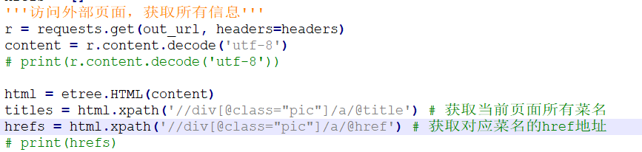
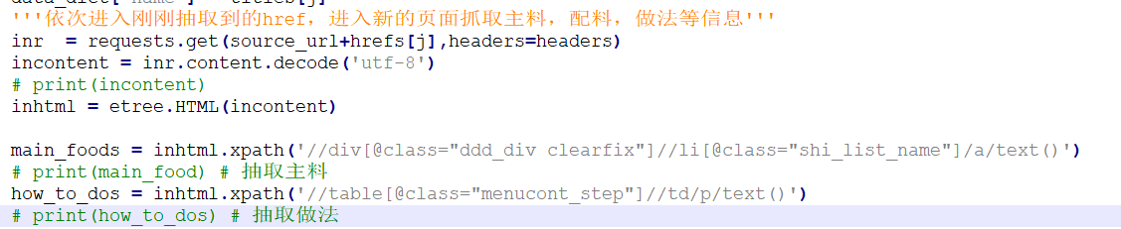
4 – Crawl Data

Slide 16
Fifth Section
05

Slide 17
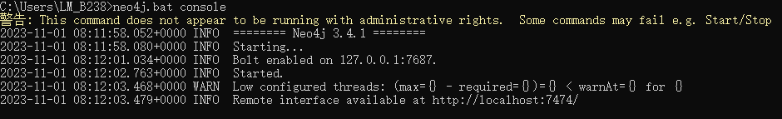
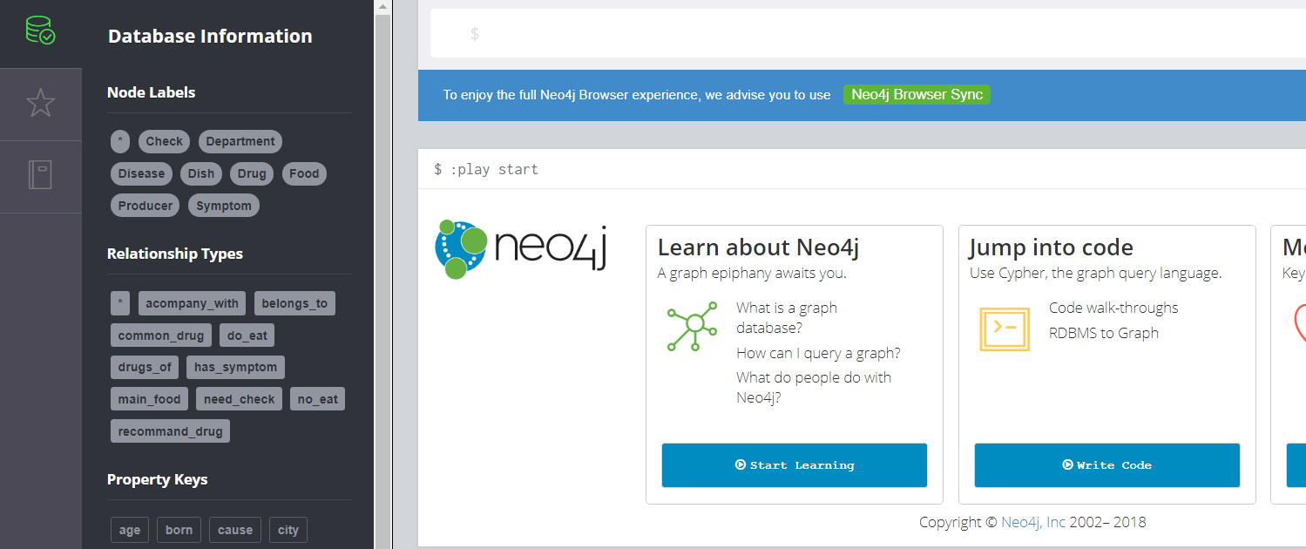
5 – build the graph
Notes:
具体使用neo4j和python构建数据库

Slide 18
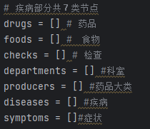
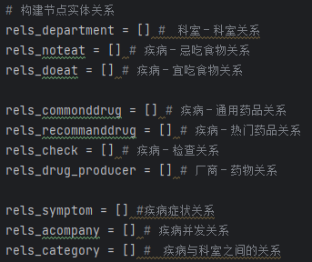
5 – build the graph
Notes:
具体使用neo4j和python构建数据库

Slide 19
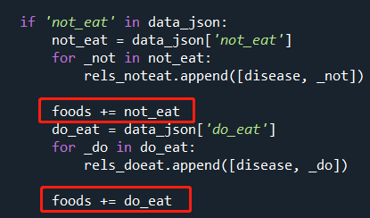
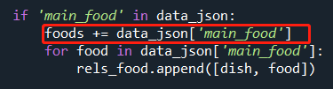

5 – build the graph
Notes:
具体使用neo4j和python构建数据库

Slide 20
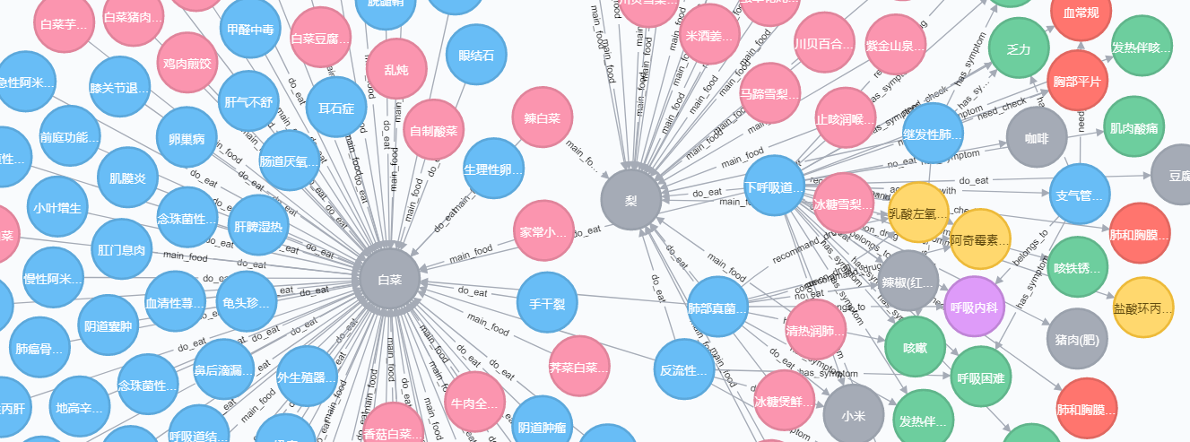
5 – build the graph
Notes:
具体使用neo4j和python构建数据库

Slide 21
THANK YOU

