Slide 1
Topic Modeling to Identify Women’s Health Concerns from Online Forums
Jocelyn Lutes

Slide 2


Project Background
Citizen Science
Maternal and Infant Health Research
Current Procedures
Mobile Application
Product Development for Incentives
CURRENT GOAL:
Identify women's health concerns from posts in online forums
Username
Password
Participate in Research!

Slide 3


Work Flow
Cleaning & Preprocessing
Topic Modeling
Pink
Blue
Exploratory Data Analysis
Data Collection
Topic Interpretation & Evaluation

Slide 4

Data
Fertility and Pregnancy Corpus
General Women’s Health Corpus
Subreddits:
r/WomensHealth
r/obgyn
r/TheGirlSurvivalGuide
Number of Posts: 30,616
Unique Authors: 19,753
Subreddits:
r/TryingForABaby
r/pregnant
r/BabyBumps
Number of Posts: 92,943
Unique Authors: 35,127
Prior to modeling, the text was cleaned, lemmatized, and vectorized using TF-IDF.

Slide 5
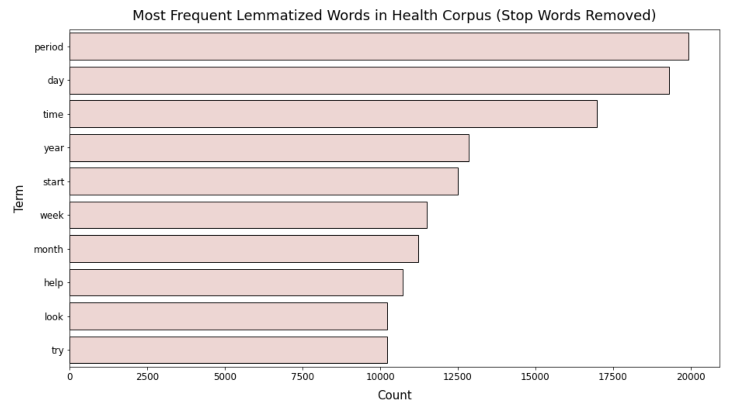
Most Frequent Words by Corpus

Slide 6
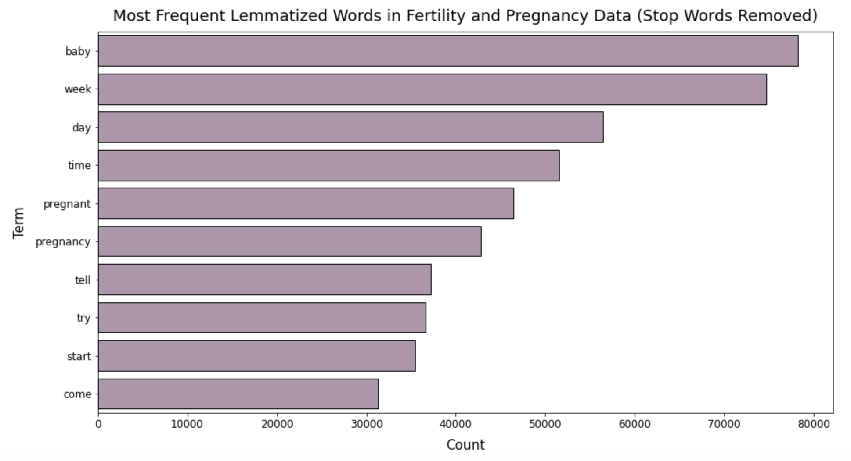
Most Frequent Words by Corpus

Slide 7
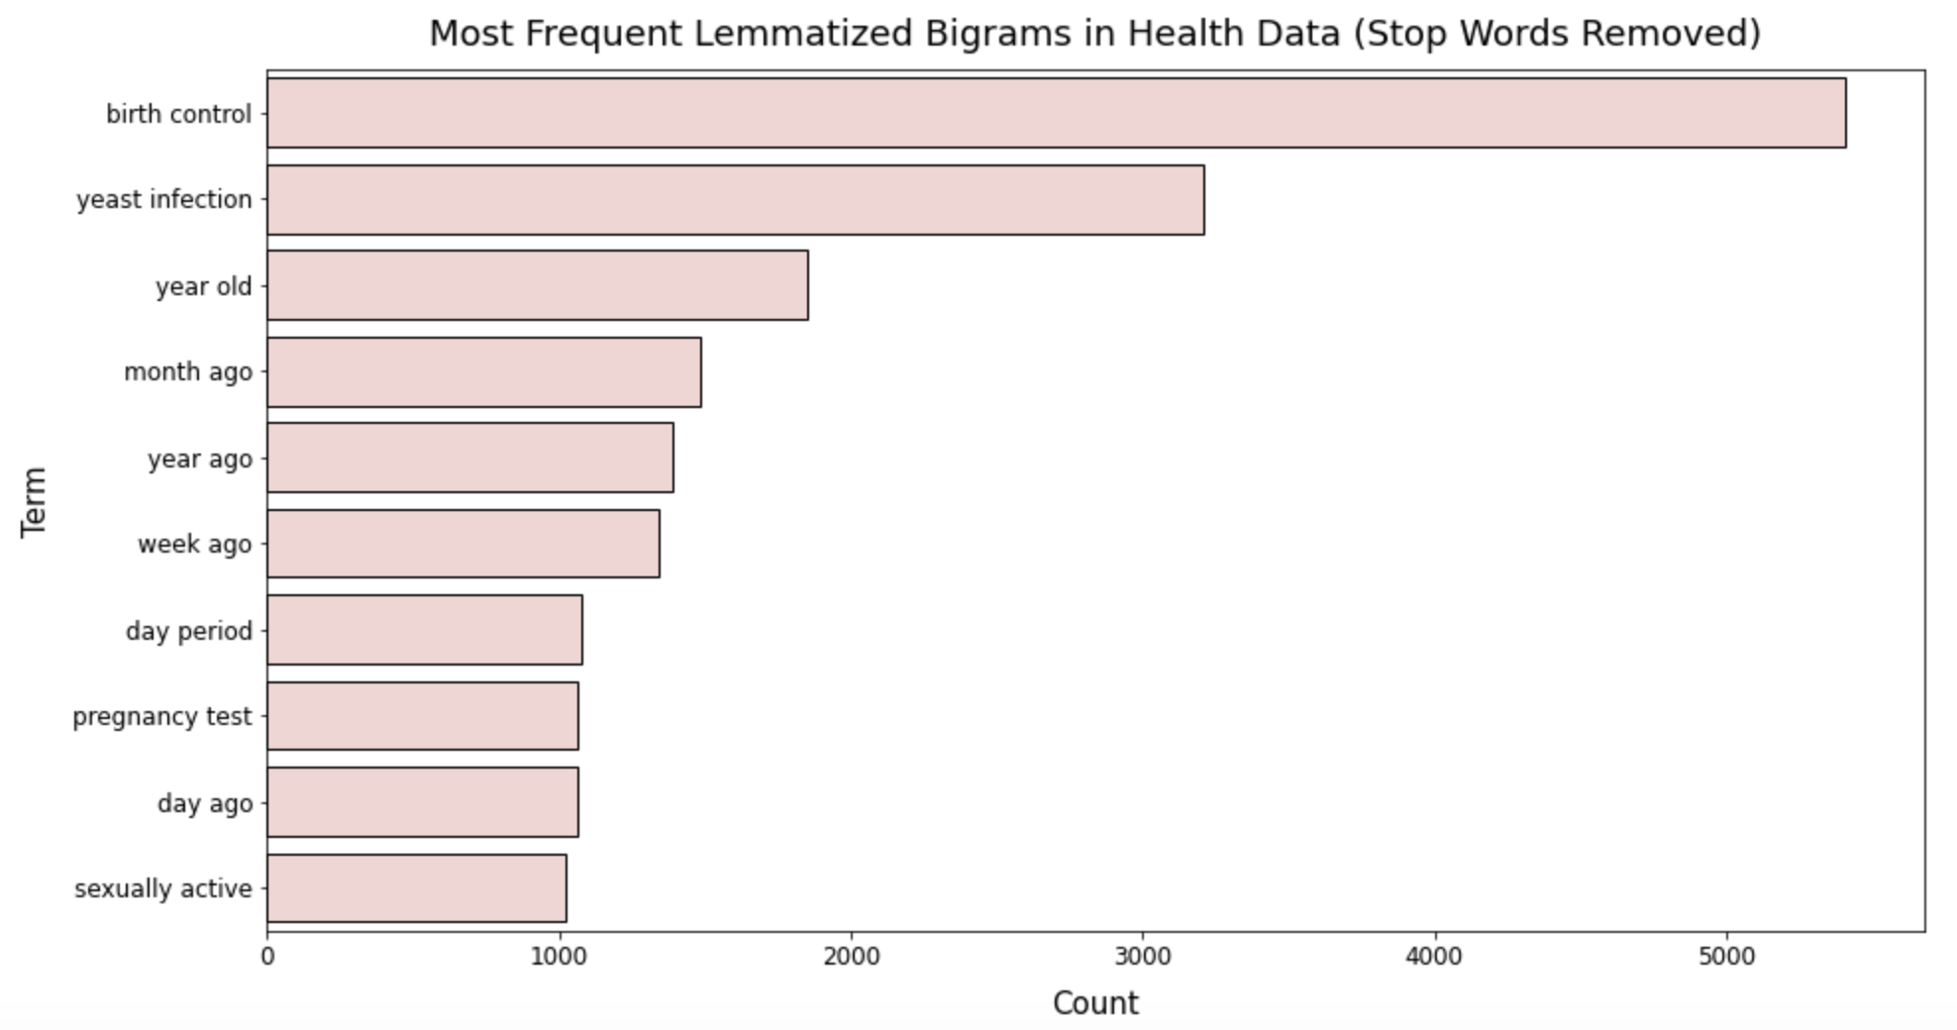
Most Frequent Bigrams by Corpus

Slide 8
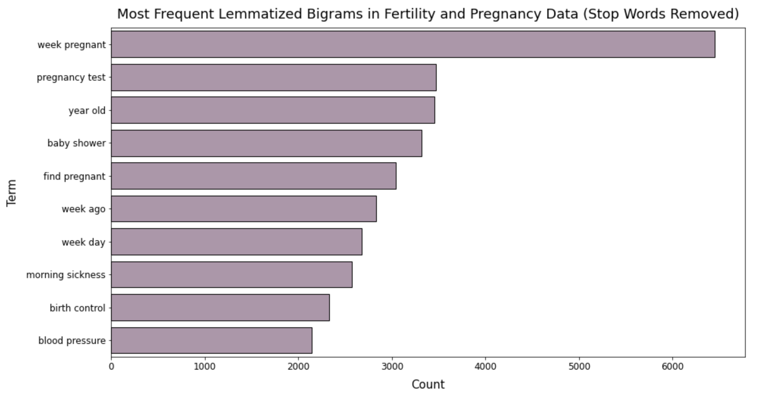
Most Frequent Bigrams by Corpus

Slide 9
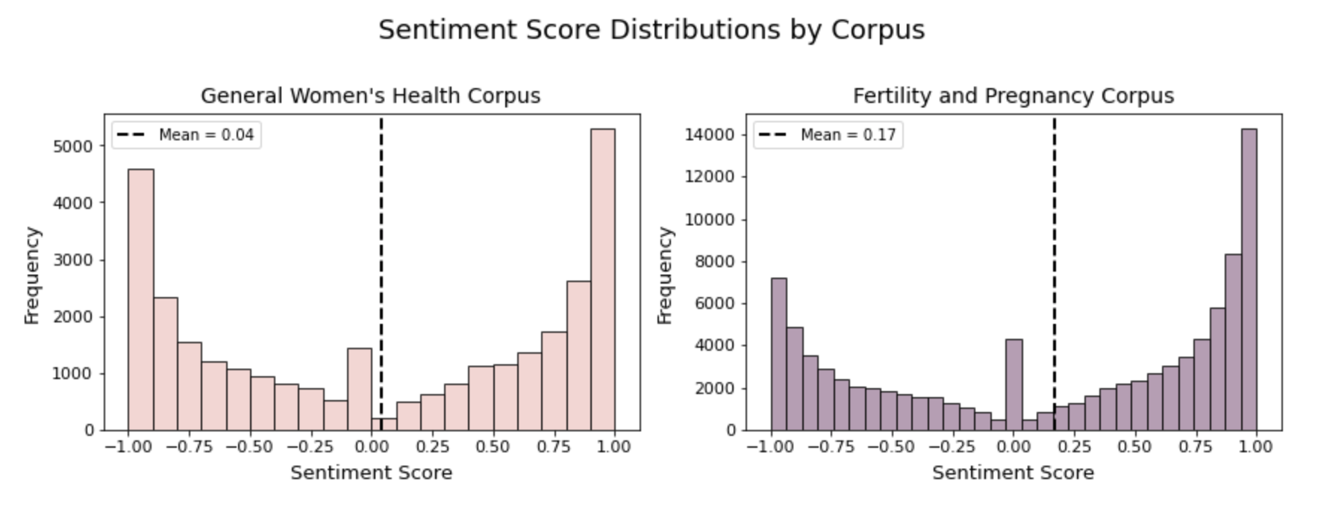
Sentiment Analysis

Slide 10
Latent Dirichlet Allocation (LDA)
Assumptions
(0.23, Word 1)
(0.17, Word 2)
(0.08, Word 3)
(0.18, Word 4)
(0.10, Word 1)
(0.04, Word 6)
Topic 1
Topic 2
Model Process
Select Number of Topics (K)
For each document, randomly assign a word to topic ( K topics total)
Repeat word assignment based on p (topic | doc) and p (word | topic)

Slide 11
Topics Identified in General Women’s Health Corpus
Topic Name | Top 5 Terms
Birth Control (IUDs and Implants) | IUD (intrauterine device), control, birth, birth control, pill
Birth Control (Pills and Condoms) | Pill, birth control, birth, control, pack
Infections (YI and BV) | Infection, yeast, yeast infection, discharge, smell
Infections (UTI) | UTI (urinary tract infection), pee, drink, antibiotic, orgasm
Menstrual Cycle & Abnormalities | Period, bleed, start, test, pregnancy
Feminine Hygiene Products | Tampon, cup, pad, menstrual, menstrual cup
General Gynecological Health | Vagina, breast, sex, pap, hurt
Pains | Pain, period, cyst, cramp, doctor
Body Image and Self-Esteem | Eat, food, self esteem, esteem, diet
Model: LDA (12 topics, 50 iterations); UMass Coherence: -2.3

Slide 12
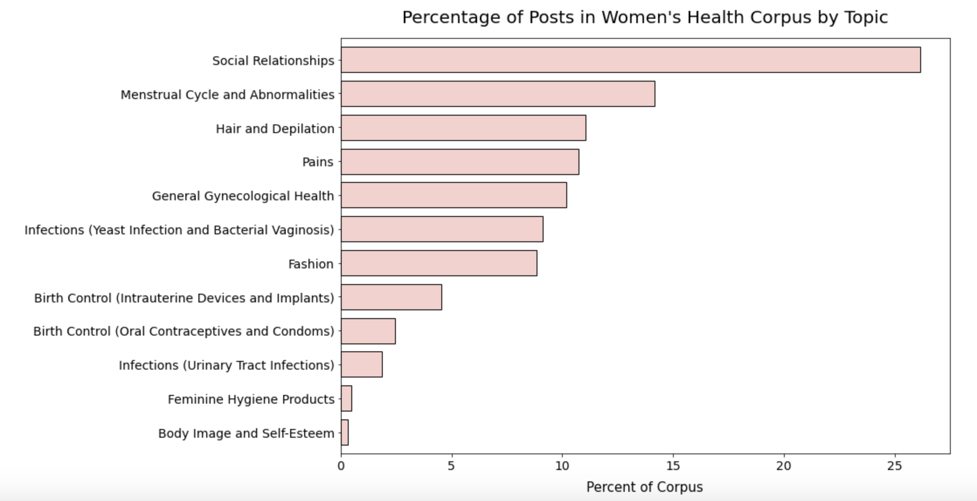
Topics Identified in General Women’s Health Corpus

Slide 13
Topics Identified in Fertility and Pregnancy Corpus
Topic Name | Top 5 Terms
Pregnancy Life Changes | Birth, work, baby, hospital, leave
Pregnancy Announcement | Baby, pregnant, tell, husband, leave
Labor and Delivery | Contraction, labor, cm, induction, induce
Nausea and Sleep | Eat, sleep, food, nausea, morning
Determination of Pregnancy | Test, period, pregnancy, pregnant, positive
Fertility | Cycle, ovulation, TTC , try, ovulate
Obstetrics Appointment | Ultrasound, doctor, blood, baby, appointment
Pains and Body Changes | Pain, belly, baby, weight, kick
Model: LDA (10 topics, 50 iterations); Umass Coherence: -1.96

Slide 14
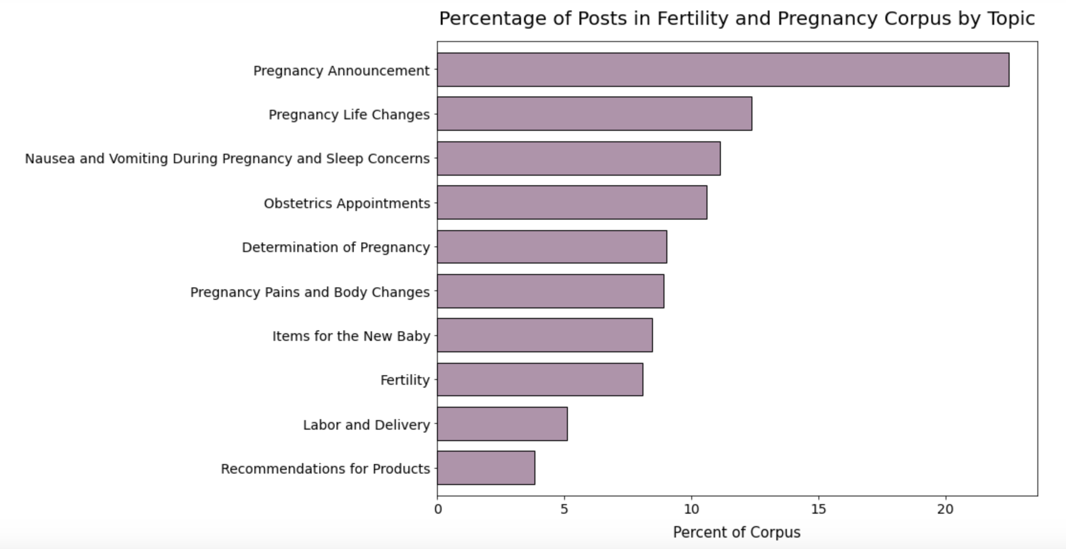
Topics Identified in Fertility and Pregnancy Corpus

Slide 15
Product Recommendations
For Non-Pregnant Users
Menstrual Cycle Abnormalities
Feminine Hygiene Products
Birth Control Options
Symptoms of Infections
Common Gynecological Issues
Fertility Options
Determination of pregnancy
For Pregnant Users
Coping with pregnancy life changes
Dealing with nausea and sleep disruptions
Obstetrics Appointments
What to expect during labor and delivery

Slide 16
Conclusions
Topic Modeling with Latent Dirichlet Allocation (LDA) successfully identified several areas of concern in the women’s health domain.
In comparison to focus groups or surveys, use of data from online forums likely allowed us to analyze data from more unique users.
Next Steps:
- Topic Modeling of Concerns during Postpartum/Early Parenthood
- Identification of concerns for pre- and post-COVID-19
- Topic Modeling within previously-identified topics

Slide 17
Thank You!
Do you have any questions?
Email: jocelyn.lutes@gmail.com
LinkedIn: jocelyn.lutes
GitHub: jlu90

