Slide 1
Categorizing and manipulating data from elanbucorpus in sql database
BY DEANNIA LUCAS

Slide 2


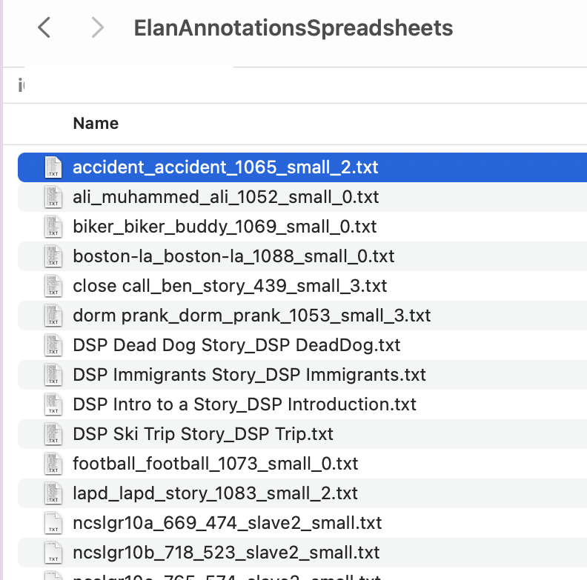
Extracted DATA FROM ELANBUcorpus for Annotations

Slide 3
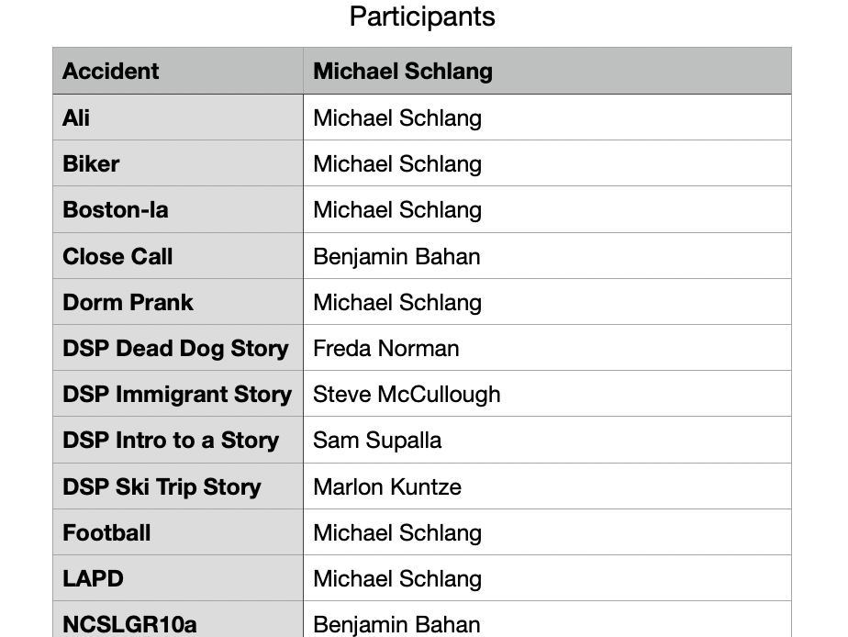
Extracted DATA FROM ELANBUcorpus for Participants

Slide 4
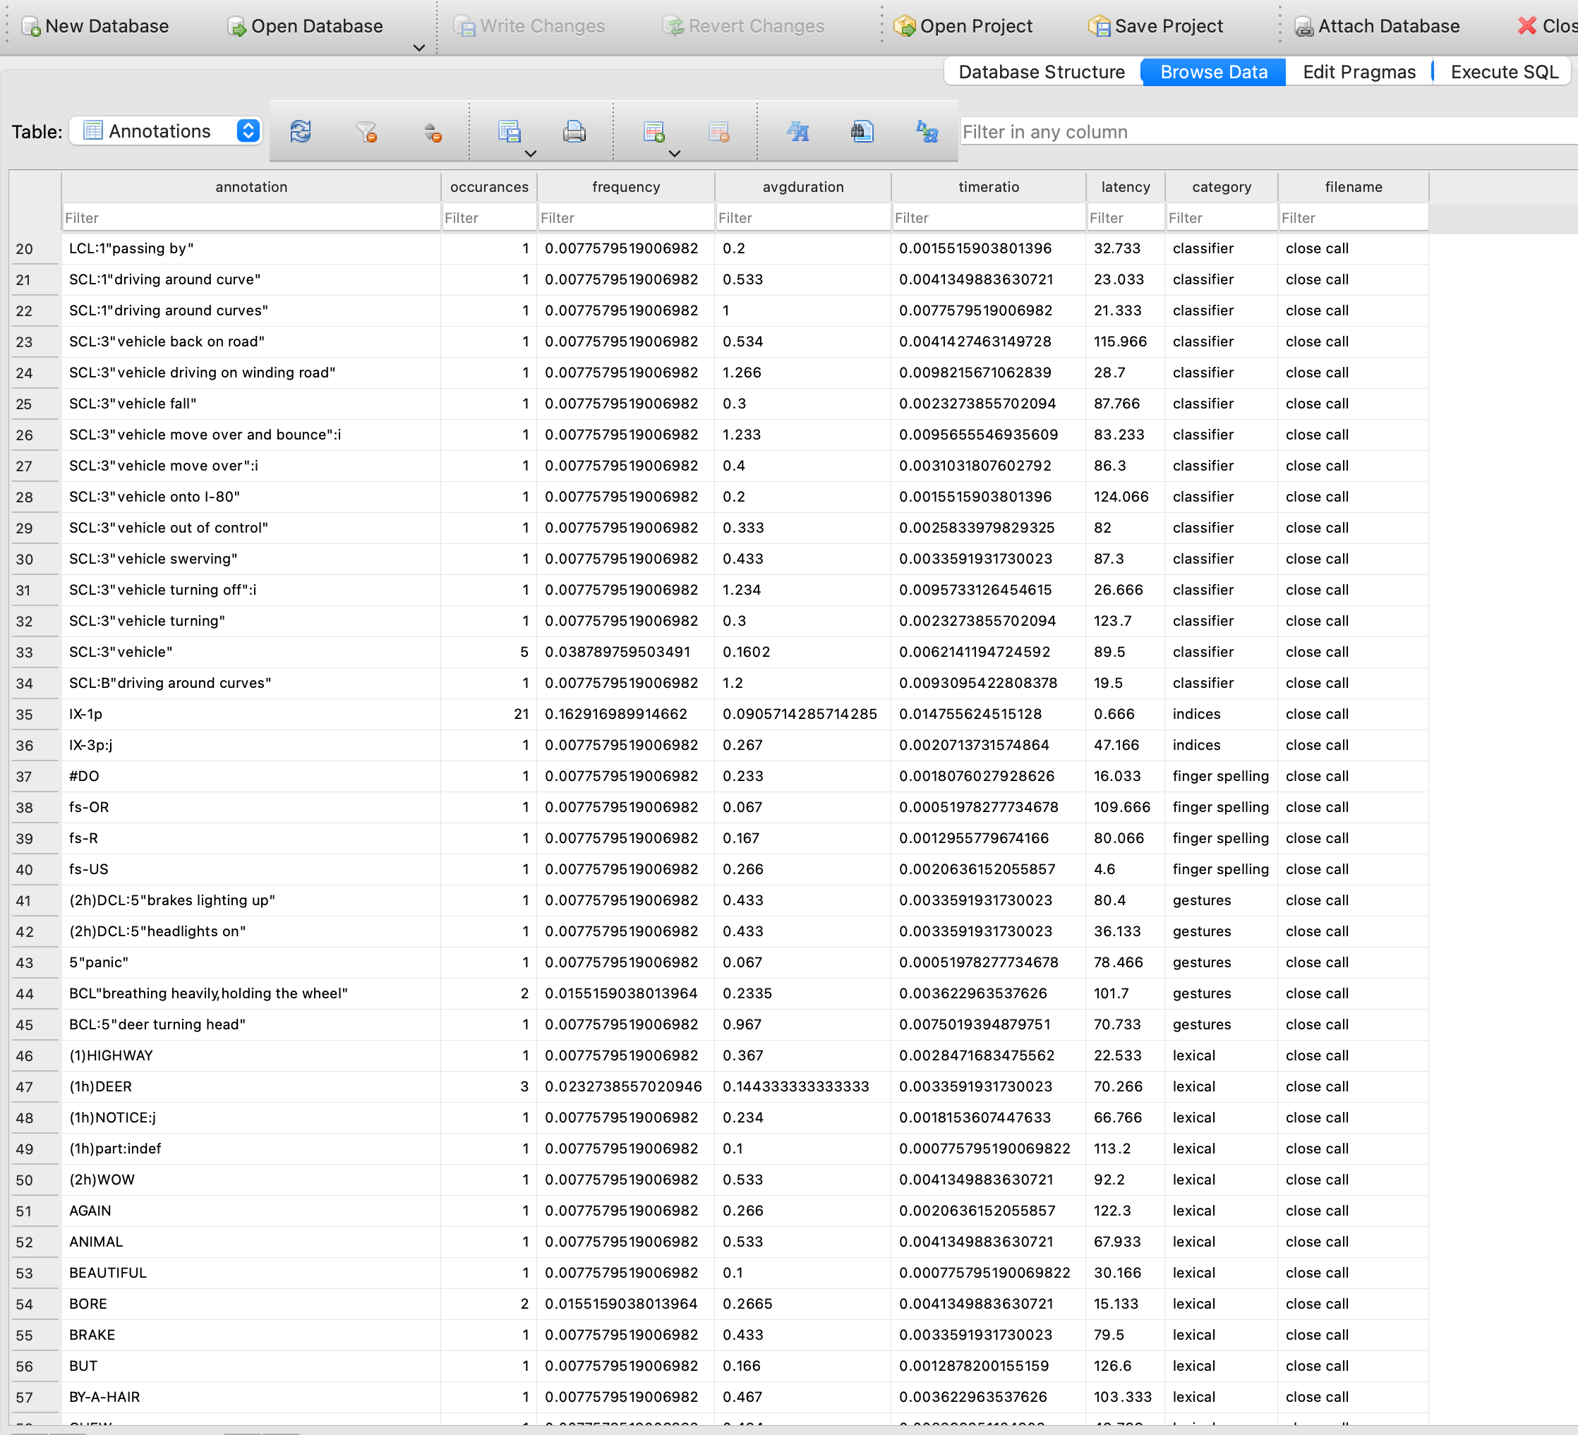
Categorized data in sql for each annotations in elanbucorpus
Classifier
Indices
Fingerspelling
Gestures
Lexical

Slide 5
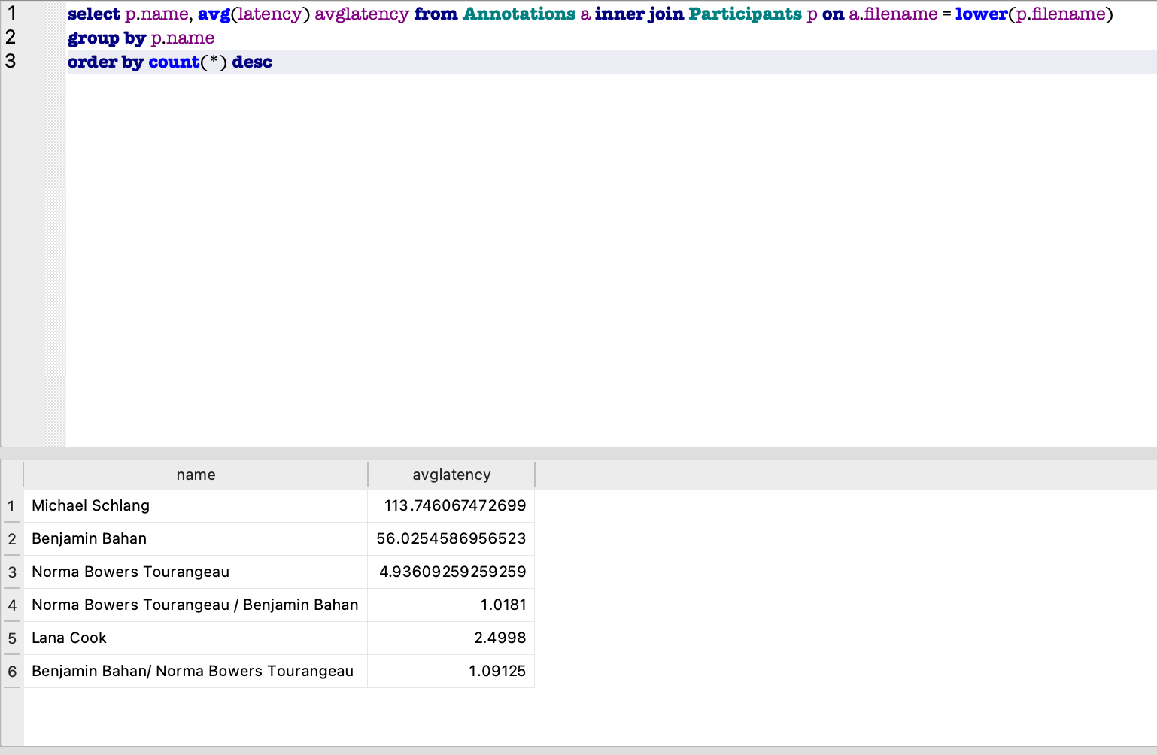
Manipulating extracted categorized data in sql using queries

Slide 6
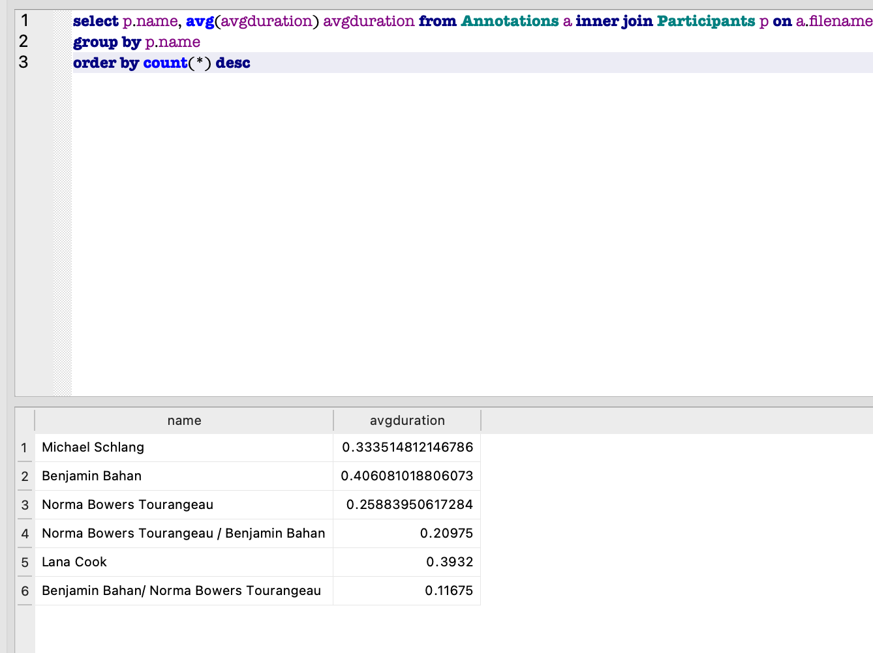
Manipulating extracted categorized data in sql using queries

Slide 7
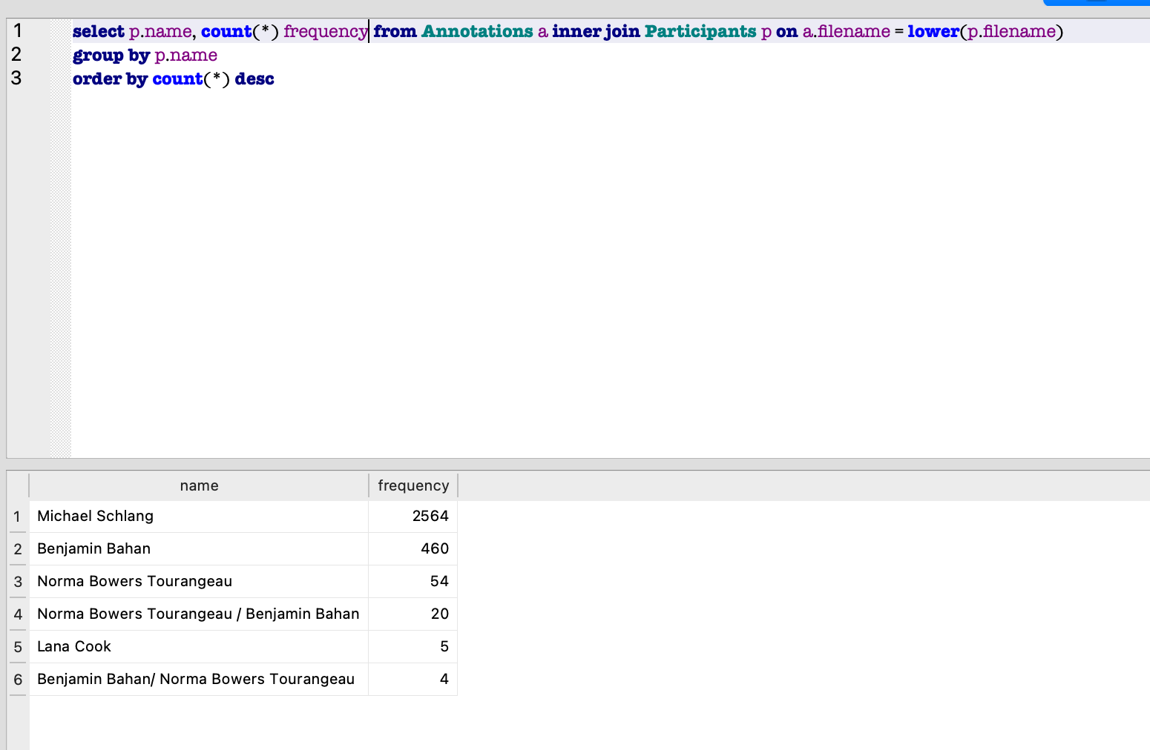
Manipulating extracted categorized data in sql using queries

