Slide 1

Annotating with ELAN
By Deannia Lucas

Slide 2

ELAN
ELAN (EUDICO Linguistic Annotator) is an annotation tool that allows you to create, edit, visualize and search annotations for video and audio data. It was developed at the Max Planck Institute for Psycholinguistics. ELAN is specifically designed for the analysis of language, sign language, and gesture, but it can be used by everybody who works with media corpora, i.e., with video and/or audio data, for purposes of annotation, analysis and documentation.
The annotation process involves three steps:
1. Defining tier types and tiers
2. Selecting time intervals
3. Entering annotations

Slide 3
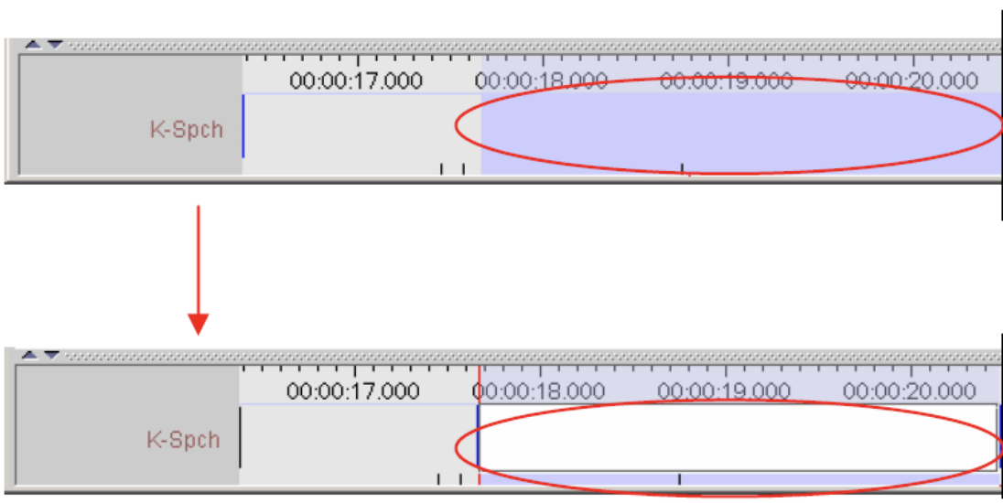
Creating an Annotation
How to create an annotation depends on the type of the tier the annotation has to be added to. On time alignable tiers new annotations usually are created with a specific begin and end time.
Eg.: Deannia’s Annotation double click specific beginning and end time
add text in white space
On non-alignable tiers annotations inherit time information from a parent annotation that they depend on.
Eg.: Sign Language Corpus- biker

Slide 4
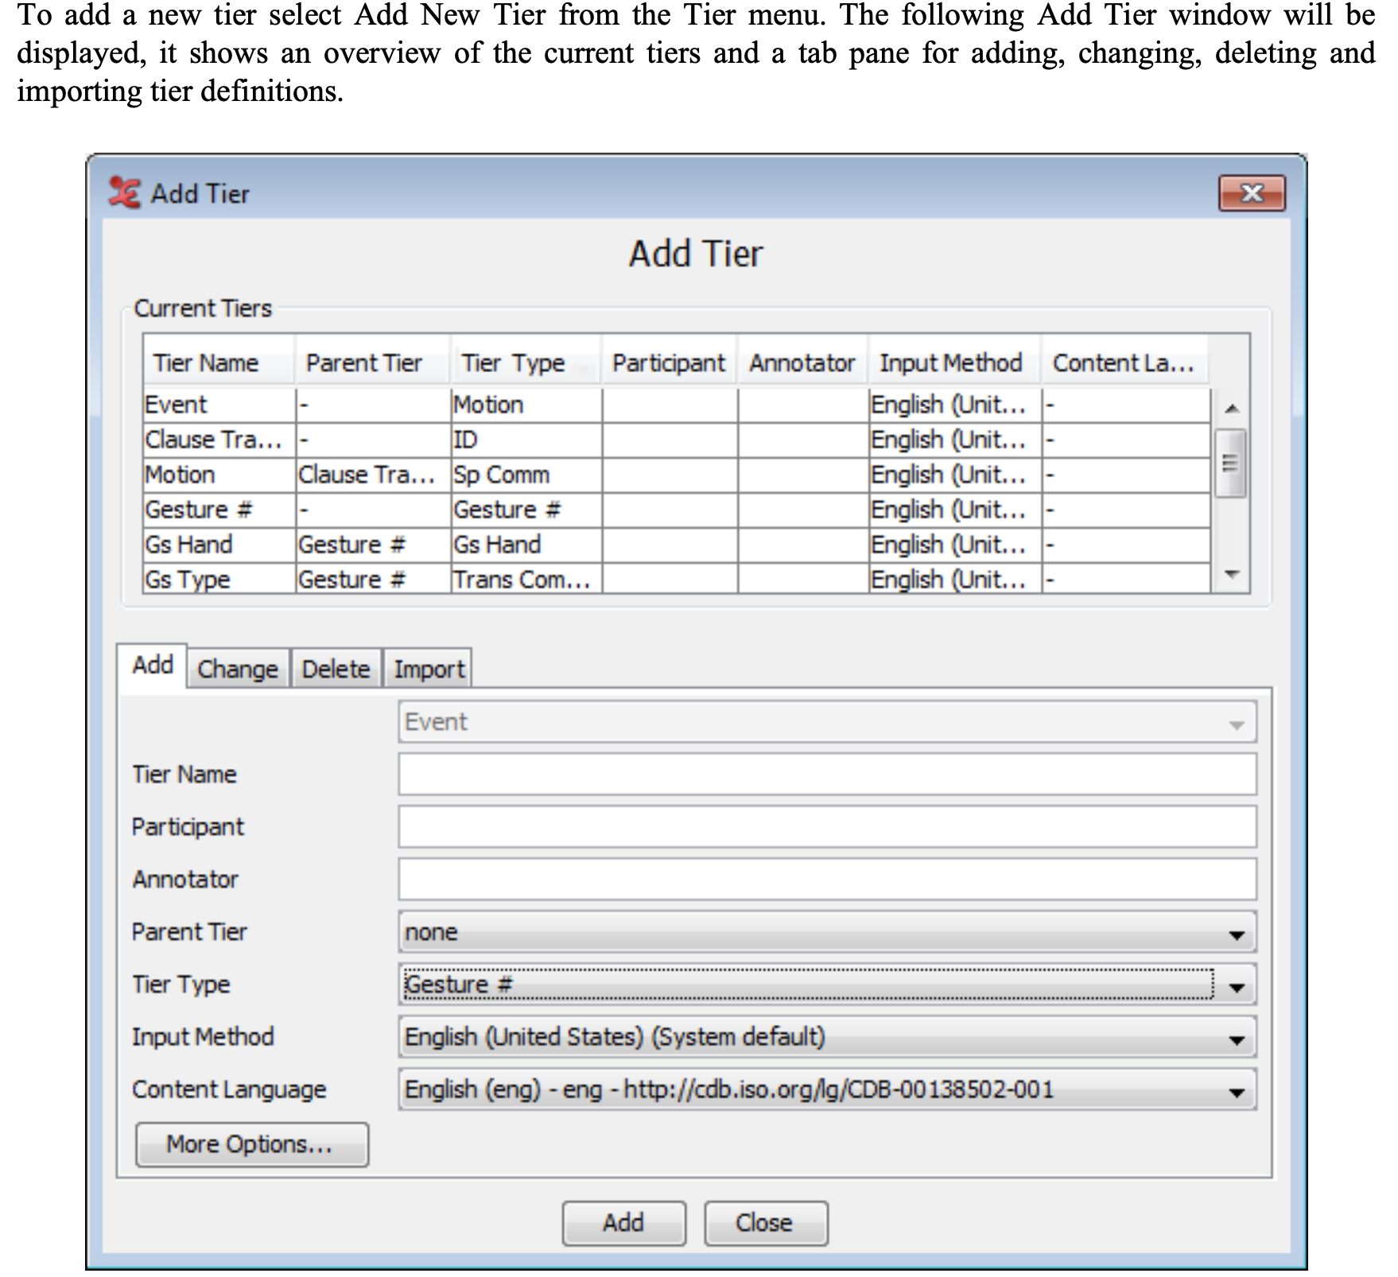
Creating/Adding a Tier
Tier Name - should be unique in the set of tiers.
Participant - name or code for the participant or subject this tier is referring to.
Annotator - name or code of the creator of the annotations on this tier.
Parent tier - the parent tier of this tier or none.
Tier Type - defines the type of this tier, the constraints that apply to it and its annotations.

Slide 5
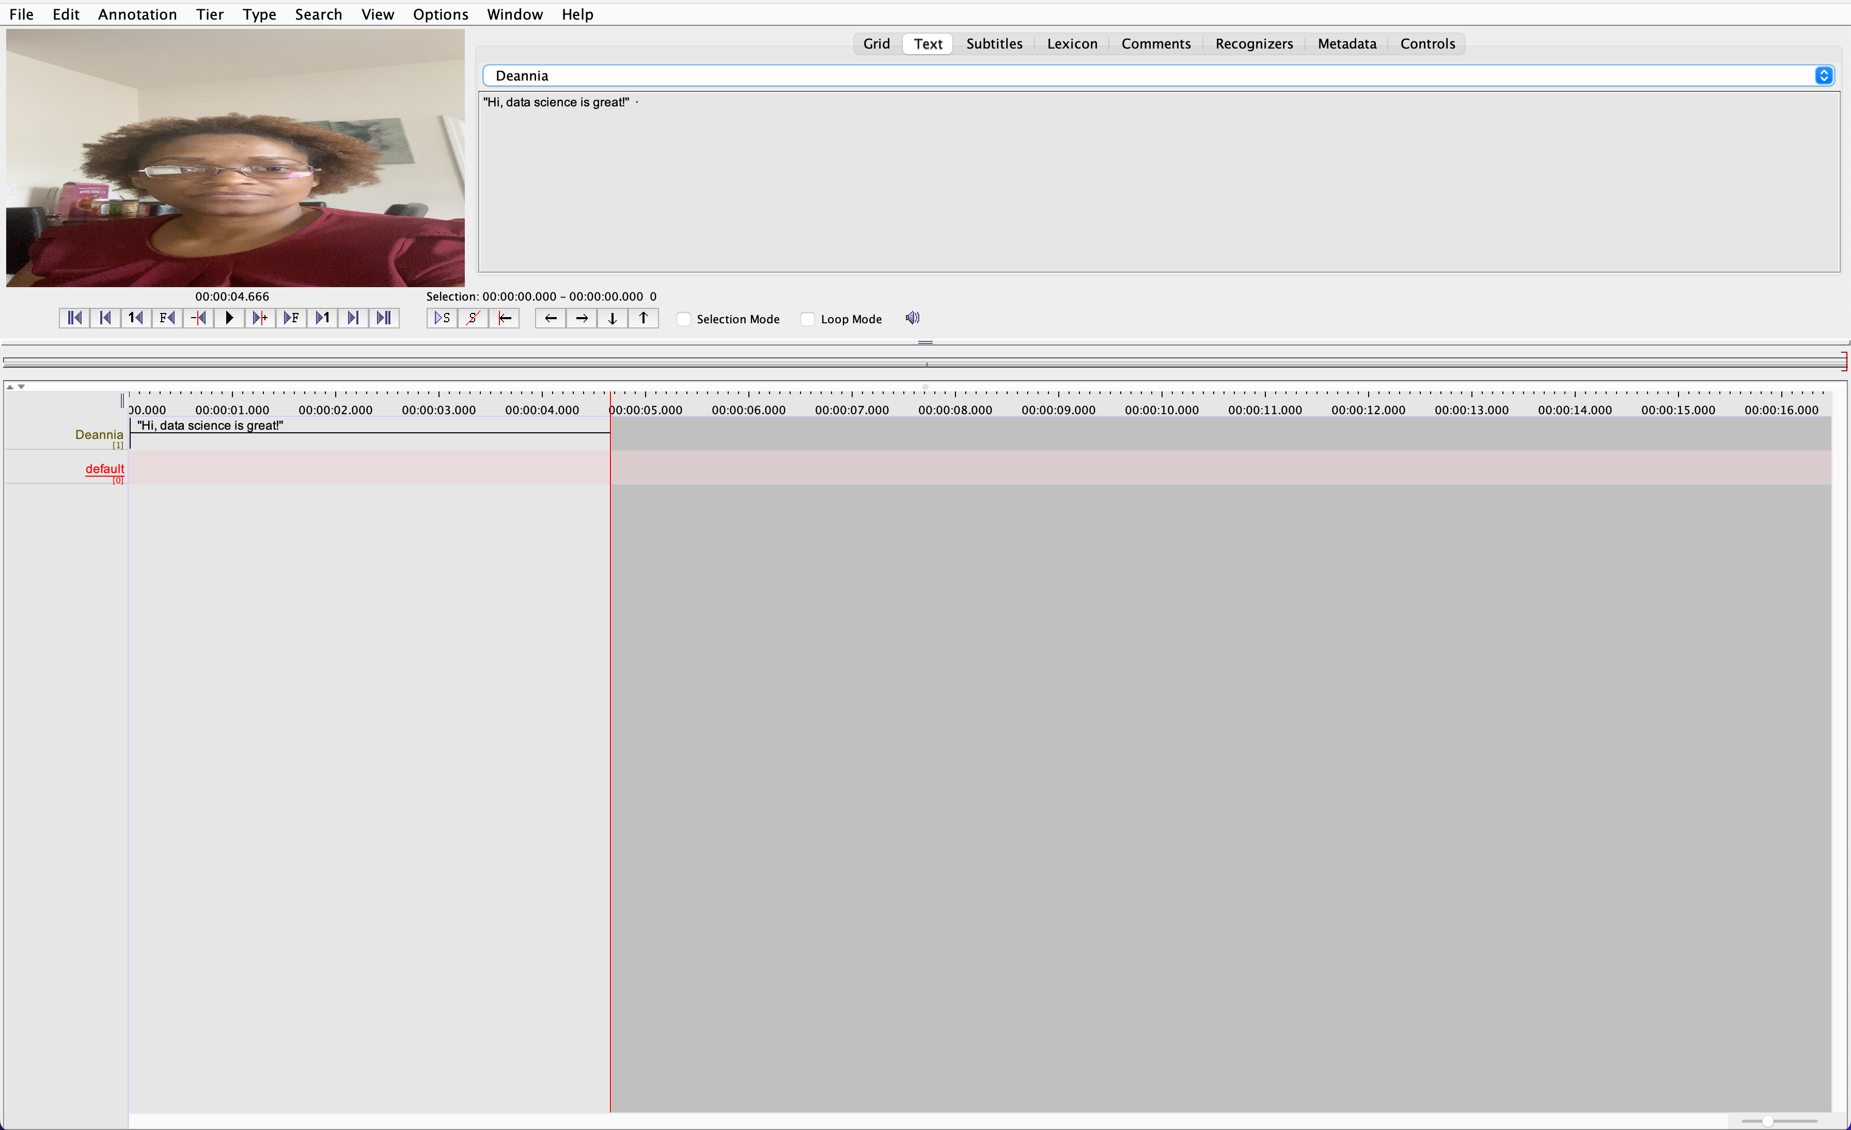
Deannia’s Annotation
An annotation is any type of text (e.g. a transcription, a translation, coding, etc.) that you enter on a tier. It is assigned to a selected time interval of the video/audio file (e.g., to the utterance of a speaker)
A tier is a set of annotations that shares the same characteristics, e.g., one tier containing the orthographic transcription in other words, this tiers is `independent’ and `time-alignable’, in which case its annotations are directly linked to a time interval of the media file.

Slide 6
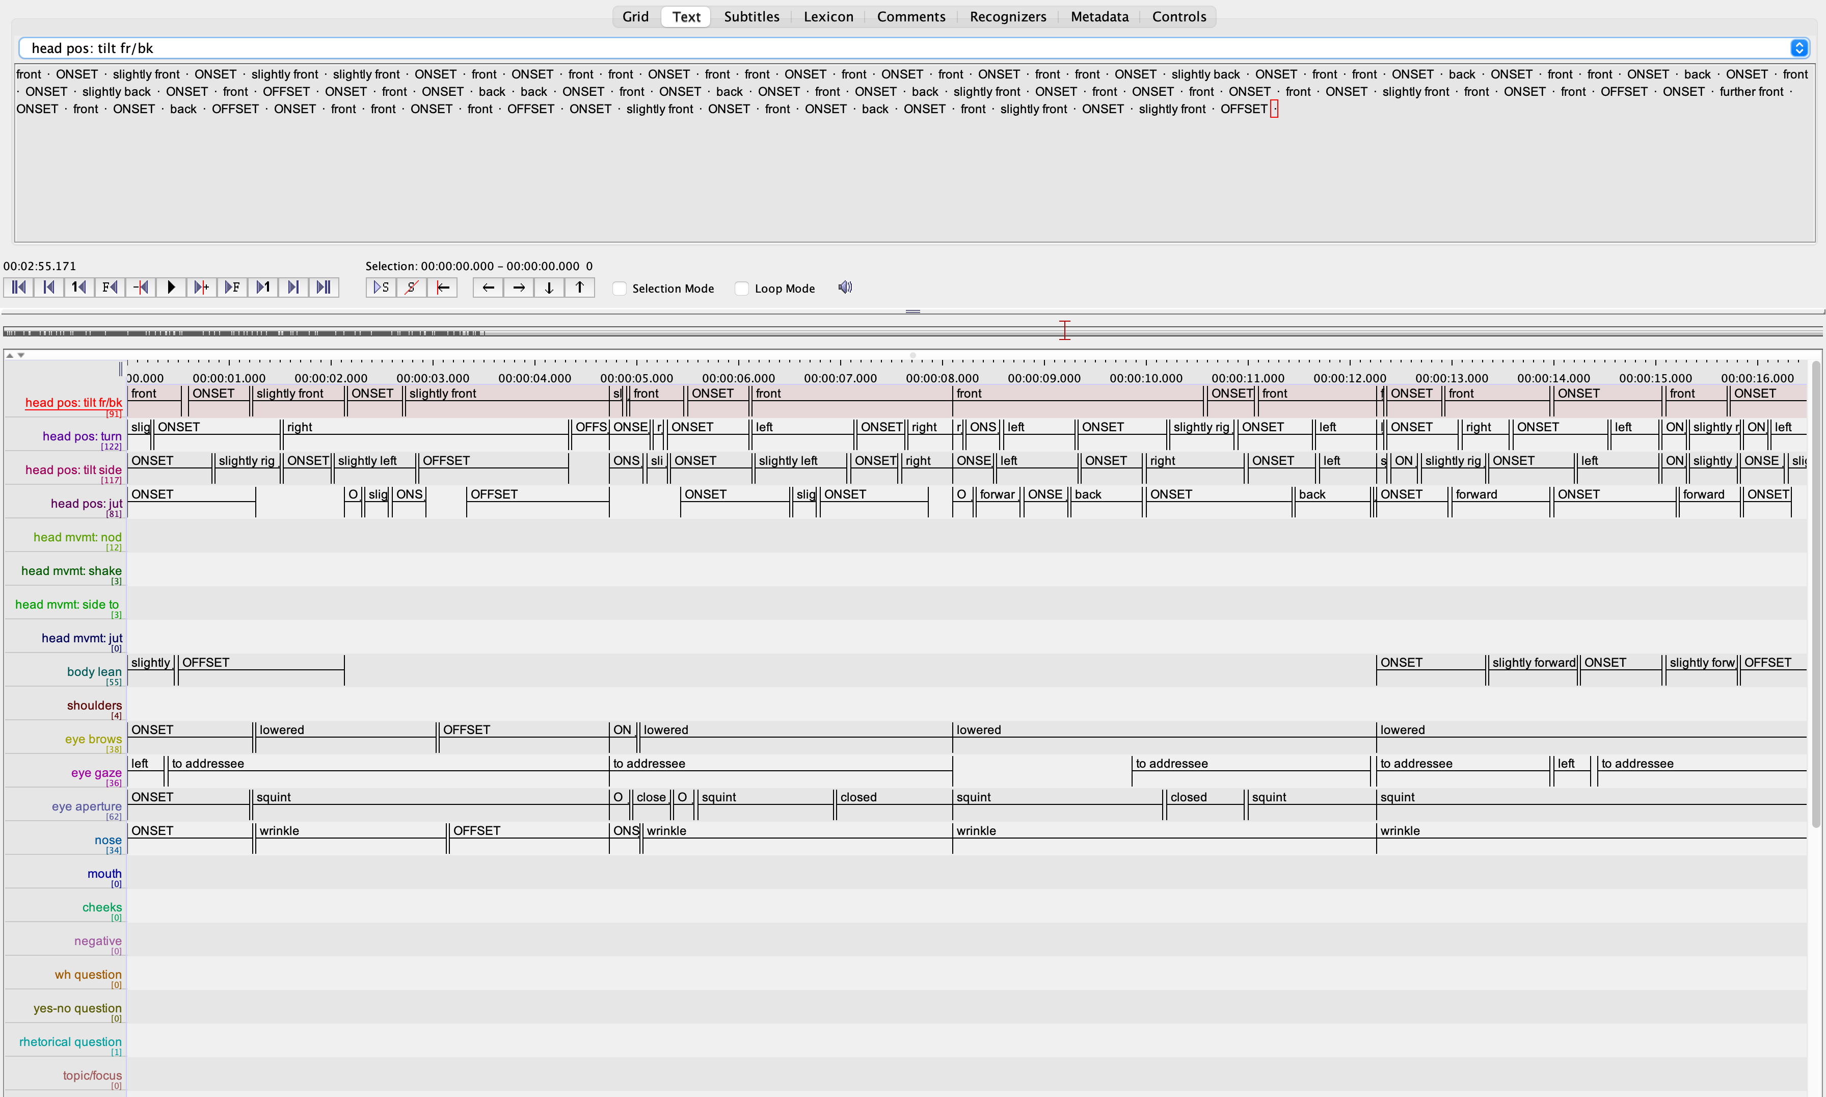
Sign Language Corpus Tiers
`referring’ tier, in which case it is linked to another tier, its so-called parent tier.
Annotations on a dependent tier each are bound to an annotation on the parent tier
the time boundaries of the child annotation cannot exceed the boundaries of the parent annotation. In other words, the child annotations are always required to be inside the interval of the parent annotation
child tier or dependent tier of parent tier.

Slide 7
Sign Language Corpus
what's it's name: biker
what's in it: this sign language reflects features of movements while riding a bike. Here the signer is expressing language using articulators such as movement; body, head, face etc.
Cautions we should know about accessing it: can only be accessed via tools and interface of ELAN

Slide 8
