Slide 1
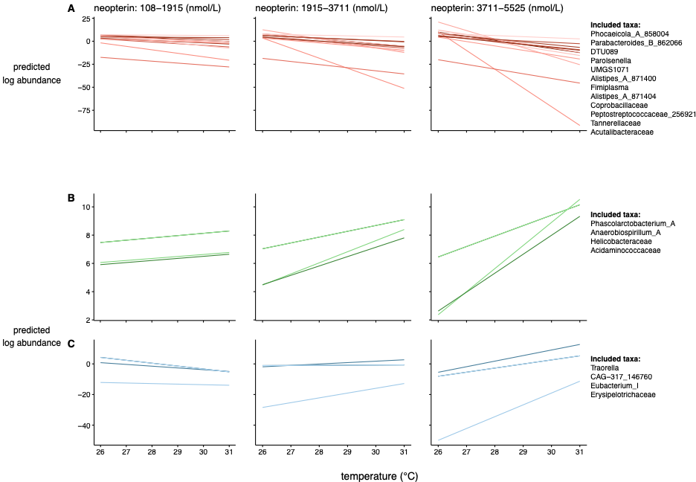
Decreasing slopes
Increasing slopes

