Slide 1
Real options
An option is a contract where one party grants (sells) the other party the right to buy or sell an asset at a specific price, within a specific time period.
A call option is the right to buy, a put option is the right to sell
The price at which the option buyer may buy or sell is called the strike or exercise price
A call option is in the money if the asset price rises above the strike price
A put option is in the money in the opposite situation
Most real estate projects have option-like aspects: develop (call), expand (call), upgrade (call), contract (put), abandon (put)…

Slide 2
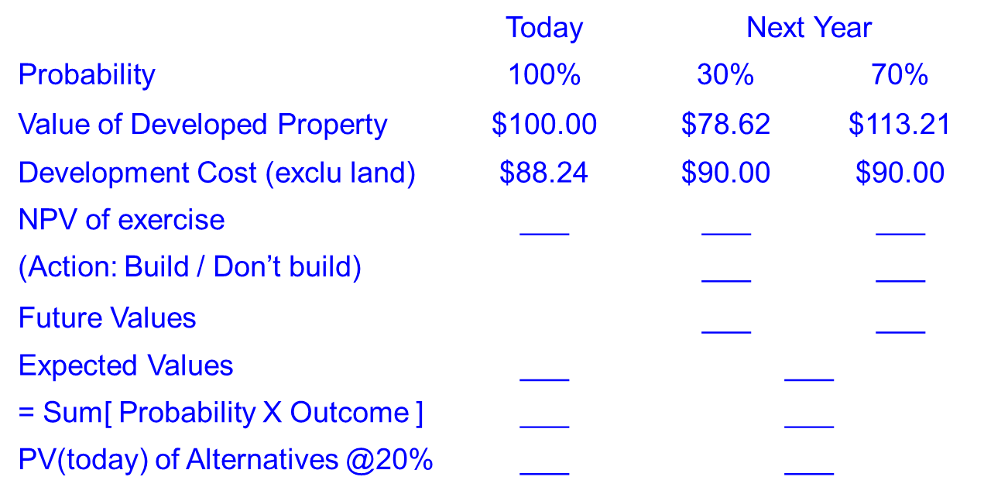
Land development option exercise
Consider a vacant land parcel and its potential development as summarized in the table below. In particular, suppose a building worth $100 million today can be developed in the land at a construction cost of $88.24 million, for an immediate profit of $11.76 million (here assume that construction is instantaneous). Now, suppose that the development option does not expire today, but rather will exist another year. Further, suppose that it is reasonable to expect that, if we wait until next year, there is a 70% chance that the market will improve and a similar building, newly completed next year, would in that case be worth $113.21 million. On the other hand, there is a 30% chance that the market will decline, which would result in a value of only $78.62 million for the new building next year. In either case, construction costs will have increased by 2%, to $90 million next year.
Complete the following table
Will the landlord wait to develop in the second year? (Show your work)
What is the option premium? (Show your work)

Slide 3
NPV Decision
NPV₀ = V₀ – P₀
Net Present Value =
PV of operating property, (i.e. value of the completed project) minus
PV of the price/cost in obtaining/developing the property (i.e. cost of development)
NPV must be;
At some “Present Time” (i.e. at the decision/commitment time)
Certainty equivalent dollars (i.e. in dollars adjusted for risk as of the time the investment is being made)
Implications
How do you assess the “risk” of the negative cash flows during development?
How do you assess the change in risk as the project achieves certain milestones?

Slide 4
Development Finance - Overview
Overview –What makes Development Finance Different?
3 Unique Features of Development Finance
Time-to-Build
Investment cash flows occur over time; not a single point in time investment
Lag between investment and receipt of cash flows
Construction Loans – almost universal in development projects
Phased Risk Regimes – Risk varies at different stages of process

Slide 5
Exhibit 2-2: The “Real Estate System”: Interaction of the Space Market, Asset Market, & Development Industry
SPACE MARKET
LOCAL
SUPPLY
DEMAND
&
ADDS
(Landlords)
(Tenants)
NATIONAL
NEW
ECONOMY
RENTS
&
OCCUPANCY
FORECAST
FUTURE
DEVELOPMENT
INDUSTRY
ASSET MARKET
IF
IS
SUPPLY
YES
DEVELPT
CASH
(Owners
PROFITABLE
FLOW
Selling)
?
CAPI
TAL
PROPERTY
MKT
MKTS
CONSTR
MARKET
REQ’D
D
EMAND
COST
VALUE
CAP
(Investors
INCLU
RATE
Buying)
LAND
= Causal flows.
= Information gathering & use.
Copyright © 2007 Thomson/South-Western, Geltner/Miller/Clayton/Eichholtz, 2e

Slide 6
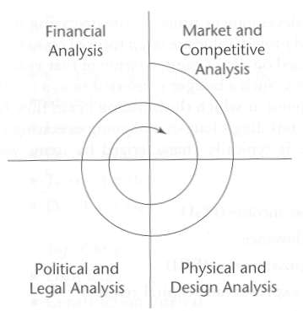
Development is an Iterative Process
A Repetitive process of Market Analysis, Design, Political Approval and Finance
Development is a multi-disciplinary, iterative process
The (famous) Graaskampian Spiral.

Slide 7
Graaskamp: 3 Types of RE Development Problems
Use in Search of a Site
Developer has a particular development specialization, or
Developer is working for a specific user.
Site in Search of a Use
Developer/Site Owner tries to determine & build the “Highest and Best Use” (HBU), or
Highest and Best Use – The Physically Possible, Legally Permissible Use that results in the Highest Value
Public entity seeks developer to build a use determined through a political process (presumably also “HBU”).
Capital in Search of a Return

Slide 8
Exhibit 29-1a: Development Project Phases:
Typical Cumulative Capital Investment Profile and Investment Risk Regimes
R
I
S
K
AS
I
N
V
E
R
S
E
S
U
C
C
E
S
S
P
R
O
B
$
C
UMULAT
IVE
INVESTME NT
$
VERY HIGH RISK
e.g.: 40% OCC
HIGH RISK
e.g.: 20% OCC
MODERATE RISK
e.g.: 10% OCC
LOW RISK
e.g.: 8% OCC
LAND OPTIONING & ASSEMBLY, PERMITTING, & DEVLPT DESIGN
⬅ CONSTRUCTION ➔
LEASE-UP & TENANT FINISHES
STABILIZED ➔
OPERATION ➔
Time ➔
LAND
PURCHASE
“Time 0”
SHELL COMPLETION
“Time T₁”
DEVLPMT COMPLETION
“Time T₂”
= CUMULATIVE INVESTMENT
= RISK LEVEL
Copyright © 2007 Thomson/South-Western, Geltner/Miller/Clayton/Eichholtz, 2e

Slide 9
SOURCES OF CAPITAL:
Exhibit 29-1b: Development Project Typical Sources of Investment Capital
D
E
DEVLPT CAPITAL
Betw 0 & T…
FROM COMMERCIAL BANKS:
TRADITIONAL CONSTRUCTION LOAN DEBT,
FROM Time 0 TO Time T₁;
AND/OR
MINI-PERM LOAN DEBT
FROM Time 0 TO Time T₂.
PERMANENT FINANCE
Beyond Time T…
FROM LICs, PFs, PRIV EQUITY :
L.T. EQUITY
OR
COMMERCIAL MORTGAGE (EITHER CMBS CONDUIT OR WHOLE LOAN)
$
C
UMULAT
IVE
INVESTME NT
$
C
ORDER OF PRIORITY IN PAYBACK
ORDER OF INVESTMENT
B
G
H
I
EXTERNAL EQUITY &/OR MEZZ DEBT INVESTORS:
OPPTY FUNDS, INSTNS, FOREIGN INVSTRS, WEALTHY INDIVIDUALS, REITS
A
F
Z
ENTREPRENEURIAL
DEVLPR SEED EQUITY
O
LAND OPTIONING & ASSEMBLY, PERMITTING, & DEVLPT DESIGN
⬅ CONSTRUCTION ➔
LEASE-UP & TENANT FINISHES
STABILIZED ➔
OPERATION ➔
Time ➔
LAND
PURCHASE
“Time 0”
SHELL COMPLETION
“Time T₁”
DEVLPMT COMPLETION
“Time T₂”
Copyright © 2007 Thomson/South-Western, Geltner/Miller/Clayton/Eichholtz, 2e

Slide 10
From Tod McGrath’s analysis of Massachusetts 40B (Low Income Housing) projects
Copyright © 2007 Thomson/South-Western, Geltner/Miller/Clayton/Eichholtz, 2e

Slide 11
Development Project Risks
Entitlement, Approval, or Permitting Risk
Cost, Timing and Uncertainty – Risk of obtaining appropriate land entitlements, construction permits, and possibly zoning variances.
Construction Risk
Materials pricing – risk that the cost of materials may change significantly from the original construction budget.
Physical Issues – Unforeseen physical issues that can impact costs (Geotechnical, environmental)
Design and Bidding – Risk of errors or omissions in the design and bidding process (i.e. between architect and contractors or between subcontractors)
Scheduling – risk that planned construction completion could be prolonged due to weather delays, labor disputes, material delivery delays, planning/scheduling errors, etc.

Slide 12
Development Project Risks (cont.)
Leasing/Sales Risk
Market Rent Risk – Risk that market rents may change unexpectedly from budget projections
Absorption Risk – Risk that forecasted absorption (leasing or unit sales) rates will not be realized.
Transaction Terms – Risk that transaction terms available in the market might change (e.g. escalations, early termination clauses, etc.)
Leasing/Sales Cost Risk – Risk of a market-driven restructure of leasing or sales commission rates.
Operating Expense Risk
Risk of a significant change in one or more fixed or variable expense categories such as insurance, utilities, electricity, real estate taxes, etc. (e.g builders risk insurance after 9/11 and/or hurricanes)

Slide 13
Development Project Risks (cont.)
Credit Risk
Risk that pre-lease tenants and/or tenants’ industry segment is negatively impacted during development.
Partnership Risk (if applicable)
Risk that accompanies any ownership less than 100% due to a myriad of factors regarding control, revenue distributions, etc.
Capital Market Risk
Financing Risk – risk that terms, conditions and availability of debt and equity may change unexpectedly.
Interest Rates – risk of a significant change in interest rates during the development period. This could affect the cost of construction or, in the case of a condominium project, the buyer’s ability to obtain suitable purchase price financing.
Alternative investment risk – risk that investor allocations or rates of return for alternative investments will change resulting in shifts in capitalization and discount rates.
Pricing Risk
Supply Risk – risk that unanticipated competitive supply will enter the market before lease-up or sellout is achieved resulting in short-, mid-, or long-term concessions, absorption, pricing, etc.
Real Estate Cycle Issues – risk that rental rates may be negatively affected by changes in market supply/demand dynamics.

Slide 14
Development Project Risks (cont.)
Event Risk
Risk of a material physical, economic, or other event occurring that significantly impacts asset operations and value. Weather, discovery of previously unknown environmental contamination, exodus of major employment providers, and terrorism comprise a sampling of such events. (“Force Majeure”)
Valuation Risk
Risk that a lack of applicable, current market data exists to accurately value the subject property.
Risk that a lack of competency exists with the appraiser engaged to specifically address issues of property type, geography, valuation analytics, market research, etc.

Slide 15
Development Project Budgeting
Hard Costs
Land cost
Site preparation costs (e.g., excavation, utilities installation)
Shell costs of existing structure in rehab projects
Contractor fees (overhead and profit)
Materials
Labor
Equipment rental
Tenant finish
Soft Costs – Fees and Permits
Soil testing
Environmental studies
Land planner fees
Architectural fees
Engineering fees
Permits
Soft Costs – Financing Costs
Loan fees
Construction loan interest
Legal fees
Soft Cost – Development and Management
Construction management and overhead costs
Developer fees
Lease-Up Costs
Marketing costs & advertising
Leasing expenses (commissions)
Tenant improvement expenditures (“build-outs”)
Working capital during lease-up (until break-even)

Slide 16
Typical Construction Finance Structure
Phase:
Construction
Lease-Up
Stabilized Operation…
C.O.
Financing:
Construction Loan
Bridge Loan
Permanent Mortgage
Source:
Commercial
Bank
Comm. Bank
Insur Co.
Via Mortg Brkr or Mortg Banker:
Life Insur. Co.
Pension Fund
Conduit ➔CMBS
Construction lender won’t approve construction loan until permanent lender has conditionally approved a “take-out” loan.
Copyright © 2007 Thomson/South-Western, Geltner/Miller/Clayton/Eichholtz, 2e
Notes:
Sometimes a “mini-perm” loan will cover both the construction and lease-up phase, usually provided by the construction lender.
It makes sense for commercial banks to supply construction loan capital, because: (i) They have local presence, enabling them to develop the type of local expertise needed to be successful (familiarity with real estate markets, developers, construction contractors); (ii) They have short-term liabilities (deposits), so they need to match these with short-term investments (which construction loans normally are). In contrast, Life insurance cos & pension funds have very long-term liabilities, which need to be matched by long-term assets that yield reliable cash flow streams.

