Slide 1
Chapter 20
Commercial Mortgage Backed Securities

Slide 2
CHAPTER OUTLINE
20.1 What Are CMBS?
20.1.1 A Brief History of the CMBS Industry
20.1.2 Magnitude of the CMBS Industry and Its “Rise and Fall” (and Rebirth?)
20.2 CMBS Structure: Pooling, Tranching, and Subordination
20.2.1 A Simplified Numerical Example of Tranching
20.2.2 Allocating the Credit Losses
20.2.3 Unbundling, Specialization, and Value Creation
20.3 CMBS Rating and Yields
20.3.1 Bond Credit Rating
20.3.2 Credit Rating, Market Yields, and CMBS Structure
20.4 Lessons from the Financial Crisis
20.5 Chapter Summary

Slide 3
20.1 What are CMBS?
CMBS are mortgage-backed securities based on commercial mortgages.
Provide claims to components of the CF of the underlying mortgages.
CMBS is an efficient source of debt capital
Issued in relatively small, homogeneous units, so as to facilitate trading by a large potential population of investors,
Including those who do not wish (or are unable) to invest large sums of money in any given security & passive investors w/out RE expertise (large pool of bond mkt capital).
Many CMBS are traded in relatively liquid public exchanges (part of the bond market).
Market for a given individual security is likely to be rather thin, but the similarity within classes of securities is great enough to allow relatively efficient price discovery and resulting high levels of liquidity in the market.
Other CMBS are privately placed initially, only traded privately (if at all).
CMBS offers investors in the bond market a variety of new securities that serve different types of investment needs

Slide 4
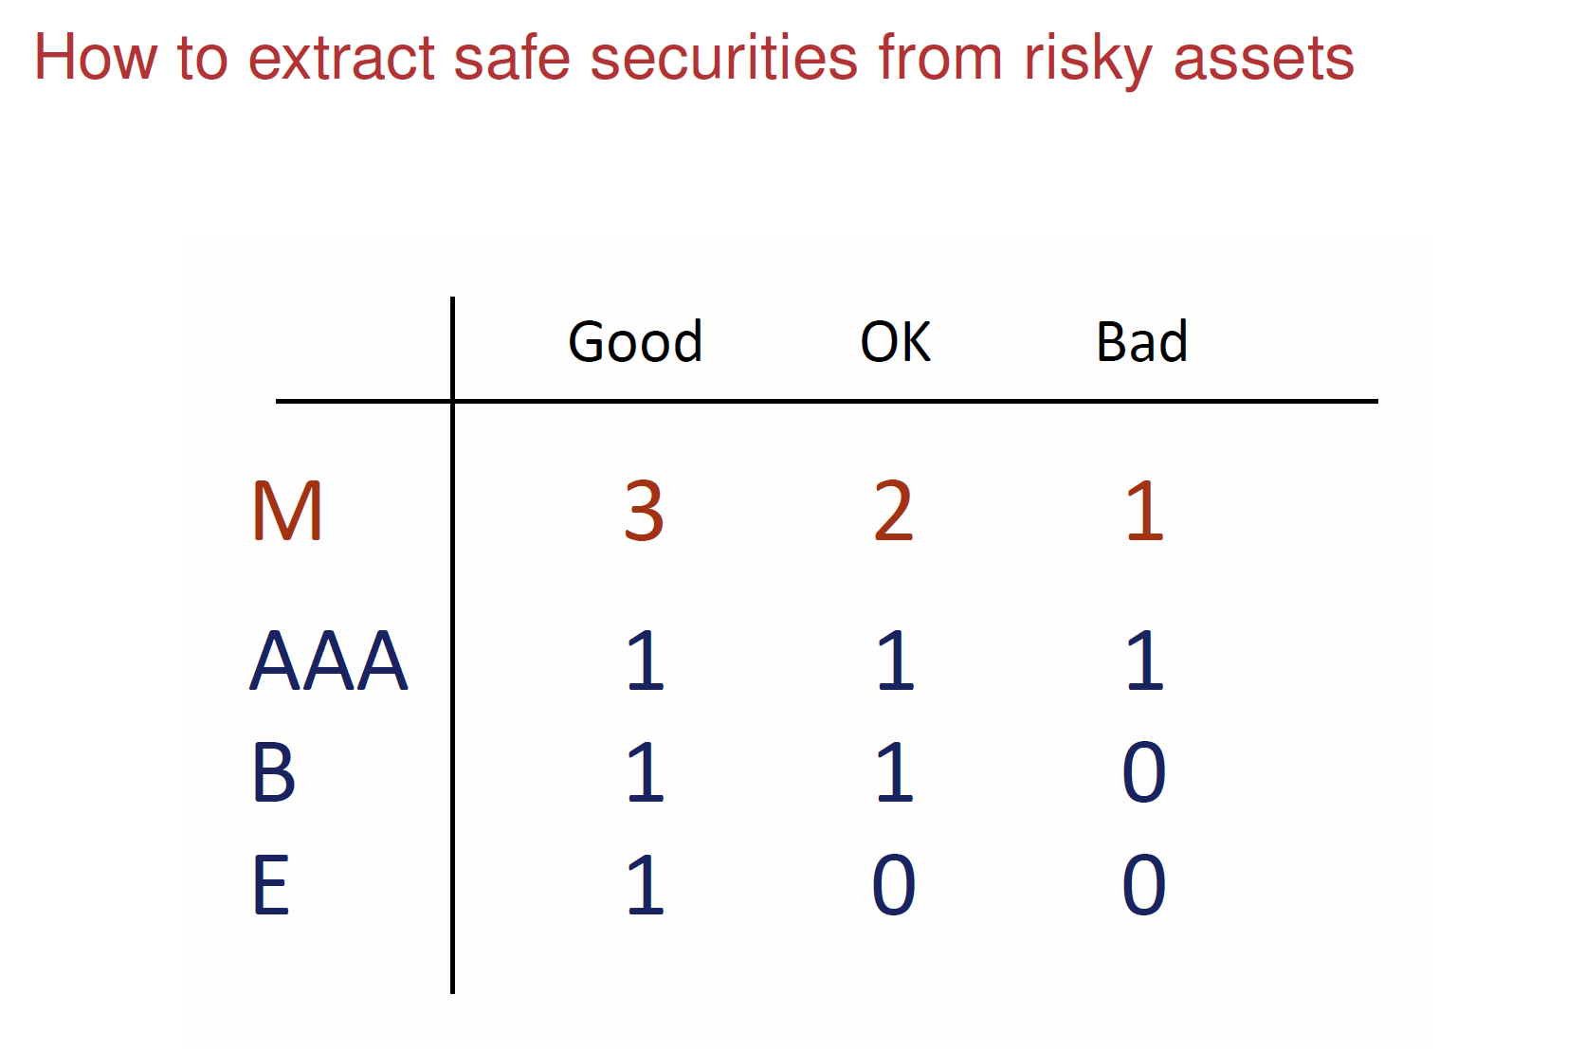

Slide 5
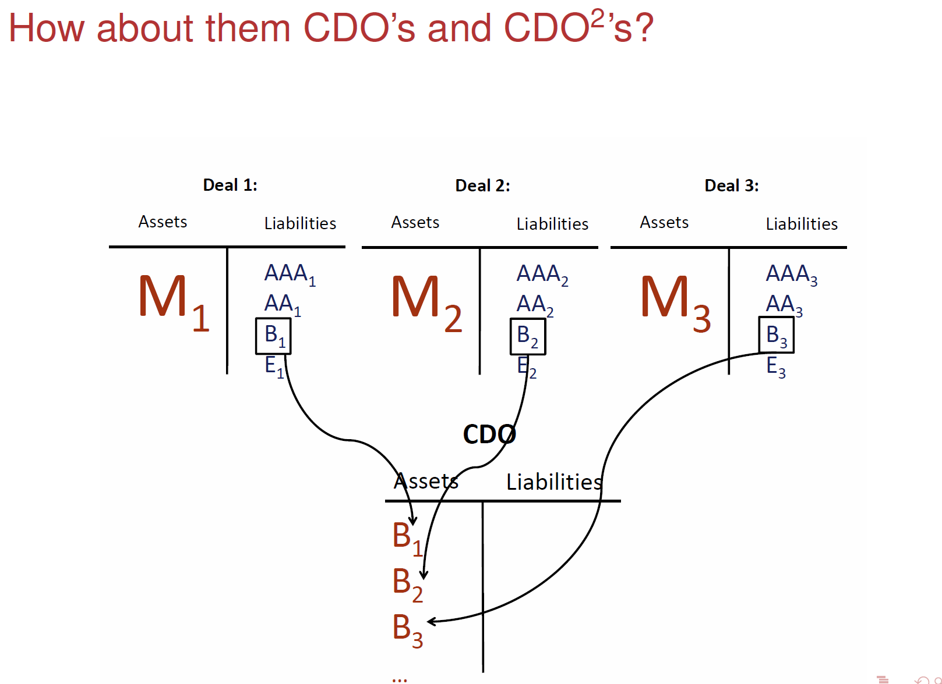

Slide 6
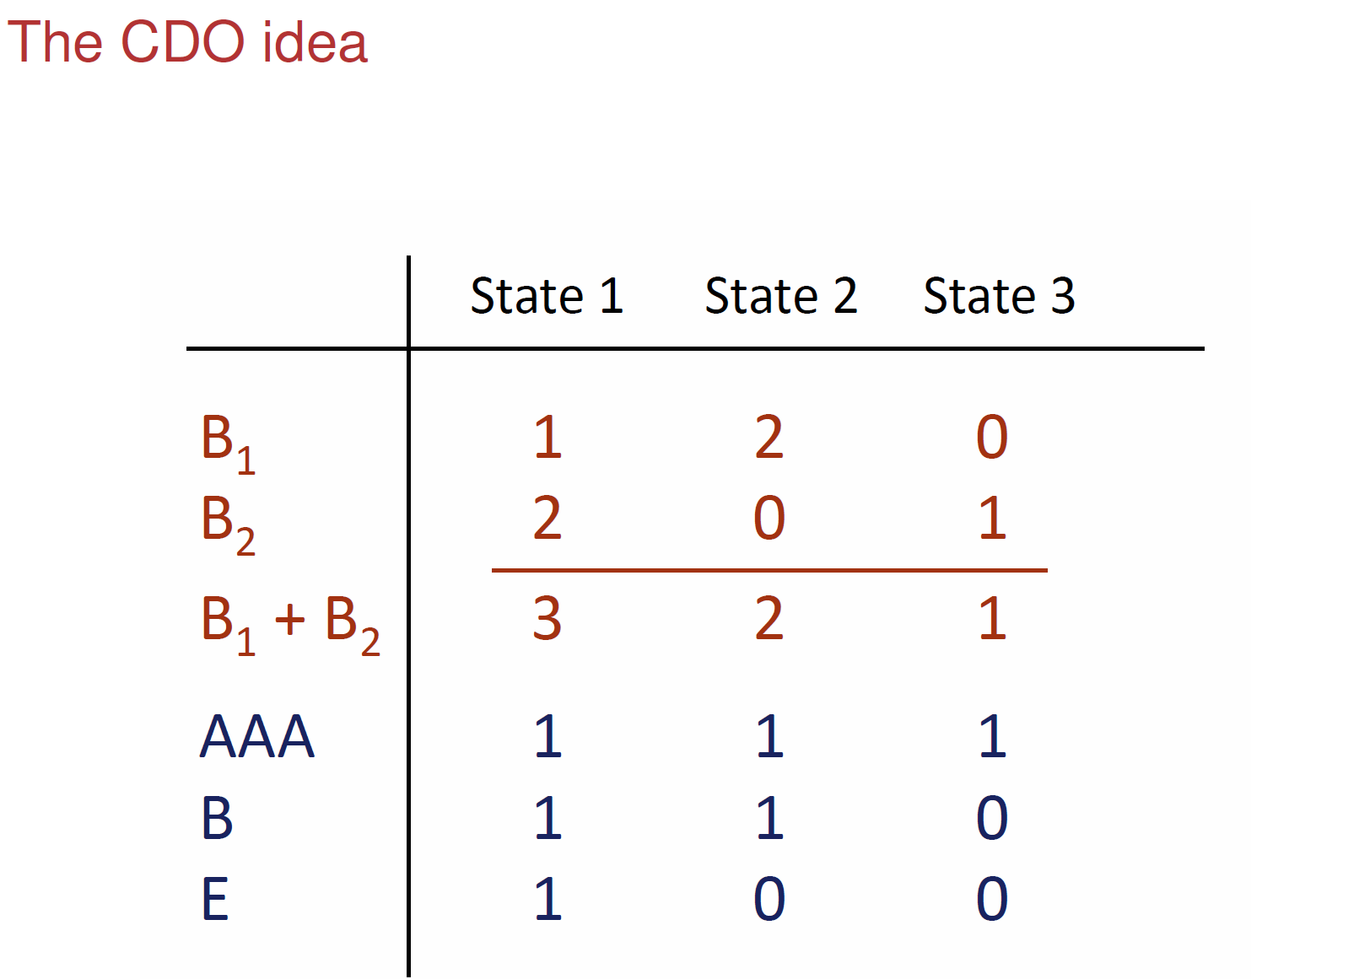

Slide 7
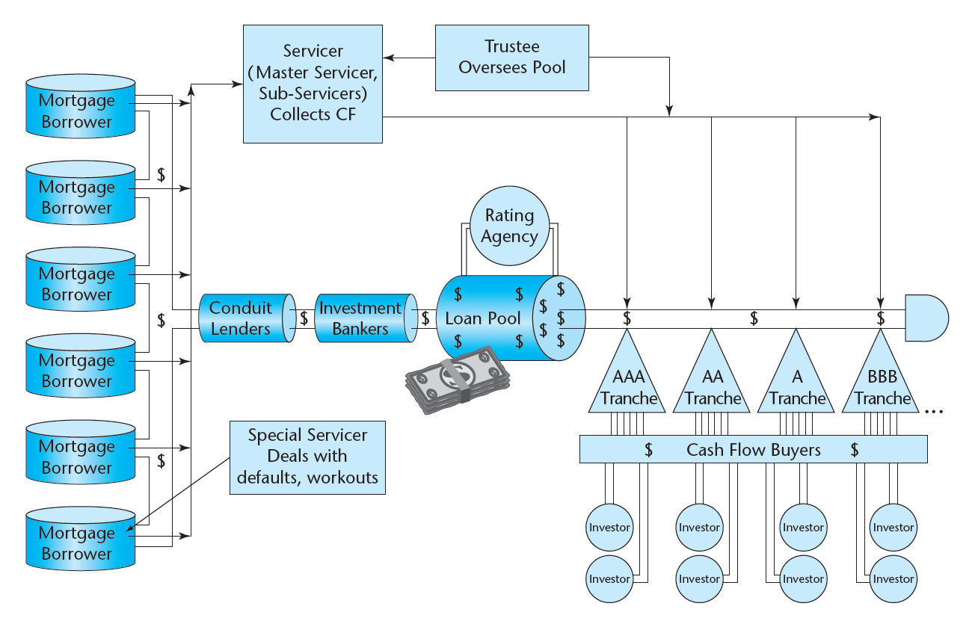
Exhibit 20-1: CMBS Securitization Process
Issues and sells bonds to investors
Pass-through entity
© OnCourse Learning

Slide 8
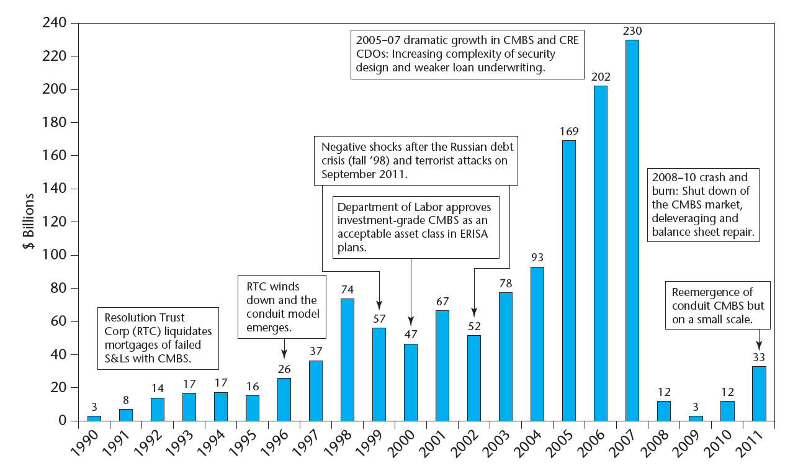
20.1.1 A Brief History of the CMBS Industry
Exhibit 20-2: CMBS Issuance, U.S., 1990-2011
Source: Based on data from Commercial Mortgage Alert and Clodfelter (2005).

Slide 9
Modern CMBS industry established in 1990s, grew to be major source of permanent CRE finance in 2000s boom…
Note: Banks & Thrifts provide shorter-term loans (< 5 yrs) and about half is typically construction loans. Major long-term permanent financing of CRE is LICs & CMBS (GSEs just apts).

Slide 10
Key to creation of CMBS industry in 1990s was devlpt by bond-rating agencies of the ability to rate the default-risk of CMBS tranches:
Bond mkt full of “passive investors” (lack time, resources, expertise to assess risk of individual bonds). Won’t invest w/out a reliable measure of default risk.
When a CMBS tranche obtains a bond rating, investors who know little or nothing about CRE feel comfortable working under the assumption that default risk of that tranche is very similar to the default risk of any other bond with the same rating.
This vastly expands the pool of potential investors and makes the public market for CMBS viable.

Slide 11
20.2 CMBS Structure: Tranching & Subordination…
Basic Structure … A senior/subordinate structure in which the cash flow from the pool of underlying commercial mortgages is used to create distinct classes of securities (bonds); the pool is cut up into tranches.
Tranching cash flow claim priority involves two primary dimensions:
Loan Contractual Retirement. ➔ Duration / Interest Rate Risk.
Credit Losses. ➔ Default Risk.
In CMBS it is usually the default risk dimension that is most important (most commercial mortgages have “prepayment protection”).
The opposite used to be true in RMBS, where duration was traditionally the prime concern, due to the greater prepayment risk in residential loans (RMBS pools from FNMA FHLMC had “default protection”).
The way the CMBS industry has worked, an “IO” class is “stripped” off of the other securities (from the excess of pool loan coupon interest over the A-Tranche coupon interest), providing shorter-duration securities that have been major source of profit to CMBS issuers.

Slide 12
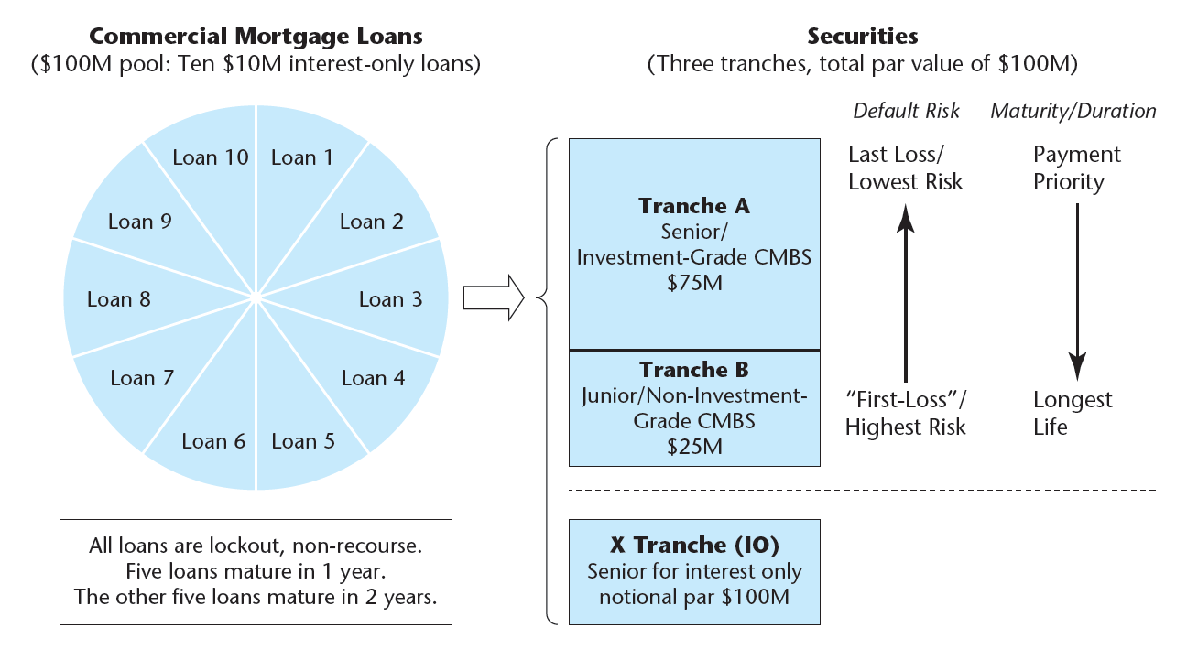
20.2.1 A Simplified Numerical Example of Tranching
EXHIBIT 20-3 CMBS Mortgage Securitization Basics: Numerical Example of Tranching and Senior/Subordinate Structure
70% LTV
© OnCourse Learning
Portions of interest payments that are not claimed by
other tranches on the basis of their par values and
coupon rates

Slide 13
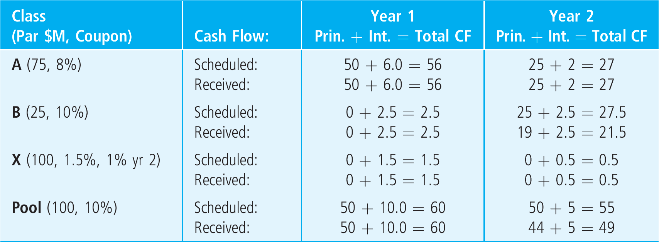
20.2.2 Example: Allocating the Credit Losses
Suppose all loans perform according to the contract in the first year,
but in the second year one of the remaining five loans defaults on its $1 million interest payment.
The loan is sold in foreclosure for net proceeds of $5 million.
Thus, the pool is short $6 million of contractual cash flow in year 2.
Exhibit 20-4: Contract vs Ex Post (realized) Cash Flows by Tranch and Year
Write on the blackboard!

Slide 14
20.2.3 Unbundling, Specialization, & Value Creation
Unbundle cash flow sources. Separate:
Principal vs Interest
Credit losses vs Contractual payments
Stratify & concentrate default risk & maturity
Specialize match of securities to investors:
AAA (& other “Investment Grade”) to passive conservative fixed-income investors
Lower-rated & “B-pieces” to specialized investors with RE expertise, more active and aggressive
Shorter maturities to investors with short-term liabilities (banks), longer maturities to investors with long-ter liabilities (LICs, PFs)
Market value of securities created in deal must exceed cost of acquiring the mortgage pool reflecting par values (OLBs) of the mortgages:
Sufficient to cover cost of securitization and pool/trust administration (including necessary profit to investment bank).

Slide 15
Exhibit 20-5: Summary of CMBS Example Bond Characteristics, Values, and Ex Post Realized Returns
Example bond pricing, for Class B, the 12% market yield implies bond price (value) is $24.15, discounting contractual cash flows @ the yield:
Example realized yield for Class B (after credit losses) is the ex post IRR based on realized cash flows & original market price:

Slide 16
20.2.1 (2e revised) A simple numerical example of tranching...
CMBS Structure of Securities in the Deal…
Three classes (tranches) are created based on the underlying pool, and sold into the bond (CMBS) market:
A-Tranche is “senior”, “investment grade” securities:
25% credit support: 25% of pool par value will be assigned credit losses (par value lost in default) before Tranche A receives any credit losses (any reduction in par due to default). ➔ Effective LTV for A tranche = (1-0.25)70% = 52.5%. (Underlying properties would have to lose 47.5% of their value before Tranche A gets hit, since it is most senior tranche.)
Shorter duration: WAM = (50/75)*1 + (25/75)*2 = 1.33 yrs.
Notes:
The expected CFs for the IO tranche are 75*.02 = $1.5M in year 1, and 25*.02 = $0.5M in year 2, so the WAM is (1.5/(1.5+0.5))*1 + (0.5/(1.5+0.5))*2 = 1.25 yrs; the mkt value is $1.5M/1.14 + $0.5M/1.14² = $1.70M.

Slide 17
B Tranche is “subordinated” (“non-investment grade” & “unrated”) securities:
Longer duration: WAM = (25/25)*2 = 2.00 yrs.
“X Tranche” (IO security)
Notional par and high claim priority on interest:
Any recovery in default allocated 1st to interest, IO variable coupon 1.5%, 1% Yr1, 2, based on notional par = entire pool (as it remains).
Notes:
Loss severity issue described here for B tranche is sometimes referred to as “levered debt”.

Slide 18
How did we determine the coupons in X?...
Consider difference between WAC in pool minus coupons in bonds:
Yr.1: A-tranche has 8% coupon on $75M par (vs 10% WAC in pool), hence:
(10% - 8%)*$75M = $1.5M extra interest, ➔ 1.5% of $100M Yr.1 total par.
Yr.2: A-tranch has 8% coupon on $25M remaining par (vs 10% WAC in pool):
(10% - 8%)*$25M = $0.5M on $50M remaining par in pool ➔ 1% coupon.
Notes:
Loss severity issue described here for B tranche is sometimes referred to as “levered debt”.

Slide 19
Value at issuance as CMBS:
The present value (mkt value) of each tranche (class of bonds) is determined by discounting the contractual cash flows to maturity of the bonds back to PV using the market yield-to-maturity (“YTM”) as the discount rate:
The idea is that at issuance the sum of the values of all of the tranches exceeds the value (cost) of the pool of all the individual mortgages:
A + B + X = $75.00 + $24.15 + $1.82 = $100.97 > $100.
Notes:
Loss severity issue described here for B tranche is sometimes referred to as “levered debt”.

Slide 20
Recall example “credit event”: one of the 2-yr loans defaults in yr.2 paying no interest that year and recovering only $5 million in foreclosure sale proceeds (5/11 = 45% “recovery rate”). What will the ex post CMBS cash flows look like?...
CMBS issue:
Default risk stratified & concentrated, wider variation:
Here Class B much riskier: -0.35% yield instead of 12.00%.
Classes A & X much less risky: 8% ex post yld = 8% YTM.
Maturity stratified & varied: Here ranges 1.25, 1.33, 2.00 years.
& Class A is bulk of pool. Allows creation of X.
Notes:
Loss severity issue described here for B tranche is sometimes referred to as “levered debt”.

Slide 21
20.3 CMBS Rating and Yields
Bond credit rating (e.g., “AAA”, “AA”, …) classifies amount of default risk in bonds. Is basic institution of bond market (goes back to early 20th century).
Facilitates passive, non-specialized investors. Rating agencies are private for-profit companies.
Originally hired by bond investors. But rating info is “public good”. Agencies can’t make profit if paid only by investors. So, industry evolved, now rating agencies hired by bond issuers.
Rating agencies compete with each other for business: ➔
Potential for conflict of interest (“rating shopping”). But…
Rating agencies depend on their reputations, credibility.

Slide 22
Exhibit 20-6: Bond Ratings

Slide 23
Rating CMBS tranches (cont.)…
Variables that can be important in analyzing the credit quality of a mortgage pool and the various tranches that can be carved out of it, in either quantitative or qualitative analysis, include:
Overall average LTV ratio & DCR
Dispersion (heterogeneity) in LTV and DCR
Quality of LTV and DCR information
Property types in the pool
Property ages and lease expirations
Geographical location of properties
Loan sizes & total number of loans
Loan maturities
Loan terms (e.g., amortization, floating rates, prepayment, recourse)
Seasoning (age) of the loans
Amount of pool overcollatalization or credit enhancement
Legal structure & servicer relationships
Number of borrowers & cross-collateralization

Slide 24
Rating CMBS tranches (cont.)…
Because of the importance of the credit-rating function in determining the value and hence financial feasibility of a CMBS issue, the rating agencies played a quasi-regulatory role in the CMBS market.
The result is greater standardization, less flexibility, in commercial mortgages, especially smaller loans of the type that are most likely to be issued by conduits.

Slide 25
Since the financial crisis, rating agencies now no longer try to claim that a given credit rating for a Structured Finance product (like CMBS) is equivalent to the corresponding rating for Corporate (or muni) bonds. They designate the ratings with a “(sf)” suffix.
In the early days of the CMBS industry (1990s), they probably could not have gotten away with this. The bond mkt needed to “believe” that the ratings meant the same thing as what they were familiar with. But by now, the MBS industry may (may) have enough history that it will work?...

Slide 26
During the 2000s a major part of the credit cycle was CMBS…
CMBS accounted for up to half of all CRE credit (more than half of permanent debt) during peak bubble period.

Slide 27
Exhibit 20-7: History of CMBS Subordination Levels,
1995-2008 (pre-crisis)
What should these have been?...

Slide 28
The pre-crash history of Rating Agency CMBS subordination levels…
What should it have said (to the rating agencies) when starting in 2004 the bond mkt began to demand (and “price”, i.e., pay for) “super-senior” tranches above the AAA subordination cut-off?...

Slide 29
The pre-crash history of Rating Agency CMBS subordination levels…
If 12% was the worst case ACLI credit loss experience, and AA should be protected against that, then shouldn’t the AA protection have been a bit greater than 12% subordination?... ➔ Problem 2004-2007.

Slide 30
The pre-crash history of Rating Agency CMBS subordination levels…
Furthermore…
How much sense does it make to think of a constant level of “correct” subordination if real estate prices are highly cyclical?...

Slide 31
How the (bond) market prices the same amount of (rated) default risk (AAA) varies over time.
Downward pressure on spreads ➔ Upward pressure on rating agency subord. Requirments…
Exh.20-9:
Big event:
1998 fin crisis (Russia, Asia, LTCM): Liquidity shock, quick recovery
Prior to 2008 crisis, bond mkt yields (prices) were not signaling fear, were putting downward pressure on subordination (except “Super-Srs” demand was a hint).
Early history: Mkt learning, spreads falling
Mature industry: RE boom after 2001 recession & stock mkt tech bust: spreads falling (along with subord.)

Slide 32
Exh.20-10:
All of the prior history & experience was as nothing compared to 2008-09
1998 crisis

