Slide 1
Securities Market Theory:
Possession, Repo and Re-hypothecation
Jean-Marc Bottazzi Jaime Luque Mário Páscoa
J.P. Morgan, Capula and
Paris School of Economics
U. Carlos III (Madrid)
U. Nova de Lisboa
FEUNL

Slide 2
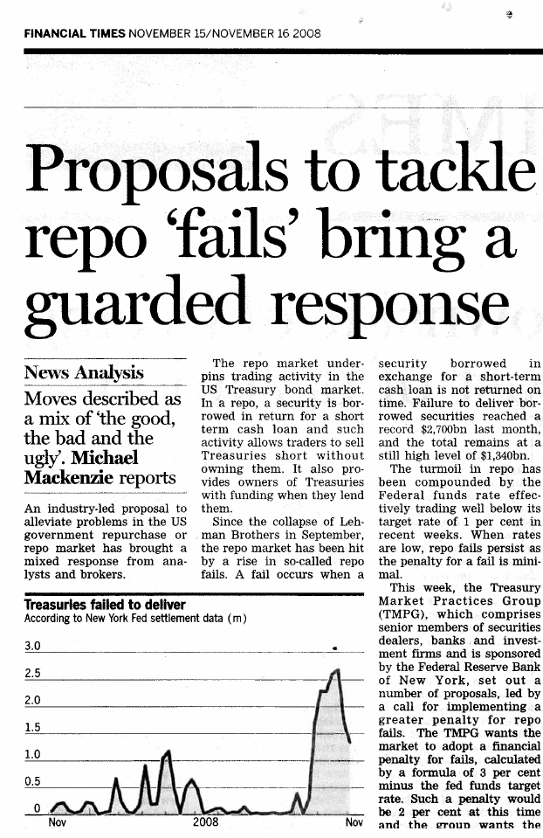
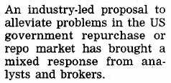
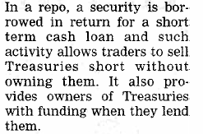
A public call to understand repo markets
…
Lehman Brothers collapse

Slide 3
Repo markets attracted lot of attention in the recent credit crisis.
However, repos have always been part of the tools at the central bankers disposal.
The recent crisis revealed us how intricate
funding, leverage and pricing are.
Notes:
Solly arb desk in the repo

Slide 4
Recent call for regulation
Lehman default
Fail problem after Lehman
Naked Short controversy

Slide 5
What is a repo?
A repo trade = security sale + future repurchase of that amount at a predetermined date and price.
Repo rate = future repurchase price – current price
Is a repo a collateralized loan?
Why use repo markets?
Borrower of cash (short in repo): To finance the purchase of a security.
Borrower of the security (long in repo): To short a security through reverse repo.

Slide 6
The Repo Rate
The difference between the future repurchase price and the current price corresponds to a level of interest rate which is called the repo rate. The repo rate is a market level.
General Collateral (GC) rate: the upper bound on the repo rate for a specific security.
Specialness: the desirability of being in possession of the security pushes the repo rate below the GC rate (Duffie 1996)
  The high cost of borrowing a security reflects its relative scarcity, in which case the security trades on special in the repo market.

Slide 7
Difference with a mortgage? Re-hypothecation!
Mortgage: A house pledged is sold only in default situation.
Repo: Once a security has been pledged in a repo transaction it can be:
  sold in the securities market
  re-lent
An equivalent security has to be returned at the end of the repo transaction (fungibility of securities is key) = > Fails
Notes:
Re-hyporthecation

Slide 8


Short sales constraints and the box: the missing inequality in financial theory
The box constraint: non-negative title balance of the security.
Getting long a security in the securities or repo markets both increase the amount of the security in the box.
Getting short a security in the securities or repo markets both decrease the amount of the security in the box.
The obligation to reverse in securities before shorting them re-establishes the upper hemi-continuity of the budget correspondence. The classical problem of the existence of equilibrium (Hart’s problem) is solved endogenously.

Slide 9
Shorting ≠ Issuing
Issuers of securities (=> special powers in firms, and debt issuer)
One needs to borrow a security to short it.
Traditional Financial theory is linear on the financial variables

Slide 10
Leverage
The repo collateral multiplier
Countably many transactions at each date.
There is a security available, C, priced in the securities market at q. Let
There is an exogenous haircut for repo operations, 0<h<1,
(the value of the loan is the haircutted value of the collateral)

Slide 11
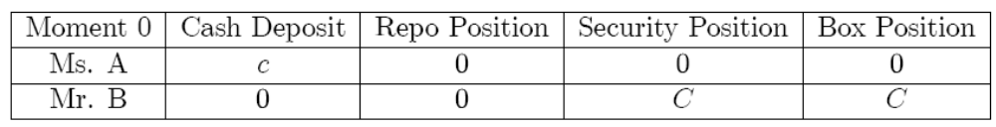

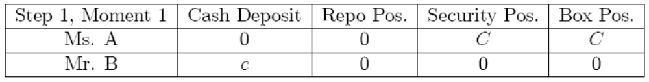
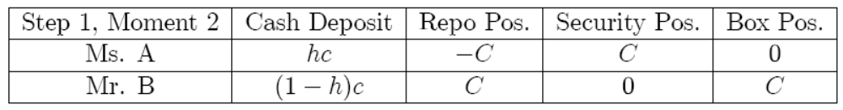
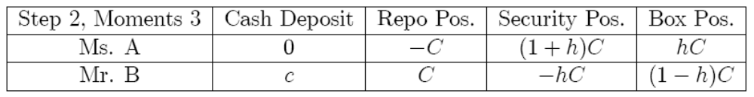
The Repo Collateral Multiplier
endowment
Step 2 starts and agents replicate Step 1. This is moment 3.
short sale

Slide 12
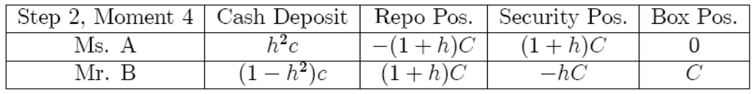
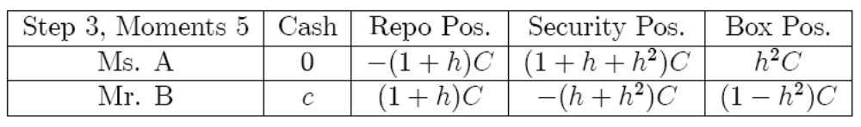
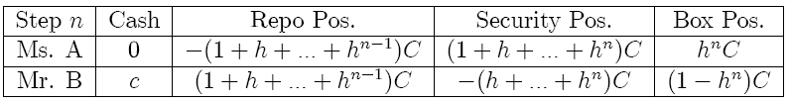
Now Step 3 of the leverage build up starts.
After the n iteration of repo operations followed by cash market operations:

Slide 13
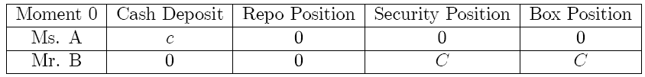
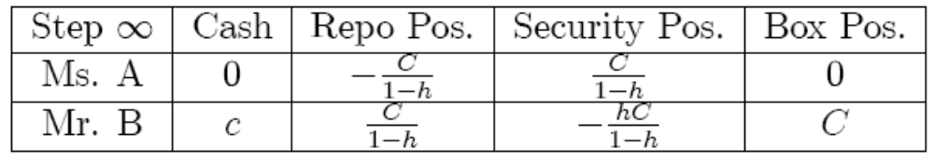
Leverage long position of 1/(1-h)
In the limit the amount of the security in Mr. A and Mr. B’s box are 0 and C, respectively, which coincide with the initial positions in moment 0.
Net Mr. A has managed to leverage her cash 1/(1-h) times to build a security long position, without any uncertainty being resolved.

Slide 14
Modeling repo and security markets
General equilibrium model where delivery promises are fully honored.
We consider an economy with J={1,…,j,…,J} securities for trade in both the security and repo markets. Securities are real (pay in commodities).
The set of agents is I={1,…,i,…,I}
The set of commodities is L={1,…,l,…,L}

Slide 15
Timing
  Date 0: Agents trade in repo, securities and commodities.
  Date 1: Agents trade securities and commodities.
  (S states of nature)
  Date 2: Agents trade commodities.
  (S states of nature)

Slide 16








The constraints at date 0
New component
The budget constraint (BC.0):
  where and accounts for the gross trades on security j net of the security endowments, that is,
The box constraint (Box.0): non-negative balance of security title of ownership
BC at date 1, state s,
where
BC at date 2, state s,

Slide 17

Pricing securities: liquidity
New components

Slide 18
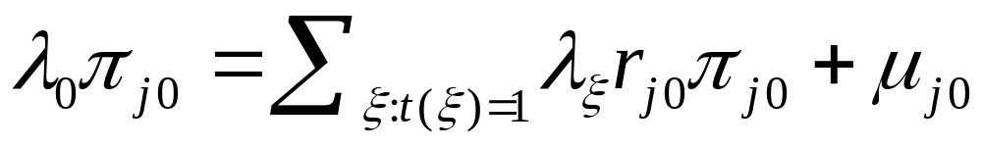
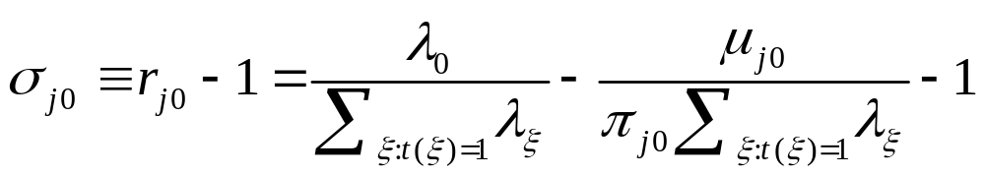

What do FOC tell us about the repo rate?
The FOC on repo trades is
then
where

Slide 19

Repo Specialness
Repo specialness: when the repo rate of a specific security is below this GC rate.
The necessity of an equilibrium approach: Repo rates are bounded by above (GC rate), but there is no obvious lower bound on such rate.
If a security is on special there is an incentive for the owner of the specific security to lend it in the repo market. However, such opportunities are not scalable and are limited by the very scarcity of the security available at the date repo agreements are made.

Slide 20



Equilibrium
Def: An equilibrium for this economy consists on an allocation of commodity bundles, net asset positions and repo positions t together with the corresponding price vector
such that:
Commodities market clears:
Securities market clears:
Repo market clears:

Slide 21




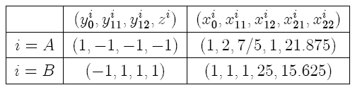


An example of robust specialness
Three dates economy, with one good and one security, paying 1 unit of the good in each state of date 1.
Two agents A and B. Commodity endowments are
Agent A is the only with security endowments
Agents’ preferences are , where:
The following prices and allocations constitute an equilibrium
The equilibrium is specialness robust with

Slide 22





Assumptions
A1:
A2: For every state s, the return matrix of type L x J does not have null rows.
  Under A1 and A2, if short sales are constrained, an equilibrium exists.
  Under A1 and A2, if the values of short sales and repo are constrained, an equilibrium exists.

Slide 23

Re-hypothecation
The modified box constraint:
…

Slide 24










Proof of Lemma 1

Slide 25
Two institutional arrangements that end up limiting the amount of leverage:
  Segregated accounts
  Constrained dealers

Slide 26
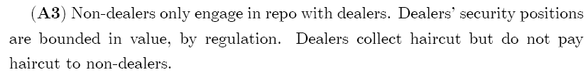
Constrained dealers
Non-dealer’s budget constraint:
Dealer’s budget constraint:
We assume that:

Slide 27
We have the following results:

Slide 28




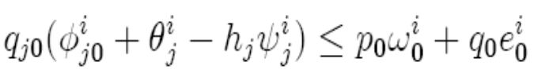



Proof of Lemma 2
The box constraint implies that
:
Again by the box constraint:
So,
Then for a dealer is bounded.
By the dealer’s box constraint the values of dealers’ repo short positions are bounded and, therefore, the values of non-dealers’ repo long positions are bounded

Slide 29
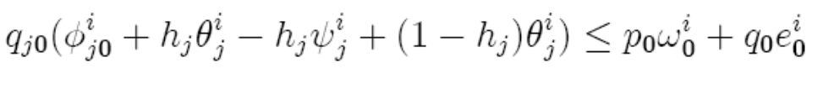

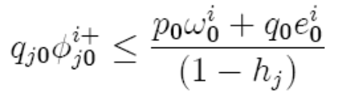

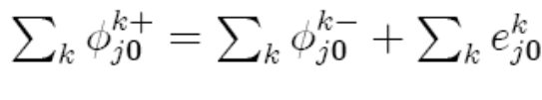
It remains to bound non-dealers security positions
As
by the box constraint we get
So
And is also bounded in value as

Slide 30
Conclusions
Securities market is not like derivatives market
The box: scarcity of securities and specialness
Re-hypothecation
Issuance is not Shorting
Leverage
Equilibrium approach key to approach it all

Slide 31


The conclusion:

Slide 33
Fails Vs. Default
A fail is the failure to return the security by the borrower of the security.
A default is the failure to return cash by a borrower of funds.
A default scenario is much more serious, triggering a full bankruptcy of the borrower of cash (the short in repo).
In such situation, all the positions in the box of the short are sealed and given to the creditors.

