Slide 1
Commercial Real Estate Mortgages
Default &
Mortgage Underwriting

Slide 2
Additional Topics
Expected Returns and Default
Mortgage Underwriting

Slide 3
Expected Returns (Revisited)
“Contractual Yield” (aka Stated Yield )
= YTM based on contractual obligation, assuming no default, all payments made as required by the loan contract
Credit Loss
Shortfalls to the lender as a result of default and foreclosure
Results in…
Yield Degradation
Effect of credit loss on contractual yield
(i.e. how much has the yield declined due to the credit loss or default)

Slide 4
Expected Returns (Revisited)

Slide 5
Expected Returns (Revisited)
It is the impact of Default Risk on the “ex ante” return is what investors care about (i.e. expected return going into an investment)
Expected Return (aka “Expected Yield” or “Ex Ante Yield”)
= E[r] = Mean of probability distribution of future total return on the mortgage investment.
Hazard Function
Probability function of default happening in each year of a loan
Conditional probability of default at each point in time given that default has not already occurred before then
Recovery Rate
If a borrower defaults and the lender forecloses, what percentage of the OLB is the lender able to recover from

Slide 6
Example “Conditional Yield Degradation”

Slide 7
18.1.3 Yield Degradation in Typical Commercial Mortgages
The most widely used empirical evidence on commercial mortgage hazard rates in the U.S. is that of Snyderman and subsequent studies at Morgan-Stanley.*
Notes:
* The most recent of these studies published (Esaki, 2002) is in the 11.432 course supplemental reader that can be purchased from the MIT Copy Center.

Slide 8
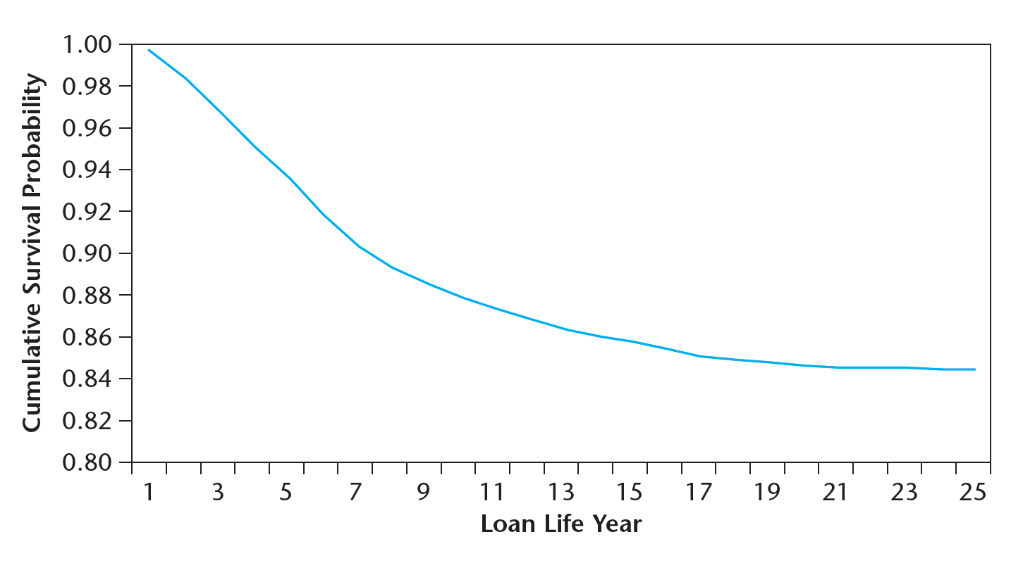
The implied survival function and cumulative default probability is shown here:
EXHIBIT 18-2 Typical Commercial Mortgage Survival Rates
Source: Based on data from Esaki et al. 2002.
Overall Average Default Probability = 16%.
1 out of 6 commercial mortgages in the U.S. default at some point in their lives.
© 2014 OnCourse Learning. All Rights Reserved.

Slide 9
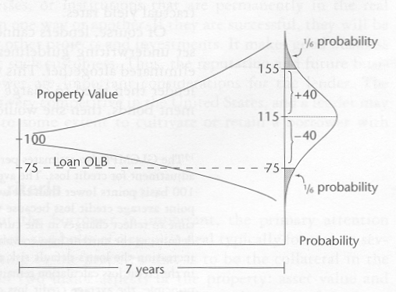
Volatility, LTV and Risk
Assume
$100 initial value, growing 2%/year
75% LTV, no amortization
15% annual volatility in price changes (i.e. Std Dev of price change)
7-year mortgage
Result
1/6 Probability of default

Slide 10
Loan Underwriting
Process lenders go through to decide to issue a commercial mortgage, and determine the terms of the loan
Underwriting considers both
Borrower – Character, Capital invested, Capacity to repay (from other resources)
Property – Collateral, Conditions, Capacity to repay (from property cash flow)
Standard Property Level Criteria
Property income criteria
Debt Service Coverage Ratio (DSCR) = PBTCF / Annual Debt Service
Typical Range of 1.20 or greater is required
Equity Before Tax Cash Flow (BTCF)
From Cash Flow pro forma; is there sufficient cash flow after debt service to properly maintain the property?
Asset value criteria
Loan to Value Ratio (LTV)
Value based on 3° party appraisal
Typical range of 60 – 75%
Loan to Cost (LTC)
Typically applied in a development or redevelopment scenario

