Slide 1
Financial Distress: Foreclosure Vs. Restructuring
These slides are based on Brown, Ciochetti, and Riddiough (2006), “Theory and evidence on the resolution of financial distress”
(40 min.)

Slide 2
Financial Distress
Financial distress occurs when a shock to project value leaves the owner-manager with a reduced equity stake
In response to the shock, the owner-manager must decide whether to default on the debt payment obligation
If default occurs, the lender must decide whether to restructure the loan or to foreclose

Slide 3
To restructure the loan or to foreclose
If restructuring, the owner-manager defaults and obtains debt-forgiveness (the lender must scale back the debt payments to give the owner-manager the incentives to maximize the project value)
If foreclosure and non-recourse, a buyer of the foreclosed asset provides its own equity stake to compensate the lender

Slide 4
In the case of foreclosure
In the case of foreclosure, the lender either:
Sells the asset immediately
Sells the asset at a later date
It is costly for the lender to carry an asset in inventory, as it is most effectively managed by an industry expert with an equity stake in the project

Slide 5
Model framework
No default: owner-manager pays P0
Negative
shock to
project value
occurs
Restructure loan
Default
Manage asset
in-house
Foreclose
Sell asset to
outside investor

Slide 6
First intuition: wealth of potential buyers
When the pool of potential buyers is strong, the foreclosed asset is sold immediately because there is little gain from waiting for better-capitalized buyers to emerge
When there are no well-capitalized potential buyers, the lender incurs the cost of carrying the asset in anticipation of a higher sales price in the near future

Slide 7
Endogenous borrower default
In equilibrium endogenous default is determined by the interaction of:
project value shock magnitudes,
the relative efficiency of management,
the wealth level of potential buyers

Slide 8
Main result:
Lender renegotiates the debt when pool of outside buyers is shallow. In this case, and when the continuation value is positive, the borrower defaults strategically to obtain debt forgiveness
Default and foreclosure occur when the project value shock is sufficiently large and the pool of outside buyers is strong

Slide 9
Liquidation
Liquidation is avoided when the lender gains associated with foreclosure and asset sale are low. For instance, when:
Management skills are in short supply (e.g., when incumbent managers are more efficient than outside managers). The buyer has not sufficient wealth to compensate for management inefficiencies and can therefore pay the lender a considerable share of the gains from improving the investment decisions
Potential buyers have limited wealth

Slide 10
Summary of theoretical results

Slide 11
Empirical analysis
Data set:
2589 commercial real estate assets covering a period between 1974 and 1995.
Commercial real estate assets are typically all owner-managed and financed with a single mortgage loan

Slide 12
Important numbers:
Period 1986-1990: Annual default rates persistently high, with peak at 6.3%
LTV ratios between 71% to 75%

Slide 13
Default and restructuring
Loan status:
1) restructured,
2) foreclosed
3) sale of foreclosed asset
807 of the (nonrecourse) loans experienced a payment default

Slide 14
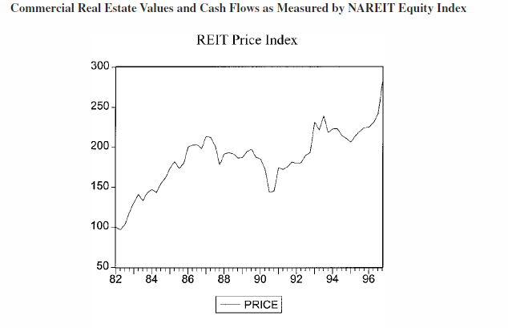
Downturn late 1980s, early 1990s due to overbuilding and credit problems
-30%

Slide 15
Empirical analysis predictions
Sale is delayed in the absence of deep-pocket investors
When potential buyers had limited wealth (real estate downturn), only about 12% of foreclosed assets was sold per year
Assets are sold relatively quickly when potential buyers are well-capitalized
When the industry began an extended recovery, the lender sold 40% of its year-beginning inventory

Slide 16
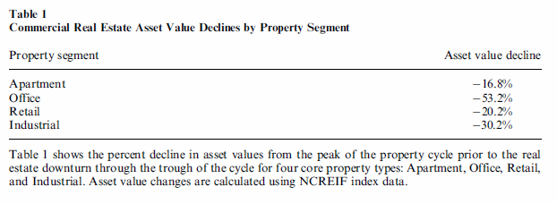
Cross-sectional variation:
Office properties, which experienced an especially industry shock, were sold more slowly than apartment properties, which experienced a much smaller shock
LEAST OVERBUILT
MOST OVERBUILT

Slide 17
Price distortion
An adverse shock to wealth created a wedge between the fundamental value of assets and the price at which assets could be sold. Assets where found to have 20 to 30% discounts to their fundamental value on average
The lender perceived asset values would return to fundamental values either as well-capitalized outsiders entered the industry or as insiders recapitalized

Slide 18
A paradox
Foreclosure occurred more frequently with loans that defaulted during the worst years of the downturn - a time when it was more difficult for the lender to sell foreclosed property
Restructuring became more prevalent as market conditions improved and there was a ready market for foreclosed properties
What explains these paradoxical outcomes?

Slide 19
What explains these paradoxical outcomes? Endogenous borrower default
The downturn in commercial real estate values simultaneously constrained buyers and made default attractive to the borrower.
While the lender may have preferred to restructure in presence of limited industry wealth, foreclosure rates were high because borrowers were willing to walk away from the assets
During the recovery period, continuation values were higher, and borrowers defaulted only when they anticipated a restructuring !

Slide 20
Cross-sectional analysis:
Restructuring is
negatively related to
the extent of the project value shock
the strength for the market foreclosed assets
positively related to the asset management’s specificity
When potential buyers have limited wealth, the lender prefers restructuring over foreclosure, and delayed over immediate sale

