Slide 1
Financial Feasibility Analysis (Front-door, Back-door)
In this lecture we present the “Simple Financial Feasibility Analysis” (SFFA) to analyze the feasibility of a real estate investment.
This model is also known as “Front Door Back Door”, a term coined by James Graaskamp.
Reading Material:
Book: Fundamentals of Real Estate Development (pages 243-254), by James Graaskamp
Book: Commercial Real Estate Finance and Analysis (Chapter 28.4), by D. Geltner and N. Miller

Slide 2
Introduction
Model’s characteristics:
Feasibility based on a single year cash flow model
Simple debt and equity capital structure
Shorthand for the way investors talk about real estate investments
We will focus on the Front Door model. Main question is: Given project cost, what rents are required?

Slide 3
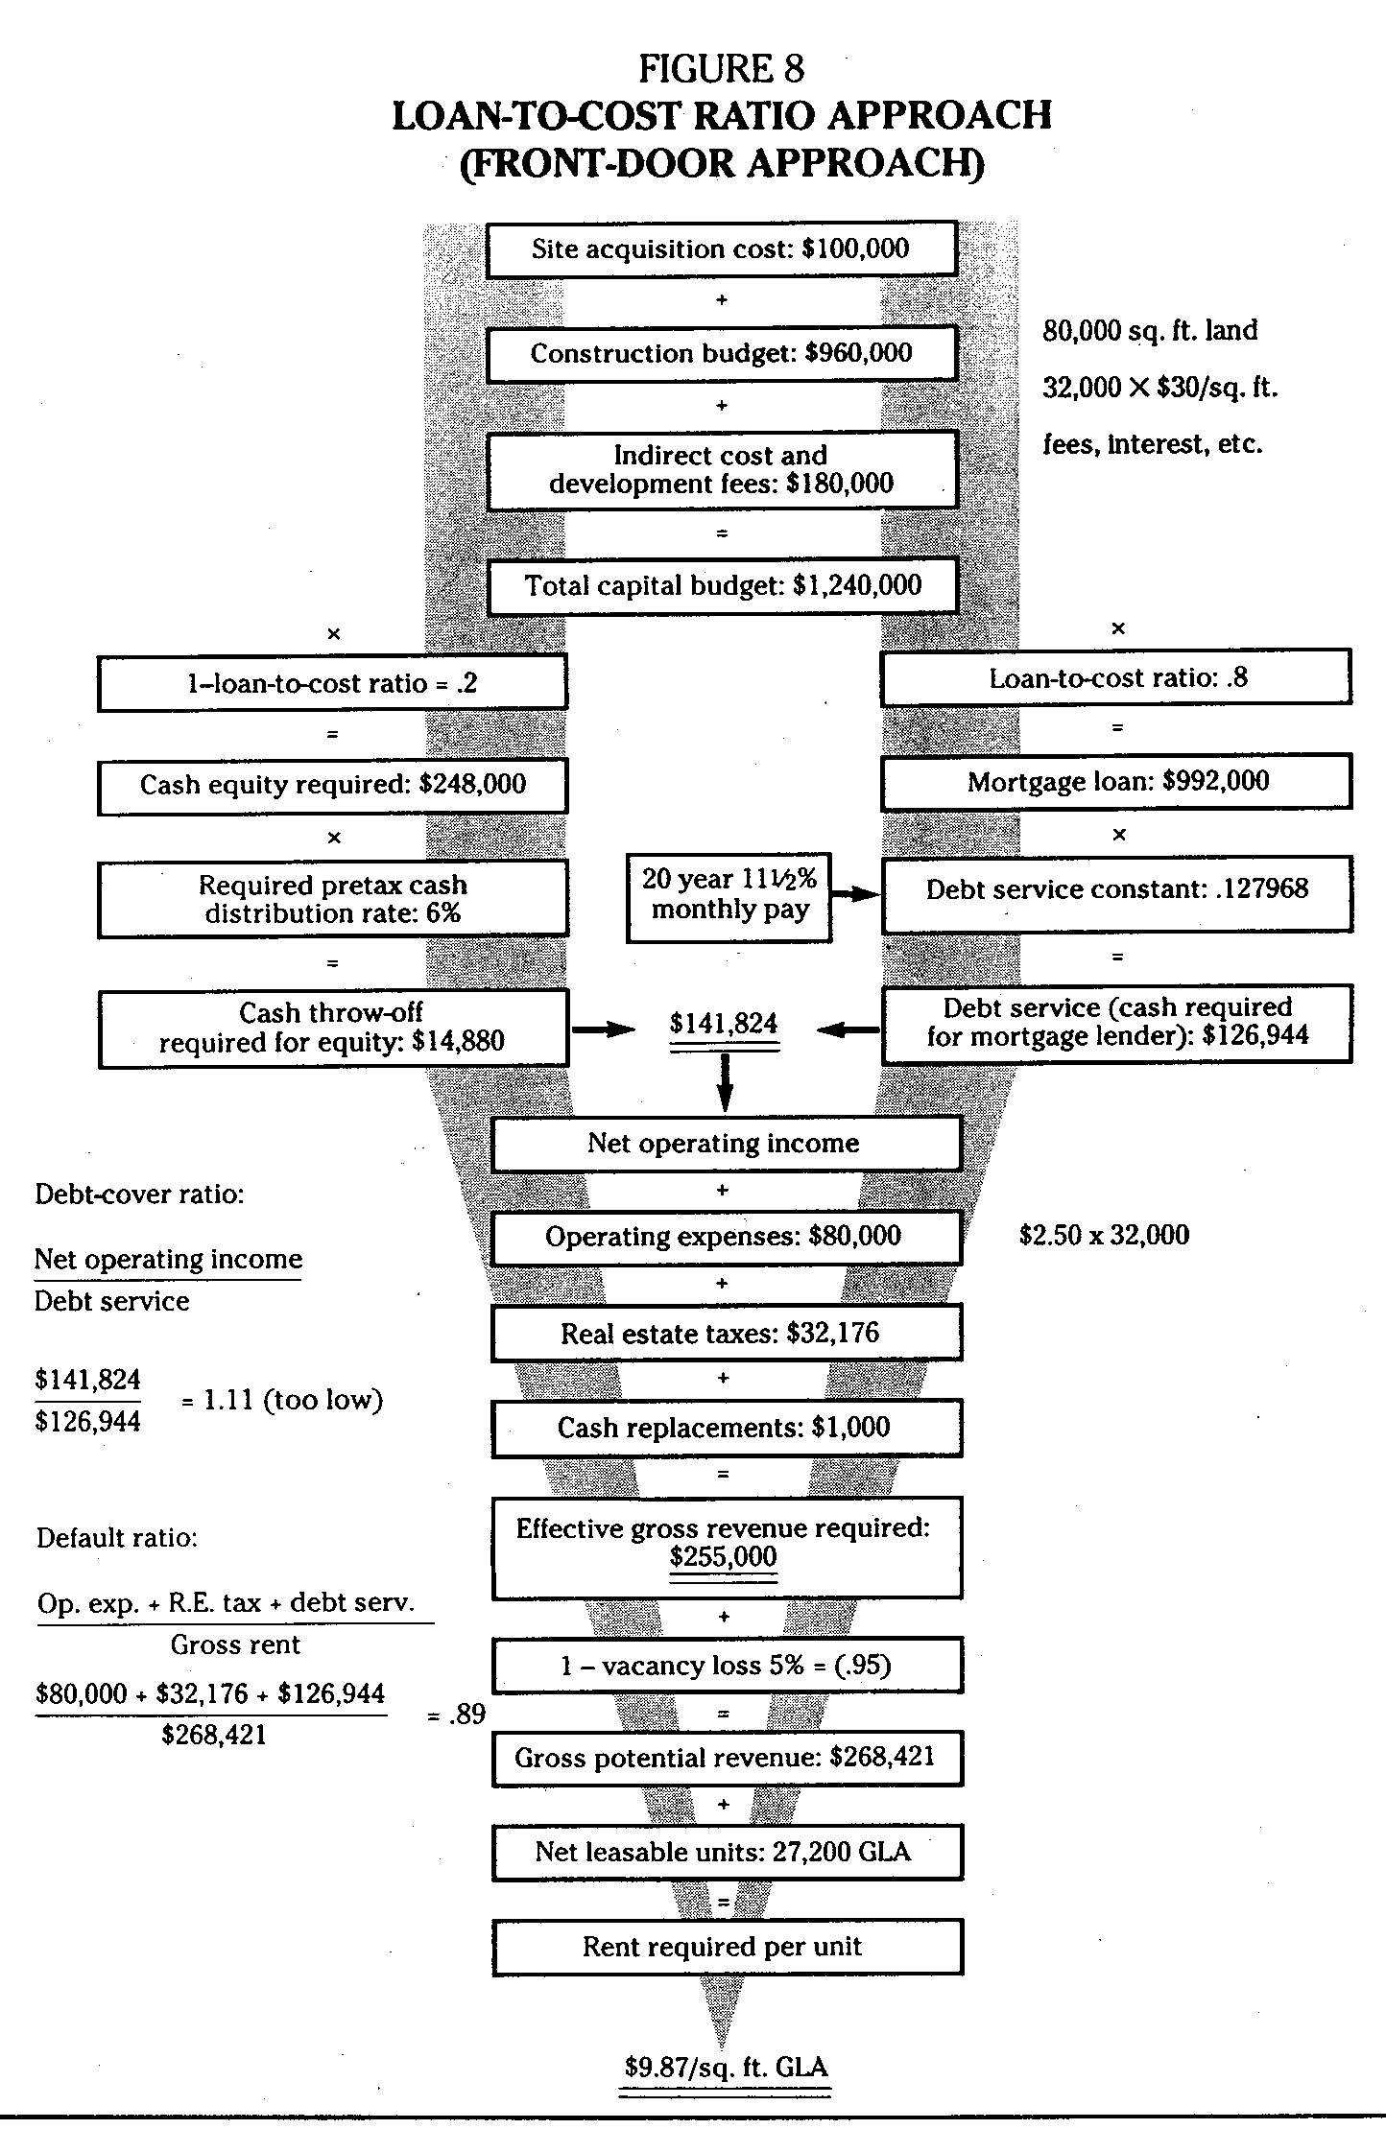
Front Door Approach
Front Door
Given Project Costs
What rent (PGI) is required to make the project feasible?
Constraints
Lender Debt Service
Debt Service Coverage Ratio (DSCR)
Equity Investor Dividend
Minimum Equity Dividend Rate (EDR) (a.k.a. Equity Cash-on-Cash (CoC)
Lender Capital Structure:
Maximum Loan-to-Cost/Value (LTV)
See Graaskamp, Fundamentals of Real Estate Development, page 250
Definitions
ADS=PMT*12
MC=ADS/loan
DSCR=NOI/ADS

Slide 4
FD/BD Limitations
Limitations and shortcomings
Single period, static model
ignores or makes implicit assumptions about market dynamics over time (e.g. supply/demand dynamics, changing cash flows, etc.)
Time value of money;
ignores or makes implicit assumptions about cash flow timing and risks (e.g. construction process risk, deal structuring)
Overly simplistic capital structure
ignores or makes implicit assumptions about debt and equity investment decisions (e.g. project specific risks, EDR versus appreciation, equity and debt structures)
Front-door/Back-door model is useful for
“Back of the envelope” screening of opportunities; a starting point for analysis
Understanding and communicating broad dynamics of real estate markets
Never use this simplistic model for making actual investment decisions

