Slide 1
Real Estate Debt, Leverage and Risk
Debt and Equity Structures

Slide 2
Topics
Mechanics of Leverage (“Gearing” in UK English)
Effects on Expected Return
Effects on Risk in Return
Weighted Average Cost of Capital
Negative and Positive Leverage
Effect of Leverage on Growth and Yield
Conclusion

Slide 3
The analogy of physical leverage & financial leverage
A Physical Lever...
500
lbs
2 feet
5 feet
200
lbs
LIFTS
If you have 200 pounds of force and you have the use of a simple lever,
you can lift more than 500 pounds
"Leverage Ratio" = 500/200 = 2.5

Slide 4
Financial Leverage
$4,000,000
EQUITY
BUYS
INVESTMENT
$10,000,000
PROPERTY
"Leverage Ratio" = $10,000,000 / $4,000,000 = 2.5
Equity = $4,000,000
Debt = $6,000,000
"Loan-to-Value” (LTV) Ratio = $6,000,000/$10,000,000 = 60%

Slide 5
Leverage
The use of debt to finance an equity investment creates what is called leverage (or “gearing”) in the equity investment, because it allows equity investors to magnify:
The amount of underlying physical capital they control
The risk and return performance of the equity
By attaching debt to a property, we generate a debt investment opportunity and an equity investment opportunity.
Each component differs substantially regarding:
Expected return (r) and risk
Expected yield (y) and growth (g), where r=y+g
The art of the deal is designing debt and equity slices, like the slices of a pie, in a way that maximizes the willingness of each party to pay for their slice.
Without losing sight of the key trade off between return and risk.

Slide 6
Examples
Consider the purchase of a property for a price of 100. Suppose that after one year the property generates 10 in rent and is worth 110. Compute the return on investment under the following financing scenarios:
100% with equity
50% LTV IO (interest only) mortgage priced at 10%
90% LTV IO mortgage priced at 10%
90% LTV IO mortgage priced at 30%.
(see excel calculations)

Slide 7
Example: Uncertainty and Risk
Now suppose that the investment outcomes above are what we will call the optimistic scenario. Let the pessimistic scenario assume that the property generates no rent and keeps its value of 100. Compute the total return for the property.
(In the previous excel sheet, make the reversion value equal to 100 now)
(see excel calculations)

Slide 8
Ownership, Control and Residual Claim
Equity investors have ownership of the property, which normally gives them primary governing control over the underlying asset, as long as they live up to their requirements under their debt obligation.
The debt receives a senior, or preferred, claim on the underlying asset's CF and value.
The equity gets the residual claim; i.e., the claim to the entire residual value in the investment (CF and value).

Slide 9
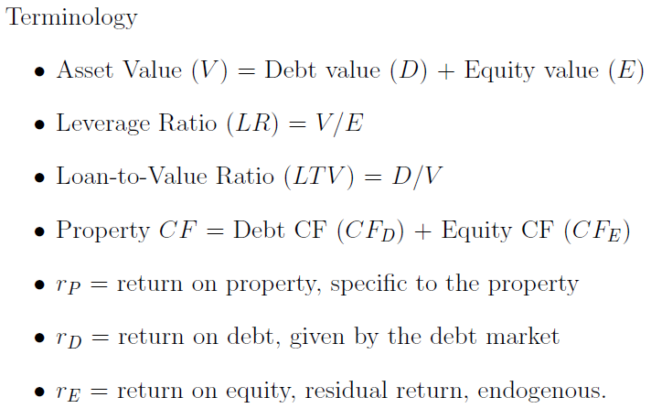
Weighted Average Cost of Capital
(it does not reflect prepayment risk of default)

Slide 10
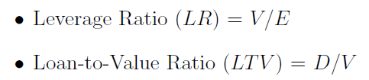
Leverage Measures: LTV vs. LR
LTV and LR are related as follows:
You have 5-10 min to prove this

Slide 11
Proof
E/V = (V-D)/D = V/D – 1 = (1/LTV) – 1 = 1/(1-LTV)
LR = V/E = D/E + 1 = LTV/(1-LTV) + 1 = 1/(1-LTV)
LTV = 1-(1/LR)

Slide 12
r_P = r_D*(LTV) + r_E*(1-LTV)
You have 5-10 min to prove this

Slide 13
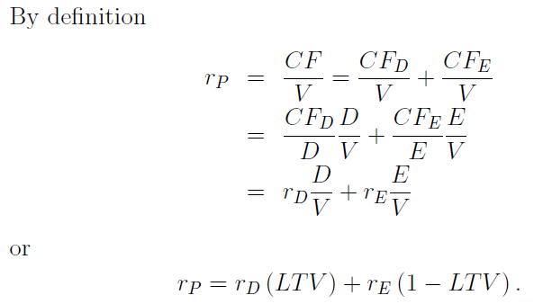
Weighted Average Cost of Capital

Slide 14
Weighted Average Cost of Capital
The WACC holds exactly for holding period returns (i.e., cases where all CFs and values are registered as of only two points in time)
The WACC holds as an approximation when it is applied over several periods when the variables change over time (e.g., the LTV drops because the mortgage is being repaid).

Slide 15
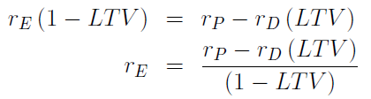
Weighted Average Cost of Capital
To highlight the endogeneity, or internal nature, of the return on equity, the basic WACC equation can be rearranged as below
Return to Equity is a function of:
Property Level Return
Cost of Debt (Return to debt)
Amount of Leverage
What is the relationship between the return on equity and the amount of leverage (LTV)? (See next slide)

Slide 16
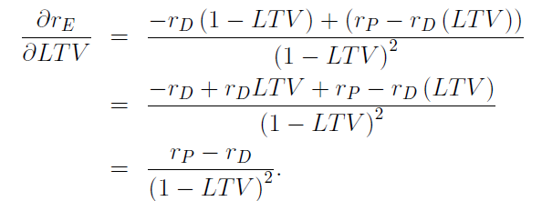
Weighted Average Cost of Capital
The return on equity depends positively on the property return and negatively on the return on debt. To clarify the relationship between the return on equity and the LTV we solve:
This last equation highlights the necessary and sufficient condition under which leverage brings about an increase in equity return:
Property return must be greater than the return on debt.
Note how the greater the LTV , the greater the impact of the next increment in LTV .

Slide 17

“Positive” and “Negative” Leverage
“Positive leverage”
When more debt will increase the equity investor’s (borrower’s) return.
Property Return > Debt Return
“Negative leverage”
When more debt will decrease the equity investor’s (borrower’s) return.
Property Return < Debt Return

Slide 18

Leverage and Risk
We can express the WACC formula in terms of LR (rather than LTV) as follows:
r_{E} = r_{D} + LR*(r_{P}-r_{D})
You have 5-10 min to prove this
Subtract the risk free rate from the relationship
Increasing leverage is NOT RISK FREE!

Slide 19
Proof
r_E = (r_P – r_D*LTV)/(1-LTV)
= LR*(r_P - r_D*(1-(1/LR))
=LR*r_P – LR*r_D + LR*r_D*(1/LR)
=r_D + LR*(r_P –r_D)

Slide 20
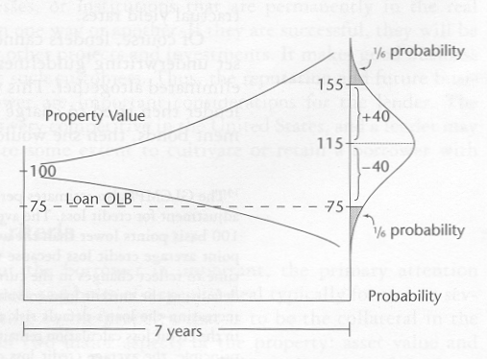
Volatility, LTV and Risk
Assume
$100 initial value, growing 2%/year
75% LTV, no amortization
7-year mortgage
Result
1/6 Probability of default

Slide 21
Yield and Growth
The math above assumed that CF was total CF for the property. We could have done the same computation focusing on operating CF for any year of a multi-year project.
Then the ratio CF/V would no longer be the total property return but the cash yield of the property, y_{P}.
The ratio CF/E is the equity cash yield, y_{E} or the cash-on-cash return.
The ratio CF/D is the yield on debt, y_{D}.
The derivation of the WACC above applies to the yield components and thus:
This application of the WACC can be used to estimate a cap rate based on cash yields

Slide 22
Yield and Growth
By definition, the total return is the sum of yield and growth. If the same equation holds for total returns and for yields, it must hold for the growth components
g_{P} = g_{D} (LTV ) + g_{E} (1 - LTV ) :
Let us rewrite the above two equations with the equity term on the left-hand side. Recall that the equity term is the endogenous term in these equations. We have
y_{E} = y_{D} + LR(y_{P} - y_{D})
g_{E} = g_{D} + LR(g_{P} - g_{D})
These relationships demonstrate how the yield and growth return components of equity differ from the yield and growth return components of the property when we add debt to a deal. Typically, debt shifts the equity investor's return away from yield (current income) and toward growth (capital gain).

Slide 23
Summary
In general, debt financing and leverage have 3 major effects:
(1) Under the typical assumption that the loan is less risky than the underlying property, leverage will increase the ex ante total return on the equity investment, by increasing the risk premium in that return.
(2) Under the same relative risk assumption, leverage will increase the risk of the equity investment, normally proportionately with the increase in the risk premium noted in (1).
(3) Under the typical situation of non-negative price appreciation in the property and non-negative amortization in the loan, leverage will usually shift the expected return for the equity investor relatively away from the current income component and towards the growth or capital appreciation component.
All three effects can be quantified, at least to a useful approximation, by use of the WACC formula.

