Slide 1
Computer Security:
Principles and Practice
Fourth Edition
By: William Stallings and Lawrie Brown
Notes:
Lecture slides prepared for “Computer Security: Principles and Practice”, 4/e, by William Stallings and Lawrie Brown, Chapter 16, “Physical and Infrastructure Security”.

Slide 2
Chapter 16
Physical and Infrastructure Security
Notes:
This chapter is concerned with physical security and with some overlapping
areas of premises security. We survey a number of threats to physical security and
a number of approaches to prevention, mitigation, and recovery. To implement
a physical security program, an organization must conduct a risk assessment to
determine the amount of resources to devote to physical security and the allocation
of those resources against the various threats. This process also applies to logical
security. This assessment and planning process is covered in Chapters 14 and 15 .

Slide 3
Physical and Infrastructure Security
Logical security
Protects computer-based data from software-based and communication-based threats
Physical security
Also called infrastructure security
Protects the information systems that contain data and the people who use, operate, and maintain the systems
Must prevent any type of physical access or intrusion that can compromise logical security
Premises security
Also known as corporate or facilities security
Protects the people and property within an entire area, facility, or building(s), and is usually required by laws, regulations, and fiduciary obligations
Provides perimeter security, access control, smoke and fire detection, fire suppression, some environmental protection, and usually surveillance systems, alarms, and guards
Notes:
[PLAT14] distinguishes three elements of information system (IS) security:
• Logical security: Protects computer-based data from software-based and
communication-based threats. The bulk of this book deals with logical security.
• Physical security: Also called infrastructure security . Protects the information
systems that contain data and the people who use, operate, and maintain the
systems. Physical security also must prevent any type of physical access or
intrusion that can compromise logical security.
• Premises security: Also known as corporate or facilities security. Protects the
people and property within an entire area, facility, or building(s), and is usually
required by laws, regulations, and fiduciary obligations. Premises security provides
perimeter security, access control, smoke and fire detection, fire suppression, some
environmental protection, and usually surveillance systems, alarms, and guards.

Slide 4
Physical Security Overview
Involves two complementary requirements:
Prevent damage to physical infrastructure
Concerns include information system hardware, physical facility, support facilities, and personnel
Prevent physical infrastructure misuse that leads to the misuse or damage of protected information
Includes vandalism, theft of equipment, theft by copying, theft of services, and unauthorized entry
Protect physical assets that support the storage and processing of information
Notes:
For information systems, the role of physical security is to protect the physical assets
that support the storage and processing of information. Physical security involves
two complementary requirements. First, physical security must prevent damage to
the physical infrastructure that sustains the information system. In broad terms, that
infrastructure includes the following:
• Information system hardware: Includes data processing and storage
equipment, transmission and networking facilities, and offline storage media.
We can include in this category supporting documentation.
• Physical facility: The buildings and other structures housing the system and
network components.
• Supporting facilities: These facilities underpin the operation of the information
system. This category includes electrical power, communication services, and
environmental controls (heat, humidity, etc.).
• Personnel: Humans involved in the control, maintenance, and use of the
information systems.
Second, physical security must prevent misuse of the physical infrastructure
that leads to the misuse or damage of the protected information. The misuse of the
physical infrastructure can be accidental or malicious. It includes vandalism, theft of
equipment, theft by copying, theft of services, and unauthorized entry.

Slide 5
Physical Security Threats
Physical situations and occurrences that threaten information systems:
Environmental threats
Technical threats
Human-caused threats
Notes:
In this section, we look at the types of physical situations and occurrences that can
constitute a threat to information systems. There are a number of ways in which such
threats can be categorized. It is important to understand the spectrum of threats to
information systems so that responsible administrators can ensure that prevention
measures are comprehensive. We organize the threats into the following categories:
• Environmental threats
• Technical threats
• Human-caused threats
We begin with a discussion of natural disasters, which are a prime, but not the only,
source of environmental threats. Then we look specifically at environmental threats,
followed by technical and human-caused threats.

Slide 6
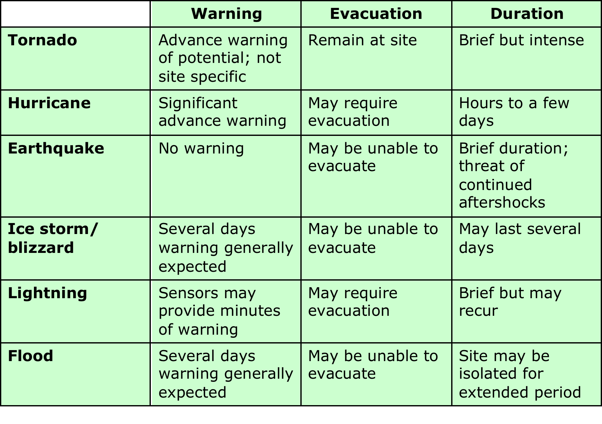
Table 16.1 Characteristics of Natural Disasters
Source: ComputerSite Engineering, Inc.
Notes:
Natural disasters are the source of a wide range of environmental threats to data
centers, other information processing facilities, and their personnel. It is possible to
assess the risk of various types of natural disasters and take suitable precautions so
that catastrophic loss from natural disaster is prevented.
Table 16.1 lists six categories of natural disasters, the typical warning time for
each event, whether or not personnel evacuation is indicated or possible, and the
typical duration of each event. We comment briefly on the potential consequences
of each type of disaster.

Slide 7
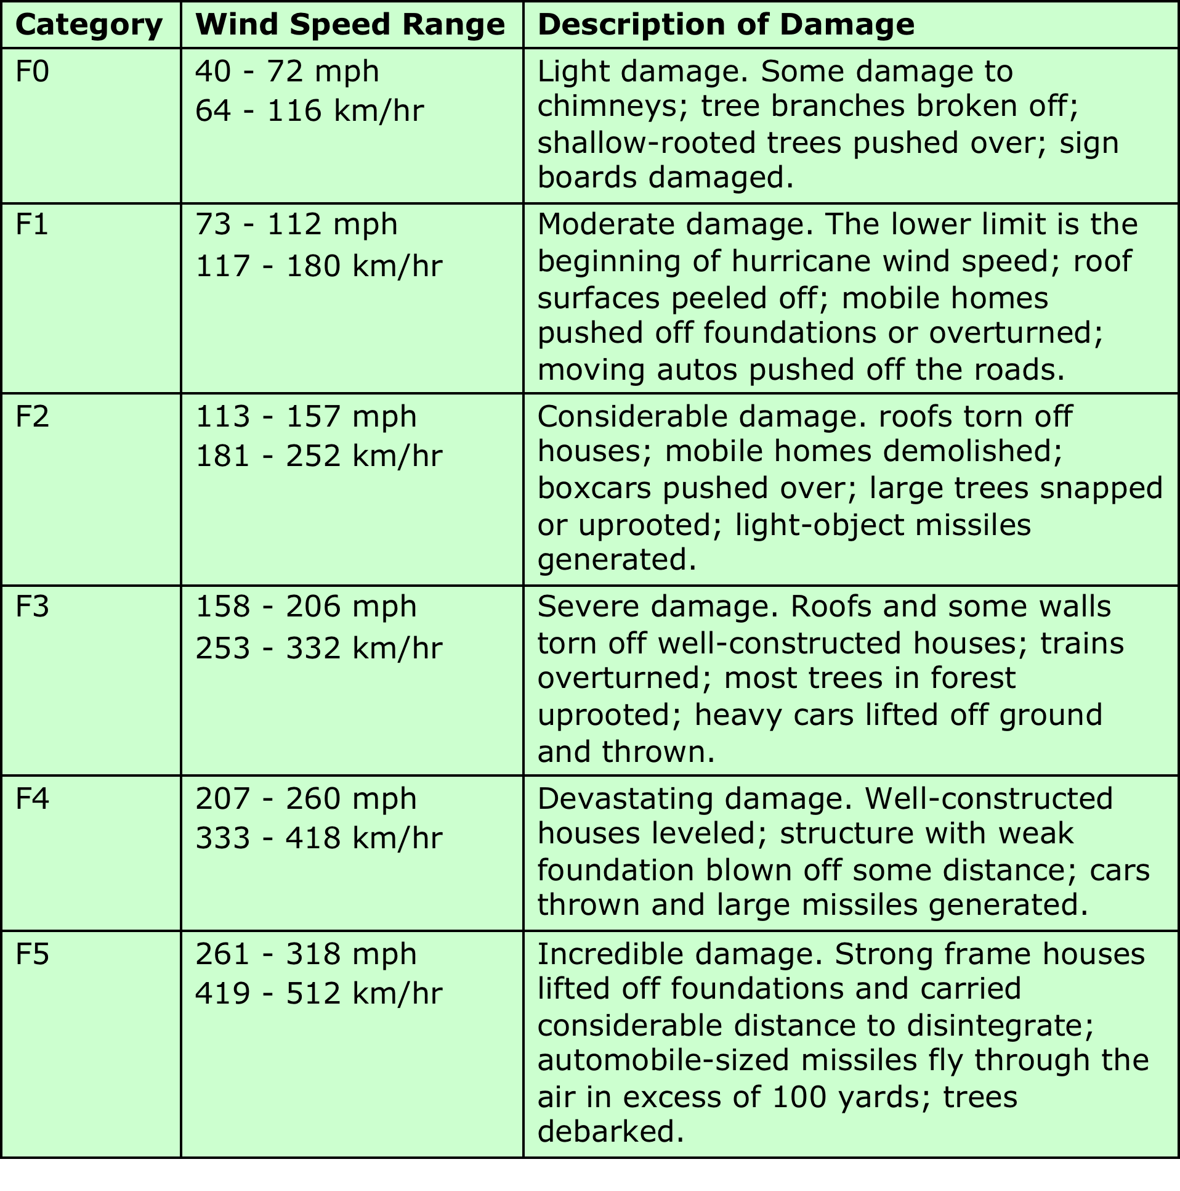
Table 16.2 Fujita Tornado Intensity Scale
(Table is on page 510 in the textbook)
Notes:
A tornado can generate winds that exceed hurricane strength in a narrow
band along the tornado’s path. There is substantial potential for structural damage,
roof damage, and loss of outside equipment. There may be damage from wind and
flying debris. Off site, a tornado may cause a temporary loss of local utility and
communications. Off-site damage is typically followed by quick restoration of services.
Tornado damage severity is measured by the Fujita Tornado Scale ( Table 16.2 ).

Slide 8
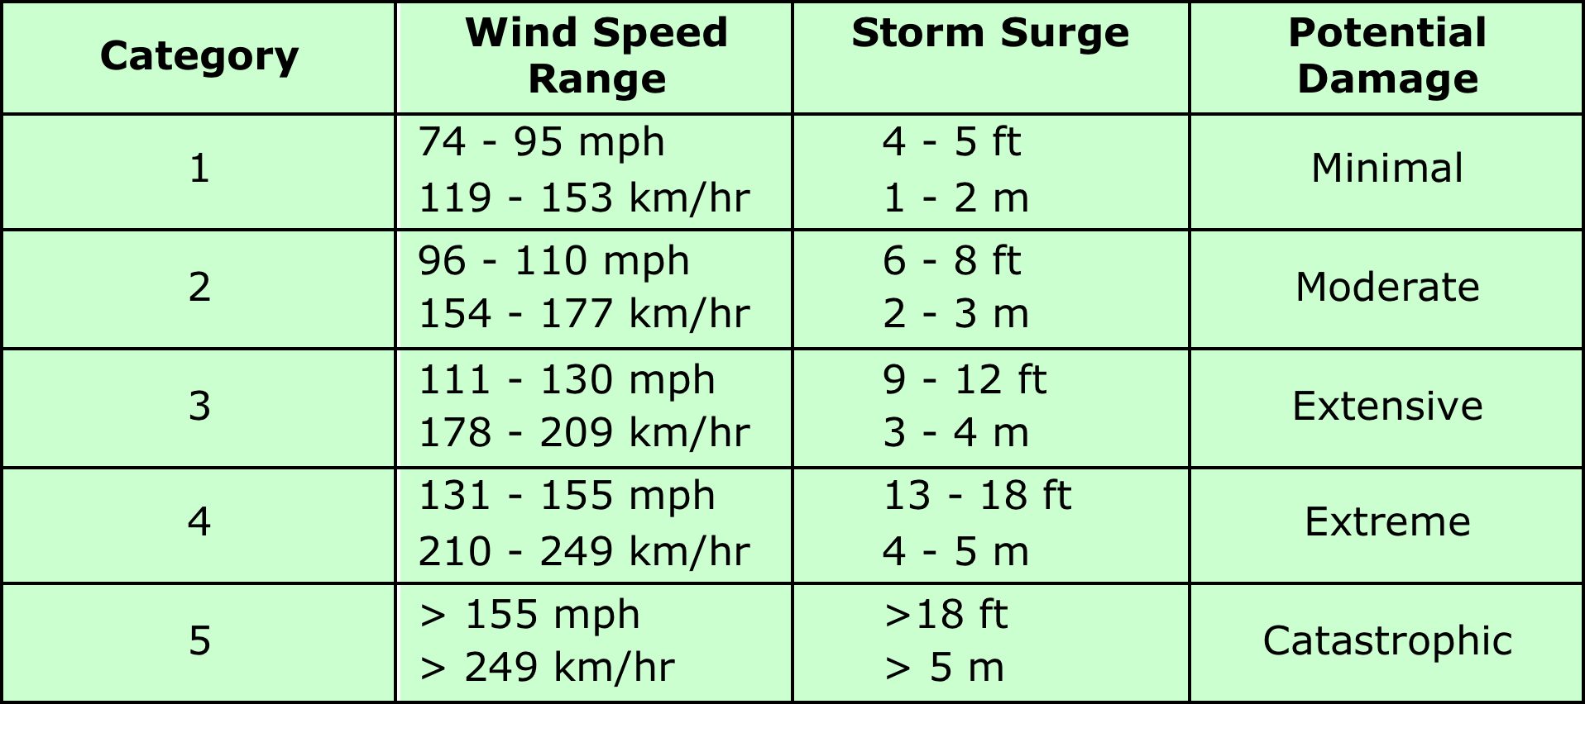
Table 16.3 Saffir/Simpson Hurricane Scale
(Table is on page 511 in the textbook)
Notes:
Hurricanes, tropical storms, and typhoons, collectively known as tropical
cyclones, are among the most devastating naturally occurring hazards. Depending
on strength, cyclones may also cause significant structural damage and damage to
outside equipment at a particular site. Off site, there is the potential for severe
region-wide damage to public infrastructure, utilities, and communications. If on-site
operation must continue, then emergency supplies for personnel as well as a backup
generator are needed. Further, the responsible site manager may need to mobilize
private poststorm security measures, such as armed guards.
Table 16.3 summarizes the widely used Saffir/Simpson Hurricane Scale. In
general, damage rises by about a factor of four for every category increase [PIEL08].
A major earthquake has the potential for the greatest damage and occurs
without warning. A facility near the epicenter may suffer catastrophic, even
complete, destruction, with significant and long-lasting damage to data centers and
other IS facilities. Examples of inside damage include the toppling of unbraced
computer hardware and site infrastructure equipment, including the collapse of
raised floors. Personnel are at risk from broken glass and other flying debris. Off
site, near the epicenter of a major earthquake, the damage equals and often exceeds
that of a major hurricane. Structures that can withstand a hurricane, such as roads
and bridges, may be damaged or destroyed, preventing the movement of fuel and
other supplies.
An ice storm or blizzard can cause some disruption of or damage to IS facilities
if outside equipment and the building are not designed to survive severe ice and
snow accumulation. Off site, there may be widespread disruption of utilities and
communications and roads may be dangerous or impassable.
The consequences of lightning strikes can range from no impact to disaster.
The effects depend on the proximity of the strike and the efficacy of grounding and
surge protection measures in place. Off site, there can be disruption of electrical
power and there is the potential for fires.
Flood is a concern in areas that are subject to flooding and for facilities that
are in severe flood areas at low elevation. Damage can be severe, with long-lasting
effects and the need for a major cleanup operation.

Slide 9
Table 16.4 Temperature Thresholds for Damage to Computing Resources
Source: Data taken from National Fire Protection Association.
Notes:
Computers and related equipment
are designed to operate within a certain temperature range. Most computer systems
should be kept between 10 and 32 degrees Celsius (50 and 90 degrees Fahrenheit).
Outside this range, resources might continue to operate but produce undesirable
results. If the ambient temperature around a computer gets too high, the computer
cannot adequately cool itself, and internal components can be damaged. If the
temperature gets too cold, the system can undergo thermal shock when it is turned
on, causing circuit boards or integrated circuits to crack. Table 16.4 indicates the
point at which permanent damage from excessive heat begins.
Another concern is the internal temperature of equipment, which can be
significantly higher than room temperature. Computer-related equipment comes
with its own temperature dissipation and cooling mechanisms, but these may
rely on, or be affected by, external conditions. Such conditions include excessive
ambient temperature, interruption of supply of power or heating, ventilation, and
air-conditioning (HVAC) services, and vent blockage.
High humidity also poses a threat to electrical and electronic equipment.
Long-term exposure to high humidity can result in corrosion. Condensation can
threaten magnetic and optical storage media. Condensation can also cause a short
circuit, which in turn can damage circuit boards. High humidity can also cause a
galvanic effect that results in electroplating, in which metal from one connector
slowly migrates to the mating connector, bonding the two together.
Very low humidity can also be a concern. Under prolonged conditions of low
humidity, some materials may change shape, and performance may be affected.
Static electricity also becomes a concern. A person or object that becomes statically
charged can damage electronic equipment by an electric discharge. Static electricity
discharges as low as 10 volts can damage particularly sensitive electronic circuits,
and discharges in the hundreds of volts can create significant damage to a variety of
electronic circuits. Discharges from humans can reach into the thousands of volts, so
this is a nontrivial threat.
In general, relative humidity should be maintained between 40% and 60% to
avoid the threats from both low and high humidity.

Slide 10
Notes:
Perhaps the most frightening physical threat is fire. It is a threat
to human life and property. The threat is not only from direct flame, but also
from heat, release of toxic fumes, water damage from fire suppression, and smoke
damage. Further, fire can disrupt utilities, especially electricity.
The temperature due to fire increases with time, and in a typical building, fire
effects follow the curve shown in Figure 16.1.

Slide 11
Table 16.5 Temperature Effects
Notes:
Smoke damage related to fires can also be extensive. Smoke is an abrasive.
It collects on the heads of unsealed magnetic disks, optical disks, and tape drives.
Electrical fires can produce an acrid smoke that may damage other equipment and
may be poisonous or carcinogenic.
The most common fire threat is from fires that originate within a facility,
and, as discussed subsequently, there are a number of preventive and mitigating
measures that can be taken. A more uncontrollable threat is faced from wildfires,
which are a plausible concern in the western United States, portions of Australia
(where the term bushfire is used), and a number of other countries.
To get a sense of the damage caused
by fire, Tables 16.4 and 16.5 shows the temperature at which various items melt or
are damaged and therefore indicates how long after the fire is started such damage
occurs.

Slide 12
Water Damage
Primary danger is an electrical short
A pipe may burst from a fault in the line or from freezing
Sprinkler systems set off accidentally
Floodwater leaving a muddy residue and suspended material in the water
Due diligence should be performed to ensure that water from as far as two floors above will not create a hazard
Notes:
Water and other stored liquids in proximity to computer
equipment pose an obvious threat. The primary danger is an electrical short,
which can happen if water bridges between a circuit board trace carrying voltage
and a trace carrying ground. Moving water, such as in plumbing, and weather created
water from rain, snow, and ice also pose threats. A pipe may burst from
a fault in the line or from freezing. Sprinkler systems, despite their security
function, are a major threat to computer equipment and paper and electronic
storage media. The system may be set off by a faulty temperature sensor, or a
burst pipe may cause water to enter the computer room. In any large computer
installation, due diligence should be performed to ensure that water from as far
as two floors above will not create a hazard. An overflowing toilet is an example
of such a hazard.
Less common, but more catastrophic, is floodwater. Much of the damage
comes from the suspended material in the water. Floodwater leaves a muddy
residue that is extraordinarily difficult to clean up.

Slide 13
Chemical, Radiological, and Biological Hazards
Pose a threat from intentional attack and from accidental discharge
Discharges can be introduced through the ventilation system or open windows, and in the case of radiation, through perimeter walls
Flooding can also introduce biological or chemical contaminants
Notes:
Chemical, radiological, and biological hazards pose a growing threat, both from intentional attack and
from accidental discharge. None of these hazardous agents should be present in
an information system environment, but either accidental or intentional intrusion
is possible. Nearby discharges (e.g., from an overturned truck carrying hazardous
materials) can be introduced through the ventilation system or open windows and,
in the case of radiation, through perimeter walls. In addition, discharges in the
vicinity can disrupt work by causing evacuations to be ordered. Flooding can also
introduce biological or chemical contaminants.
In general, the primary risk of these hazards is to personnel. Radiation and
chemical agents can also cause damage to electronic equipment.

Slide 14
Dust and Infestation
Dust
Infestation
Often overlooked
Rotating storage media and computer fans are the most vulnerable to damage
Can also block ventilation
Influxes can result from a number of things:
Controlled explosion of a nearby building
Windstorm carrying debris
Construction or maintenance work in the building
Covers a broad range of living organisms:
High-humidity conditions can cause mold and mildew
Insects, particularly those that attack wood and paper
Notes:
Dust is a prevalent concern that is often overlooked. Even fibers
from fabric and paper are abrasive and mildly conductive, although generally
equipment is resistant to such contaminants. Larger influxes of dust can result
from a number of incidents, such as a controlled explosion of a nearby building
and a windstorm carrying debris from a wildfire. A more likely source of influx
comes from dust surges that originate within the building due to construction or
maintenance work.
Equipment with moving parts, such as rotating storage media and computer
fans, are the most vulnerable to damage from dust. Dust can also block ventilation
and reduce radiational cooling.
One of the less pleasant physical threats is infestation, which covers a
broad range of living organisms, including mold, insects, and rodents. High-humidity
conditions can lead to the growth of mold and mildew, which can be harmful to both
personnel and equipment. Insects, particularly those that attack wood and paper,
are also a common threat.

Slide 15
Technical Threats
Electrical power is essential to run equipment
Power utility problems:
Under-voltage - dips/brownouts/outages, interrupts service
Over-voltage - surges/faults/lightening, can destroy chips
Noise - on power lines, may interfere with device operation
Electromagnetic interference (EMI)
Noise along a power supply line, motors, fans, heavy equipment, other computers, cell phones, microwave relay antennas, nearby radio stations
Noise can be transmitted through space as well as through power lines
Can cause intermittent problems with computers
Notes:
This category encompasses threats related to electrical power and electromagnetic
emission.
Electrical power is essential to the operation of an information
system. All of the electrical and electronic devices in the system require power, and
most require uninterrupted utility power. Power utility problems can be broadly
grouped into three categories: undervoltage, overvoltage, and noise.
An undervoltage condition occurs when the IS equipment receives less voltage
than is required for normal operation. Undervoltage events range from temporary
dips in the voltage supply, to brownouts (prolonged undervoltage), to power
outages. Most computers are designed to withstand prolonged voltage reductions
of about 20% without shutting down and without operational error. Deeper dips
or blackouts lasting more than a few milliseconds trigger a system shutdown.
Generally, no damage is done, but service is interrupted.
Far more serious is an overvoltage condition. A surge of voltage can be caused
by a utility company supply anomaly, by some internal (to the building) wiring fault, or
by lightning. Damage is a function of intensity and duration, and the effectiveness of
any surge protectors between your equipment and the source of the surge. A sufficient
surge can destroy silicon-based components, including processors and memories.
Power lines can also be a conduit for noise. In many cases, these spurious
signals can endure through the filtering circuitry of the power supply and interfere
with signals inside electronic devices, causing logical errors.
Noise along a power supply line is only one
source of electromagnetic interference (EMI). Motors, fans, heavy equipment, and
even other computers generate electrical noise that can cause intermittent problems
with the computer you are using. This noise can be transmitted through space as
well as through nearby power lines.
Another source of EMI is high-intensity emissions from nearby commercial
radio stations and microwave relay antennas. Even low-intensity devices, such as
cellular telephones, can interfere with sensitive electronic equipment.

Slide 16
Human-Caused Threats
Less predictable, designed to overcome prevention measures, harder to deal with
Include:
Unauthorized physical access
Information assets are generally located in restricted areas
Can lead to other threats such as theft, vandalism or misuse
Theft of equipment/data
Eavesdropping and wiretapping fall into this category
Insider or an outsider who has gained unauthorized access
Vandalism of equipment/data
Misuse of resources
Notes:
Human-caused threats are more difficult to deal with than the environmental
and technical threats discussed so far. Human-caused threats are less
predictable than other types of physical threats. Worse, human-caused threats
are specifically designed to overcome prevention measures and/or seek the
most vulnerable point of attack. We can group such threats into the following
categories:
• Unauthorized physical access: Those without the proper authorization
should not be allowed access to certain portions of a building or complex
unless accompanied with an authorized individual. Information assets such as
servers, mainframe computers, network equipment, and storage networks are
generally located in a restricted area, with access limited to a small number
of employees. Unauthorized physical access can lead to other threats, such as
theft, vandalism, or misuse.
• Theft: This threat includes theft of equipment and theft of data by copying.
Eavesdropping and wiretapping also fall into this category. Theft can be
at the hands of an outsider who has gained unauthorized access or by an
insider.
• Vandalism: This threat includes destruction of equipment and data.
• Misuse: This category includes improper use of resources by those who
are authorized to use them, as well as use of resources by individuals not
authorized to use the resources at all.

Slide 17
Physical Security Prevention and Mitigation Measures
One prevention measure is the use of cloud computing
Inappropriate temperature and humidity
Environmental control equipment, power supply
Fire and smoke
Alarms, preventative measures, fire mitigation
Smoke detectors, no smoking
Water
Manage lines, equipment location, cutoff sensors
Other threats
Appropriate technical counter-measures, limit dust entry, pest control
Notes:
In this section, we look at a range of techniques for preventing, or in some cases
simply deterring, physical attacks. We begin with a survey of some of the techniques
for dealing with environmental and technical threats and then move on to
human-caused threats. Standards including ISO 27002 (Code of practice for information security
management, 2013) and NIST SP 800-53 (Recommended Security Controls for Federal
Information Systems, January 2015) include lists of controls relating to physical and
environmental security, as we showed in Tables 15.2 and 15.3.
One general prevention measure is the use of cloud computing. From a
physical security viewpoint, an obvious benefit of cloud computing is that there is a
reduced need for information system assets on site and a substantial portion of data
assets are not subject to on-site physical threats. See Chapter 13 for a discussion of
cloud computing security issues.
Dealing with this problem is primarily a matter of having environmental-control equipment of appropriate
capacity and appropriate sensors to warn of thresholds being exceeded. Beyond
that, the principal requirement is the maintenance of a power supply, discussed
subsequently.
Dealing with fire involves a combination of alarms, preventive
measures, and fire mitigation. [MART73] provides the following list of necessary
measures:
1. Choice of site to minimize likelihood of disaster. Few disastrous fires
originate in a well-protected computer room or IS facility. The IS area
should be chosen to minimize fire, water, and smoke hazards from adjoining
areas. Common walls with other activities should have at least a one-hour
fire-protection rating.
2. Air conditioning and other ducts designed so as not to spread fire. There are
standard guidelines and specifications for such designs.
3. Positioning of equipment to minimize damage.
4. Good housekeeping. Records and flammables must not be stored in the IS
area. Tidy installation if IS equipment is crucial.
5. Hand-operated fire extinguishers readily available, clearly marked, and
regularly tested.
6. Automatic fire extinguishers installed. Installation should be such that
the extinguishers are unlikely to cause damage to equipment or danger to
personnel.
7. Fire detectors. The detectors sound alarms inside the IS room and with
external authorities, and start automatic fire extinguishers after a delay to
permit human intervention.
8. Equipment power-off switch. This switch must be clearly marked and
unobstructed. All personnel must be familiar with power-off procedures.
9. Emergency procedures posted.
10. Personnel safety. Safety must be considered in designing the building layout
and emergency procedures.
11. Important records stored in fireproof cabinets or vaults.
12. Records needed for file reconstruction stored off the premises.
13. Up-to-date duplicate of all programs stored off the premises.
14. Contingency plan for use of equipment elsewhere should the computers be
destroyed.
15. Insurance company and local fire department should inspect the facility.
To deal with the threat of smoke, the responsible manager should install
smoke detectors in every room that contains computer equipment as well as under
raised floors and over suspended ceilings. Smoking should not be permitted in
computer rooms.
For wildfires, the available countermeasures are limited. Fire-resistant
building techniques are costly and difficult to justify.
Prevention and mitigation measures for water threats must
encompass the range of such threats. For plumbing leaks, the cost of relocating
threatening lines is generally difficult to justify. With knowledge of the exact layout of
water supply lines, measures can be taken to locate equipment sensibly. The location
of all shutoff valves should be clearly visible or at least clearly documented, and
responsible personnel should know the procedures to follow in case of emergency.
To deal with both plumbing leaks and other sources of water, sensors are vital.
Water sensors should be located on the floor of computer rooms, as well as under
raised floors, and should cut off power automatically in the event of a flood.
For chemical, biological, and radiological threats, specific technical approaches are available, including infrastructure design, sensor design and placement, mitigation procedures, personnel training, and so
forth. Standards and techniques in these areas continue to evolve.
As for dust hazards, the obvious prevention method is to limit dust through
proper filter maintenance and regular IS room maintenance.
For infestations, regular pest control procedures may be needed, starting with
maintaining a clean environment.

Slide 18
Mitigation Measures Technical Threats
Uninterruptible power supply (UPS) for each piece of critical equipment
Critical equipment should be connected to an emergency power source (like a generator)
To deal with electromagnetic interference (EMI) a combination of filters and shielding can be used
Notes:
To deal with brief power interruptions, an uninterruptible power supply (UPS)
should be employed for each piece of critical equipment. The UPS is a battery
backup unit that can maintain power to processors, monitors, and other equipment
for a period of minutes. UPS units can also function as surge protectors, power noise
filters, and automatic shutdown devices when the battery runs low.
For longer blackouts or brownouts, critical equipment should be connected
to an emergency power source, such as a generator. For reliable service, a range
of issues need to be addressed by management, including product selection,
generator placement, personnel training, testing and maintenance schedules,
and so forth.
To deal with electromagnetic interference, a combination of filters and
shielding can be used. The specific technical details will depend on the infrastructure
design and the anticipated sources and nature of the interference.

Slide 19
Mitigation Measures Human-Caused Physical Threats
Physical access control
Restrict building access
Controlled areas patrolled or guarded
Locks or screening measures at entry points
Equip movable resources with a tracking device
Power switch controlled by a security device
Intruder sensors and alarms
Surveillance systems that provide recording and real-time remote viewing
Notes:
The general approach to human-caused physical threats is physical access control.
Based on [MICH06], we can suggest a spectrum of approaches that can be used to
restrict access to equipment. These methods can be used in combination.
1. Physical contact with a resource is restricted by restricting access to the
building in which the resource is housed. This approach is intended to deny
access to outsiders but does not address the issue of unauthorized insiders or
employees.
2. Physical contact with a resource is restricted by putting the resource in a
locked cabinet, safe, or room.
3. A machine may be accessed, but it is secured (perhaps permanently bolted)
to an object that is difficult to move. This will deter theft but not vandalism,
unauthorized access, or misuse.
4. A security device controls the power switch.
5. A movable resource is equipped with a tracking device so that a sensing portal
can alert security personnel or trigger an automated barrier to prevent the
object from being moved out of its proper security area.
6. A portable object is equipped with a tracking device so that its current
position can be monitored continually.
The first two of the preceding approaches isolate the equipment. Techniques
that can be used for this type of access control include controlled areas patrolled
or guarded by personnel, barriers that isolate each area, entry points in the barrier
(doors), and locks or screening measures at each entry point.
Physical access control should address not just computers and other IS
equipment but also locations of wiring used to connect systems, the electrical
power service, the HVAC equipment and distribution system, telephone and
communications lines, backup media, and documents.
In addition to physical and procedural barriers, an effective physical access
control regime includes a variety of sensors and alarms to detect intruders and
unauthorized access or movement of equipment. Surveillance systems are frequently
an integral part of building security, and special-purpose surveillance systems for
the IS area are generally also warranted. Such systems should provide real-time
remote viewing as well as recording.
Finally, the introduction of Wi-Fi changes the concept of physical security in
the sense that it extends physical access across physical boundaries such as walls
and locked doors. For example, a parking lot outside of a secure building provides
access via Wi-Fi. This type of threat and the measures to deal with it are discussed
in Chapter 24.

Slide 20
Recovery from Physical Security Breaches
Most essential element of recovery is redundancy
Provides for recovery from loss of data
Ideally all important data should be available off-site and updated as often as feasible
Can use batch encrypted remote backup
For critical situations a remote hot-site that is ready to take over operation instantly can be created
Physical equipment damage recovery
Depends on nature of damage and cleanup
May need disaster recovery specialists
Notes:
The most essential element of recovery from physical security breaches is
redundancy. Redundancy does not undo any breaches of confidentiality, such as the
theft of data or documents, but it does provide for recovery from loss of data. Ideally,
all of the important data in the system should be available off site and updated as
near to real time as is warranted based on a cost/benefit trade-off. With broadband
connections now almost universally available, batch encrypted backups over private
networks or the Internet are warranted and can be carried out on whatever schedule
is deemed appropriate by management. In the most critical situations, a hot site can
be created off site that is ready to take over operation instantly and has available to
it a near-real-time copy of operational data.
Recovery from physical damage to the equipment or the site depends on the
nature of the damage and, importantly, the nature of the residue. Water, smoke,
and fire damage may leave behind hazardous materials that must be meticulously
removed from the site before normal operations and the normal equipment suite
can be reconstituted. In many cases, this requires bringing in disaster recovery
specialists from outside the organization to do the cleanup.

Slide 21
Physical and Logical Security Integration
Numerous detection and prevention devices
More effective if there is a central control
Integrate automated physical and logical security functions
Use a single ID card
Single-step card enrollment and termination
Central ID-management system
Unified event monitoring and correlation
Need standards in this area
FIPS 201-1 “Personal Identity Verification (PIV) of Federal Employees and Contractors”
Notes:
Physical security involves numerous detection devices, such as sensors and
alarms, and numerous prevention devices and measures, such as locks and physical
barriers. It should be clear that there is much scope for automation and for
the integration of various computerized and electronic devices. Clearly, physical
security can be made more effective if there is a central destination for all alerts
and alarms and if there is central control of all automated access control mechanisms,
such as smart card entry sites.
From the point of view of both effectiveness and cost, there is increasing interest
not only in integrating automated physical security functions but in integrating,
to the extent possible, automated physical and logical security functions. The most
promising area is that of access control. Examples of ways to integrate physical and
logical access control include the following:
• Use of a single ID card for physical and logical access. This can be a simple
magnetic-strip card or a smart card.
• Single-step user/card enrollment and termination across all identity and access
control databases.
• A central ID-management system instead of multiple disparate user directories
and databases.
• Unified event monitoring and correlation.
As an example of the utility of this integration, suppose that an alert indicates
that Bob has logged on to the company’s wireless network (an event generated by
the logical access control system) but did not enter the building (an event generated
from the physical access control system). Combined, these two events suggest that
someone is hijacking Bob’s wireless account.
For the integration of physical and logical access control to be practical, a wide range
of vendors must conform to standards that cover smart card protocols, authentication
and access control formats and protocols, database entries, message formats, and so
on. An important step in this direction is FIPS 201-2 [ Personal Identity Verification
(PIV) of Federal Employees and Contractors ], issued by NIST in 2013. This standard
defines a reliable, government-wide PIV system for use in applications such as access
to federally controlled facilities and information systems. The standard specifies a PIV
system within which common identification credentials can be created and later used
to verify a claimed identity. The standard also identifies Federal government-wide
requirements for security levels that are dependent on risks to the facility or
information being protected. The standard applies to private-sector contractors as
well, and serves as a useful guideline for any organization.

Slide 22
Notes:
Figure 16.2 illustrates the major components of FIPS 201-2 compliant systems.
The PIV front end defines the physical interface to a user who is requesting access to
a facility, which could be either physical access to a protected physical area or logical
access to an information system. The PIV front end subsystem supports up to three factor
authentication; the number of factors used depends on the level of security
required. The front end makes use of a smart card, known as a PIV card, which is a
dual-interface contact and contactless card. The card holds a cardholder photograph,
X.509 certificates, cryptographic keys, biometric data, and a cardholder unique identifier
(CHUID), explained subsequently. Certain cardholder information may be
read-protected and require a personal identification number (PIN) for read access
by the card reader. The biometric reader, in the current version of the standard, is a
fingerprint reader or an iris scanner.
The standard defines three assurance levels for verification of the card and the
encoded data stored on the card, which in turn leads to verifying the authenticity of the
person holding the credential. A level of some confidence corresponds to use of the card
reader and PIN. A level of high confidence adds a biometric comparison of a fingerprint
captured and encoded on the card during the card-issuing process and a fingerprint
scanned at the physical access point. A very high confidence level requires that the
process just described is completed at a control point attended by an official observer.
The other major component of the PIV system is the PIV card issuance and
management subsystem . This subsystem includes the components responsible for
identity proofing and registration, card and key issuance and management, and the
various repositories and services (e.g., public key infrastructure [PKI] directory,
certificate status servers) required as part of the verification infrastructure.
The PIV system interacts with an access control subsystem, which includes
components responsible for determining a particular PIV cardholder’s access to a
physical or logical resource. FIPS 201-2 standardizes data formats and protocols for
interaction between the PIV system and the access control system.
Unlike the typical card number/facility code encoded on most access control cards,
the FIPS 201-2 CHUID takes authentication to a new level, through the use of an expiration
date (a required CHUID data field) and an optional CHUID digital signature. A
digital signature can be checked to ensure that the CHUID recorded on the card was digitally
signed by a trusted source and that the CHUID data have not been altered since the
card was signed. The CHUID expiration date can be checked to verify that the card has
not expired. This is independent from whatever expiration date is associated with cardholder
privileges. Reading and verifying the CHUID alone provides only some assurance
of identity because it authenticates the card data, not the cardholder. The PIN and biometric
factors provide identity verification of the individual.

Slide 23
Notes:
Figure 16.3 , based on [FORR06], illustrates the convergence of physical and
logical access control using FIPS 201-2. The core of the system includes the PIV
and access control system as well as a certificate authority for signing CHUIDs.
The other elements of the figure provide examples of the use of the system core for
integrating physical and logical access control.
If the integration of physical and logical access control extends beyond a
unified front end to an integration of system elements, a number of benefits accrue,
including the following [FORR06]:
• Employees gain a single, unified access control authentication device; this cuts
down on misplaced tokens, reduces training and overhead, and allows seamless
access.
• A single logical location for employee ID management reduces duplicate data
entry operations and allows for immediate and real-time authorization revocation
of all enterprise resources.
• Auditing and forensic groups have a central repository for access control
investigations.
• Hardware unification can reduce the number of vendor purchase-and-support
contracts.
• Certificate-based access control systems can leverage user ID certificates
for other security applications, such as document e-signing and data
encryption.

Slide 24
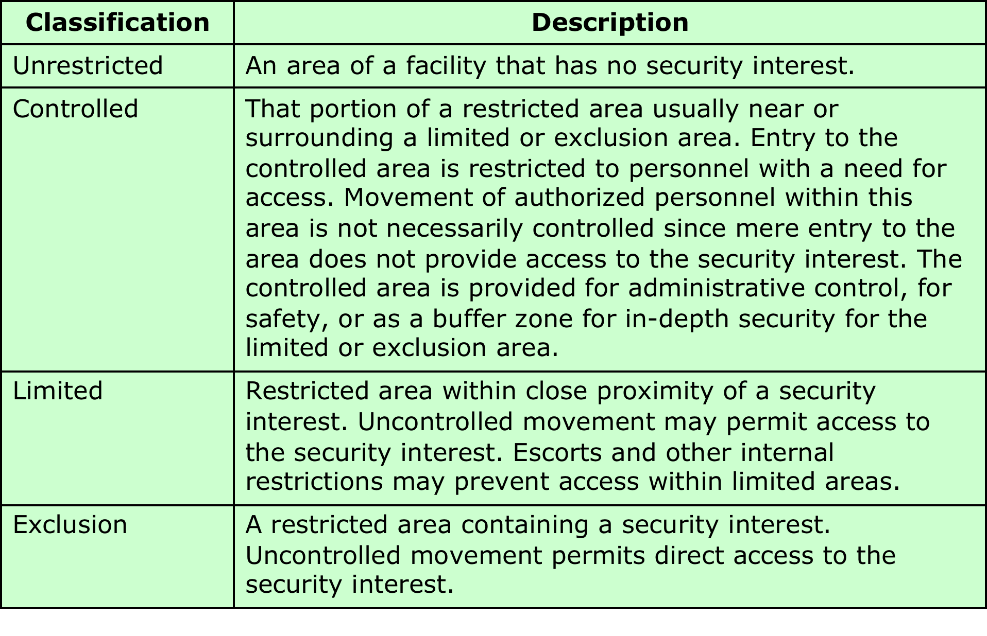
Table 16.6 Degrees of Security and Control for Protected Areas (FM 3-19.30)
Notes:
FIPS 201-2 defines characteristics of the identity credential that can be interoperable
government-wide. It does not, however, provide specific guidance for applying this
standard as part of a physical access control system (PACS) in an environment in
which one or more levels of access control is desired. To provide such guidance, in
NIST SP 800-116 [ A Recommendation for the Use of PIV Credentials in
Physical Access Control Systems (PACS) 2008), was issued and is being revised as of 2017.
SP 800-116 makes use of the following authentication mechanisms:
• Visual (VIS): Visual identity verification of a PIV card is done by a human
guard. The human guard checks to see that the PIV card looks genuine,
compares the cardholder’s facial features with the picture on the card, checks
the expiration date printed on the card, verifies the correctness of other data
elements printed on the card, and visually verifies the security feature(s) on
the card.
• Cardholder unique identifier (CHUID): The CHUID is a PIV card data
object. Authentication is implemented by transmission of the CHUID from
the PIV card to PACS.
• Biometric (BIO): Authentication is implemented by using a fingerprint or iris
data object sent from the PIV card to the PACS.
• Attended biometric (BIO-A): This authentication mechanism is the same as
BIO authentication but an attendant supervises the use of the PIV card and
the submission of the PIN and the sample biometric by the cardholder.
• PIV authentication key (PKI): PACS may be designed to perform public key
cryptography-based authentication using the PIV authentication key. Use of
the PKI provides two-factor authentication, since the cardholder must enter a
PIN to unlock the card in order to successfully authenticate.
• Card authentication key (CAK): The CAK is an optional key that may be
present on any PIV card. The purpose of the CAK authentication mechanism
is to authenticate the card and therefore its possessor. The CAK is unique
among the PIV keys in several respects: The CAK may be used on the contactless
or contact interface in a challenge/response protocol; and the use of
the CAK does not require PIN entry.
All of these authentication mechanisms, except for CAK, are defined in
FIPS 201-2. CAK is an optional PIV mechanism defined in SP800-116. SP800-116
is designed to address an environment in which different physical access points
within a facility do not all have the same security requirements, and therefore
the PIV authentication mechanism should be selected to conform to the security
requirements of the different protected areas.
SP 800-116 recommends that authentication mechanisms be selected on the
basis of protective areas established around assets or resources. The document
adopts the concept of “Controlled, Limited, Exclusion” areas, as defined in
[ARMY10] and summarized in Table 16.6 . Procedurally, proof of affiliation is
often sufficient to gain access to a controlled area (e.g., an agency’s badge to that
agency’s headquarters’ outer perimeter). Access to limited areas is often based on
functional subgroups or roles (e.g., a division badge to that division’s building or
wing). The individual membership in the group or privilege of the role is established
by authentication of the identity of the cardholder. Access to exclusion areas may
be gained by individual authorization only.

Slide 25
Notes:
Figure 16.4a illustrates a general model defined in SP 800-116. The model
indicates alternative authentication mechanisms that may be used for access to
specific areas. The model is designed such that at least one authentication factor is
required to enter a controlled area, two factors for a limited area, and three factors
for an exclusion area.
Figure 16.4b is an example of the application of SP800-116 principles to
a commercial, academic, or government facility. A visitor registration area is
available to all. In this example, the entire facility beyond visitor registration is a
controlled area available to authorized personnel and their visitors. This may be
considered a relatively low-risk area, in which some confidence in the identity of
those entering should be achieved. A one-factor authentication mechanism, such as
CHUID+VIS or CAK, would be an appropriate security measure for this portion
of the facility. Within the controlled area is a limited area restricted to a specific
group of individuals. This may be considered a moderate-risk facility and a PACS
should provide additional security to the more valuable assets. High confidence in
the identity of the cardholder should be achieved for access. Implementation of
BIO-A or PKI authentication mechanisms would be an appropriate countermeasure
for the limited area. Combined with the authentication at access point A, this
provides two-factor authentication to enter the limited area. Finally, within the
limited area is a high-risk exclusion area restricted to a specific list of individuals.
The PACS should provide very high confidence in the identity of a cardholder for
access to the exclusion area. This could be provided by adding a third authentication
factor, different from those used at access points A and B.
The model illustrated in Figure 16.4a , and the example in Figure 16.4b ,
depicts a nested arrangement of restricted areas. This arrangement may not be
suitable for all facilities. In some facilities, direct access from outside to a limited
area or an exclusion area may be necessary. In that case, all of the required authentication
factors must be employed at the access point. Thus a direct access point
to an exclusion area may employ, in combination, CHUID+VIS, BIO or BIO-A,
and PKI.

Slide 26
Summary
Physical security prevention and mitigation measures
Environmental threats
Technical threats
Human-caused physical threats
Integration of physical and logical security
Personal identity verification
Use of PIV credentials in physical access control systems
Overview
Physical security threats
Natural disasters
Environmental threats
Technical threats
Human-caused physical threats
Recovery from physical security breaches
Notes:
Chapter 16 summary.

