Slide 1
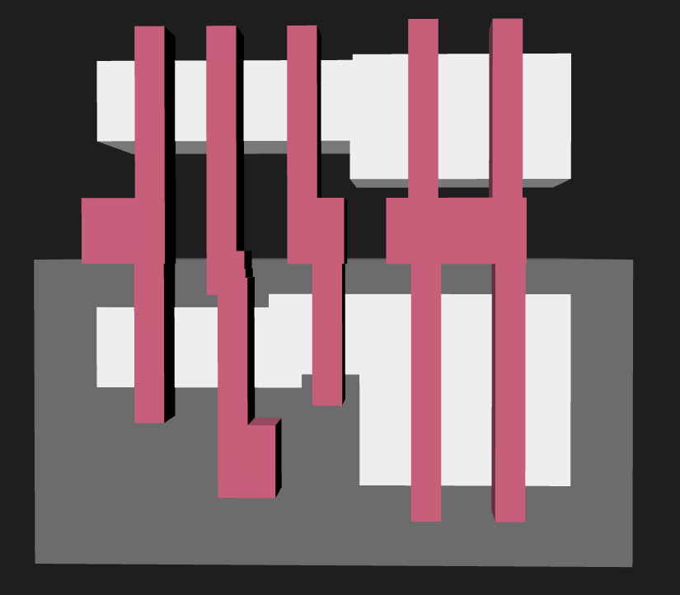
NMOS region
poly
diff
PMOS region
nwell

Slide 2
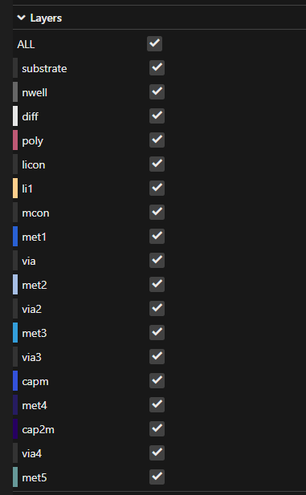

Slide 3
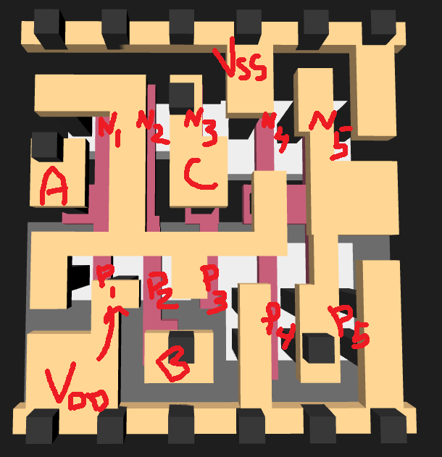
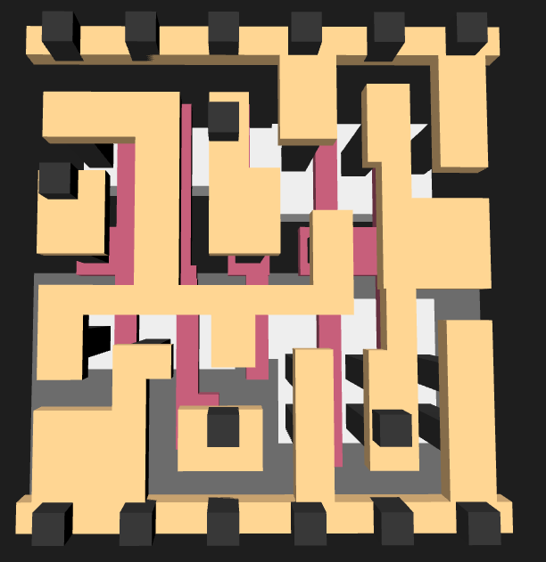
V_{ss}
N₁
N₂
N₃
N₄
N₅
A
C
X
P₁
P₂
P₃
P₄
P₅
B
V_{dd}

Slide 4
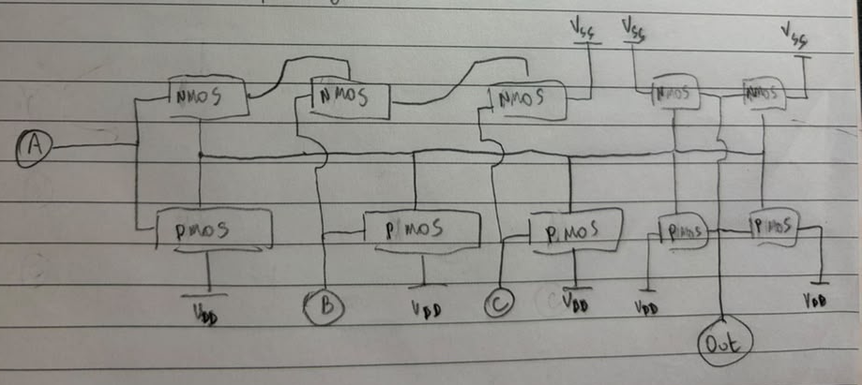

Slide 5
(a) Overlapping layers
(b) Touching geometry

Slide 6
