Slide 3
COMMANDER’S ORDERS
Greetings, Sentry. I hope you are getting used to your aerial observation post.
REMAINING ENERGY

Slide 4
COMMANDER’S ORDERS
Look at the NEXT button on your right to scroll through my daily communication.
REMAINING ENERGY

Slide 5
COMMANDER’S ORDERS
Your role is to spot enemy troops approaching. They can come from all around your post.
REMAINING ENERGY

Slide 6
COMMANDER’S ORDERS
To spot an enemy, you only need to look at it until the indicator becomes green.
REMAINING ENERGY

Slide 7
COMMANDER’S ORDERS
Your anti-grav boots are supplied by a finite source of energy.
REMAINING ENERGY

Slide 8
COMMANDER’S ORDERS
However, do not worry : we will provide you with a new energy supply everyday.
REMAINING ENERGY

Slide 9
COMMANDER’S ORDERS
That is all for today. Good luck, Sentry, and stay sharp.
REMAINING ENERGY

Slide 10
COMMANDER’S ORDERS
Good morning, Sentry. I have some bad news.
REMAINING ENERGY

Slide 11
COMMANDER’S ORDERS
The energy supply that was intended for you was not delivered properly.
REMAINING ENERGY

Slide 12
COMMANDER’S ORDERS
I am afraid you will have to hold with your current reserves.
REMAINING ENERGY

Slide 13
COMMANDER’S ORDERS
That is all for today. Stay sharp, Sentry : the sky is cloudier today.
REMAINING ENERGY

Slide 14
COMMANDER’S ORDERS
Good morning, Sentry. Today is a very special day.
REMAINING ENERGY

Slide 15
COMMANDER’S ORDERS
Not that we have received your energy supply : however, we have found a workaround.
REMAINING ENERGY

Slide 16
COMMANDER’S ORDERS
Your boots have been equipped with an emergency propulsion system.
REMAINING ENERGY

Slide 17
COMMANDER’S ORDERS
When enabled, the gauge below will go red. Practically, there is now difference.
REMAINING ENERGY

Slide 18
COMMANDER’S ORDERS
We are done. Stay sharp, Sentry.
REMAINING ENERGY

Slide 19
COMMANDER’S ORDERS
We are done. Stay sharp, Sentry.
REMAINING ENERGY
EMERGENCY MODE

Slide 20
COMMANDER’S ORDERS
…Sentry. The weather is better today.
REMAINING ENERGY

Slide 21
COMMANDER’S ORDERS
However, I am afraid you will have to rely again on the emergency system.
REMAINING ENERGY
EMERGENCY MODE

Slide 22
COMMANDER’S ORDERS
The war is soon coming to an end ; stay sharp.
REMAINING ENERGY
EMERGENCY MODE

Slide 23
Day 1

Slide 24
Day 2

Slide 25
Day 3

Slide 26
Day 4

Slide 27
Day 5
(300 km from there…)

Slide 28
Day 6

Slide 29
NEXT
PREVIOUS

Slide 30
FRANÇAIS
ANGLAIS
NEERLANDAIS

Slide 31
FRENCH
ENGLISH
DUTCH

Slide 32
FRANS
ENGELS
NEDERLANDS

Slide 33
NEXT
SUIVANT
VOLGENDE

Slide 34
PREVIOUS
PRECEDENT
VORIGE

Slide 35


Slide 36
RESTART
REDEMARRER
HERSTARTEN

Slide 37
당신의
어머니와
섹스

Slide 42
CLOUDWALKER

Slide 43
A game by JLV
Ludum Dare 44 – “Your life is currency”
Terrain generated by following Sebastian Lague’s outstanding tutorial series :
https://www.youtube.com/playlist?list=PLFt_AvWsXl0eBW2EiBtl_sxmDtSgZBxB3
Cloud shader made after PuckLovesGames’s video tutorial :
https://www.youtube.com/watch?v=LLUUIAKFgWg
Sound effects and music :
Cakewalk by Bandlab (Wind SFX, Explosion SFX, Heartbeat SFX, BG Music)
Graphics
Blender, PowerPoint (Fonts), https://cpetry.github.io/TextureGenerator-Online/
Skybox : Spacescape Generator by Alex Peterson
Random text on the final paper :
http://www.randomtextgenerator.com/
Engine and Libraries
Unity 2018.3.8f1
Google VR SDK

Slide 44
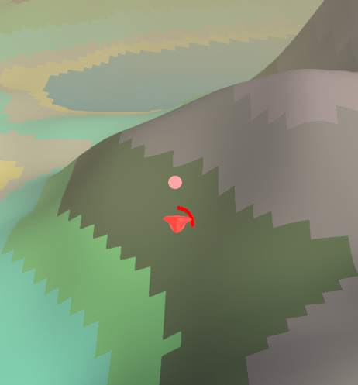


Slide 45

CLOUDWALKER

