Slide 1
New IFNg score calculation method

Slide 2
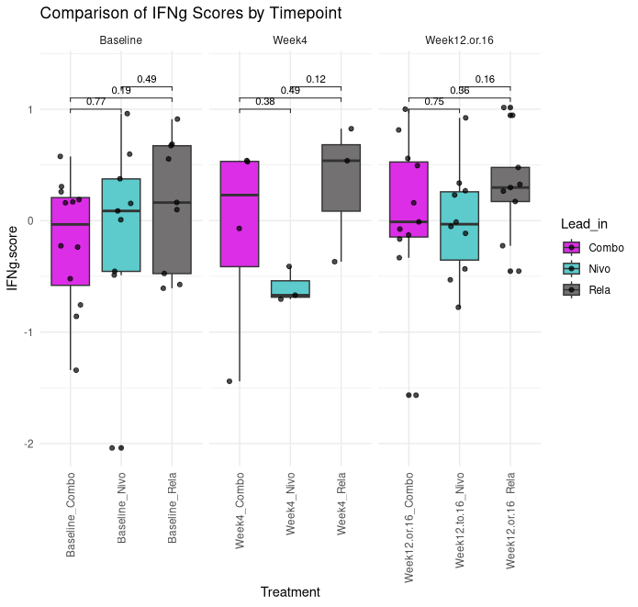
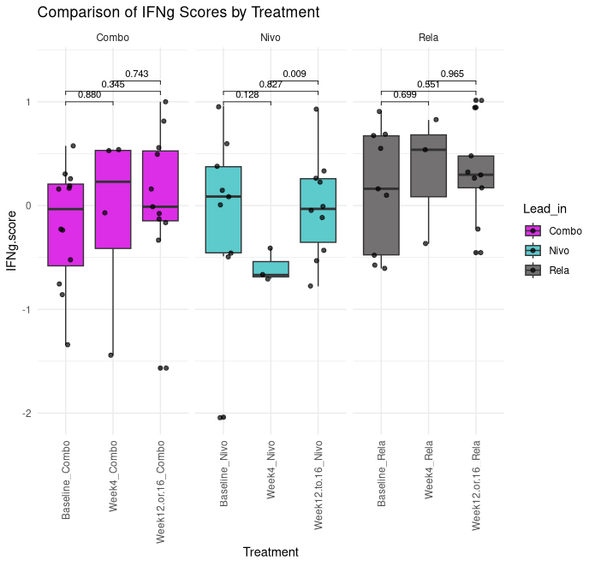
New IFNg score calculation by timepoint and leadin (w stats and correct colors)

Slide 3
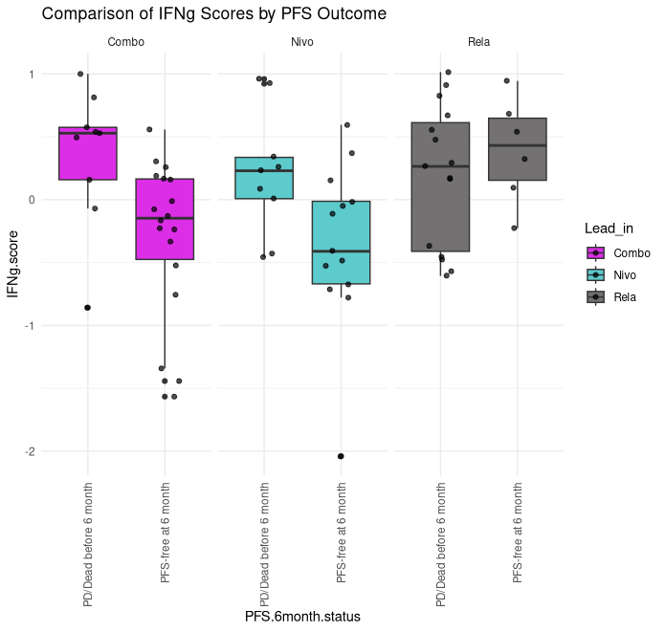
IFNg scores by PFS outcome (add stats)

Slide 4
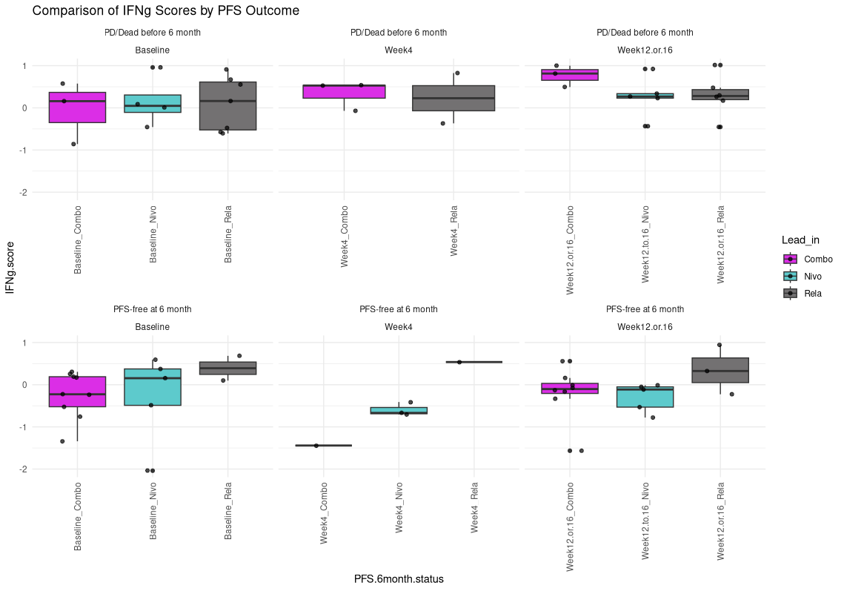
IFNg scores by PFS outcome and timepoint

Slide 5
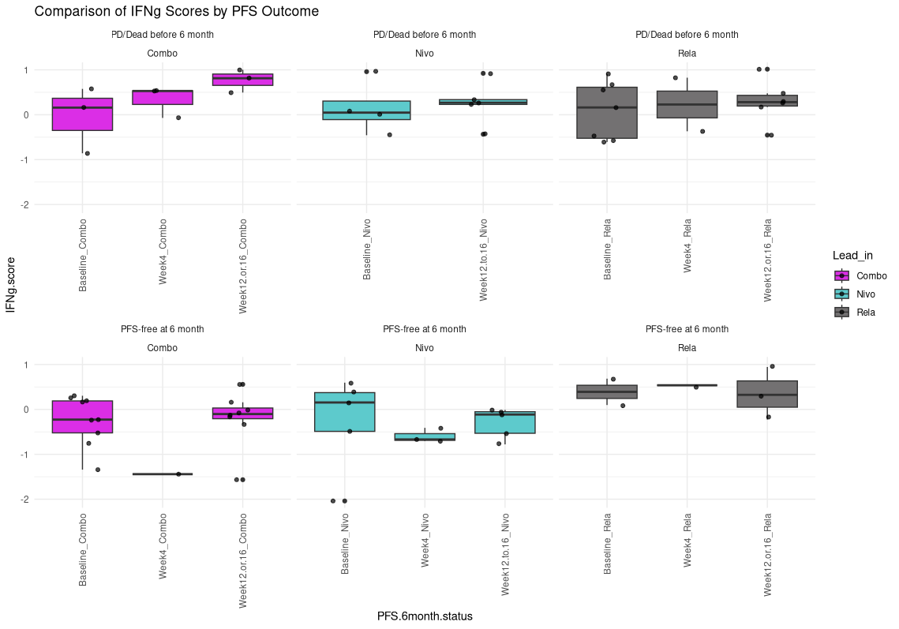
IFNg scores by PFS outcomes and Lead-in

Slide 6
Corrected IFNg scores

Slide 7
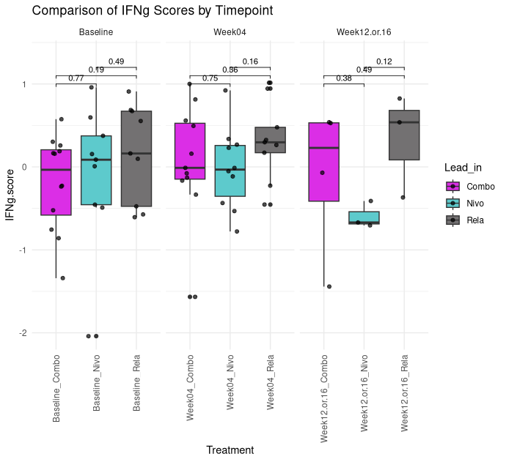
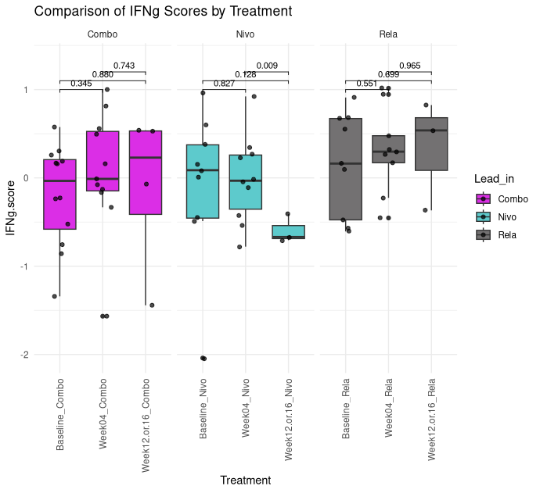
Corrected IFNg score plots with stats

Slide 8
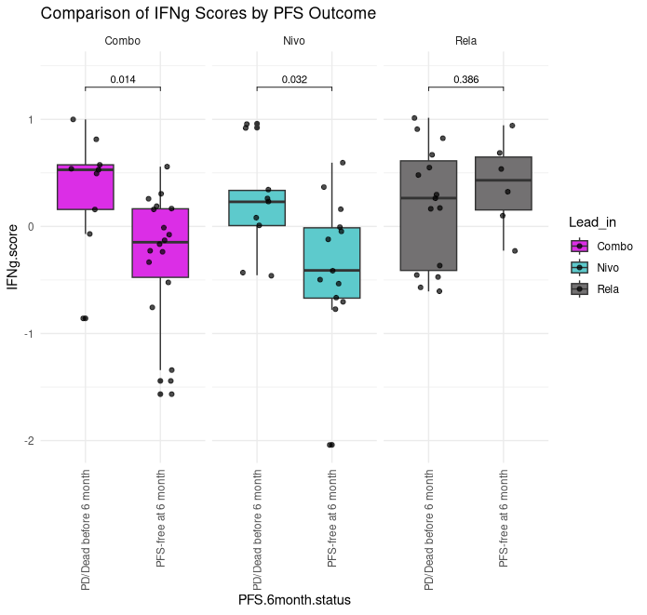
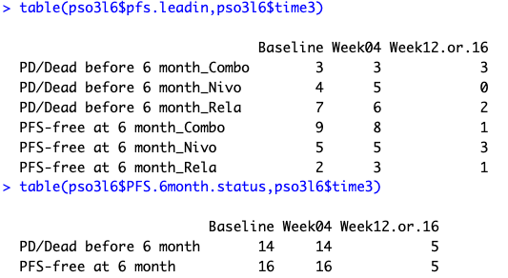
Correct IFNg score plot by PFS outcome

Slide 9
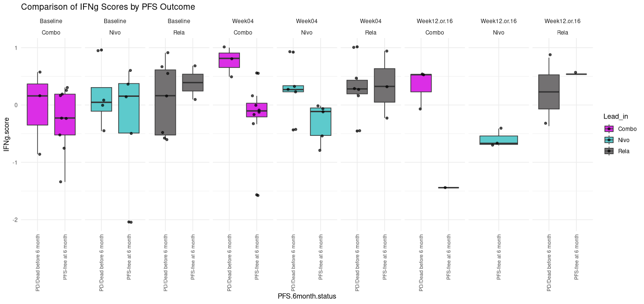
Correct IFNg score plot by PFS outcome split by timepoint
Have tried ‘compare_means’ with these subsets, it throws an error that there are not enough samples to do the t-test
3
9
4
5
7
2
3
8
5
5
6
3
3
1
3
2
1

Slide 10
New plots 02/26/26

Slide 11
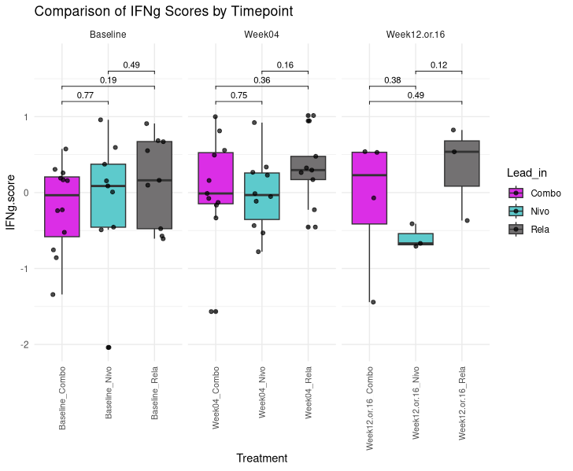
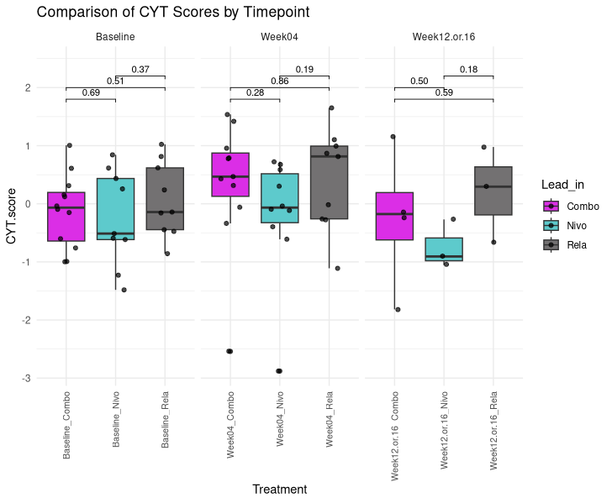
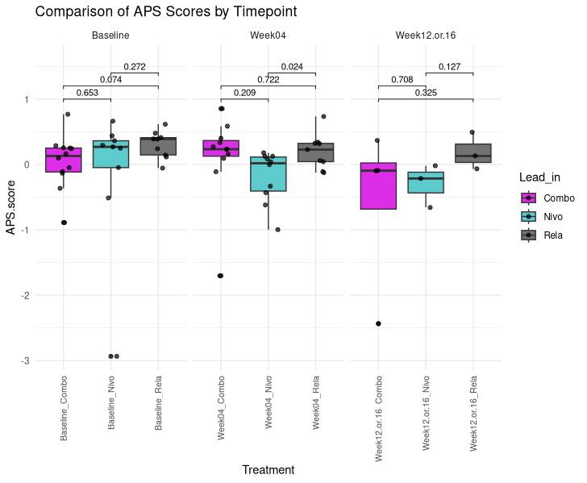
Comparison of scores by time:

Slide 12
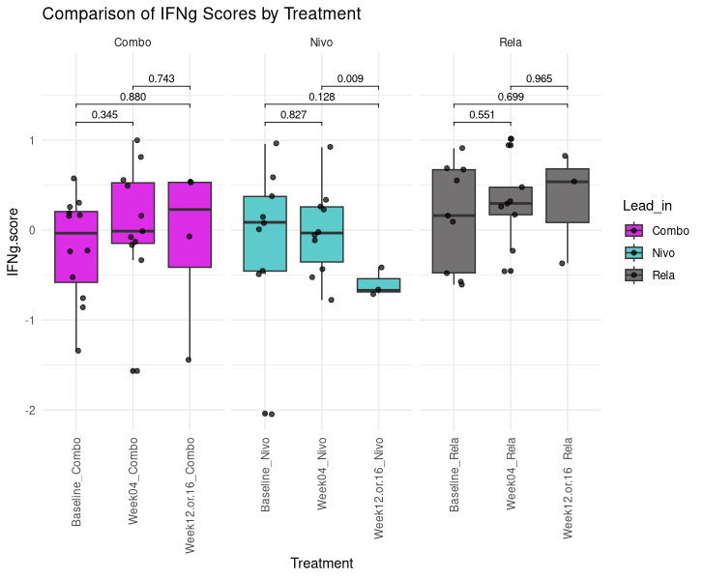
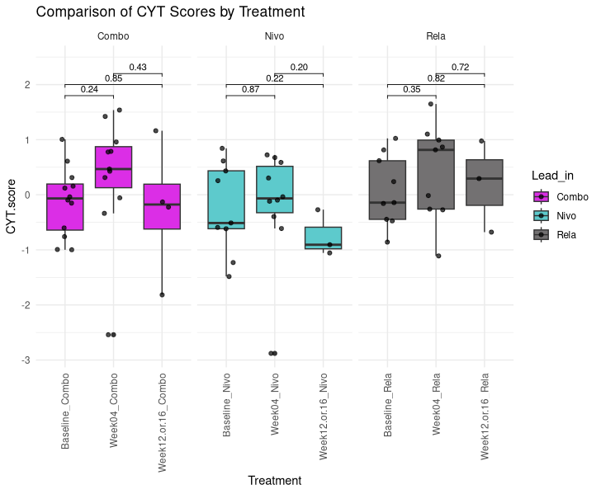
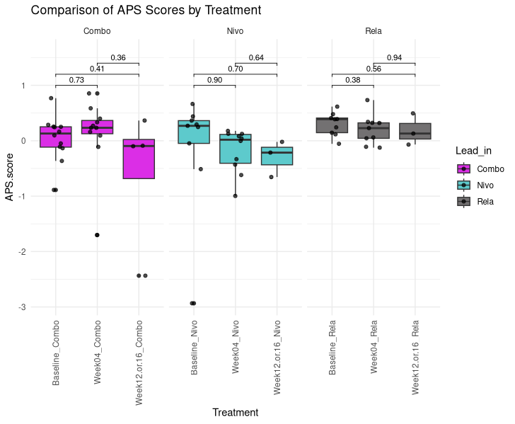
Comparison of scores by Lead_in

