Slide 1
The Battle of Neighborhoods
Comparing Toronto, Canada to US Cities

Slide 2
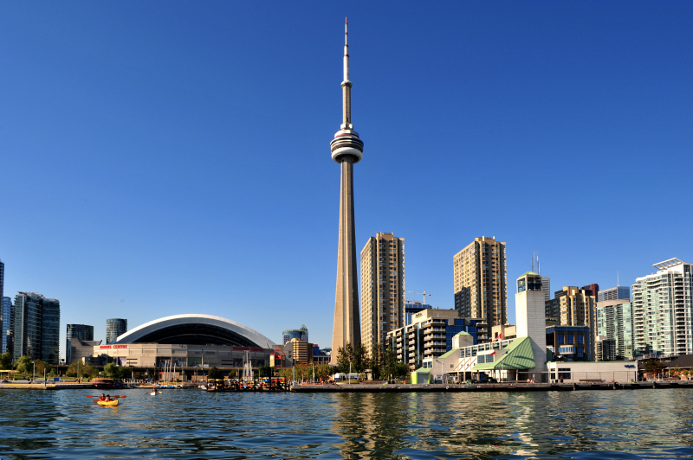
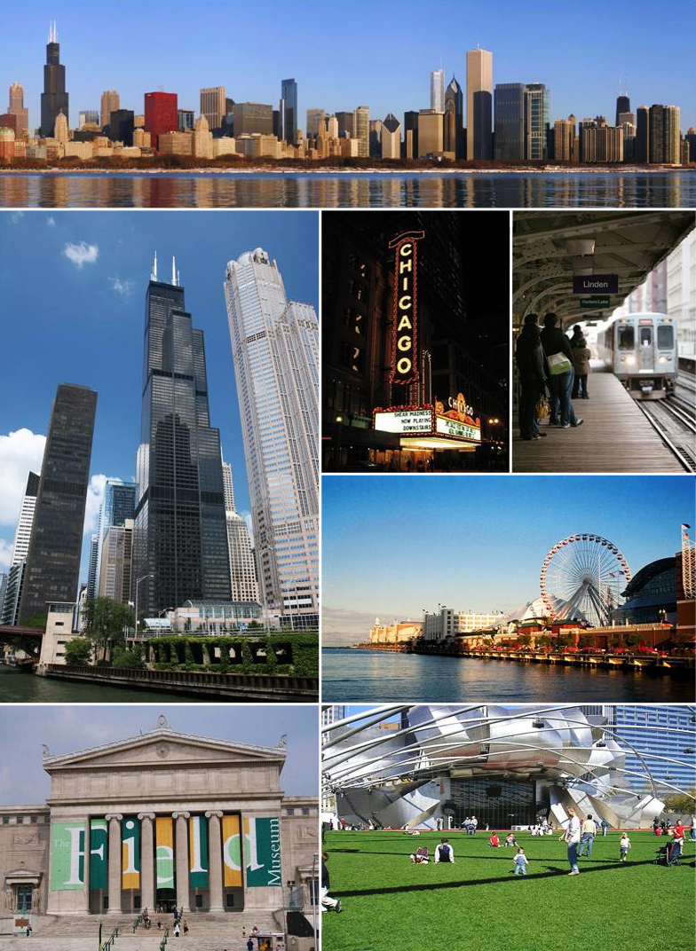
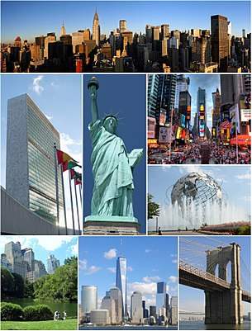
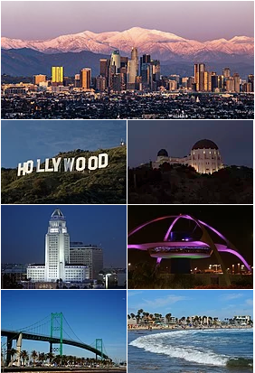
The focus is to use Foursquare data for Toronto, Canada and compare it to that of three US cities: Chicago, Los Angeles and New York, and determine which US city Toronto is most like.

Slide 3
Neighborhood and coordinate data for all four cities were gathered from various online sources and the. Foursquare API was used to produce the venue data for each neighborhood.
 | Neighborhood | Neighborhood Latitude | Neighborhood Longitude | City | Venue | Venue Latitude | Venue Longitude | Venue Category
0 | Grand Boulevard | 41.816814 | -87.606708 | Chicago | Some Like It Black Creative Arts Bar | 41.818432 | -87.605251 | Juice Bar
1 | Grand Boulevard | 41.816814 | -87.606708 | Chicago | Just Turkey Restaurant | 41.815248 | -87.606212 | BBQ Joint
2 | Grand Boulevard | 41.816814 | -87.606708 | Chicago | Norman's Bistro | 41.816795 | -87.601809 | Restaurant
3 | Grand Boulevard | 41.816814 | -87.606708 | Chicago | Honey 1 BBQ | 41.816910 | -87.607320 | BBQ Joint
4 | Grand Boulevard | 41.816814 | -87.606708 | Chicago | Family Dollar | 41.813800 | -87.606318 | Discount Store

Slide 4
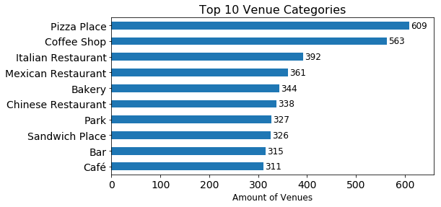
Lots of Pizza Places, which is likely attributable to New York and Chicago as both cities claim fame for their pizza. Italian, Mexican and Chinese are common non-continental cuisines and bakeries and bars are common as well.

Slide 5
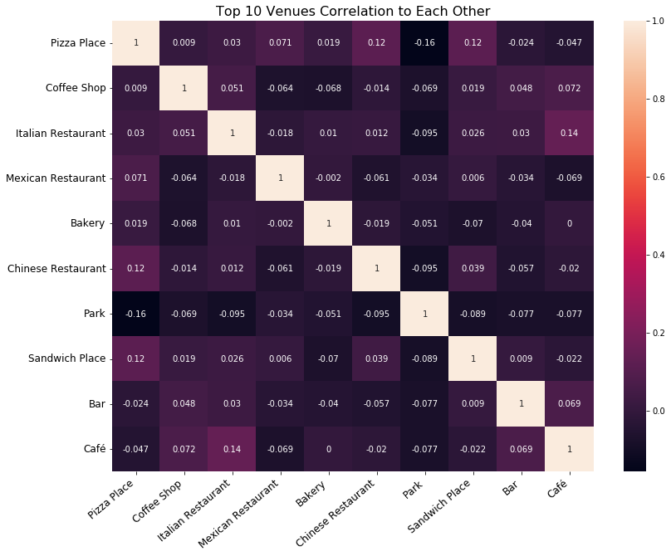
The top 10 venues do not seem to have much correlation to each other.
In fact, Pizza Place and Park have the greatest correlation at -0.157.

Slide 6
Top 10 venue categories and their dependent with the highest correlation:
Top 10 Venues | Dependent | Correlation
Sandwich Place | ATM | 0.398361
Chinese Restaurant | Dim Sum Restaurant | 0.317655
Bar | Drugstore | 0.315890
Café | College Stadium | 0.266386
Coffee Shop | College Auditorium | 0.253476
Italian Restaurant | Spa | 0.225283
Pizza Place | Empanada Restaurant | 0.200907
Mexican Restaurant | Strip Club | 0.170390
Bakery | Dance Studio | 0.135972
Park | Pizza Place | -0.156821

Slide 7
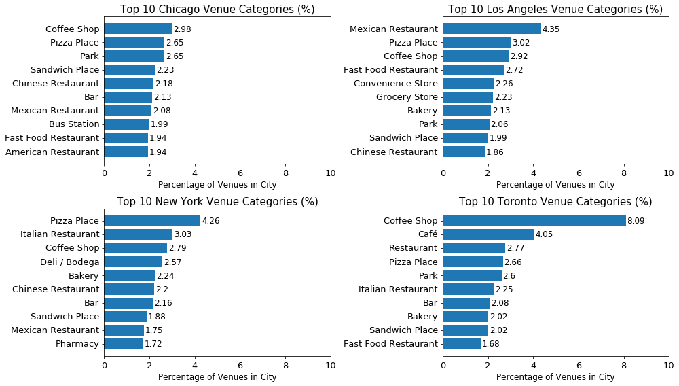
Top Venue Categories Per City

Slide 8
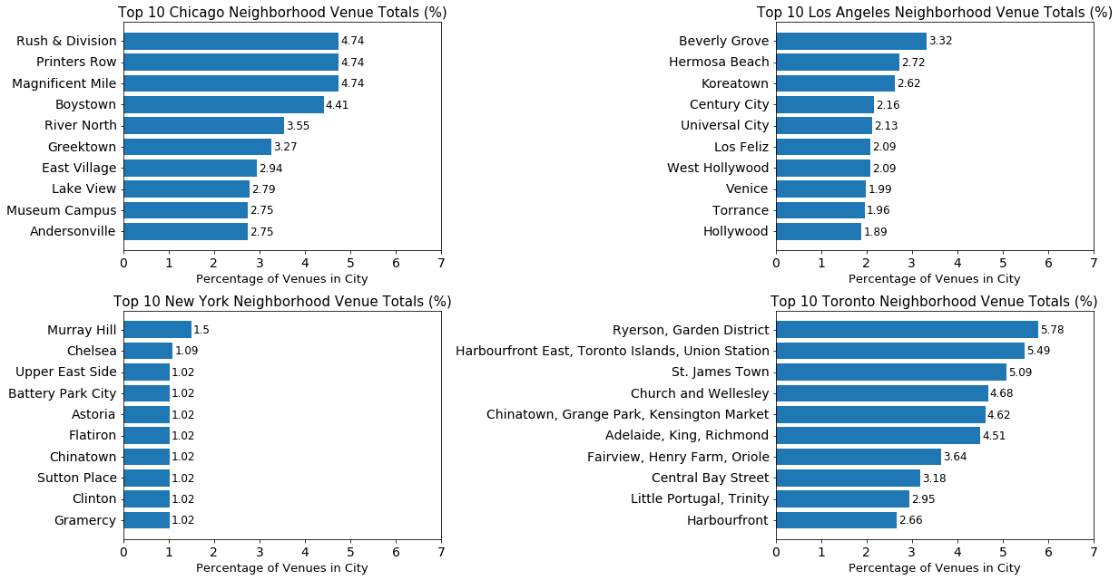
Top Neighborhood Venue Totals

Slide 9
Clustering
Under sampled neighborhood venue data from each US city and paired it with a similar data from Toronto, then used k-Means to produce two clusters. The more separated the two cities are (i.e. Toronto in one cluster and the US city in the other) than the cities are not very alike.
Sampled and fitted the model 200 times and recorded the percentages of both cities in the clusters.

Slide 10
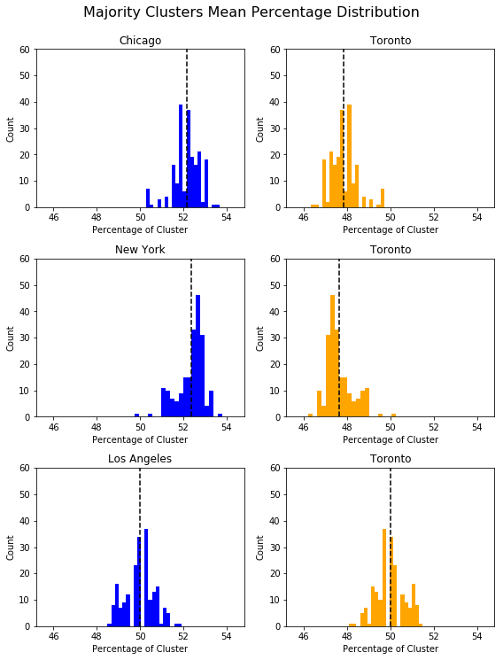
The two clusters k-Means produced were apparently split into of neighborhoods that predominantly hosted dining venues and those that did not. The majority cluster was nearly 10x the minority.
The Toronto/Los Angeles pair’s mean percentage is right at 50%.

Slide 11
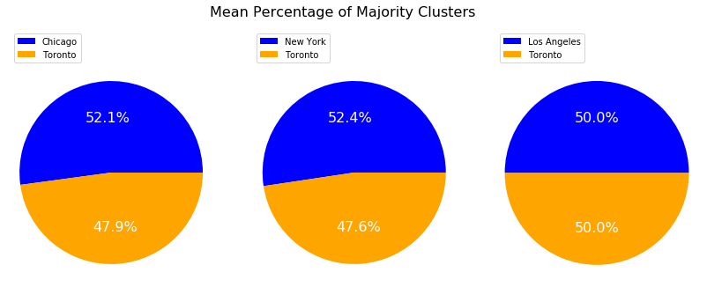
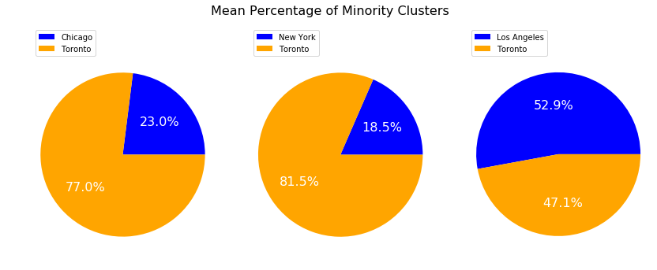

Slide 12
Classification
I will use the same dataset as in clustering but use the city names as the labels to predict. I will check which Toronto neighborhoods were labeled incorrectly and what city label was applied. The most common incorrect label will be the city Toronto is most like. Logistic regression is an appropriate option since this is binary classification. This time, I will use oversampling.

Slide 13
Tuned Logistic Regression Parameters: {'C': 100}
Accuracy score is 0.967
Best score is 0.973
Toronto 97.42
Los Angeles 2.58
96.7% accuracy is very good. We can see that 2.58% of Toronto neighborhoods were mislabeled as Los Angeles with none mislabeled as either New York or Chicago. The percentage is small, to be sure, but it does provide another indicator that Toronto is more like Los Angeles than either New York or Chicago.

Slide 14
Summary
The indicators may not be especially profound, since all four cities are in North America, very large, economically developed and culturally diverse. However, the data does illustrate certain patterns and both classification and clustering point to Toronto having more in common with Los Angeles than either Chicago or New York.

Slide 15
Sources
Chicago:
https://data.cityofchicago.org/api/geospatial/bbvz-uum9?method=export&format=GeoJSON
Los Angeles:
https://usc.data.socrata.com/api/geospatial/r8qd-yxsr?method=export&format=GeoJSON
New York:
https://cocl.us/new_york_dataset
Toronto:
https://en.wikipedia.org/wiki/List_of_postal_codes_of_Canada:_M
https://cocl.us/Geospatial_data
Foursquare Developer API:
https://foursquare.com/developers/login?continue=%2Fdevelopers%2Fapps

