Slide 1
Record Labels
Classifying musical genres using song lyrics

Slide 2
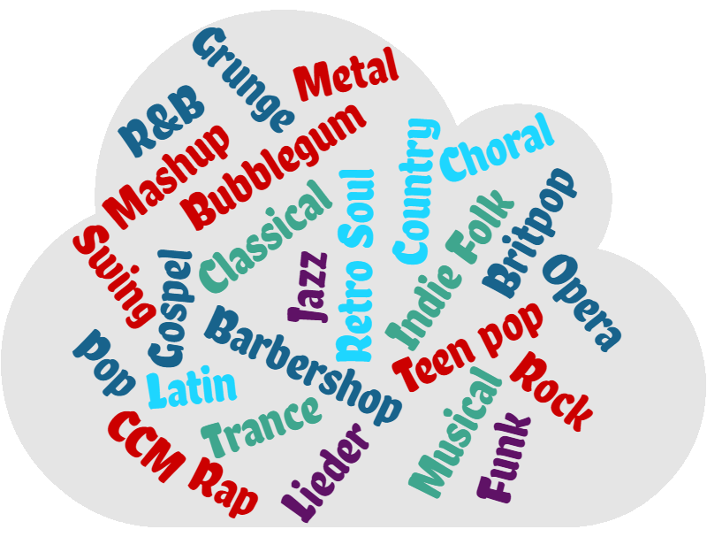
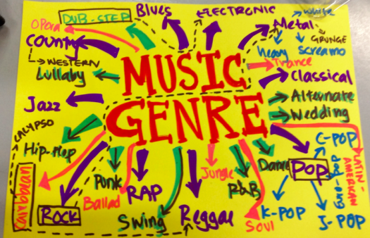

What defines music genres? Tempo? Key? Instruments?

Slide 3
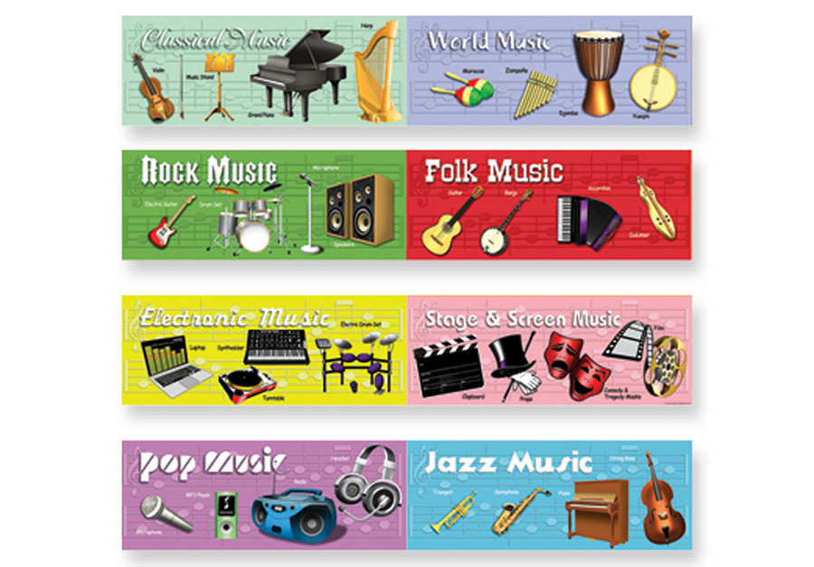
Do lyrics define genre?
Goals of the project:
Gather lyrics from artists under five specific genres: heavy metal, rap, country, pop and rock.
Determine how accurately Natural Language Processing techniques can label lyrics’ genres

Slide 4
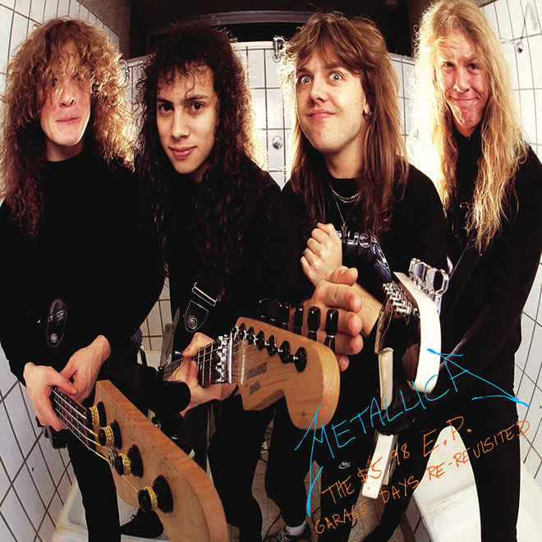
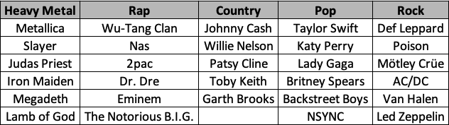
Artist Samples
For each of the five genres, I selected six specific artists (except country, because I was getting far more lyrics per artist than the other genres). The goal was to acquire lyrics for as many of each artist’s songs as I could.
Through the Musixmatch API and LyricWiki database, I was able to gather over 3000 lyrics across all five genres.

Slide 5
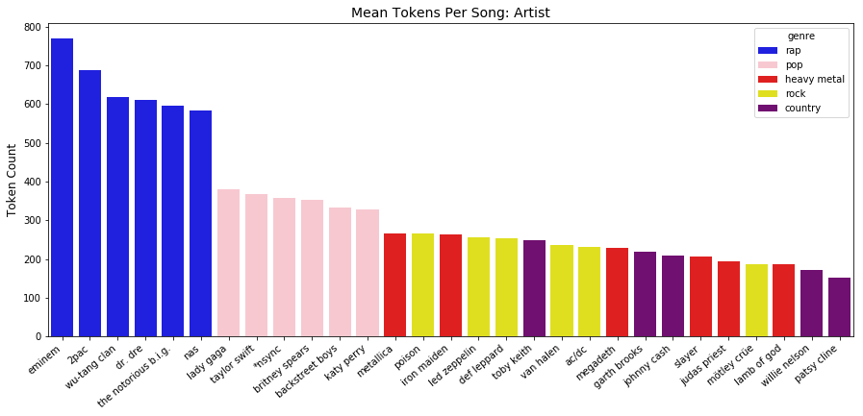
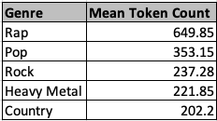
Overall, rap artists have the most words (tokens) per song. Country has the fewest.

Slide 6

NLP Steps for Processing Lyric Text
Remove punctuation / contractions.
Replace misspelled tokens with correct spelling and common slang with proper English (e.g. “wanna” : “want to”).
Lemmatize tokens
Remove all stop words (e.g. “the”, “and”, etc.) and other meaningless tokens (e.g. “woo” and “haha”).
Repeat over several iterations to clean text as much as possible.

Slide 7
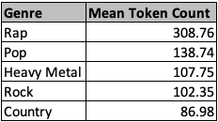
On average, NLP cleaning removed over half of the lyric tokens. Rap still has the most.

Slide 8

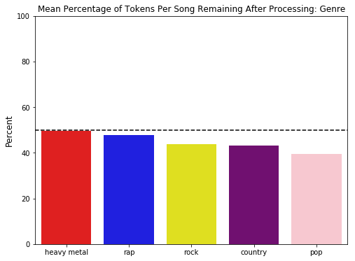
On average, heavy metal retained a greater percentage of their original tokens after NLP processing (49.5%). Pop retained the least (39.6%).

Slide 9
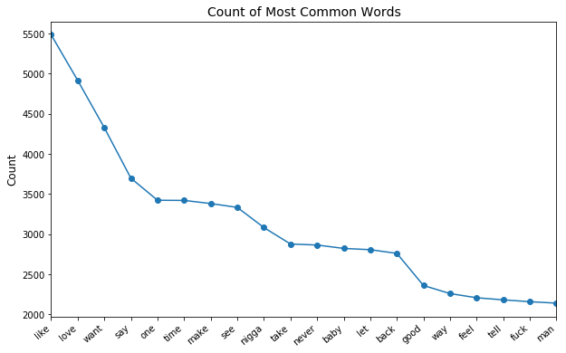
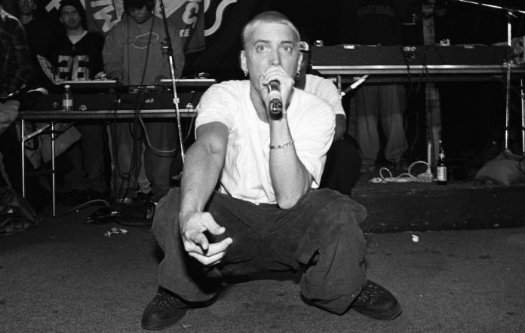
What are the most common tokens?
Mostly ubiquitous terms such as “like” and “say”.
Terms that are common for contemporary music like “love” and “baby”, especially in the pop and country genres.
Profanity that is frequent in rap and some heavy metal.

Slide 10
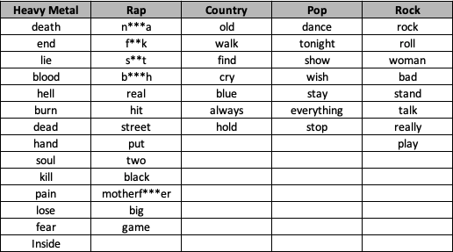
What are the most common tokens that are unique to each genre?
Counted the 50 most common tokens in each genre, then returned those that were unique to one genre.
Overall, the tokens in the table summarize the themes of each genre well.
Added frequency of these specific tokens as a feature to the data set to be used in modeling.

Slide 11

Other features added to data set for each song:
Pre-NLP
Count of characters in lyrics.
Count of tokens.
Mean characters per token.
Count of contractions.
Post-NLP
Count of tokens.
Mean characters per token.
Count of non-duplicate tokens
Count of spelling edits made.
Count of tokens lemmatized.
Form of speech of each token (noun, verb, etc.)
Frequency of unique tokens (previous slide.)

Slide 12
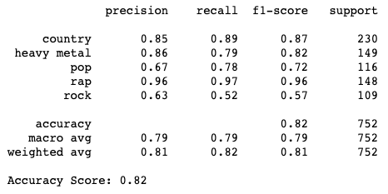
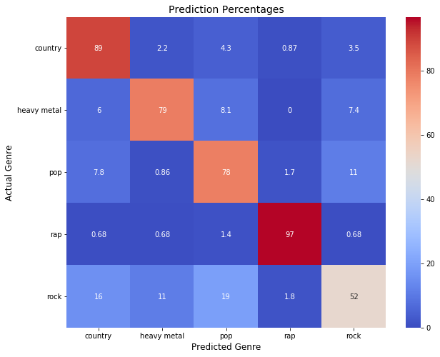
Naïve Bayes classifying. Rap was the easiest to label with accuracy of 97%. Rock was most difficult at 52%.

Slide 13
Summary
Using Naïve Bayes, rap was the most accurately classified genre (97%), which is understandable given the volume of tokens per song and the relatively unique use of language. Country also has a unique lyrical syntax which would bolster the success of predictions there (89%).
Rock was difficult to label, which could illustrate that the genre is more generic in terms of content and construction. It may be more common for elements of rock to spill into country, pop and metal and vice versa than I expected and there are not enough unique elements to truly set it apart.
More data (songs / lyrics) would likely boost the performance of the model, but considering my focus was solely on lyrics with no consideration to track run time, tempo and other features that may be helpful, I'd say the model works better than expected.

