Slide 1


Slide 2
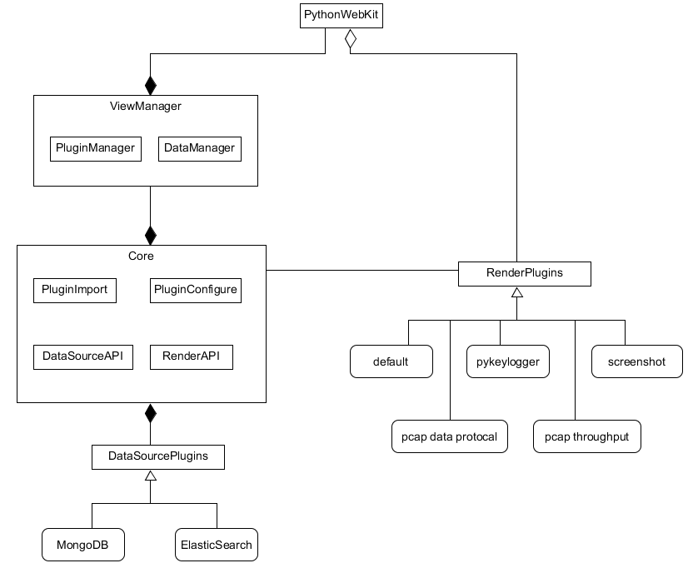
DSS Visualizer Design

