Slide 1
Airline Data Analysis Project IST 687
Joyce Woznica jlwoznic@syr.edu

Slide 2
Project Update 1
Submitted 2/5/2019

Slide 3
Project Update 1: Overall Summary
Accomplishments this Past Period Reviewed dataset (attributes) and which variables might contribute to satisfaction of flyers Developed initial list of business questions Reviewed how reading the dataset (XLS) into R data frame for manipulation | What’s working well Correlating previous lessons to data set Finding enough time to work on project
Plans for next Update Read in dataset Cleanse data and initial manipulations Start to review data models and visualization (plots and graphs) Start to interpret data to begin to answer business questions | Issues/What’s Not Working Well Nothing yet – just feeling a bit unfocused

Slide 4
Business Questions
Which airlines (Airline Code/Airline Name) have the highest satisfaction rates?
Why? What do they have in common?
What is contributing to this rate?
How does Southeast stack up against the other airlines?
How do cancellations and delays affect satisfaction?
What contributes to first time flyers satisfaction?
Does membership in a frequent flyer program affect satisfaction?
What variable(s) (or combination of variable(s)) contribute the most to satisfaction for flyers?
Class of Service
Origin/Destination City and State
Travel Day of the month
Type of plane (Airline Code)
Gender and/or Age
Airline Status
Distance

Slide 5
Initial Variable Selection
Variable | Definition
Satisfaction | Rating from 1 (low) to 5 (high) of satisfaction
Airline Status | Status with airline (frequent flyer)
Age | Age of traveler
Gender | Gender of traveler – male or female
Number of Flights | Number of flights taken by this traveler
Class | Class of travel (first, business, etc.)
Day of Month | Day of the month of travel
Airline Code | Specific airline code name
Airline Name | Specific airline name
Origin City and Origin State | Origin City and State for flight
Destination City Destination State | Destination City and State for flight
Departure Delay in Minutes | How many minutes of departure delay
Arrival Delay in Minutes | How many minutes of arrival delay
Flight Cancelled | If flight was cancelled (yes/no)
Flight Distance | Distance between origin and destination

Slide 6
Project Update 2
Submitted 2/21/2019

Slide 7
Project Update 2: Overall Summary
Accomplishments this Past Period Simplified column names for easier manipulation Determined NA and arrived at an approach for handling depending on data Example: setting flight minutes and delay minutes to 0 when Flight Cancelled=‘Yes’ Example: omitted rows where the Satisfaction value was NA Reviewed general descriptive statistics: mean, mode, range, etc. Reviewed multiple linear regression Completed generic plots of data for visualization | What’s working well Reviewing old homework and google for best ways to analyze data Good data determined from various descriptive statistics Progression is solid
Plans for next Update Fine tune multiple linear regression to only high confidence variables Try additional visualizations for interpreting data Heat maps, scatterplots, boxplots, etc. Begin to find ways to specifically answer proposed business questions Map airports and satisfaction to US map | Issues/What’s Not Working Well A little overwhelmed A bit frustrated at plotting

Slide 8
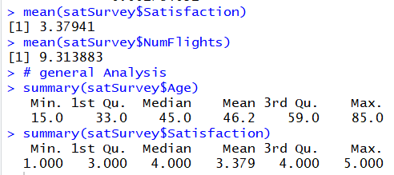
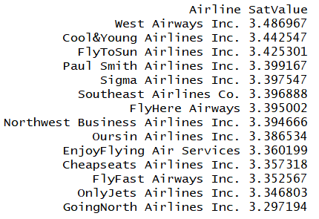


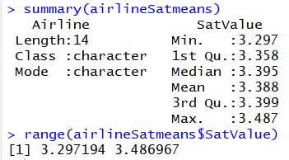
General Descriptive Statistics
Overall Mean Satisfaction across all airlines is about 3.4
Overall Mean number of flights taken by all individuals surveyed is about 9.3
Average age of travelers is 46 years
Some ranked Satisfaction as low as 1 and as high as 5 (range)
West Airways has the highest mean Satisfaction rating while GoingNorth Airlines has the least.
However, there is not much range between the highest and lowest means
Reviewed some of the specific variables.

Slide 9
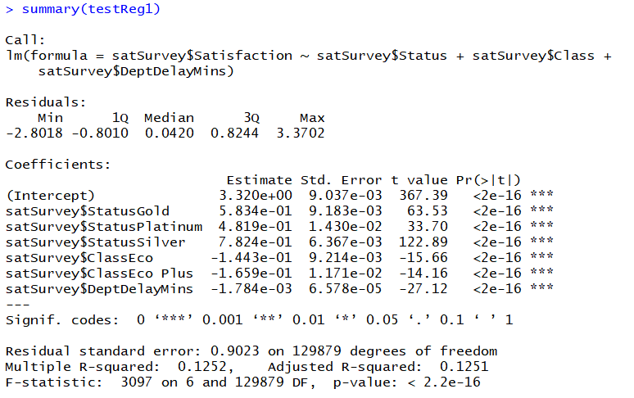
Additional descriptive statistics
Attempted to look at some correlation between variables.
Independent Variables
Departure Delays
Status
Class of Service
Dependent Variable
Satisfaction
Saw no strong multiple R-squared associating these variables.
Looking to further tune this information and apply other regression tests.

Slide 10
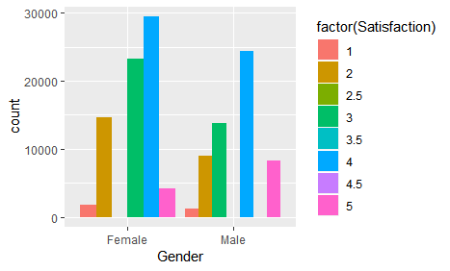

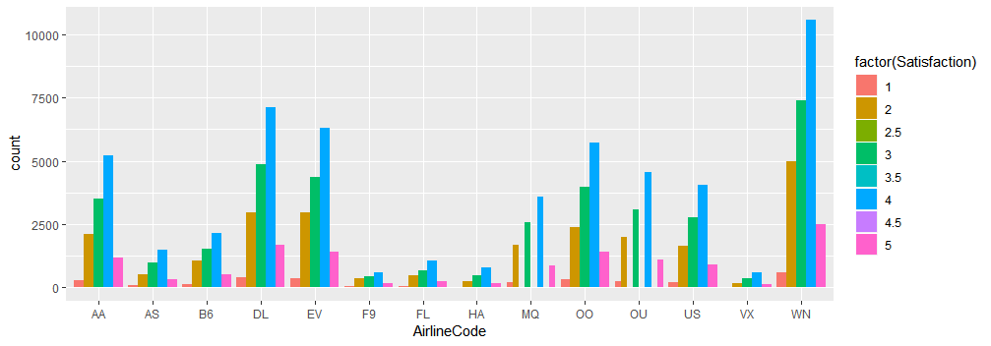
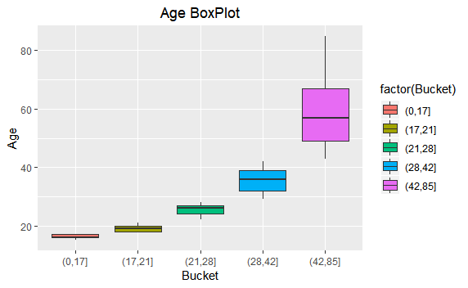
Information for initial analysis
Looks like there are more pleased male travelers (sat=5) than female travelers, but also could be skewed by there being more female responders.
Data appears to be weighted as some have traveled more airlines than others.
We have a larger group of flyers over 42 years of age

Slide 11
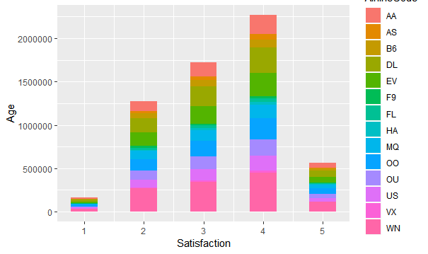
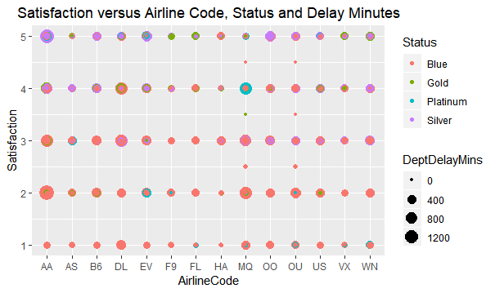
Further Plotting Investigation
Determine if Delay affects satisfaction by airline.
Trying to see how age and airline compare for satistisfaction.

Slide 12
Project Update 3
Submitted 3/12/2019

Slide 13
Project Update 3: Overall Summary
Accomplishments this Past Period Created Word document and began to update document with findings and information Cleaned up R-code adding comments and separating into appropriate groups for displaying in final project More plotting and used of regression and interpreting the results | What’s working well Correlating previous lessons to data set
Plans for next Update Finish any further modeling Do some additional plots of data Interpret results and make recommendations for Southeast Airlines | Issues/What’s Not Working Well Life is getting in the way of finding time to work on the project

Slide 14
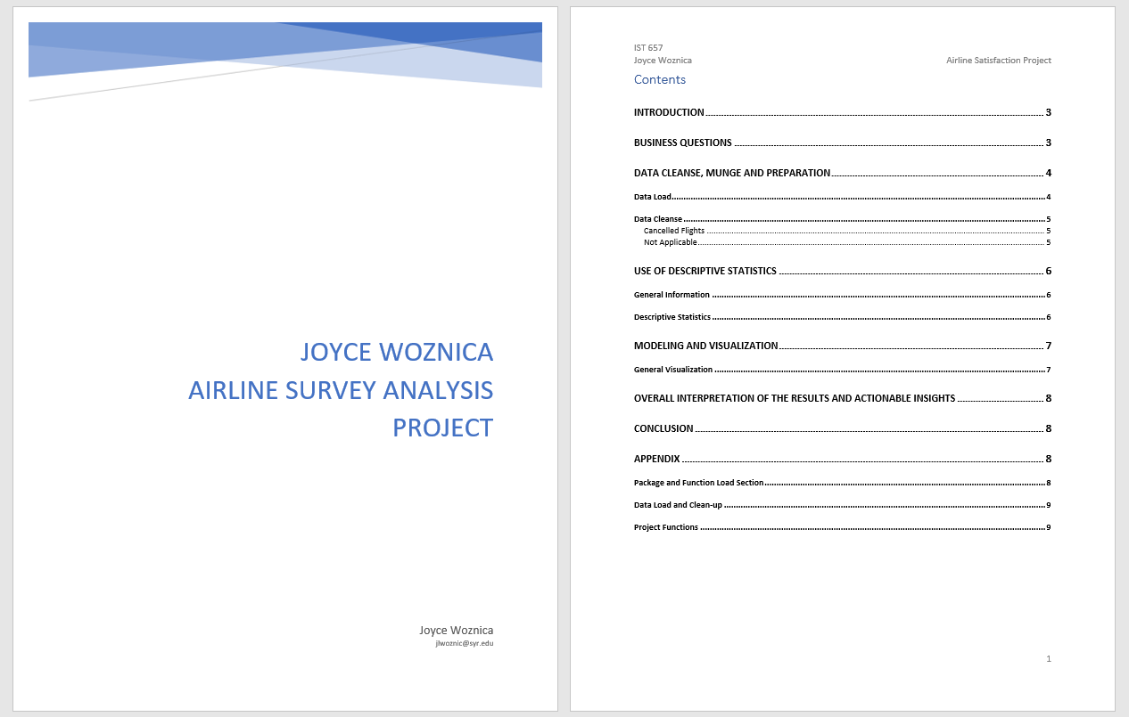
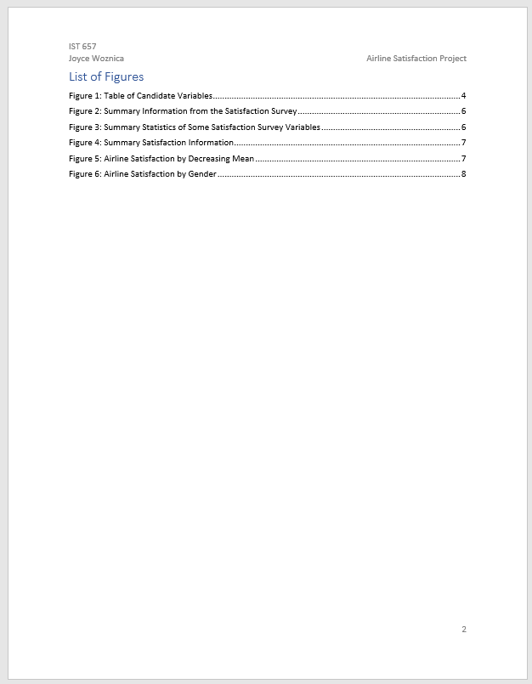
Initial Document Created

Slide 15
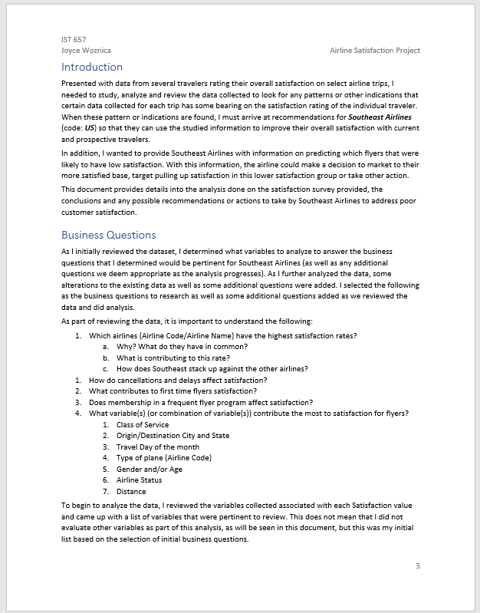
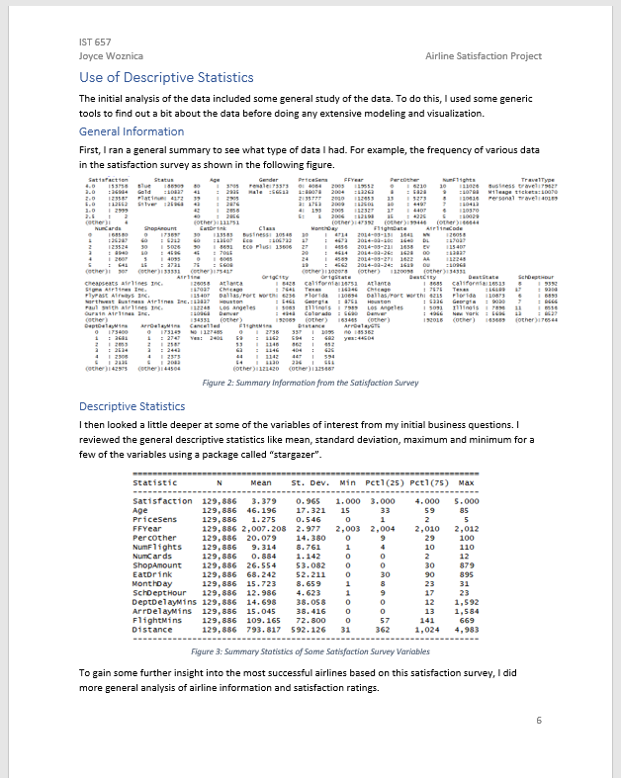
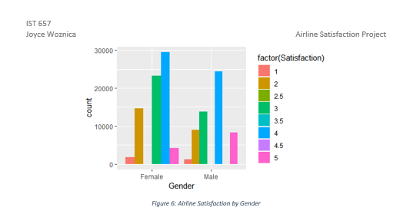
Began to enter Information into document

Slide 16
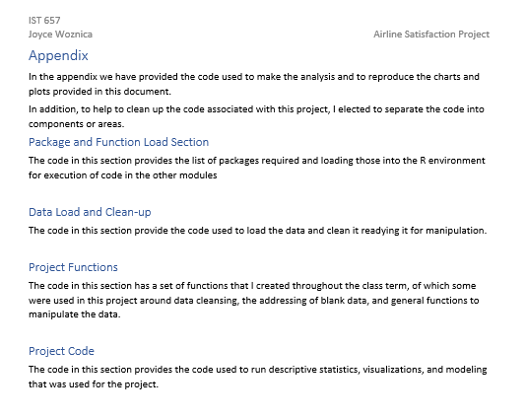
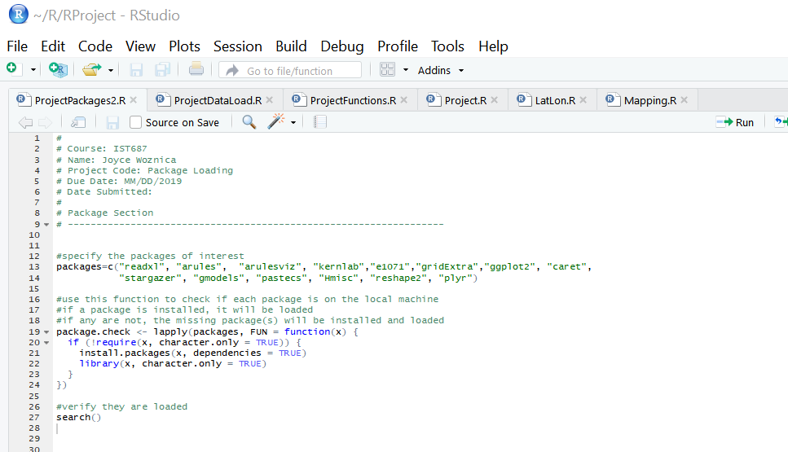
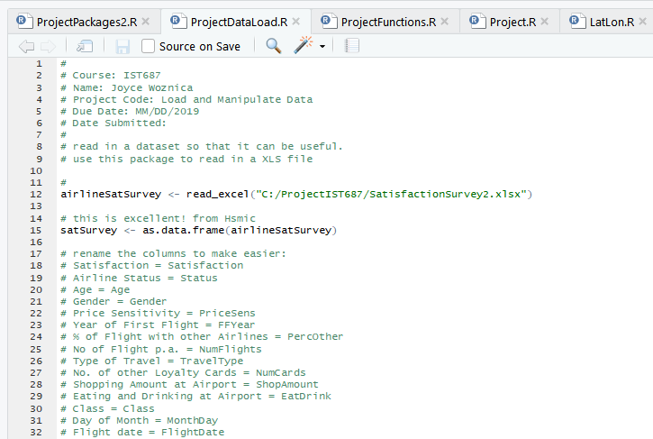
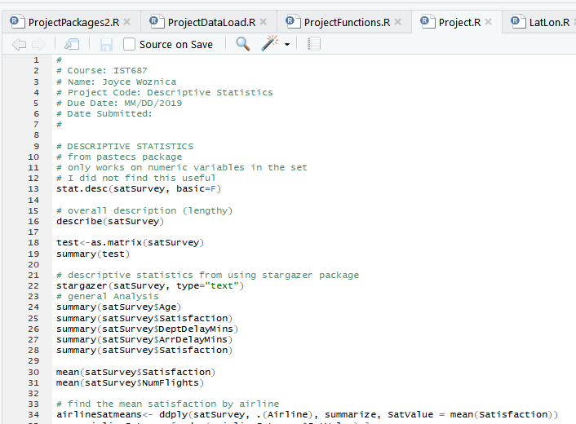
Cleaned Up Code for Inclusion

