Slide 1
HW10 Framework

Slide 2
2 data sets
MLK speech
Affinity Sentiment

Slide 3
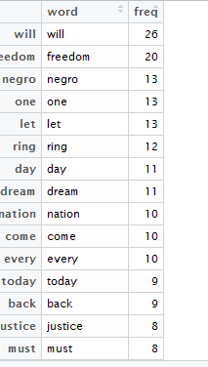
MLK Data set (MLK speech)
MLK.txt --→ TDM format -→ word frequency df

Slide 4
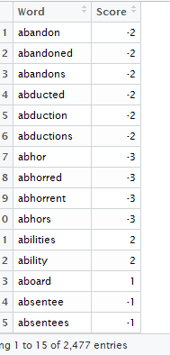
AFFINN (Sentiment) Data Set

Slide 5
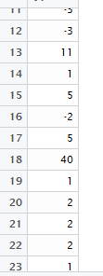
Word frequency * Affinity Sentiment Score = Extended score by word
*
=
Need to match on word to perform the multiplication
Sum extended score/total words

Slide 6
Word frequency * Affinity Sentiment Score = Extended score by word
# > overallScore
[1] 113
> overallScore/totalWords
[1] 0.1343639
Sum extended score/total words

Slide 7
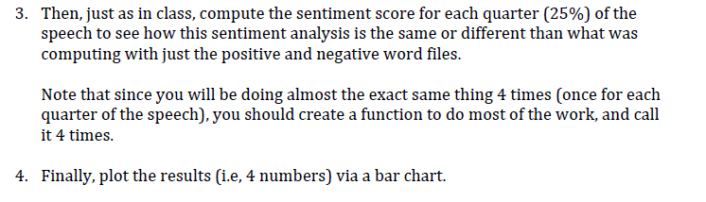
Posted to Files: TM Lab Positive Negative,, code example for quarter segmentation. Data sets to run this code have been posted to files area. I’m ok if you don’t use a function but at least get the bar chart

Slide 8
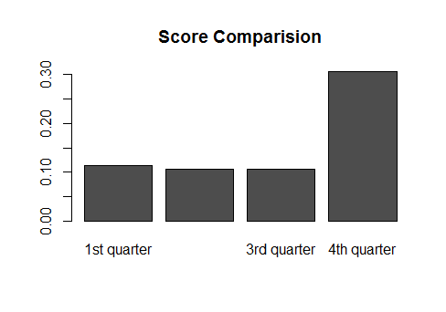
> Score1
[1] 0.1128527
> Score2
[1] 0.1061224
> Score3
[1] 0.1065089
> Score4
[1] 0.3055556

