Slide 1
HW7 Framework

Slide 2
Step 1
Packages: gdata, zipcode, ggplot2, openintro, ggmap
Read, cleanse, merge
MedianZip.xls
Zipcode
Merged Data Set Example – next slide

Slide 3
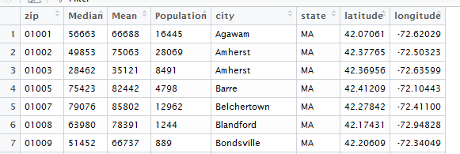

Slide 4
Step2
Create “simpler df”
Create map average median income by state w/legend
Create map: population by state with legend
“simpler df” – example next slide
Sample maps – subsequent slides

Slide 5
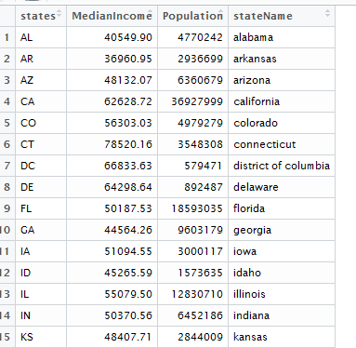

Slide 6
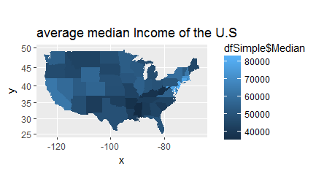

Slide 7
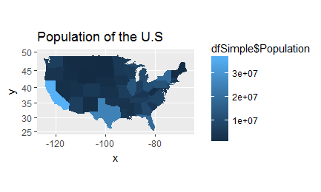

Slide 8
Step 3
Income by zipcode

Slide 9
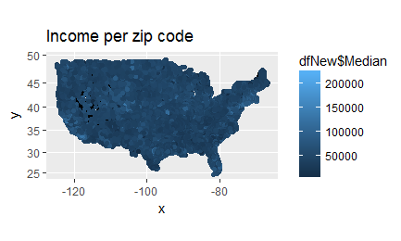

Slide 10
Step 4
Zip code density
mapD <- mapZip + geom_density_2d(data = dfNew, aes(x = dfNew$longitude, y = dfNew$latitude))

Slide 11
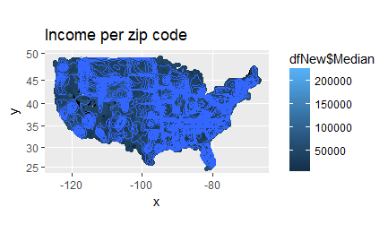

Slide 12
Step 5
Zoom In - NYC

Slide 13
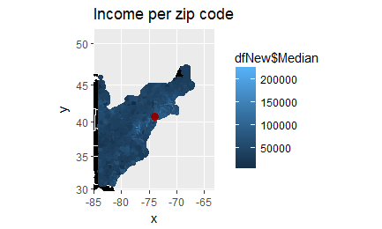
mapZipZoomed <- mapZip + geom_point(aes(x = latlon$lon, y = latlon$lat), color="darkred", size = 3)

Slide 14
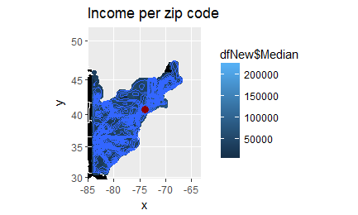
mapDZoomed <- mapD + geom_point(aes(x = latlon$lon, y = latlon$lat), color="darkred", size = 3)

