Slide 1
HW4 Support Material

Slide 2
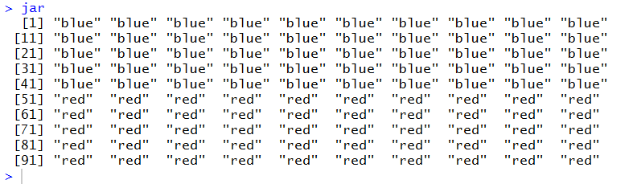
Create a variable ‘jar’ that has 50 red and 50 blue marbles

Slide 3
Take a sample of 10
60% Red

Slide 4
7.
Replicate 20
Sample 10
8.
Replicate 20
Sample 100
9.
Replicate 100
Sample 100
Note: 2 approaches in synchronous code to q 7, 8, 9 covered in synch session. I recommend 2nd approach
What do the histograms from 7, 8, 9 tell you about the Law of Large Numbers and the Central Limit Theorem

Slide 5
Data Science
Law of large numbers
If you run a statistical process a large number of times, it will converge on a stable result.
Central limit theorem
For sample means, and taking into account the “law of large numbers,” the distribution of sampling means resembles a bell-shaped or normal distribution
The center of that distribution, the mean of the sample means, gets close to the population mean.

Slide 6
Please note deliverables for Q 7,8, 9
Sampling code – replicate, sample
printVecinfo – uses output of sampling code
Histogram of samples generated from sampling code
Step 3
printVecinfo for each airquality variable
Histogram for each airquality variable
Your submission in a word doc
Unexecuted code
Console executed code
Histogram plots

Slide 7
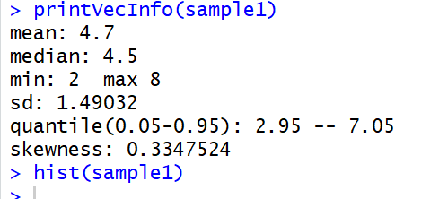
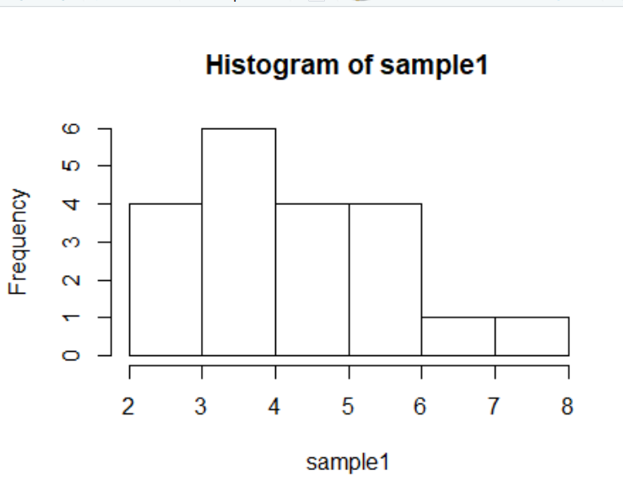
Q7 example output

Slide 8
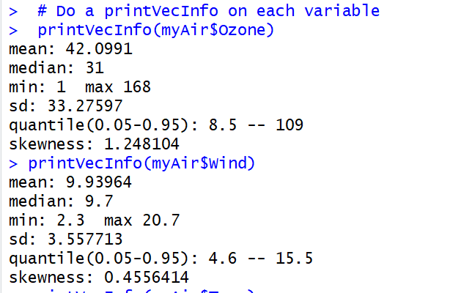
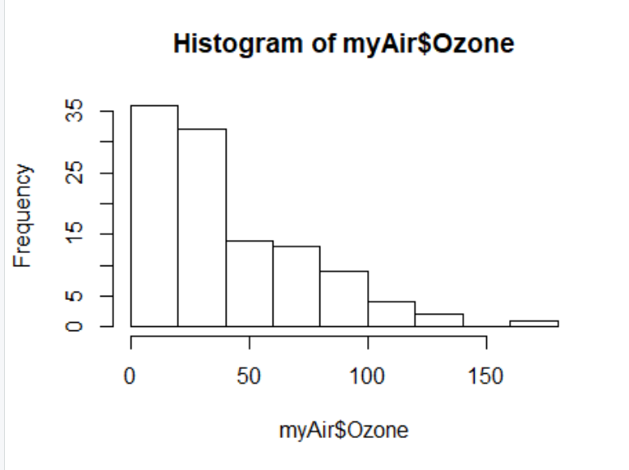
Q12 example output

