Slide 1
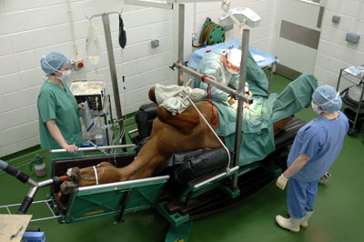
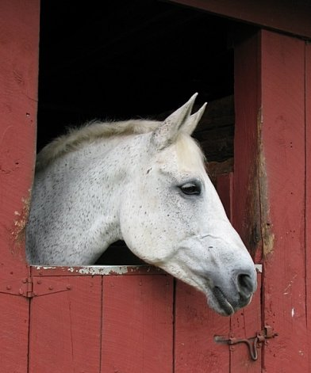
Horse Colic
Joyce Woznica jlwoznic@syr.edu

Slide 2
Agenda
Review
Brief Introduction
Restatement of Motivation and Problem Statement
Data – Additional Cleanup
Exploratory Data Analysis (EDA) and Visualization
Models
Decision Trees & Random Forest
Naïve Bayes
Association Rule Mining
Support Vector Machines
Regression
Neural Network
Results
Conclusions

Slide 3
Brief Introduction
2013:
Colic Surgical Cost $13,500 Estimated 2019 Cost: $17,500
Equine colic is relatively common
“Colic” simply means “abdominal pain”
In horses, it is a severe condition
Horses cannot regurgitate
The horse’s small and large intestine is approximately 84 feet long
There are a variety of different causes of colic, some of which can prove fatal without surgical intervention. Colic surgery is usually an expensive procedure as it is major abdominal surgery, often with intensive aftercare. Among domesticated horses, colic is the leading cause of premature death. The incidence of colic in the general horse population has been estimated between 4 and 10 percent over the course of their lifetime. Clinical signs of colic generally require treatment by a veterinarian.
Notes:
Equine colic is a relatively common disorder of the digestive system. Although the term colic, in the true definition of the word, simply means “abdominal pain,” the term in horses refers to a condition of severe abdominal discomfort characterized by pawing, rolling, and sometimes the inability to defecate.
There are a variety of different causes of colic, some of which can prove fatal without surgical intervention. Colic surgery is usually an expensive procedure as it is major abdominal surgery, often with intensive aftercare. Among domesticated horses, colic is the leading cause of premature death. The incidence of colic in the general horse population has been estimated between 4 and 10 percent over the course of their lifetime. Clinical signs of colic generally require treatment by a veterinarian.
Among the general equine population four to 10 out of every 100 horses experience a colic episode during their lifetime; of these, 1-2% require surgical treatment (2006AAEP Proceedings).
25-30% of horses admitted to the university clinic for colic require surgery while the rest are treated with medical therapy. "In 5-10% of cases a horse is humanely euthanized because of a poor prognosis or economical considerations,
Colic can be divided broadly into several categories [2]:
• excessive gas accumulation in the intestine (gas colic)
• simple obstruction
• strangulating obstruction
• non-strangulating infarction
• inflammation of the gastrointestinal tract (enteritis, colitis) or the peritoneum (peritonitis)
• ulceration of the gastrointestinal mucosa
Types of Colic in Horses
Gas Colic
Gas colic occurs when there is excessive build up of gas within the intestines of the horse. These horses can often have a lot of flatulence.
Spasmodic Colic
Spasmodic colic is the result of intestinal cramps or spasms. This type of colic can also have intestinal hyper motility.
Impaction Colic
Impaction colic accounts for 10% of all colics attended by veterinarians. These occur where partially digested feed, typically roughage, builds up in the large intestine of the horse and stops moving, resulting in a blockage or impaction. With impaction colic, the horse is not passing dung.
Sand Colic
Sand colic occurs in horses living in sandy areas, or horses fed from sandy ground. Fine particle sand builds up in the large intestines resulting in colic.
Twisted Gut
A twisted gut occurs where a portion of the intestine twists on itself (intestinal torsion) or where a portion of intestine inverts into itself (intussusception). This uncommon type of colic accounts for less than 4% of colics overall, but it is very serious and life threatening.
Displacement/Entrapment Colic
Displacements occur when an area of the intestine moves from its normal location in the abdominal cavity to somewhere else, naturally this is not a common type of colic. When the displacements cannot freely move back to its original location, it becomes an entrapment. Displacements and entrapments are very serious because this change in location stretches the blood supply to the area of intestine and can result it being compressed or squashed.
Strangulation Colic
Strangulation colic is very uncommon, but very serious. Strangulation colic occurs when the blood supply to an area of intestines is cut off (strangulated). Cutting off the blood supply, results in rapid death of the intestine wall, a serious life threatening situation.
It is important to realize however, that the vast majority of colics never have their exact causation determined. Happily, this “unidentified type” of colic, also has a recovery rate of over 95%. This can be interpreted as; most horses get a mild form of colic, which is successfully treated by their veterinarian, making further investigation unnecessary.

Slide 4
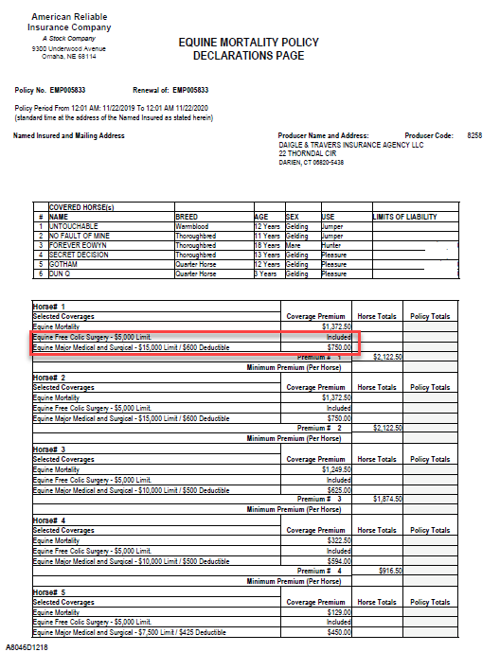

Motivation
I lost a horse to colic
Equine insurance is most often used for colic
Insurance saved my horse’s life the first time
If we could understand when it is going to happen, maybe we can intervene in time

Slide 5
Problem Statement
Given a set of symptoms and horse presentation – Can we predict the outcome of a specific colic case?
Death
Euthanize
Live
Ideally, if we have this information and understand what data is most important in determining the severity of the colic – can we proactively take measures to save the horse?
Notes:
Predict whether or not a horse can survive based upon past medical conditions

Slide 6
Data Table
Variable | Definition
Surgery | yes or no
Age | adult (≥6 months), young (<6 months)
Hospital Number | Case number for hospital (only unique if horse treated one time only)
Rectal Temperature | Rectal temperature in degrees Celsius (normal=37.8)
Pulse | Heartrate in beats per minute (normal 30-40)
Respiratory Rate | Respiration rate (normal 8-10)
Extremities Temperature | Normal, warm, cool, cold
Peripheral pulse | Normal, increased, reduced, absent
Mucous membranes | Normal pink, bright pink, pale pink, pale cyanotic, bright red/injected, dark cyanotic (normal pink to bright pink is normal)
Capillary Refill Time | ≥ 3 seconds, < 3 seconds (< 3 seconds normal)
Pain | Alert (no pain), depressed, intermittent mild pain, intermittent severe pain, continuous severe pain
Peristalsis | Gut Activity. Hypermotile, normal, hypomotile, absent
Abdominal Distension | None, slight, moderate, severe
Nasogastric Tube | Gas coming from tube. None, slight, significant
Nasogastric reflux | None, ≥ 1 liter, < 1 liter
Nasogastric Reflux PH | Scale from 0 to 14 (normal = 7)
Rectal Examination (feces) | Normal, increased, decreased, absent
Abdomen | Normal, other, firm in large intestine, distended small intestine, distended large intestine
Packed Cell Volume | Number of red blood cells by volume (normal is 30-50)
Total Protein | Numeric. (normal is 6-7.5 (gms/dL)
Abdomen Fluid | Clear, cloudy, serosanguinous
Abdomen Fluid PH | Numeric
Outcome | Lived, died, euthanized
Surgical Lesion | Yes, no
Type of Lesion * this is repeated 3 times Lesion1 Lesion2 Lesion3 | 1st Number (site): 1-gastric, 2-small intestine, 3-large colon, 4-large colon and cecum, 5-cecum, 6-traverse colon, 7-retum/descending colon, 8-uterus, 9-bladder, 11-all intestinal sites, 00-none 2nd Number (type): 1-simple, 2-strangulation, 3-inflammation, 4-other 3rd Number (subtype): 1-mechanical, 2-paralytic, 0-N/A 4th Number (code): 1- obturation, 2-intrinsic, 3-extrinsic, 4-adynamic, 5-volvulus/torsion, 6-intussuption, 7-thromboembolic, 8-hernia, 9-lipoma/slenic incarceration, 10-displacement, 0-N/A
Cp_data | Pathology data present? Yes or no

Slide 7
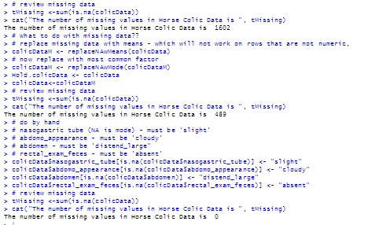
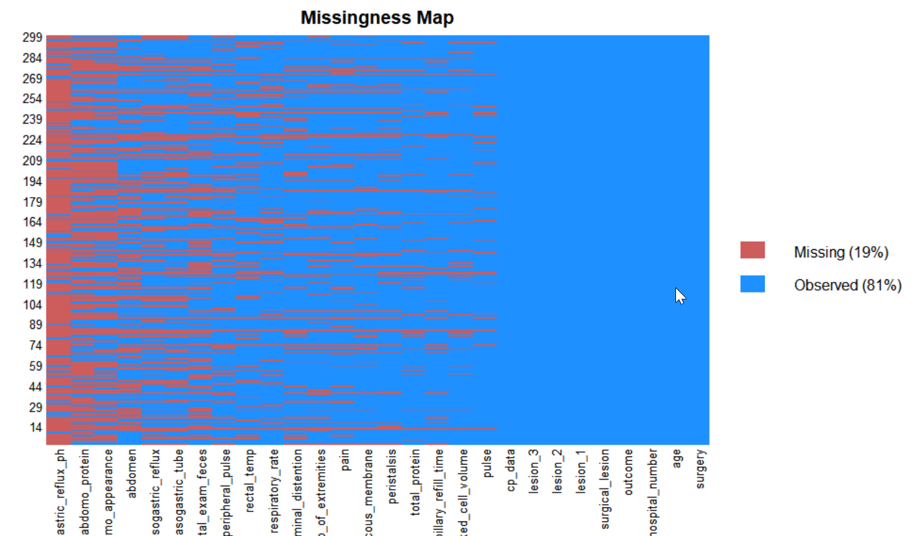
The Data
The data consists of 299 horses with 28 observations per horse.
However, one column has 3 or 4 data items grouped together
There is significant missing data (30%)
However, most of the relevant data is there for each horse
Total N/As in data was 1602
Reduced to 0 with mean and mode replacement
Some data is just blank
Lesion2 and lesion3

Slide 8
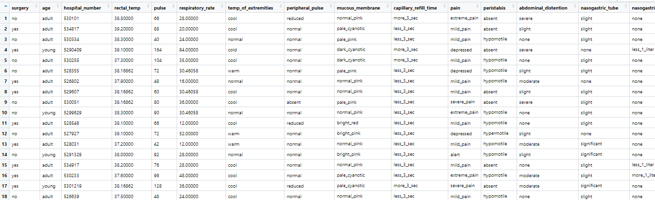
Snipet of Data

Slide 9
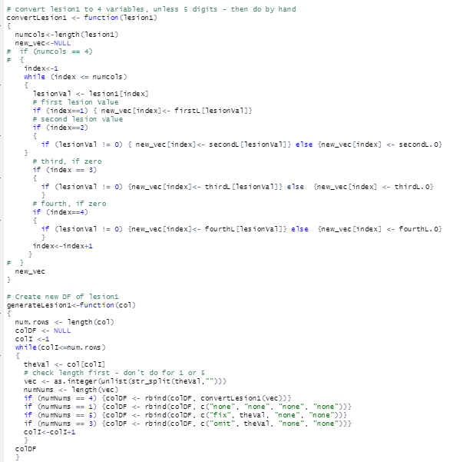
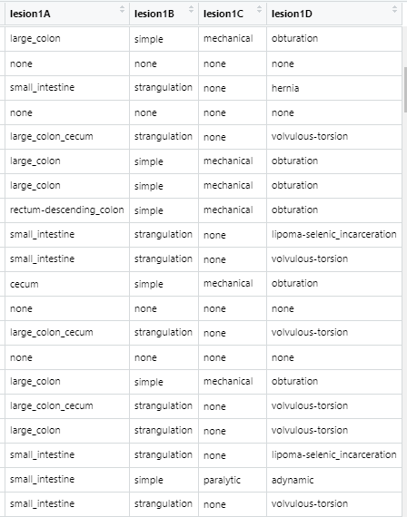
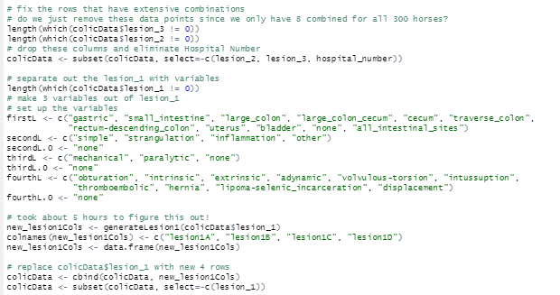
Lesion
The lesion column (lesion 1) was expanded to provide more detail
Convert Numbers to actual values

Slide 10
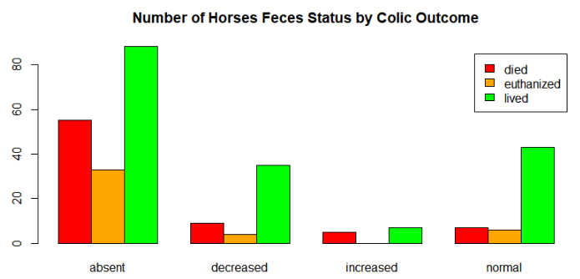
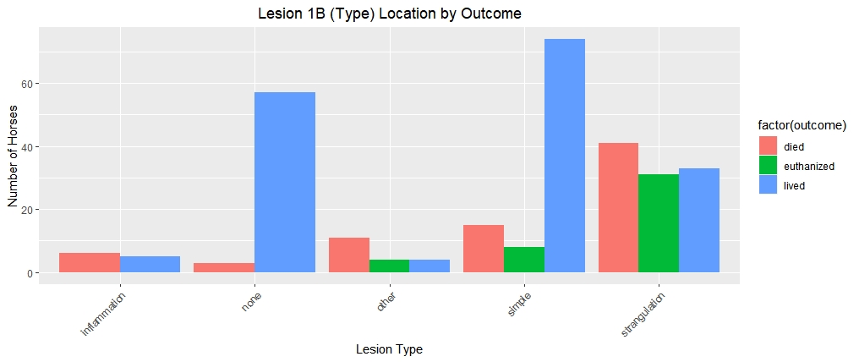
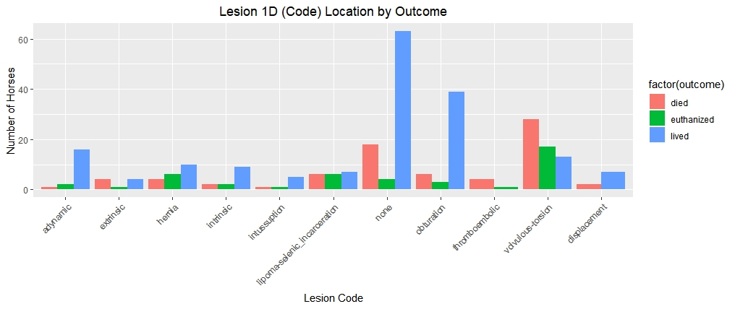
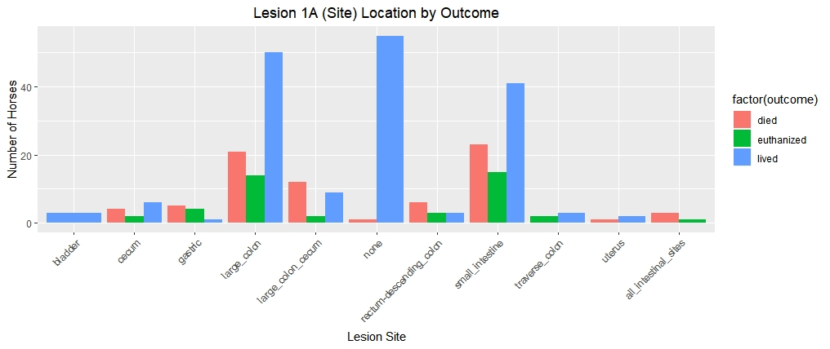
Visualizations

Slide 11
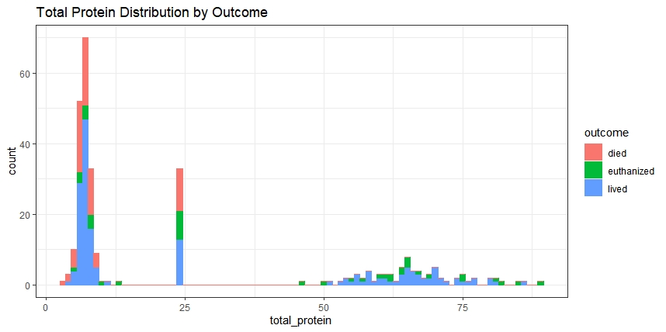
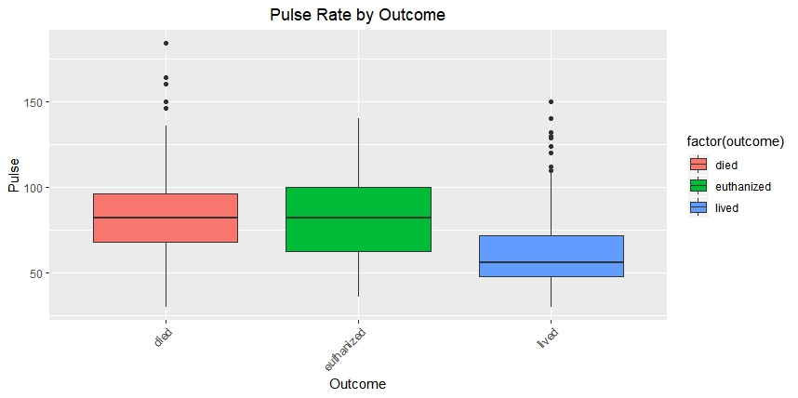
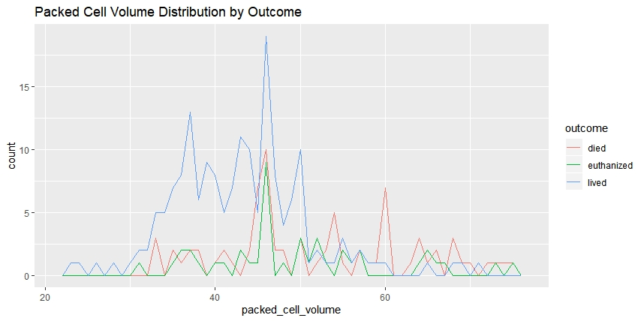
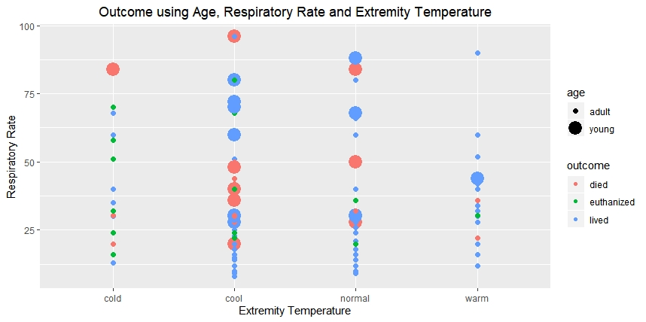
Additional Visualizations

Slide 12

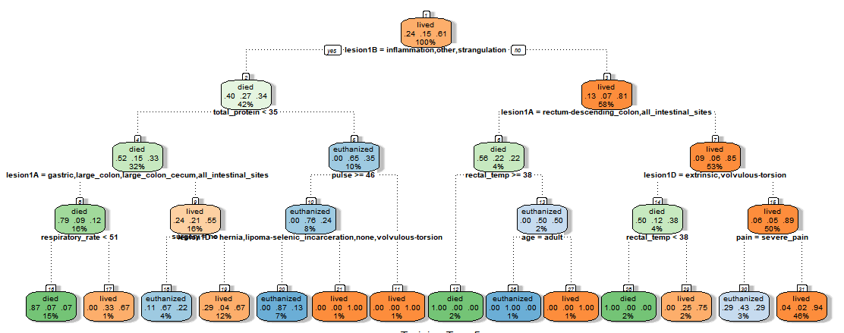
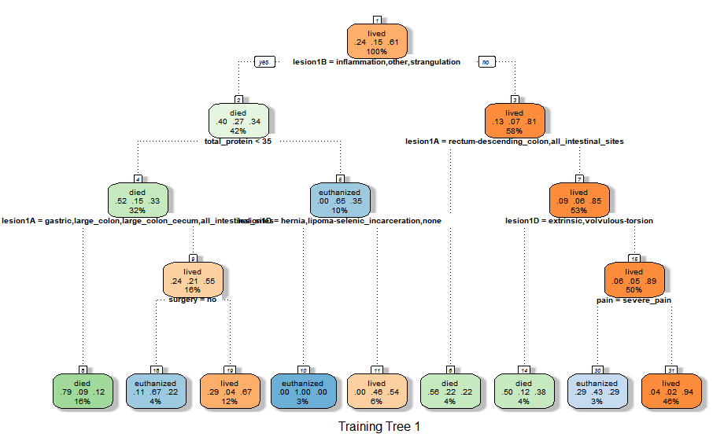
Modeling Decision Tree

Slide 13
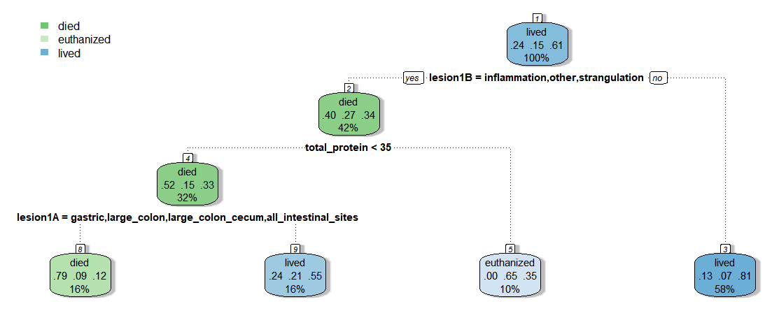
Modeling Decision Tree Pruned
Accuracy 65%

Slide 14
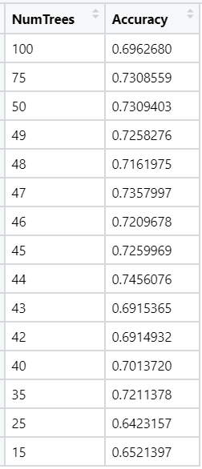
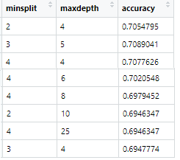
Modeling Decision Tree and Random Forest
K-Fold Cross Validation, K = 4
Notes:
Cross Validation with Decision tree (4-fold)

Slide 15
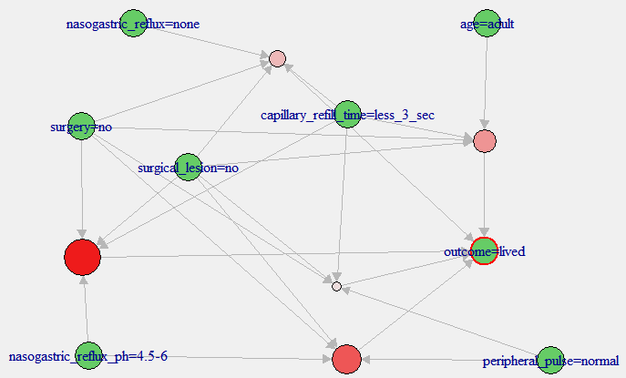
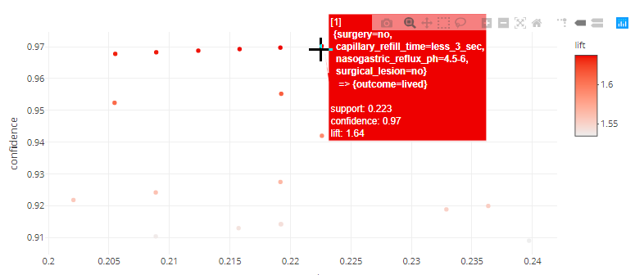
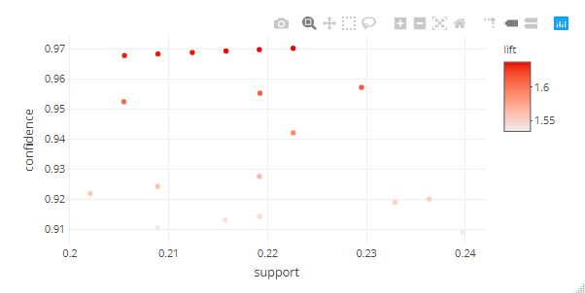
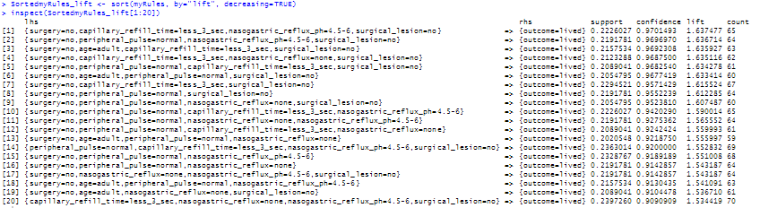
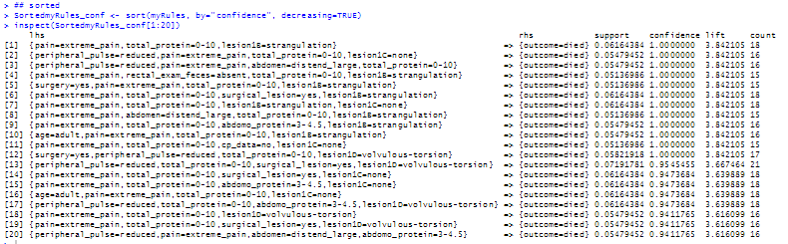
Modeling Association Rule Mining
Confidence minimum of 0.9
Support minimum of 0.20
Minimum ‘left hand side’ = 2
Maximum ‘left hand side’ = 5
Notes:
Decreasing Confidence

Slide 16
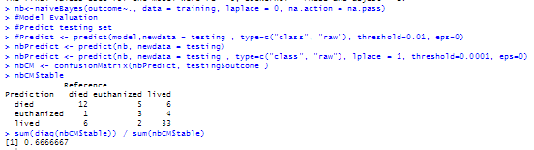

Modeling Naïve Bayes
Notes:
Both the train using the “nb” classifier and the naivebayes function were both executed. The first providing an accuracy of 70% for both true and false classifications. Using the naivebayes function, this accuracy decreased to 66.67%. Both similar to that found using decision trees.
Then a similar approach was taken to run the Naïve Bayes method for k-fold validation by splitting the training data into 4 sets of random samples. Then the accuracy was determined from the final confusion matrix for this model.

Slide 17
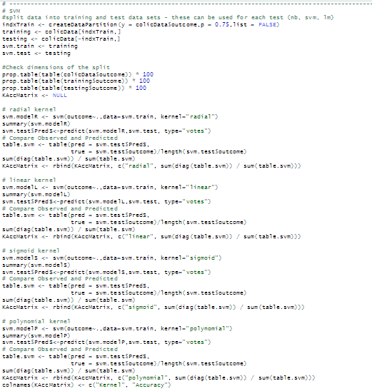
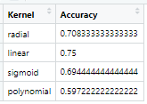
Modeling Support Vector Machines

Slide 18
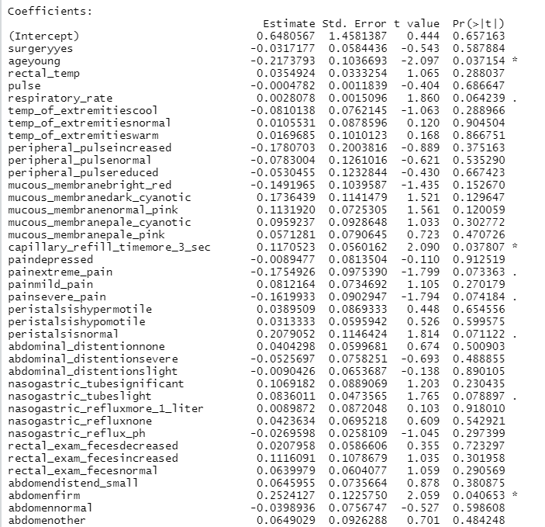
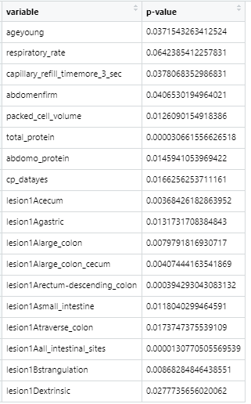
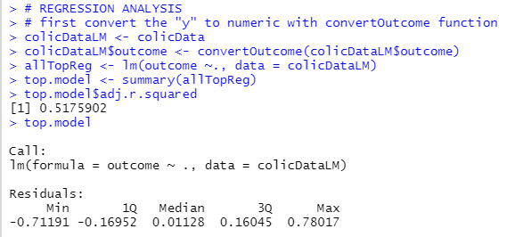
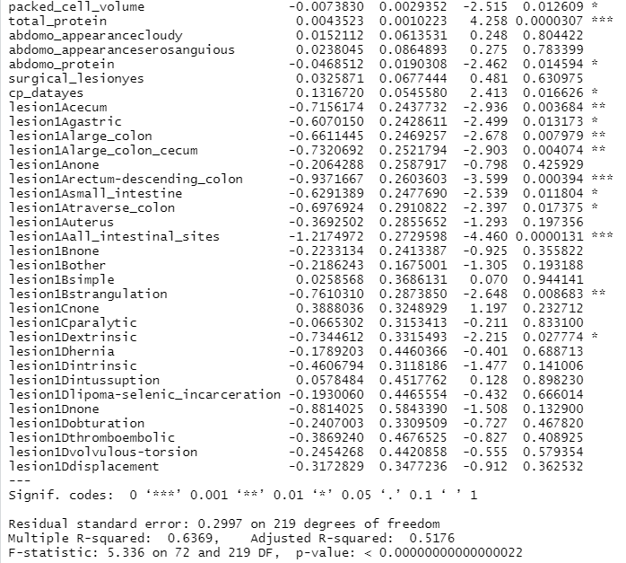
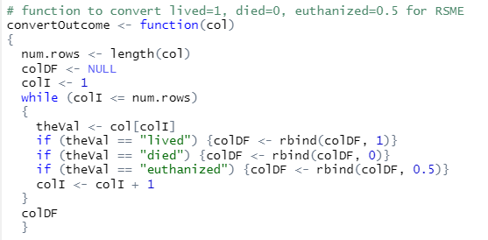
Modeling Regression
Lived =1
Died = 0
Euthanized = 0.5
Adjusted R-squared .5176

Slide 19
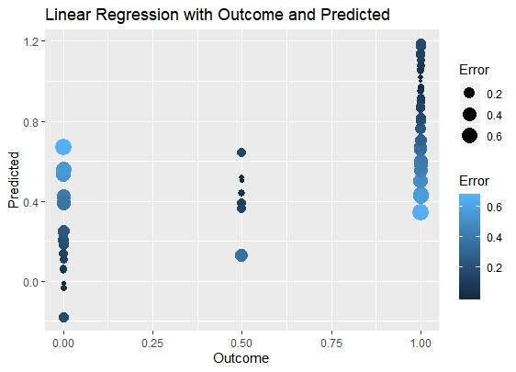
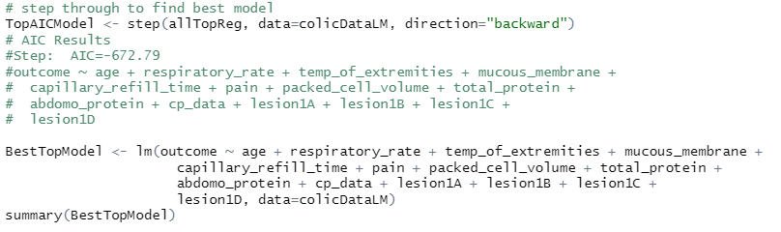
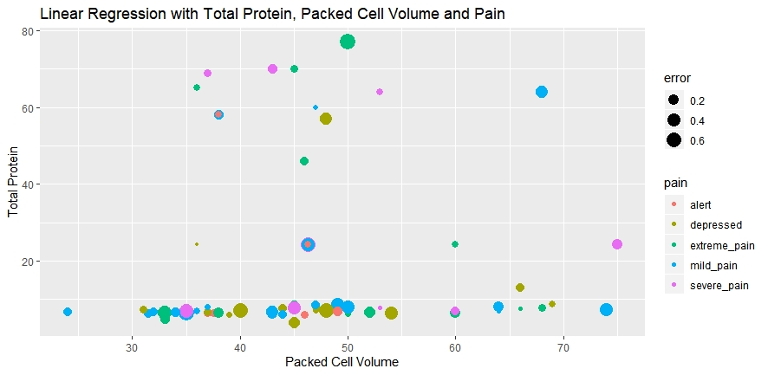

Modeling Regression
Adjusted R-squared .5356
Notes:
In this case, certain prediction errors were large depending on the packed cell volume and the pain level. It was interesting to see that when the total protein was low, the errors were much smaller regardless of the pain level.

Slide 20
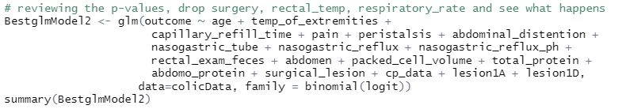
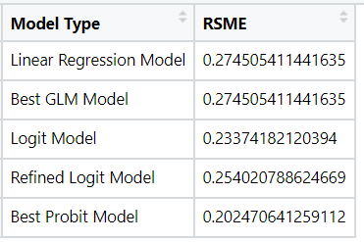
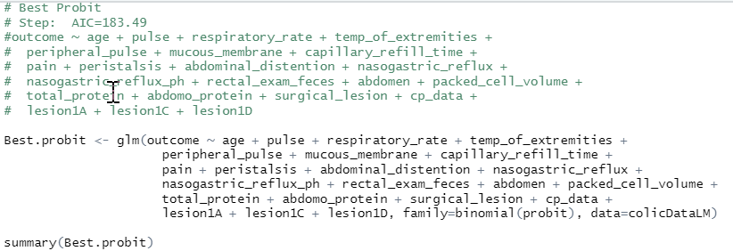
Modeling Logit and Probit
Notes:
Root Mean Square Error (RSME) which is the standard deviation of the residuals or how far the residuals are spread out. This shows how concentrated the data is around what is the line of best fit

Slide 21
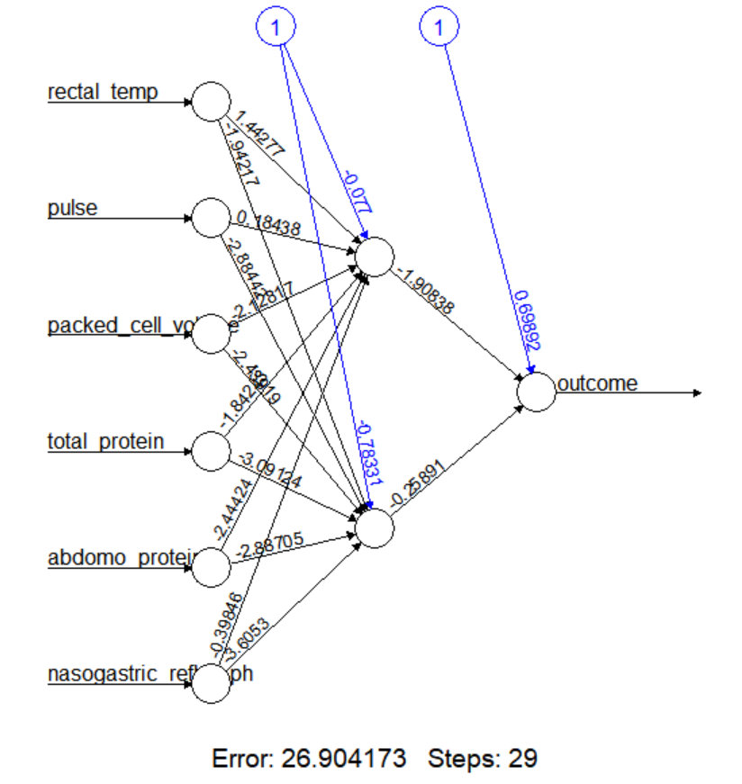
Modeling Neural Network
Used only continuous variables

Slide 22
Summary of Results
Overall - difficult to predict with data set provided
Almost all models were between 60% and 75% accuracy
Certain variables were of significance:
Lesion location
Total Protein
Respiratory Rate
Capillary Refill Time
Packed Cell Volume
Abdomen Protein
Lesion Type
Linear Kernel with Support Vector Machines proved to be the best with 75% accuracy of predictions
RSME were generally good despite low adjusted R-squared for linear regressions, probit and logit

Slide 23
Conclusions
Missing Data could have been an issue
Data is very old (1989), so much has changed and been improved
Things not captured that would have helped
Studies have shown lactate levels are important
Monitoring lactate levels in samples of peritoneal fluid can help a vet predict which colicky horses require surgery.
Horse age should be in finer groupings
Young (under 6 months) and Adult (6 months or older). Needs to be finer granularity
Sex may prove important: Mare/Gelding/Stallion
Previous Colic and/or colic surgery
Travel/Stressful Conditions
On any medications (Doxycycline, Tetracycline, dexamethasone)?
Linear Regression needed further in depth analysis to prove valuable
Difficult comparing models with no common comparison algorithm
Converting all factors to numeric data could have possibly helped
Notes:
Peritoneal D-lactate concentration was strongly correlated with plasma D-lactate concentration (r=0.71; P<.001). Peritoneal and plasma D-lactate concentrations were positively correlated with peritoneal (r=0.8; P<.001) and plasma L-lactate (r=0.33; P=.001) concentrations, respectively. Peritoneal D-lactate concentration was negatively correlated with survival to discharge (U=430.5; P<.001). Median peritoneal D-lactate concentration of horses with septic peritonitis (455.2 μmol/L) and horses with gastrointestinal rupture (599.5 μmol/L) were higher compared with horses with nonstrangulating obstructions (77.7 μmol/L). A cut-off concentration of peritoneal D-lactate of 116.6 μmol/L had a sensitivity of 0.813 and a specificity of 0.651 to differentiate between nonstrangulating and strangulating obstructions.

Slide 24
References
This dataset was originally published by the UCI Machine Learning Database: http://archive.ics.uci.edu/ml/datasets/Horse+Colic
Title: Horse Colic database
Source Information:
Creators: Mary McLeish & Matt Cecile Department of Computer Science University of Guelph Guelph, Ontario Canada N1G 2W1
Donor: Will Taylor (taylor@pluto.arc.nasa.gov) Date: 8/6/1989
Additional Source
Pricard, William R. of Veterinary Medical Teaching Hospital at University of California-Davis
https://www.ncbi.nlm.nih.gov/pubmed/21815898
Referenced information for developing this project
Notes:
TItle: Horse Colic database 2. Source Information -- Creators: Mary McLeish & Matt Cecile Department of Computer Science University of Guelph Guelph, Ontario, Canada N1G 2W1 mdmcleish@water.waterloo.edu -- Donor: Will Taylor (taylor@pluto.arc.nasa.gov) -- Date: 8/6/89
Peritoneal and plasma D-lactate concentrations in horses with colic.
Yamout SZ¹, Nieto JE, Beldomenico PM, Dechant JE, leJeune S, Snyder JR.
Author information
1William R. Pritchard Veterinary Medical Teaching Hospital, University of California-Davis, Davis, CA 95616, USA.

