Slide 1
Microsoft Power BI
Joyce Woznica

Slide 2
Agenda
What is Power BI?
Features
What can Power BI do?
How does it work?
Demonstration
How to use it
Benefits
Learning Curve

Slide 3
What is Power BI?
Business Intelligence (BI)
Technology-driven process for analyzing data and presenting information
Power BI
Cloud-based business analytics service from Microsoft
Fast and easy to use
Data discovery and exploration
Works on multiple devices
Connects to all types of data sources
Notes:
Power BI has three pricing plans:
Power BI Desktop: This offering is free to any single user and includes data cleaning and preparation, custom visualizations and the ability to publish to the Power BI service.
Power BI Pro: The Pro plan costs $9.99/user/month. It includes data collaboration, data governance, building dashboards with a 360-degree real-time view and the ability to publish reports anywhere. Users can try it a free trial for 60 days before purchasing the subscription.
Power BI Premium: The Premium plan starts at $4,995 a month per dedicated cloud compute and storage resource.

Slide 4
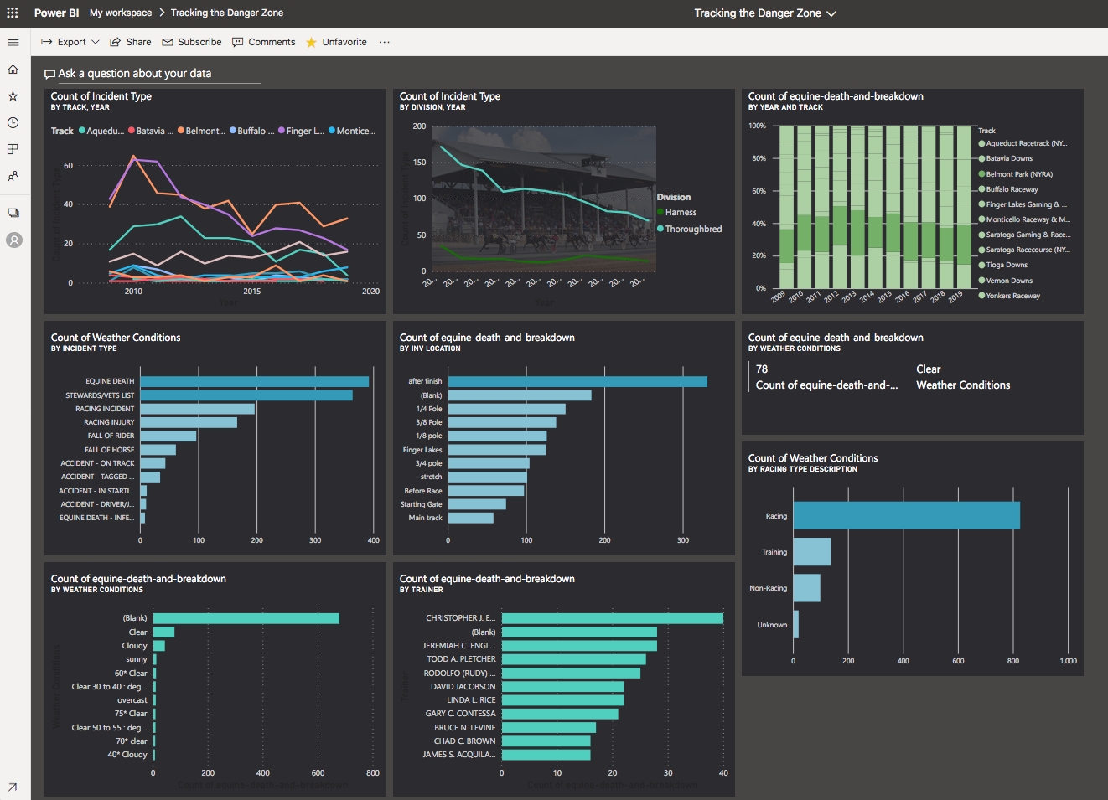
What can Power BI Do?
Natural language querying
Live dashboards
Visualizations
Reporting

Slide 5
How does it work
Connect to data source(s)
Provide initial insights
Ask questions of your data
What is the average sales by region?
What is our best-selling product by sales representative?
Can create live dashboard views with a scheduled data refresh
Pin report graphs and insight graphs to dashboards
Share dashboards

Slide 6
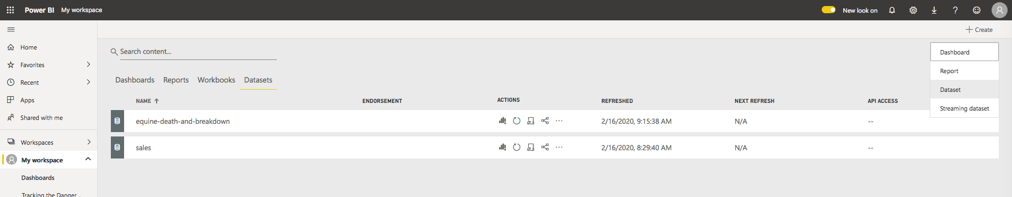
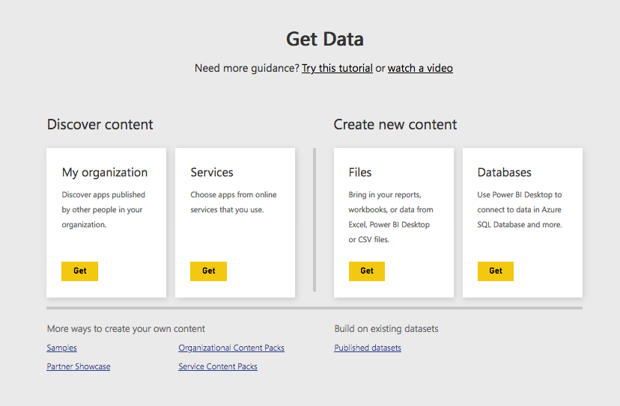
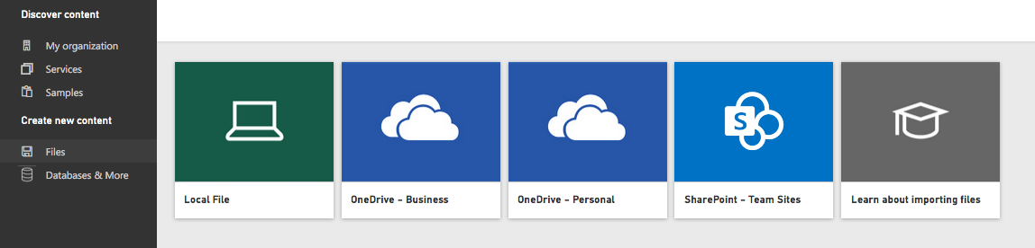
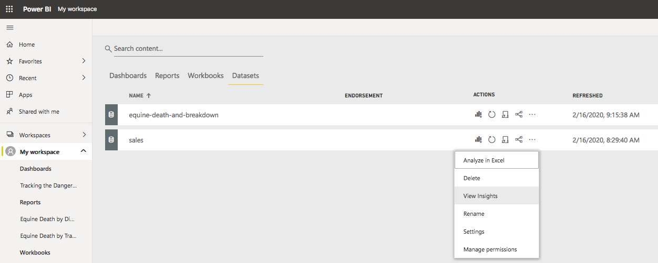
Data Source Connection

Slide 7
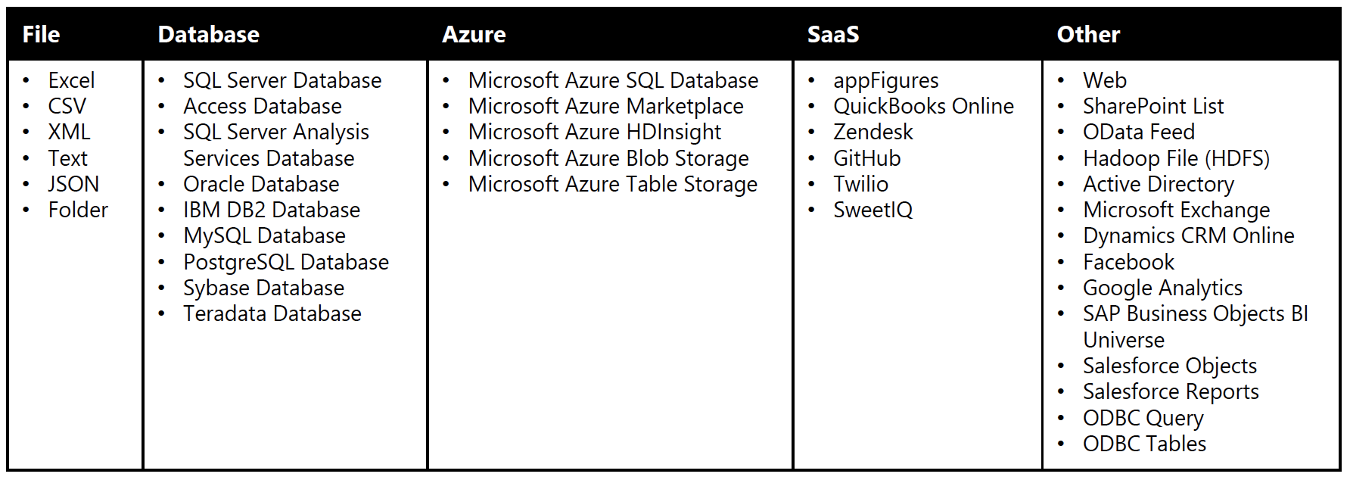
Data Sources

Slide 8
Data Preparation
Data transformation
Cleanse data removing errors
Pivot columns/rows
Modify table/row/column names
Remove data
Build data relationships and adjust relationship types
Uncover correlations, relationships within the data

Slide 9
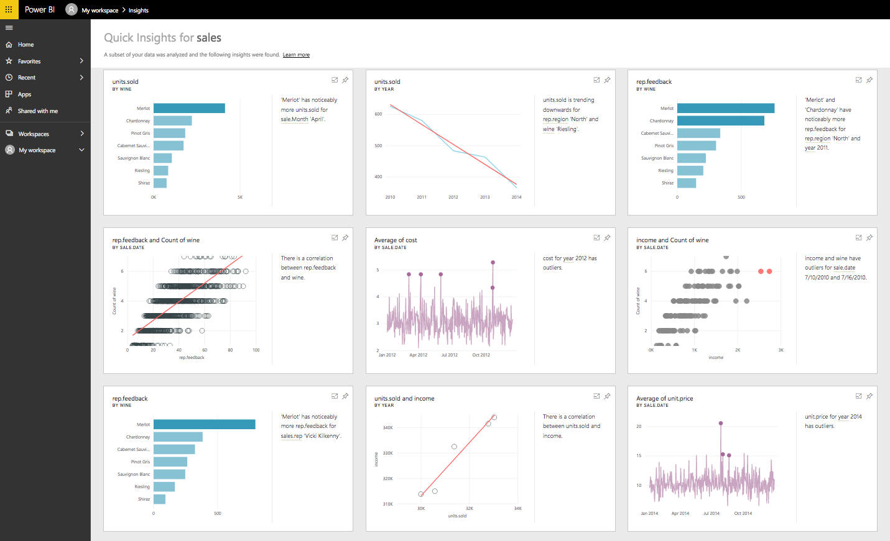
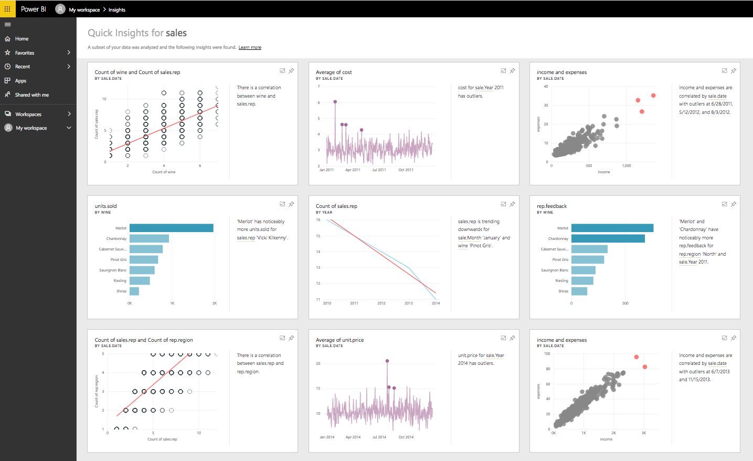
Data Exploration and Visualization

Slide 10
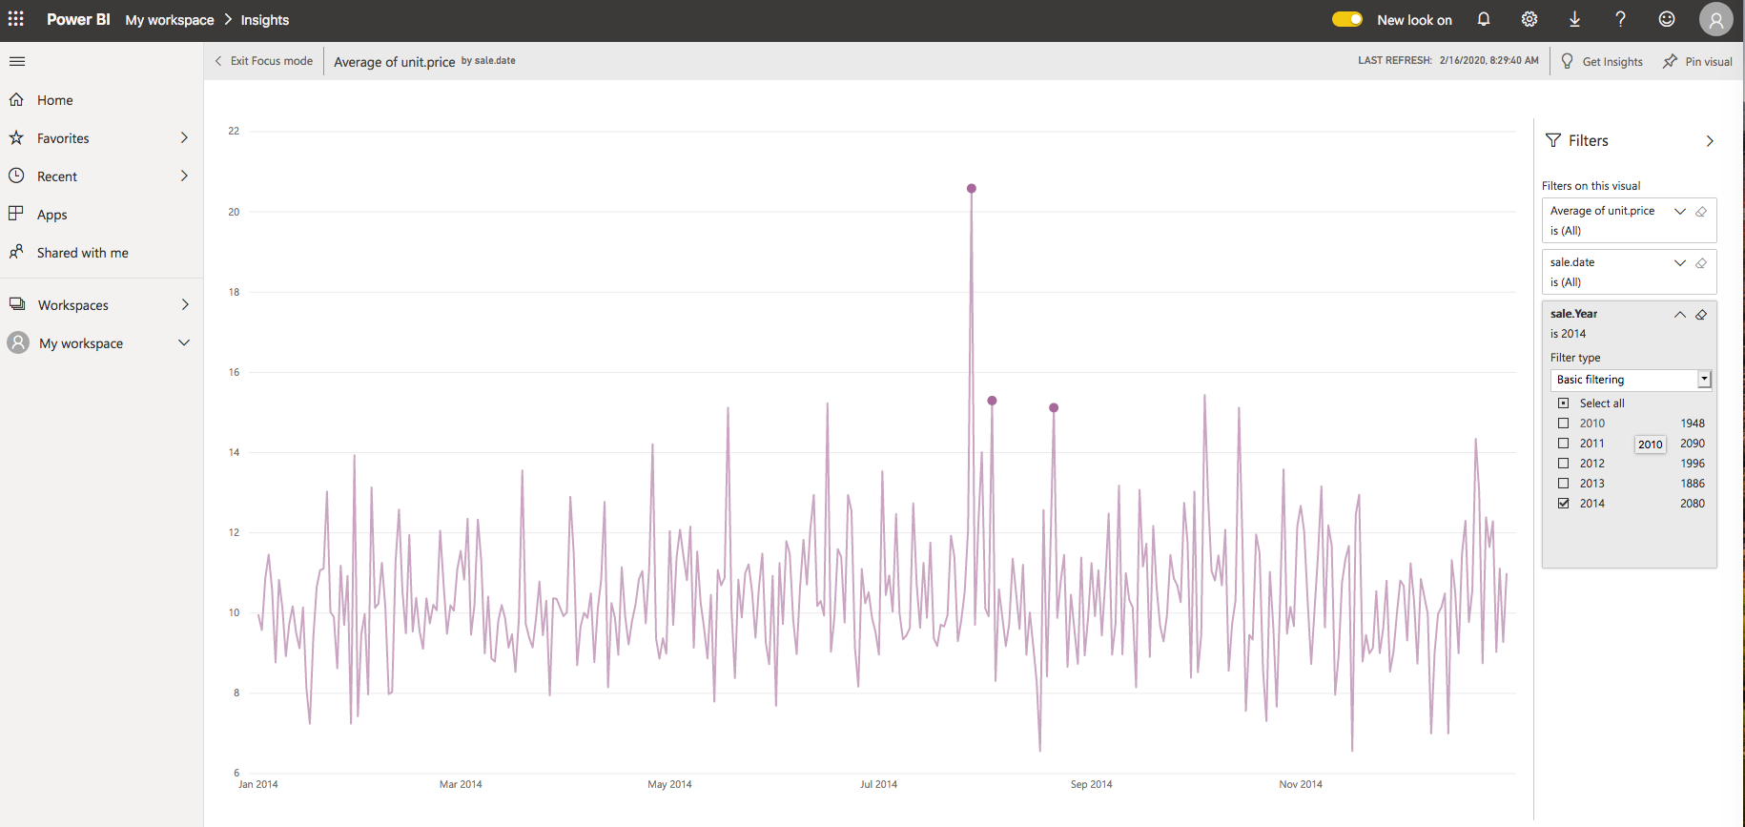
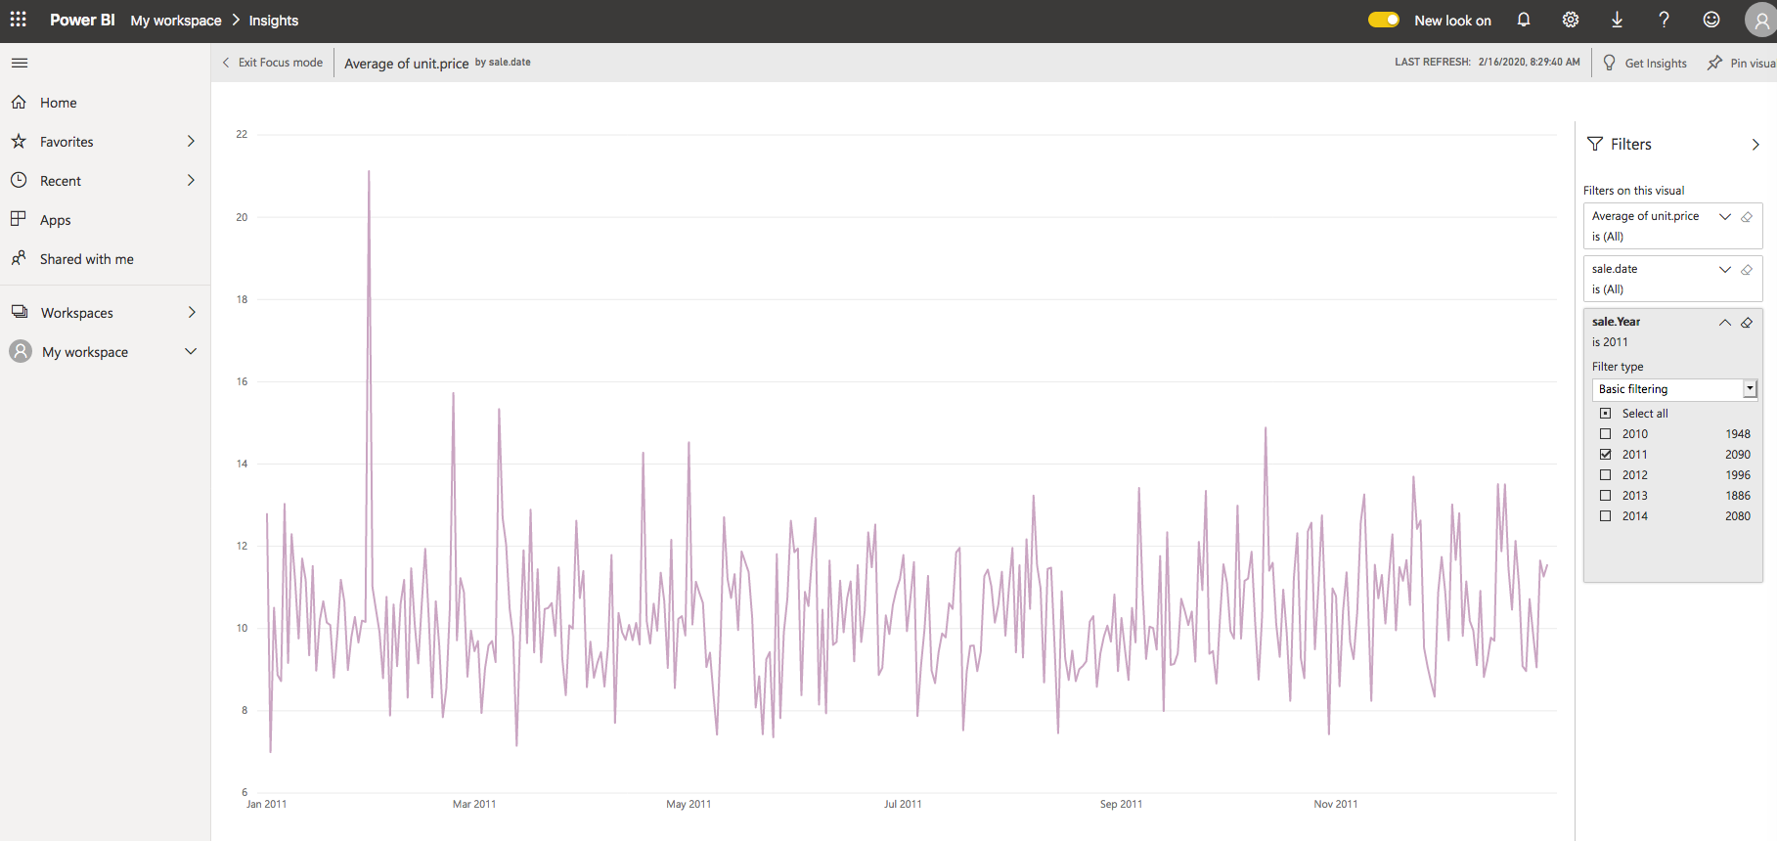
Focus View

Slide 11
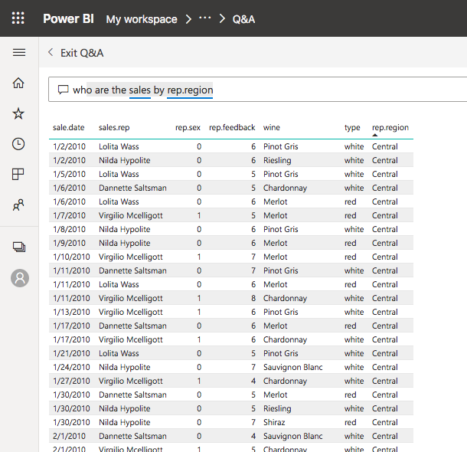
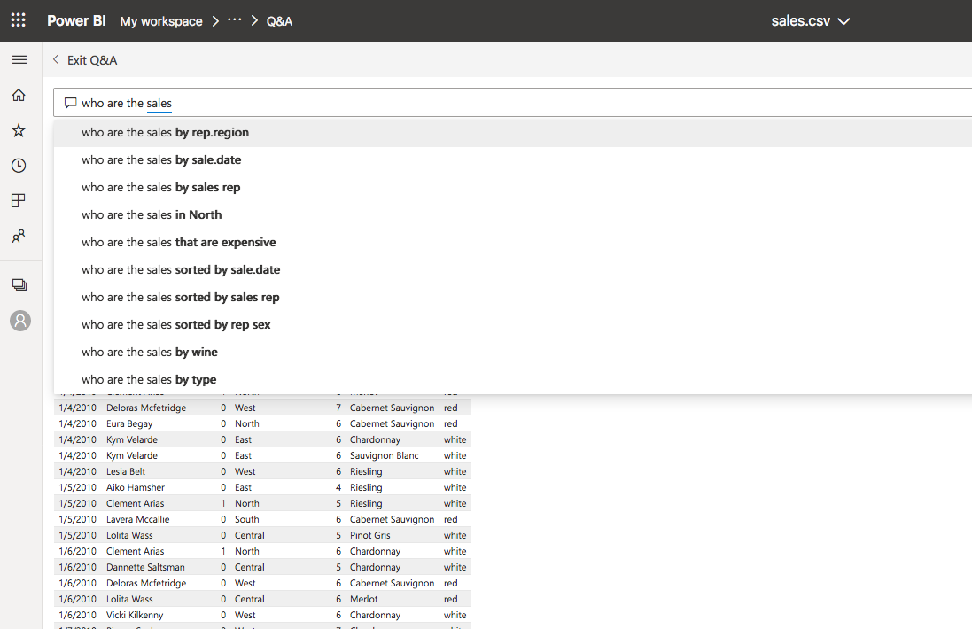
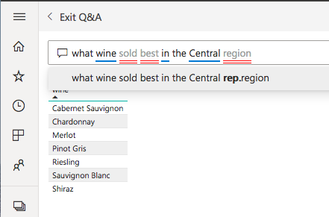
Asking Questions of Data

Slide 12
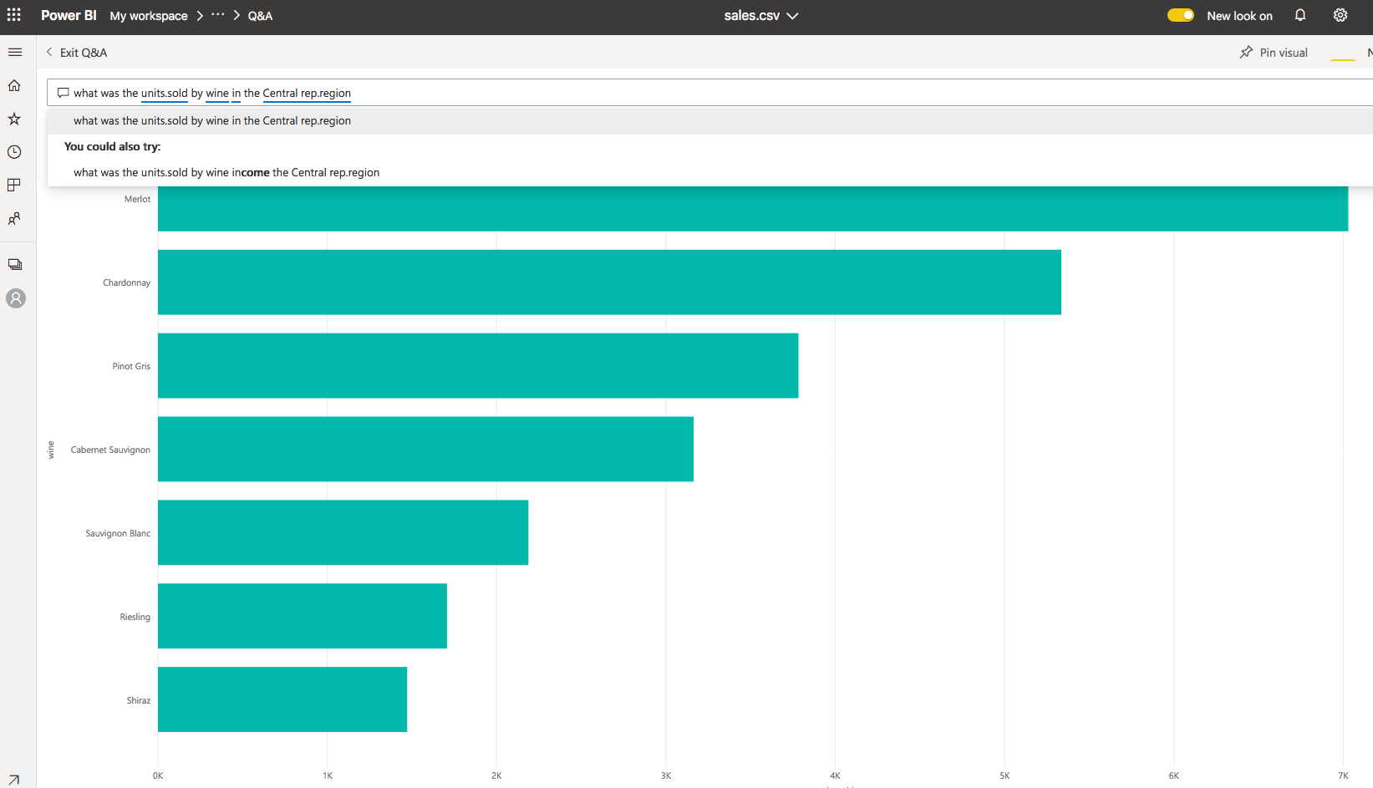
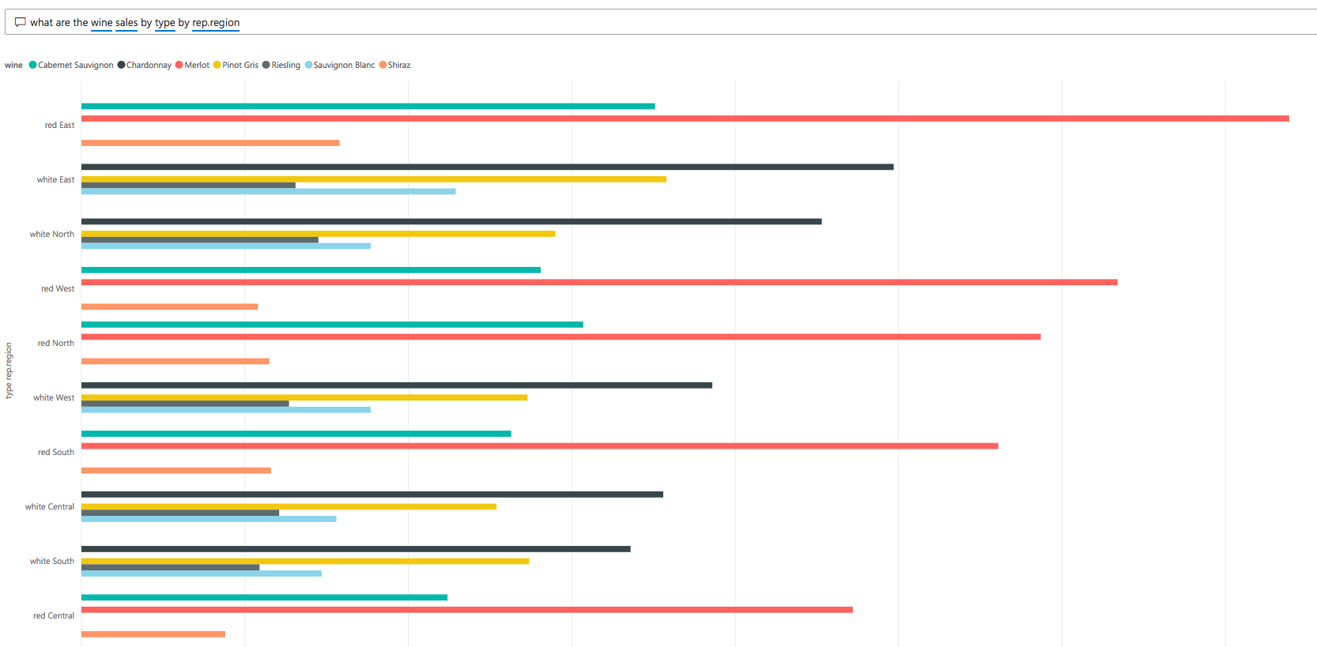
Questions with Graphed Answers

Slide 13
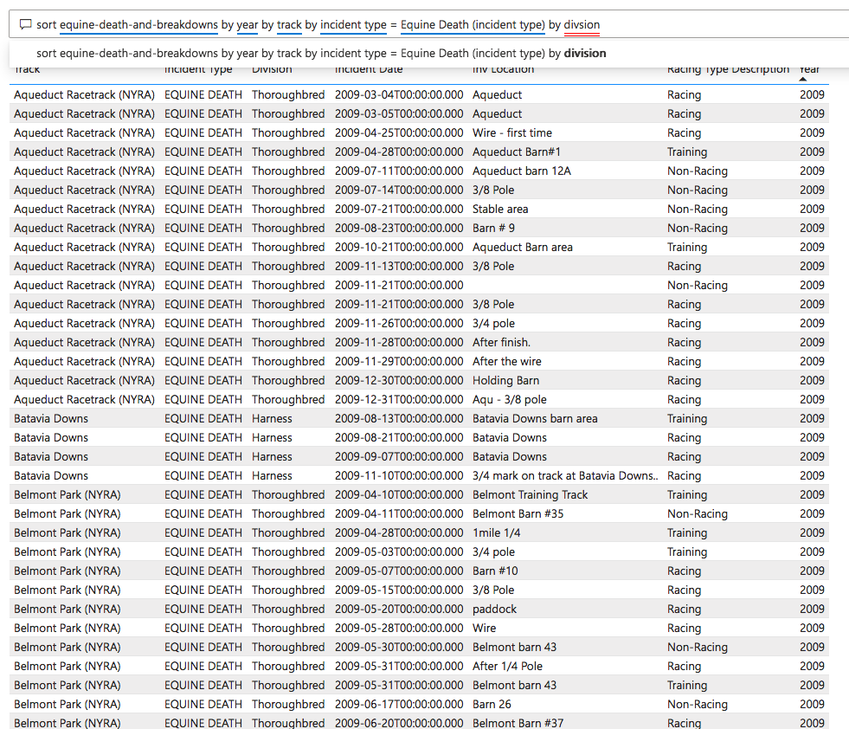
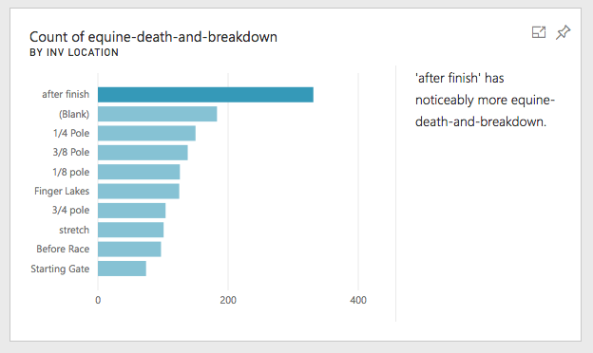
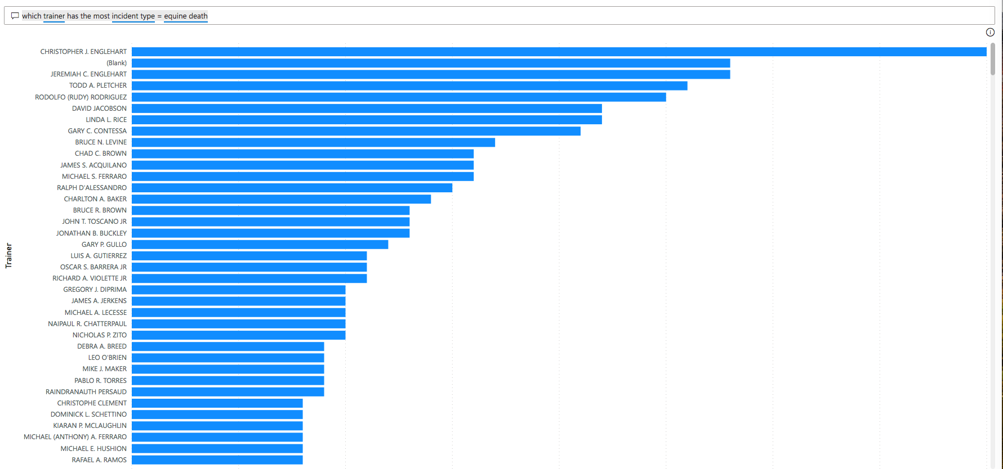
Building my Own Taking Advantage of the features

Slide 14
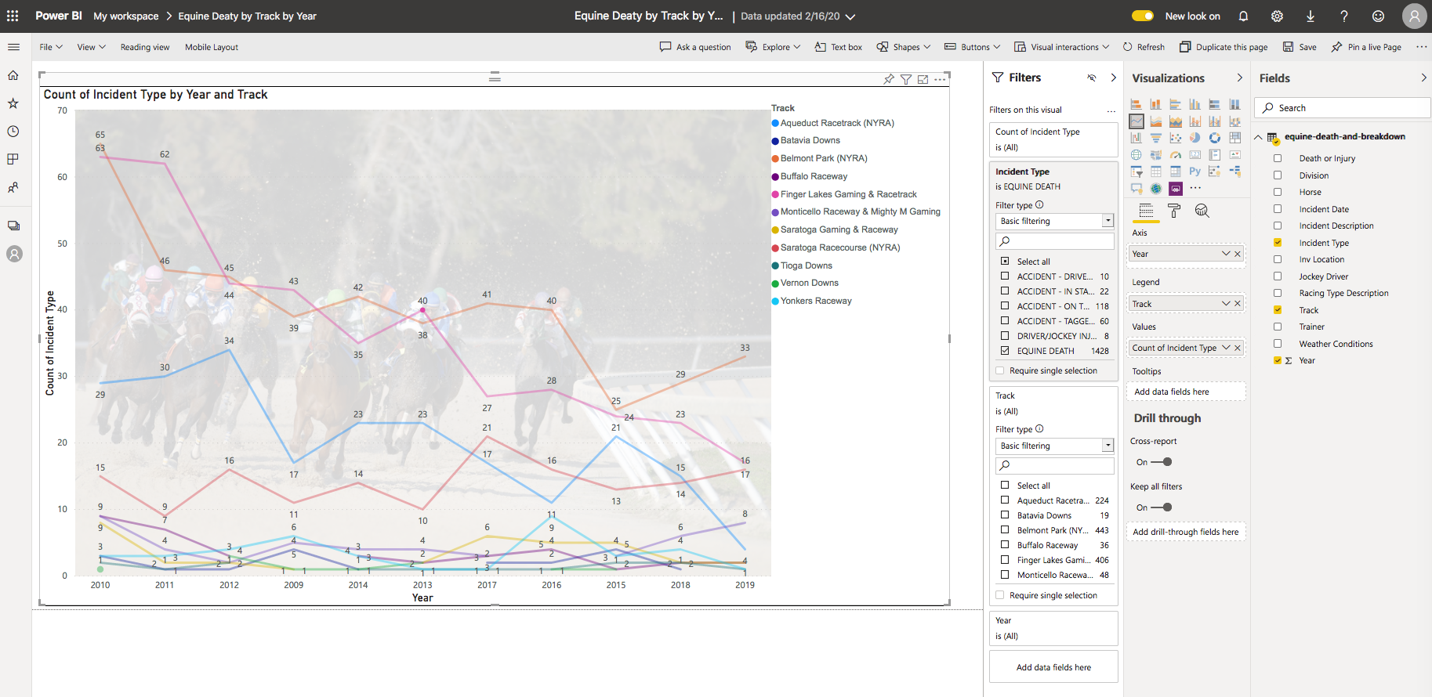
Building my Own Taking Advantage of the features

Slide 16
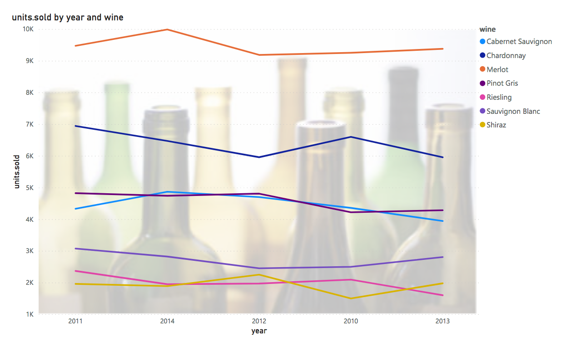
Demonstration
Yep, LIVE DEMONSTRATION

Slide 17
Benefits of Power BI
Pre-built dashboards
Real-time dashboard updates
Secure data source connections
Natural language query for intuitive data exploration
Integrated with other Microsoft products

Slide 18
Learning Curve
Quite simple to use
I learned Power BI in less than 2 hours
I found it easier and more intuitive than Tableau
The ability to ask questions aided in speeding up the learning curve
I was impressed

Slide 19
Thank you
Joyce Woznica

