Slide 1
FanDuel Fantasy Football Lineup assistant
Thinkful Final Capstone
By: James Chase

Slide 2
Agenda
Introduction
Techniques Used

Slide 3
Introduction
FanDuel is a daily fantasy sports provider which hosts various competitions for it's members to compete in to win cash prizes. The premise goes something like this: Some sport (football in our case) will have a weekly slate of games, and FanDuel will offer a competition to assemble the best players for the week into a roster. The roster will have two constraints - a salary cap, and positional constraints. Based off of the players real-world performance, you team will earn point
Objective:
The goal is to score as many points with your roster as possible to win cash prizes.

Slide 4
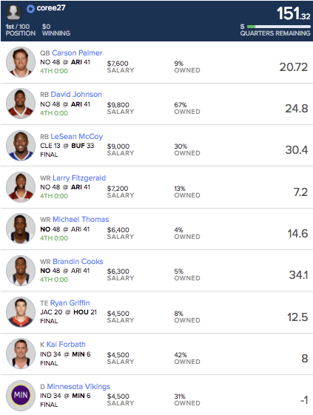
Constraints:
Positional constraints
(1 QB, 2RB, 3WR, 1TE, 1 FLEX(RB/WR/TE), 1 Def
Salary Cap
FanDuels salary cap is $60,000
Competitions:
Double Up
Place in top 43.5% of the pool and double your money
GPP
Best lineup wins thousands, with subsequent places earning less on sliding scale i.e(1st - 1,000, 2nd 500, 3rd 250, etc)
Some competitions can have up to 150 entries
Basic Strategy:
Balance (For Double Up)
You only need to beat 55.5% of the field
Hit Home Run (For GPP)
Hit on High Risk/Reward players could pay off big
Find value
Cheaper players who outperform their price tag
The goal is to spread out optimized entries over a competition that can, on average, win more than lose to turn a profit
FLEX (RB/WR/TE)

Slide 5
Product
Daily Fantasy Sports is incredibly competitive with point totals needed to hit to win money increasing every year. I want this to be a tool to help choose optimal lineup combinations to win real money.
Due to the huge variability in sports, the idea is to enter a large number of lineups, that if win a weekly double more than 50% of the time, will result in a positive return.
This tool acts as a guideline to provide weekly lineup combinations, that when entered en masse, will return a positive ROI.
FLEX (RB/WR/TE)

Slide 6
Techniques Used
Web Scraper:
Scraped FanDuel data from 2011-2018
Downloaded data scraped from ProFootballReference.com containing weekly gamelogs for all NFL players
Wrangling/Engineering
Married the two datasets on weekly basis for players
Engineered features to reflect a lag in the players performance -- wouldn’t have current week’s data for the FanDuel competition.
Used Time Series’ concept of trailing average for point predictions
One-Hot Encoded categorical features (Team, Oppt, Home/Away)
Modeling Predicted Points earned per week per player
Gradient Boosting Regressor
On normalized and non-normalized data
Random Forest Regressor
On normalized and non-normalized data
Optimizer algorithm - Genetic Algorithm
Optimized total points with positional and salary cap constraints

Slide 7
Scraper
Data Wrangling/Feature Engineering
Rotoguru.com
FanDuel data
Profootballreference.com
Weekly game log data for all players
Player metrics lag
Had to use performance metrics from previous weeks to estimate current week performance
Categorical features
Opponent, Player’s team, Home/Away, etc. could affect player performace
One Hot Encoded
Time Series trailing average
Time series trailing average concept provided some of the most explanatory variables

Slide 8
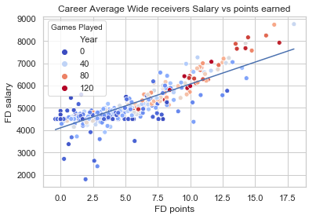
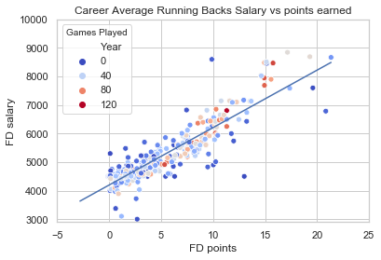
slope: 196.595132 intercept: 4104.806529
R-squared: 0.723319
p-value: 1.7361224393869536e-121
Standard error: 5.877273377578016
slope: 201.228756 intercept: 4196.532146
R-squared: 0.771636
p-value: 3.887628380844346e-118
Standard error: 5.7536417291542605
Career Averages for players

Slide 9
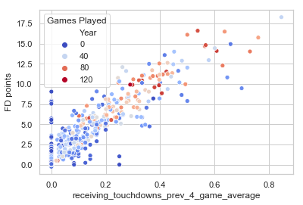
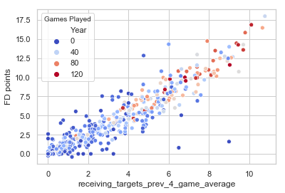
Some important features for WRs for describing FD points over a players career

Slide 10
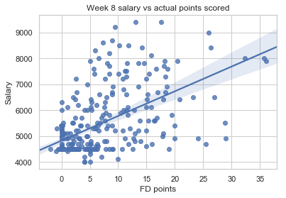
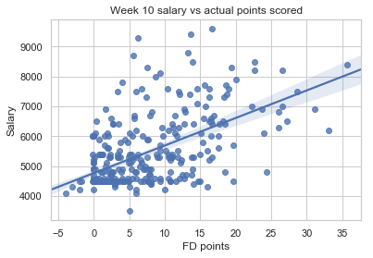
On a weekly basis, the Salary vs. Points relationship varies quite a bit.
slope: 95.372889 intercept: 4818.101832
R-squared: 0.317420
p-value: 3.391936604884979e-27
Standard error: 7.995104418304466
slope: 92.209358 intercept: 4766.624557
R-squared: 0.341035
p-value: 1.461581652472475e-32
Standard error: 6.961559180562217

Slide 11
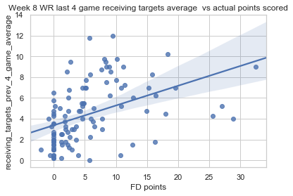
On a weekly basis, no matter the variables - the points scored relationship will have a lot of variance. Predicting athletic performance is difficult.

Slide 12
Two Highest performing models with current features
RANDOM FOREST
QB: model score: 0.906890535794649
cross_val: [0.32335351 0.36853598 0.35911184 0.30732574 0.32393582]
WR model score: 0.9018739005687333
cross_val: [0.28926124 0.25385466 0.27688006 0.33224823 0.30440299]
RB model score: 0.9174203198879174
cross_val: [0.35630565 0.45931457 0.41424991 0.37787445 0.41222407]
TE model score: 0.9038090592070069
cross_val: [0.28042494 0.31919582 0.33017283 0.23624975 0.38732065]
GRADIENT BOOST
QB model score: 0.44180979689681166
cross_val: [0.30290717 0.34153898 0.36028433 0.3270746 0.27615882]
WR model score: 0.36882813756756294
cross_val: [0.35429268 0.32374888 0.24439428 0.26094488 0.25239612]
RB model score: 0.45472016635642803
cross_val: [0.36429197 0.37318375 0.38810594 0.324294 0.35539198]
TE model score: 0.36775689639496945
cross_val: [0.23473447 0.27355978 0.30319358 0.33419174 0.28093789]
Our models have low R^2 scores, but this is to be expected because we are trying to predict athletic performance. The best way to score our models is to score the final product -- how well the predictions fit into our optimizer, and thus how many points scored our lineups will produce

Slide 13
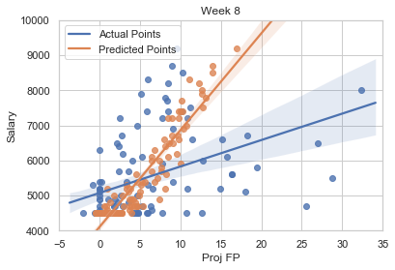
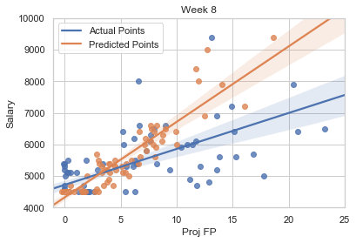
Gradient Boosting Regressor
WR
RB
The models play it safe with their predictions, and can capture the general trend - however there still exists our problem of immense variance in the actual points

Slide 14
Lineup Optimizer - Genetic Algorithm
Heuristic method to solving the an optimization problem given constraints
Positional constraints, Salary cap constraints
Uses concepts such as generations, crossover, and mutation from genetics to find an optimal solution
Population would be our individual players
The individual returned would be our lineup
Very useful in our case because:
Very Fast
Will return many different ‘optimal solutions.’
Due to the huge variance discussed earlier we want to spread out our optimal lineup combinations
Adopted from github

Slide 15
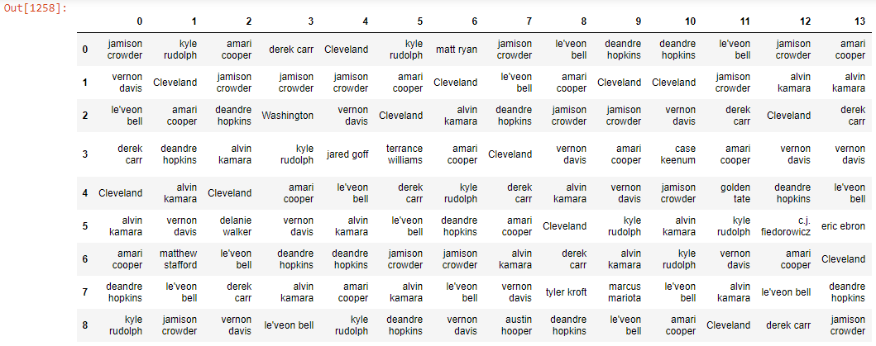
Gradient Boost / Genetic Algorithm Scoring
Genetic algorithm return 250 lineups, with one best individual. Ran the GA from based on optimizing Gradient Boost predictions 30 times. Then plotted the best lineup’s actual points scored from each run. Our goal is to maximize points. Points above 120 will generally be winning lineups.

Slide 16
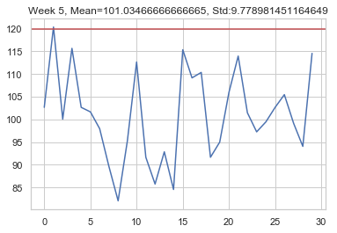
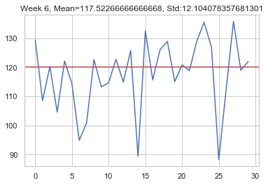
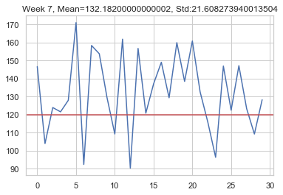
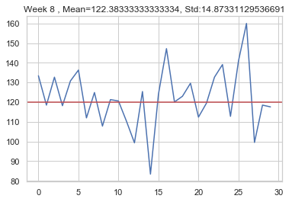
Gradient Boost / GA Results
Median:
100.76Median:
100.76
Median:
119.63
Median:
100.76
Median:
129.38
Median:
120.98

Slide 17
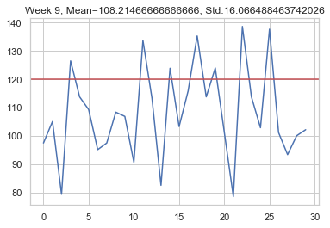
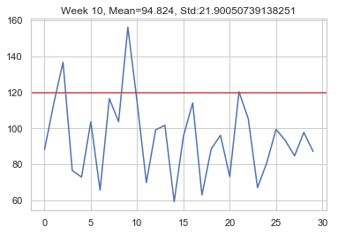
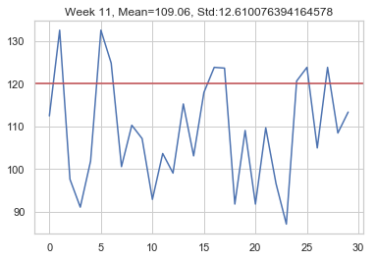
Gradient Boost / GA Results
Median:
106.02
Median:
95..89
Median:
108.76

Slide 18
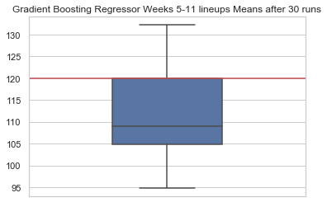
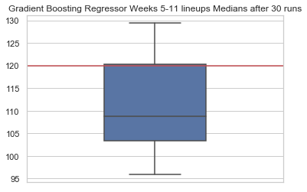
Our average over these 7 test weeks the average is 112.21 and our median is 108.76. Two weeks passed the 120 point threshold, and 1 week was at 119.63 so depending on others’ performance may have cashed during the right week.
The model currently does not account for player injuries, so it is possible that our optimal lineups contain injured players and are potentially lowering our scores.

Slide 19
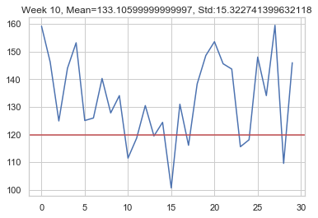
With Tyrod Taylor
Without Tyrod Taylor
The model identified Tyrod Taylor as being an extreme value so it picke him in a lot of the lineups; however, Tyrod Taylor was benched in real life because the team wanted to groom a new young quarterback. This was reflected in his FD salary but the model did not know he was benched.
Holding out Tyrod Taylor (because he was benched) drastically improved results, and made the difference between cashing out and losing money..

Slide 20
Conclusion
This tool should be used in conjunction with domain knowledge and research. The optimized lineups should be inspected for injured players or players that will have less opportunity -- because the model does not have player news features currently.
If players that are injured/benched or won’t otherwise have a regular opportunity are removed from consideration from the model -- the model can identify various combinations of value players.
Another great benefit is that it can reduce human player bias. Human players may not like a particular value player for whatever reason and resist to pick them. Daily Fantasy sites also adjust their salaries based on popularity. The more popular a player is (from news or pick %) the salary will go up. This model can provide a different perspective if players are being overvalued.

