Slide 1

Turning job-search evidence into
better-informed decisions
Ironhack AI Product Manager Final Project · Jose Manuel Lozano Barba
CAREERPILOT • FINAL PRESENTATION • JOSE MANUEL LOZANO BARBA
Notes:
CareerPilot is my Ironhack final project. It started as a broader job-search workspace, but during the project the question became much more specific: how can we help job seekers make better decisions from the information they already generate during their search? Transition: To understand that, we need to start with the user.

Slide 2





01 · PROBLEM & USER
Meet Alex.
An active job seeker managing multiple applications at the same time.
Alex has the information.
But not always the clarity to act on it.
Alex
Active job seeker
Multiple roles · Multiple decisions
OPPORTUNITIES
APPLICATIONS
OUTCOMES
CORE NEED
Which roles are worth
the effort?
What should I tailor
or change?
What might my results
be telling me?
Know where to focus next.
CAREERPILOT • FINAL PRESENTATION • JOSE MANUEL LOZANO BARBA
02
Notes:
This is Alex, a synthetic persona representing the kind of user CareerPilot is designed for: an active job seeker managing multiple applications at the same time. Alex already has information — CV versions, job descriptions, application statuses and outcomes — but the problem is not simply storing that information. The harder part is understanding what is worth the effort, what the results may be signalling, and what to do next. That is the core problem CareerPilot is trying to solve. Transition: But CareerPilot did not begin with that exact focus — research is what pushed the product in this direction.

Slide 3




02 · DISCOVERY
Research changed the product.
The evidence did not validate the original idea unchanged — it redirected it.
STARTED WITH
DIRECTIONAL SIGNALS · SURVEY n=5
CV Builder
+ Job Tracker
4/5
unclear what works
REFOCUSED ON
SECONDARY RESEARCH
4/5
Decision support
change strategy from results
USBLS · 2025
Job seekers use multiple active search methods.
Job-search evidence
→ interpretation
→ possible next action
NBER · 2025 field experiment
Personalised labour-market information improved outcomes in a specific context.
4/5
want to better understand rejection
Small sample — used as directional evidence
Contextual evidence — not CareerPilot validation
AI accelerated
research synthesis + hypothesis organisation
Human decision
changed the original concept instead of defending it
CAREERPILOT • FINAL PRESENTATION • JOSE MANUEL LOZANO BARBA
03
Notes:
CareerPilot originally started much closer to a CV builder combined with an application tracker. The research challenged that. In my five-person survey, four respondents didn't clearly know which parts of their job search worked best. Four already changed their strategy based on results. And four wanted to better understand rejection. The sample is small, so I treat those results as directional rather than market-wide validation. Competitor research also showed that FlowCV, Huntr and Teal already provide substantial CV, tracking, tailoring and analytics functionality. So the conclusion wasn't that competitors were missing those features. It was that simply combining them wouldn't create enough differentiation. That shifted CareerPilot toward helping users turn job-search evidence into interpretation and possible next actions. AI accelerated research synthesis and hypothesis organisation. I made the product decision to change the original direction. Transition: Once the problem changed, the MVP had to change with it.

Slide 4



03 · COMPETITIVE INSIGHT
Competitors confirmed the need to differentiate.
The opportunity was not to copy existing workflow tools — it was to connect evidence with interpretation and next actions.
Tool
Strong in
What it proved
CareerPilot decision
CV and cover-letter creation
CV creation is already well served.
Do not compete on advanced visual CV building.
Job capture, tracking, workflow and AI docs
Tracker + AI is already an established proposition.
Make tracking support interpretation, not define the product.
Integrated job-search workspace, resume tools and metrics
All-in-one workspace alone is not enough differentiation.
Focus on evidence-based decision support and next actions.
Strategic conclusion: CareerPilot should not be another CV builder, tracker or analytics dashboard.
CAREERPILOT • FINAL PRESENTATION • JOSE MANUEL LOZANO BARBA
04
Notes:
The competitor analysis did not show that competitors lack core workflow features. It showed the opposite. FlowCV is already strong in CV and cover-letter creation. Huntr already combines job capture, tracking, workflow and AI-assisted documents. Teal already offers a broad integrated job-search workspace with resume tools and metrics. So the product decision was not to compete by reproducing the same full workflow. CareerPilot needed to focus on the unresolved question: can we help job seekers interpret their own evidence and decide what to do next? Transition: With that positioning clear, the MVP scope had to focus on the smallest connected loop that could test it.

Slide 5
04 · PLAN
Roadmap: focus first, expand after validation.
The roadmap protects the MVP from becoming a full job-search platform too early.
NOW
Implemented MVP
LATER
External integrations
Profile + goals · CVs + AI tailoring Jobs + applications · Analysis + recommendations
Profile import · Job integrations Browser capture
02
04
03
01
NEXT
Deepen after validation
WON'T
Strategic boundaries
Advanced CV customisation · Workflows Advanced analytics · Expanded decision support
Job marketplace · Employer platform Autonomous applications
Build enough to validate → expand only when evidence supports it
AI accelerated
Rovo organised roadmap + backlog
Human decision
set scope, priorities and strategic boundaries
CAREERPILOT • FINAL PRESENTATION • JOSE MANUEL LOZANO BARBA
05
Notes:
The roadmap protects the product from becoming too broad too early. The Now horizon is the implemented MVP: profile and goals, CVs with AI tailoring, jobs and applications, outcomes, analysis, recommendations and feedback. These are not isolated features; they create the evidence needed to test the decision-support experience. Next is where we deepen the product only after validation: more advanced CV customisation, richer workflows, advanced analytics and expanded AI decision support. Later is mainly about reducing manual work through integrations. And Won't Do protects the product boundary: CareerPilot is not a job marketplace, not an employer platform and not an autonomous application agent. AI accelerated roadmap and backlog organisation with Rovo. I made the scope, prioritisation and product-boundary decisions. Transition: To make that principle buildable, it needed to become explicit product behaviour.

Slide 6





05 · BACKLOG STORY
Human review is a product requirement.
One story turns the product principle into testable behaviour.
ACCEPTANCE CRITERIA
US-31
Review AI Recommendation
Clear action
As an active job seeker, I want to review the context and reasoning behind an AI recommendation, so that I can decide whether it is relevant before taking any action.
Evidence + context
Facts ≠ AI interpretation
Uncertainty visible
Strategy → backlog → implementation → demo
No automatic action
AI may suggest · the user must understand and decide
CAREERPILOT • FINAL PRESENTATION • JOSE MANUEL LOZANO BARBA
06
Notes:
One user story captures the product philosophy especially well: As an active job seeker, I want to review the context and reasoning behind an AI recommendation so that I can decide whether it is relevant before taking any action. The acceptance criteria require the recommendation to show its supporting context, distinguish recorded evidence from AI interpretation, expose relevant uncertainty and, importantly, never execute the recommendation automatically. So human review isn't just a Responsible AI statement. It's an implementation requirement. AI helped structure the story and acceptance criteria; I kept the requirements around provenance, uncertainty and human control. Transition: Rather than explain the rest of that in Jira, I'll show you how it behaves in the product.

Slide 7








06 · LIVE MVP DEMO
From evidence to a user-controlled recommendation
Watch the decision-support loop — not a feature tour.
Context
Job
CV Match
Insight
Recommendation
Review & Feedback
CareerPilot suggests. The job seeker decides.
AI accelerated
Lovable accelerated implementation + iteration
Human decision
audited the build and kept the product exclusions
CAREERPILOT • FINAL PRESENTATION • JOSE MANUEL LOZANO BARBA
CAREERPILOT • FINAL PRESENTATION • JOSE MANUEL LOZANO BARBA
07
Notes:
Rather than showing every CareerPilot feature, I'm going to show the core decision-support loop. For the demo, I am using my own professional context and CV with a real job posting, so the analysis is based on realistic data rather than a fictional scenario. Start on the prepared saved-job detail page. 1) OVERVIEW — This user already has their professional profile, goals and CV stored in CareerPilot. They have saved this opportunity and now need to decide how much effort it deserves. 2) CV MATCH — The user can select one of their CVs and compare it with the opportunity. This is a CareerPilot CV–Job Match Assessment. It isn't an employer ATS score and it doesn't predict an interview or offer. Its purpose is to help the user understand how their CV relates to this specific job. 3) INSIGHTS — CareerPilot combines the available career context with the opportunity. Instead of returning only a score, it separates documented alignment, possible gaps, goal considerations, effort considerations and uncertainty. Pause on uncertainty: CareerPilot shouldn't turn incomplete evidence into certainty. 4) RECOMMENDATION — Based on that context, CareerPilot can suggest a possible next action. The recommendation is advisory. Nothing happens automatically. 5) REVIEW — Before acting, the user can review why CareerPilot is making the recommendation and see the evidence it is based on. AI provides the interpretation. The user evaluates whether it makes sense. 6) FEEDBACK — Click Helpful or Not Helpful. Helpful means perceived usefulness. It doesn't prove the recommendation was objectively correct, and it doesn't mean the user followed it. Reviewing or rating does not apply for the job, modify the CV or change the application record. Close: That is the CareerPilot loop: user-controlled context becomes interpretation, interpretation becomes a possible next action, and the job seeker remains responsible for the decision. Transition: But a working flow isn't the same as a validated product. The next question is whether real users actually find these recommendations useful. Demo method: live product with pre-generated analysis. If a click fails twice, switch to prepared screenshots rather than troubleshoot.

Slide 8
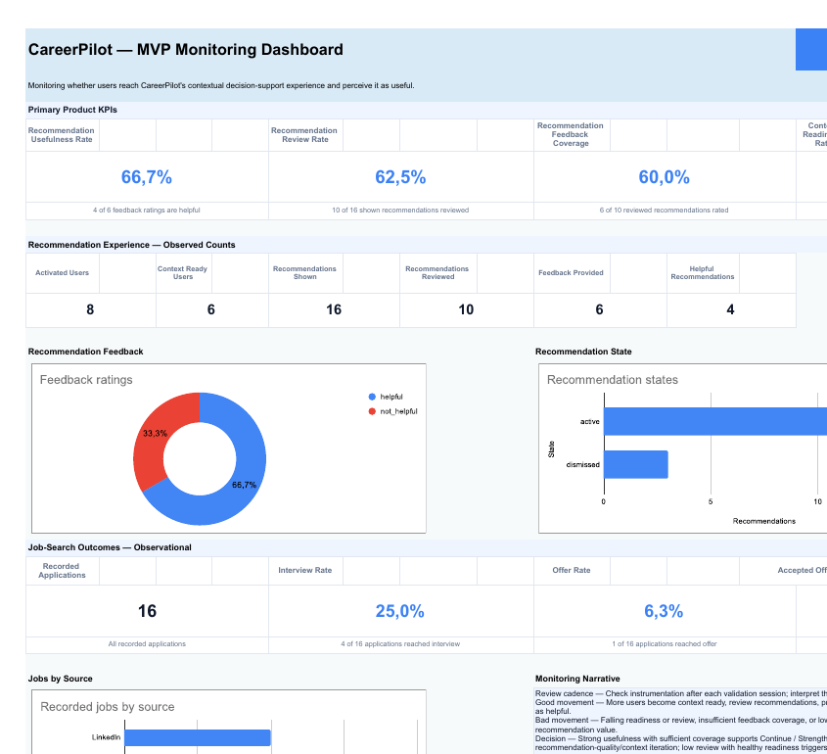
07 · POST-LAUNCH
A working MVP is not a validated product.
The measurement framework asks whether users reach the experience — and perceive the recommendations as useful.
MONITORING DASHBOARD
Open dashboard ↗
MVP NORTH STAR
Recommendation
Usefulness Rate
Do users explicitly rate the recommendation as useful?
PROVISIONAL VALIDATION TARGET
≥70% usefulness · ≥50% feedback coverage
Capstone validation threshold · not an industry benchmark
Current values are simulated demo data; the linked sheet is the live monitoring source.
CAREERPILOT • FINAL PRESENTATION • JOSE MANUEL LOZANO BARBA
08
Notes:
The primary validation question isn't how many AI outputs CareerPilot creates or how many jobs a user saves. It's whether users perceive the recommendations as useful. Recommendation Usefulness Rate is therefore the MVP North Star. But it only makes sense alongside supporting behaviour. Review Rate tells me whether people engage with recommendations. Feedback Coverage tells me whether enough reviewed recommendations are rated to interpret usefulness. Context Readiness tells me whether users reach the point where CareerPilot has enough relevant information to create meaningful recommendations. For example, high review but low usefulness would point me toward recommendation quality or grounding. Healthy context readiness but low review would make me investigate presentation or relevance. The numbers currently shown in the monitoring dashboard are simulated demonstration data, not real validation results. Interview and offer rates can be observed, but I would not claim CareerPilot caused those outcomes. Transition: And because CareerPilot is interpreting personal career information, usefulness by itself isn't enough.

Slide 9





08 · RESPONSIBLE AI
Useful AI still needs boundaries.
Responsible AI is part of the product behaviour — not a policy slide added afterwards.
Minimum necessary data
Evidence boundaries
CareerPilot identifies possibilities; the job seeker decides.
Only relevant context enters the AI task.
Facts and AI interpretation remain distinguishable.
Preserve uncertainty
Human control
Critical failure → block the capability
Unknown stays unknown — no invented explanations.
Fabricated experience · unsupported hiring guarantees · sensitive-attribute decisioning · autonomous applications
No autonomous consequential action.
AI accelerated
drafting + consistency review of guardrails
Human decision
defined final boundaries and escalation rules
CAREERPILOT • FINAL PRESENTATION • JOSE MANUEL LOZANO BARBA
09
Notes:
I defined four main boundaries. Only the minimum information needed for an AI task should be used. Recorded facts and explicit employer feedback have to remain distinguishable from AI interpretation. If CareerPilot doesn't know something — such as the actual reason for a rejection — it shouldn't invent it. And no consequential action, including applying to a job, is performed autonomously. Certain failures aren't simply UX issues. Fabricating professional experience, presenting unsupported hiring guarantees or using sensitive attributes for decisioning would be blockers for the capability. Responsible AI isn't separate from the product. The recommendation-review step you just saw is one of the product controls. AI accelerated drafting and consistency review. I made the final guardrail and escalation decisions. Transition: So the remaining milestone isn't adding more functionality. It's getting real evidence.

Slide 10




09 · CLOSE
The next milestone is evidence, not more features.
The MVP is the beginning of validation — not the end of the product process.
VALIDATE
LEARN
DECIDE
Relevant active job seekers
Behaviour + qualitative feedback
Strengthen · Iterate · Reconsider
Better evidence for decisions the job seeker still owns.
CAREERPILOT • FINAL PRESENTATION • JOSE MANUEL LOZANO BARBA
10
Notes:
The MVP is ready to move into real-user validation. Initial recruitment would focus on relevant active job seekers through direct outreach and existing networks. Educational and career-support organisations are a promising future distribution hypothesis, but I'm not treating them as validated partnerships. I would combine the behavioural metrics with qualitative observation to decide whether the core direction should be strengthened, iterated or reconsidered. If users reach the experience, understand it, trust it and consistently find the recommendations useful, Expanded AI Decision Support becomes a logical next area to explore. Final line: CareerPilot doesn't make career decisions for job seekers. It gives them better evidence for making those decisions themselves.

