Slide 1
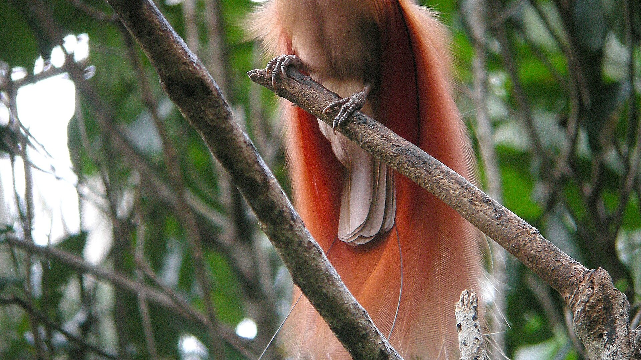

FR422 · FOREST WILDLIFE AND HABITAT
What Is Wildlife Management?
Definitions · Why it matters for PNG forests · New Guinea's rich and prehistoric wildlife
Chapter 1 (Weeks 1–2) · School of Forestry, PNG University of Technology
Dr. Jimmy Moses (Ph.D.) · Semester 2, 2026
1
Notes:
FR422 Chapter 1 (Weeks 1-2). Covers definitions, relevance to PNG forestry, and New Guinea's rich and prehistoric wildlife. Maps to LO1-LO4. Fonts sized for a large lecture hall.

Slide 2




SESSION ROADMAP
What This Session Covers
01
02
03
04
Definitions
Why it matters
Rich wildlife
Prehistoric
What 'wildlife' and 'wildlife management' mean
How wildlife underpins PNG forest management
One of Earth's richest, most distinctive faunas
Deep-time origins and megafauna of the island
Aligned to Learning Outcomes LO1–LO4 of the FR422 lesson plan
2

Slide 3
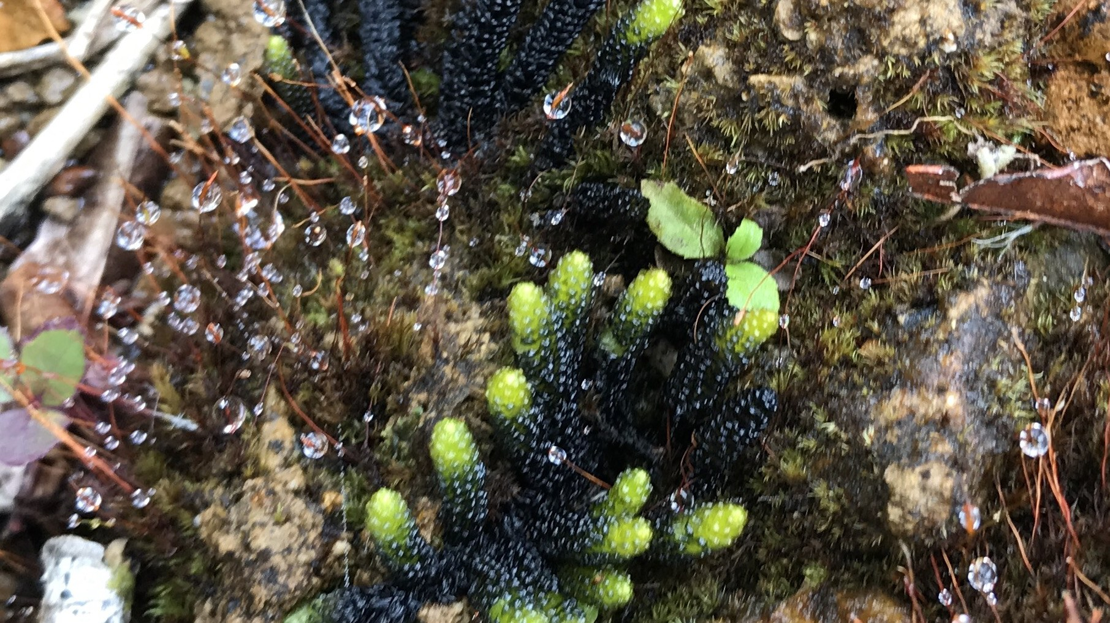
01
Definitions
Establishing a shared vocabulary before we manage anything
3

Slide 4
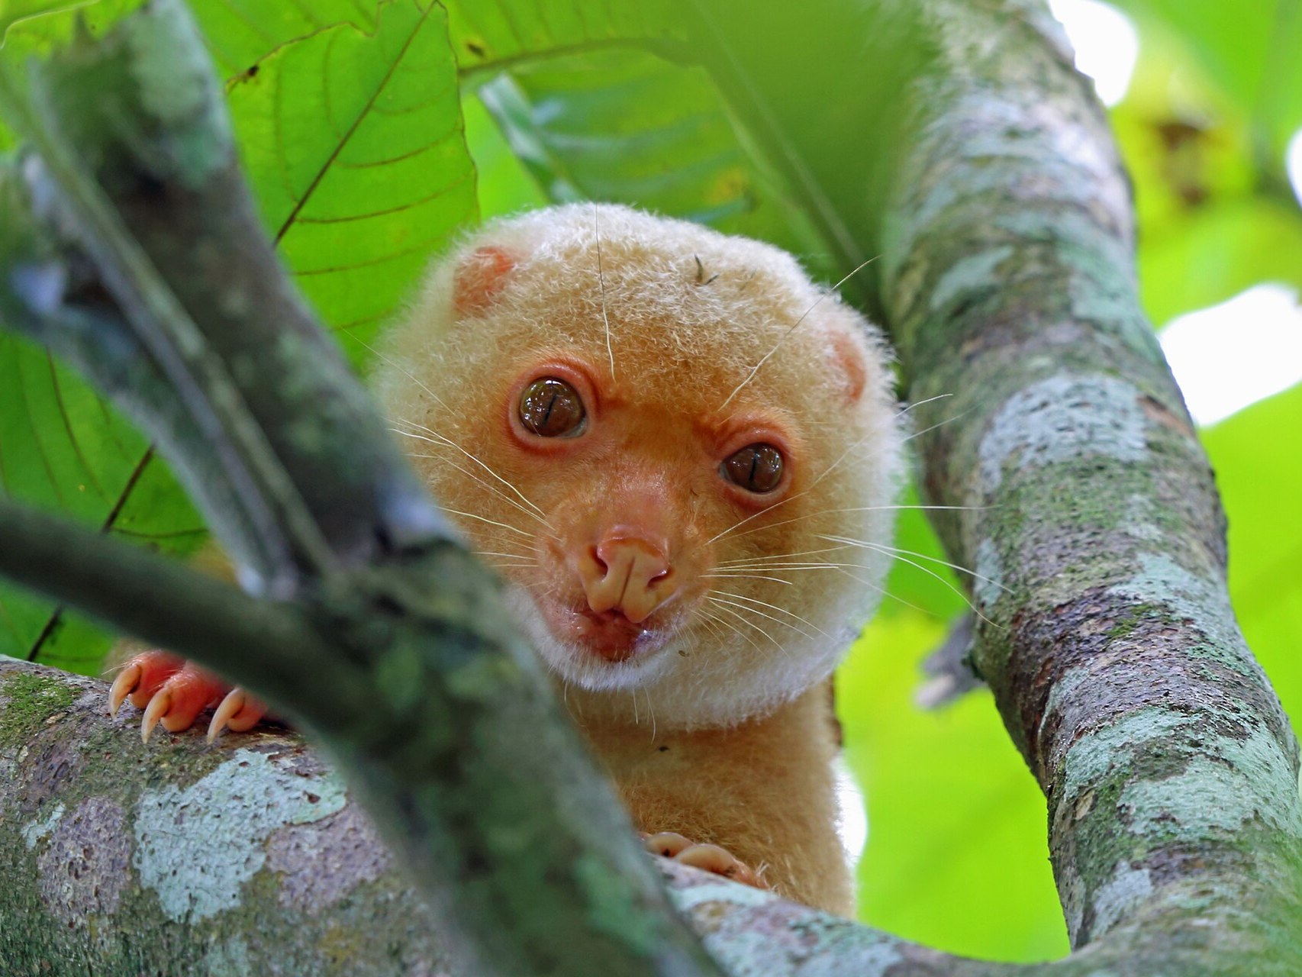


DEFINITION 1
What Is Wildlife?
Wildlife = all non-domesticated living organisms — animals, and in the broader sense plants, fungi and other organisms — that live in the wild, growing and reproducing without being introduced or tended by humans.
Primarily animals
Mammals, birds, reptiles, amphibians, fish and invertebrates in natural habitats
Broader ecological sense
Can include wild plants, fungi and whole biological communities
Free-living & self-sustaining
Populations persist and reproduce without human husbandry
Common Spotted Cuscus (Spilocuscus maculatus) — a New Guinea marsupial
4
Notes:
Stress: wildlife = non-domesticated and free-living. Ask students for local-language names of the cuscus and other species.

Slide 5


DEFINITION 2
What Is Wildlife Management?
Definition: the application of ecological principles and management tools to sustain, restore or regulate wildlife populations and their habitats — balancing the needs of wildlife, ecosystems and people.
Populations
Habitats
People
Monitor and regulate numbers — births, deaths, harvest and recovery
Protect, restore and improve the places wildlife depends on
Reconcile human use, livelihoods and culture with conservation
5

Slide 6



BUILDING THE VOCABULARY
Key Terms You'll Use All Semester
Habitat
Population
Ecosystem
The natural environment where an organism lives — food, water, shelter and space.
A group of individuals of one species living in the same area and interbreeding.
A community of living things interacting with each other and their physical environment.
Biodiversity
Sustainable use
Conservation
The variety of life — genes, species and ecosystems — in a place.
Using wildlife at a rate that lets populations renew themselves indefinitely.
Protecting and managing wildlife and habitats to prevent loss and decline.
6

Slide 7


WHAT MANAGERS ACTUALLY DO
The Four Goals of Wildlife Management
INCREASE
STABILISE
HARVEST
REDUCE
Boost numbers of rare, threatened or valued species through protection and recovery.
Hold a population steady at a healthy, sustainable level over time.
Allow regulated, sustainable use — hunting or harvest within safe limits.
Control overabundant, pest or invasive species that damage habitats or people.
7

Slide 8
02
Why It Matters for PNG Forests
Wildlife management is inseparable from sustainable forest management
8

Slide 9




THE CASE FOR MANAGEMENT
Why Wildlife Management Matters
Ecological value
Cultural value
Wildlife pollinate, disperse seeds and regulate the forest. Cassowaries and fruit bats are keystone seed-dispersers that keep PNG forests regenerating.
Wildlife is woven into custom, identity, ornament and ritual across PNG. Management must respect traditional ownership and practice.
Economic value
Threats & pressures
Bushmeat, eco-tourism, bioprospecting and sustainable use provide livelihoods. Well-managed wildlife is a renewable resource.
Habitat loss from logging and agriculture, over-hunting, invasive species and climate change all place forest wildlife at risk.
9
Notes:
Lesson-plan link: 'Why is wildlife management essential for forest management in PNG?' Ecological, cultural, economic value + threats.

Slide 10
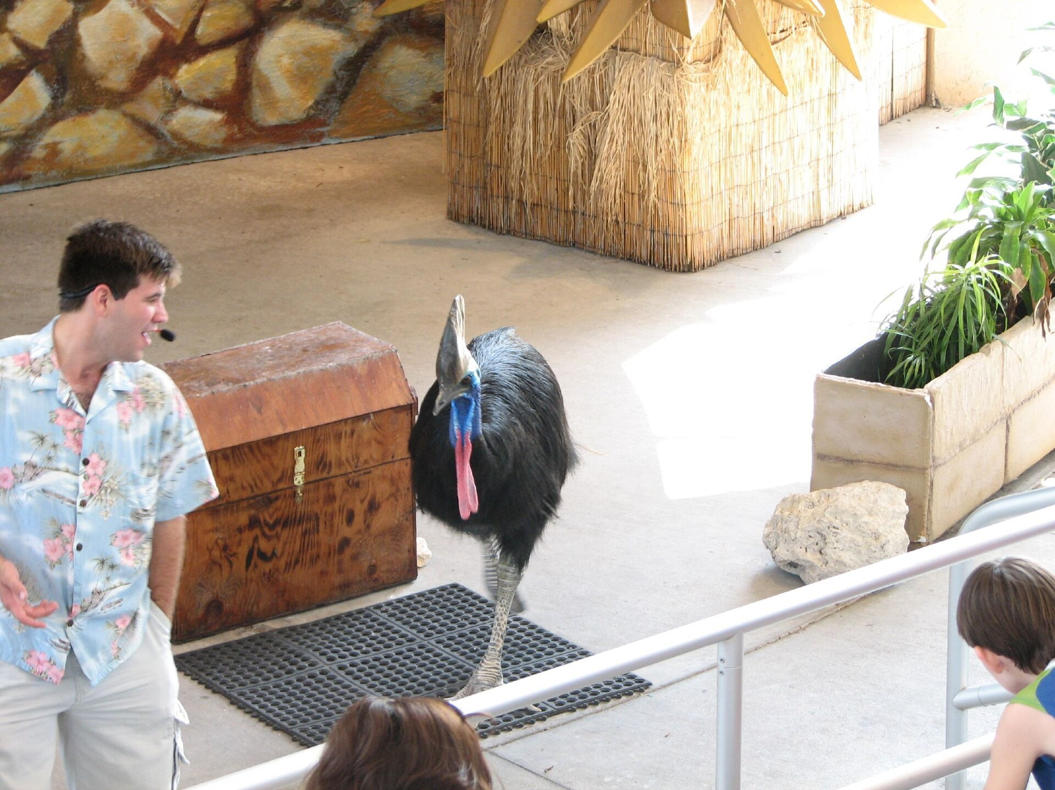
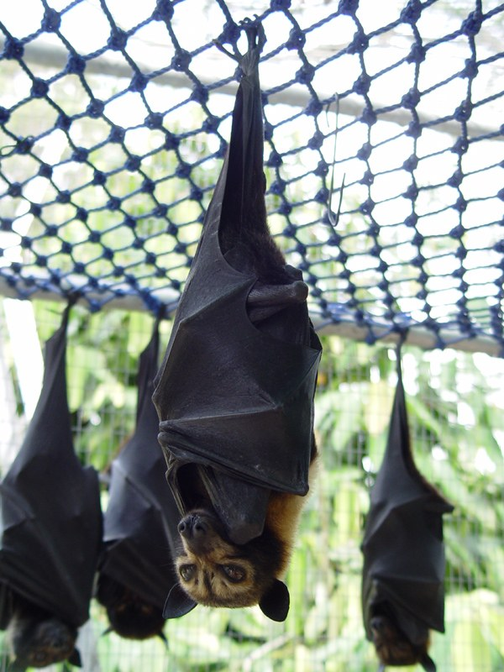
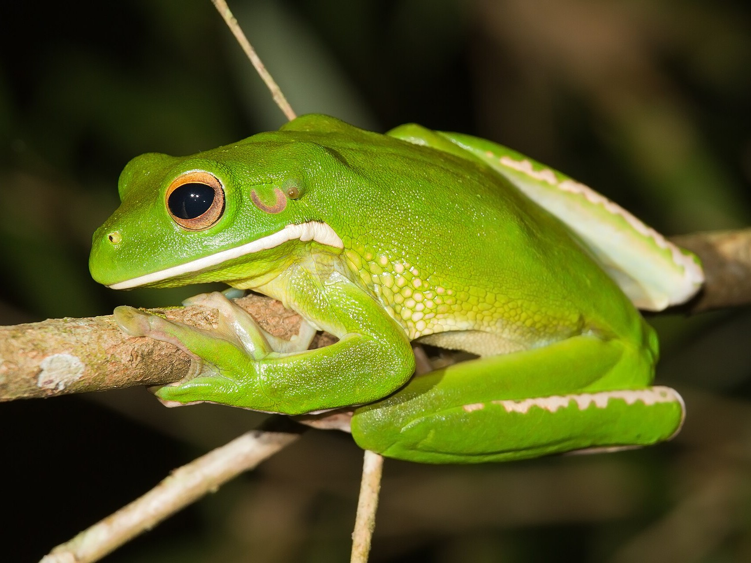
KEYSTONE SPECIES SPOTLIGHT
Forest Engineers of New Guinea
Cassowary
Fruit bats / flying foxes
Frogs & insects
Swallows large fruits whole and disperses big seeds few other animals can — vital for rainforest tree regeneration.
Travel long distances at night, spreading seeds and pollinating forest trees across the landscape.
Control insect numbers and form the base of food webs; sensitive indicators of forest health.
10

Slide 11
ONE CONNECTED SYSTEM
Wildlife and Forests Are One System
Manage one well and you sustain the other — this is why FR422 sits inside a forestry degree.
➜
➜
➜
Healthy forest
Wildlife thrives
Forest regenerates
People benefit
provides food, shelter and breeding habitat
populations stay viable and diverse
seed dispersal & pollination renew it
resources, culture & livelihoods
11

Slide 12
03
New Guinea's Rich Wildlife
A megadiverse island of endemic and extraordinary species
12
Notes:
Section: New Guinea's rich wildlife. Emphasise endemism and the global significance of PNG's forests.

Slide 13
A GLOBAL BIODIVERSITY HOTSPOT
An Island of Extraordinary Diversity
~5%
700+
~2/3
of the world's species on under 1% of Earth's land area
bird species, including most birds-of-paradise
of its species estimated to occur nowhere else
Why it matters for a forester
New Guinea holds the third-largest tract of tropical rainforest on Earth, after the Amazon and the Congo. Its wildlife and its forests rise or fall together — which makes sound wildlife management a national responsibility, not an optional extra.
13

Slide 14
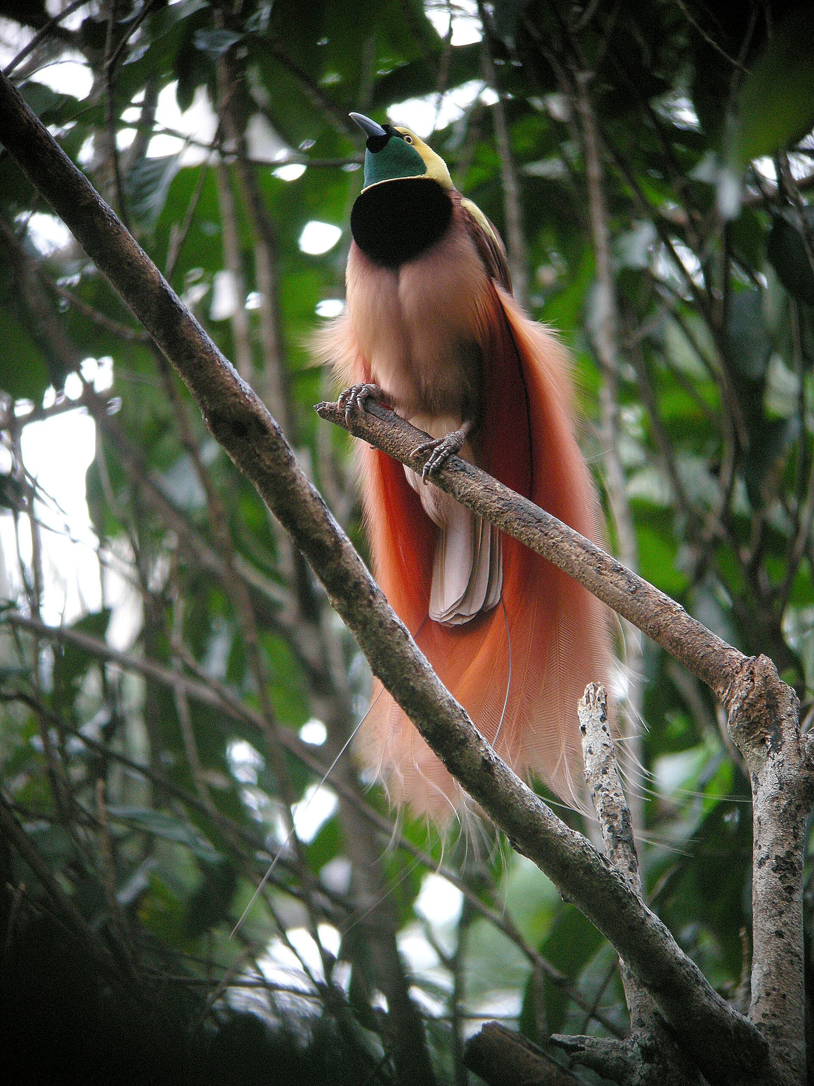
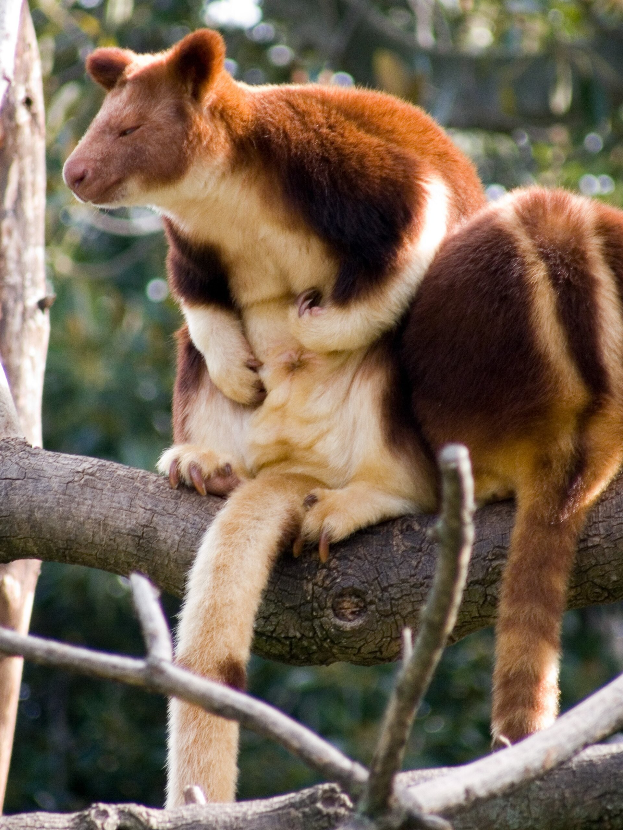
SIGNATURE WILDLIFE
Icons of New Guinea's Fauna
Birds-of-paradise
Tree-kangaroos
Cuscus & possums
Frogs & reptiles
Dazzling endemic display birds; the Raggiana is PNG's national bird (the 'kumul').
Arboreal marsupials of the canopy — kangaroos that took to the trees.
Slow-moving nocturnal marsupials found throughout the forests.
Huge, largely endemic radiations — new species still being described.
14

Slide 15
THE DRIVERS OF DIVERSITY
Why Is New Guinea So Rich?
Dramatic topography
Tropical & isolated
Sea level to peaks over 4,500 m creates a ladder of climate zones and habitats side by side.
A large tropical island long separated by sea, driving in-place evolution of unique lineages.
Mixed origins
Vast intact forest
A meeting of Australian (marsupial) and Asian faunas produced unusual combinations found nowhere else.
Extensive, structurally complex rainforest offers countless ecological niches to fill.
15

Slide 16

FOUND NOWHERE ELSE
Endemism: New Guinea's Signature
Endemic
A species is endemic when it is found naturally in one place and nowhere else on Earth.
Most birds-of-paradise are endemic to the New Guinea region
All tree-kangaroo species are restricted to New Guinea and nearby areas
Whole frog and reptile groups occur only here
New species are still being discovered and named today
Endemic species carry a special duty of care — if lost here, they are lost everywhere.
Goodfellow's Tree-kangaroo (Dendrolagus)
16

Slide 17
04
Prehistoric Wildlife
Deep-time origins that shaped today's fauna
17
Notes:
Section: prehistoric wildlife. Gondwanan ancestry, Sahul land bridge, megafauna extinctions, deep human presence.

Slide 18
HOW TODAY'S FAUNA CAME TO BE
New Guinea's Deep-Time Story
Ancient roots
Megafauna & extinctions
Marsupial megafauna
Gondwanan ancestry. New Guinea's marsupials and many plant lineages descend from the ancient southern supercontinent of Gondwana, sharing deep ancestry with Australia.
The Sahul land bridge. For long stretches of the Ice Age, lower sea levels joined New Guinea and Australia into one landmass — Sahul — letting animals move between them.
Giant relatives of today's marsupials — including large browsing diprotodontids — once roamed the region.
Late Ice-Age losses
Many of the largest species vanished in the late Quaternary, alongside climate shifts and human arrival.
Deep human presence
People have lived in New Guinea for tens of thousands of years, hunting and shaping habitats.
18

Slide 19
A ROUGH TIMELINE
From Gondwana to Today
Deep past
Gondwana breaks up; marsupial and ancient plant lineages become isolated in the Australia–New Guinea region.
1
Ice Ages
Sea levels fall and rise; New Guinea and Australia repeatedly join as Sahul and separate again.
2
~50,000+ yrs ago
Humans reach New Guinea, hunting wildlife and beginning to shape forests and grasslands.
3
Late Ice Age
Much of the largest megafauna disappears amid climate change and human pressure.
4
Today
A rich, highly endemic fauna survives — the living legacy we now aim to conserve.
5
19

Slide 20
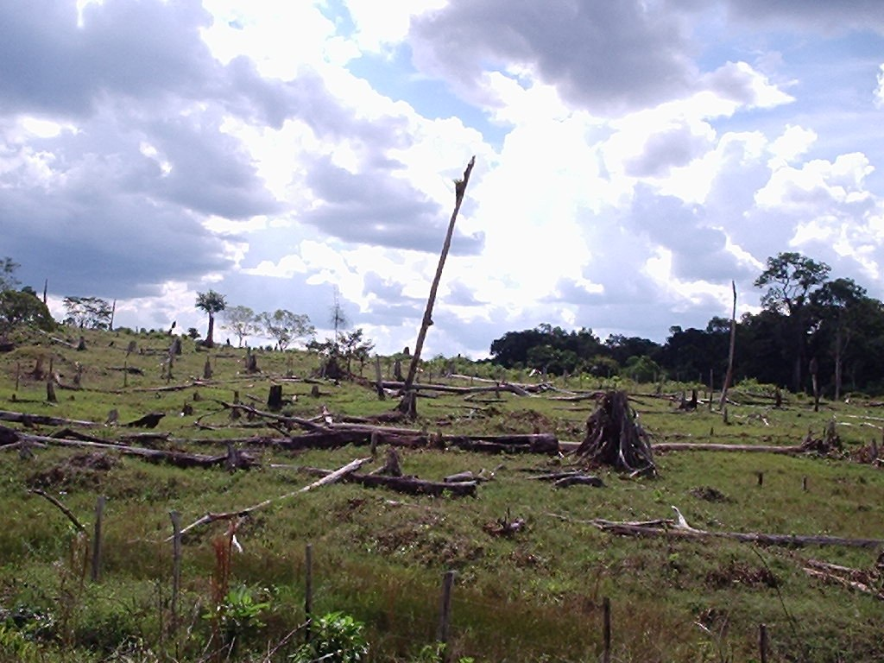


FROM PREHISTORY TO NOW
Today's Pressures on Wildlife
Habitat loss
Logging, mining and clearing for agriculture fragment and destroy forest.
Over-hunting
Unregulated hunting can push valued species into decline.
Invasive species
Introduced animals and plants outcompete or prey on native wildlife.
Climate change
Shifting climate zones threaten mountain and specialist species.
Forest clearing and logging remove the habitat wildlife depends on.
20

Slide 21
TYING IT TOGETHER
Why This Chapter Comes First
We defined the field
Knowing what wildlife and management mean gives us a shared language for the whole course.
We placed it in PNG
Wildlife management protects the forests, culture and economy this degree serves.
We looked back in time
Understanding deep-time origins explains why today's fauna is so rich — and so worth conserving.
21

Slide 22
WHAT TO REMEMBER
Key Takeaways
Management defined
Essential for forests
Applying ecological principles to sustain wildlife populations, habitats and human needs together.
Wildlife drives forest regeneration and carries deep cultural and economic value — core to forestry.
A world-class fauna
Rooted in deep time
New Guinea is megadiverse and highly endemic — shaped by topography, isolation and mixed origins.
Today's wildlife reflects a Gondwanan, Ice-Age and human-shaped prehistory we must conserve.
22

Slide 23
OVER TO YOU
Discussion Questions
In your own words, how would you define wildlife management to a village leader?
Q1
Name one PNG species and explain the ecological, cultural or economic value it provides.
Q2
Why can't forests in PNG be managed well without also managing wildlife?
Q3
What does it mean for a species to be 'endemic', and why does that raise the stakes for conservation?
Q4
Southern Cassowary — a keystone seed-disperser
23
Notes:
Use the discussion questions as a think-pair-share or oral quiz to reinforce LO1-LO4.

Slide 24
QUICK REFERENCE
Glossary Recap
Wildlife
Wildlife management
Non-domesticated, free-living organisms in natural habitats.
Using ecology and tools to sustain populations, habitats and human needs.
Habitat
Endemic
The natural home providing food, water, shelter and space.
Found naturally in one place and nowhere else on Earth.
Keystone species
Sustainable use
A species with an outsized role in holding its ecosystem together.
Harvesting at a rate populations can renew indefinitely.
24

Slide 25
Next: Wildlife Management in PNG
Policies, laws and conservation areas that put these ideas into practice (Chapter 2).
FR422 · School of Forestry · PNG University of Technology
25

