Slide 1

FR422 · FOREST WILDLIFE AND HABITAT
Wildlife Management in Papua New Guinea
Chapter 2 · Week 3
School of Forestry, PNG University of Technology
Dr. J. Moses (Ph.D.) · Semester 2, 2026
1
Notes:
FR422 Chapter 2 (Week 3). Rebuilt from Dr Moses's original lecture: same content and source images, larger type and consistent layout for lecture-hall legibility.

Slide 2





CHAPTER 2
Learning Objectives
Wildlife management policies in PNG
Laws governing wildlife management in PNG
Wildlife conservation areas in PNG (WMA, National Parks, Conservation Areas, etc.)
World Heritage Sites & others
Forestry and wildlife management
2

Slide 3
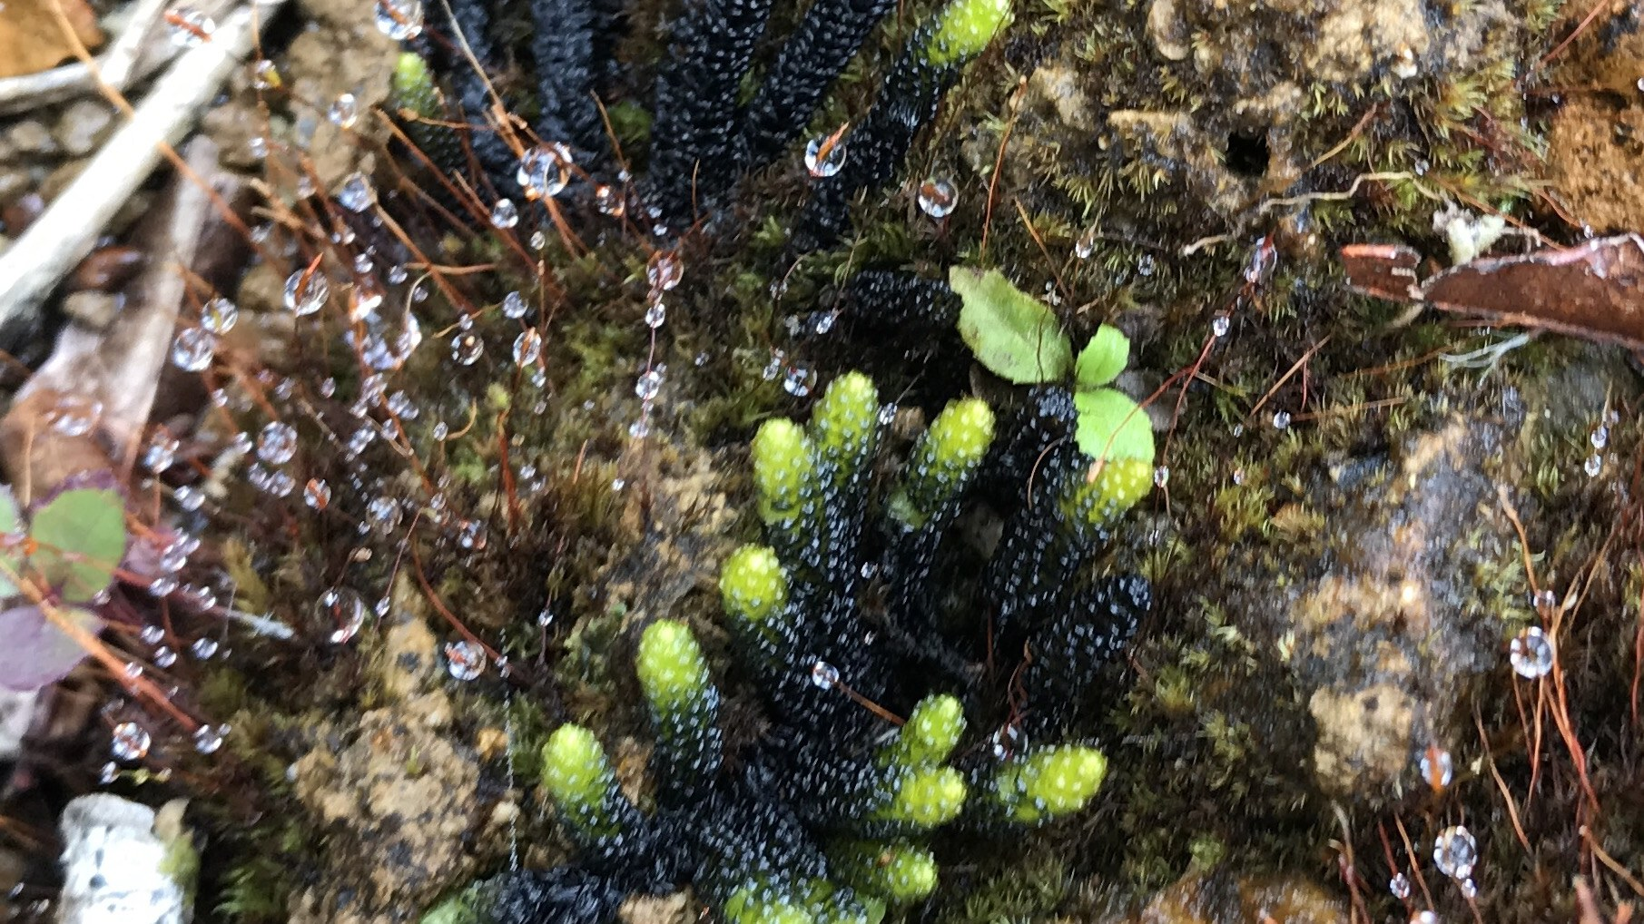
01
Wildlife Management Policies in PNG
Sustainable resource use · Conservation · Protection of endangered species
3

Slide 4
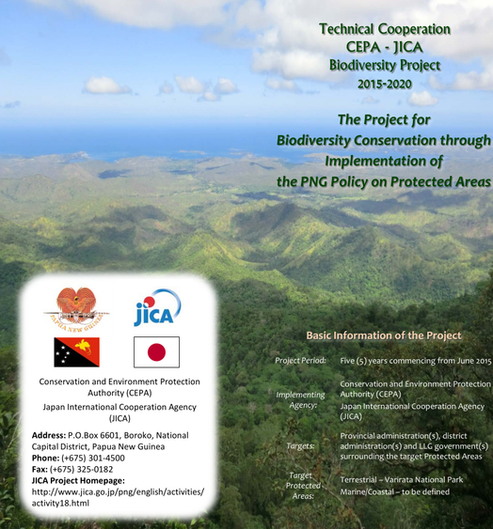
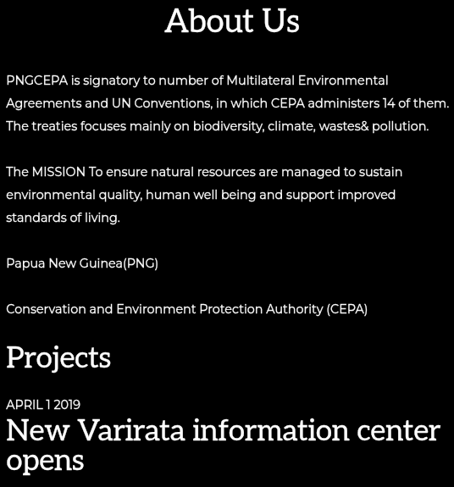
THE NATIONAL PICTURE
Wildlife Management Policies in PNG
PNG recognises the importance of wildlife management and has implemented policies to safeguard its rich biodiversity.
Policy focuses on three things:
sustainable resource use
conservation
protection of endangered species
These policies balance local community needs, economic development and the long-term survival of PNG's wildlife.
pngcepa.com/about-us
CEPA–JICA Biodiversity Project 2015–2020
4

Slide 5



THE THREE POLICY PILLARS
What PNG's Wildlife Policy Focuses On
Sustainable resource use
Conservation
Protection of endangered species
Using natural resources to meet today's needs without compromising future generations.
Protecting, managing and sustainably using ecosystems and biodiversity.
Preventing extinction and promoting recovery of at-risk species.
5

Slide 6
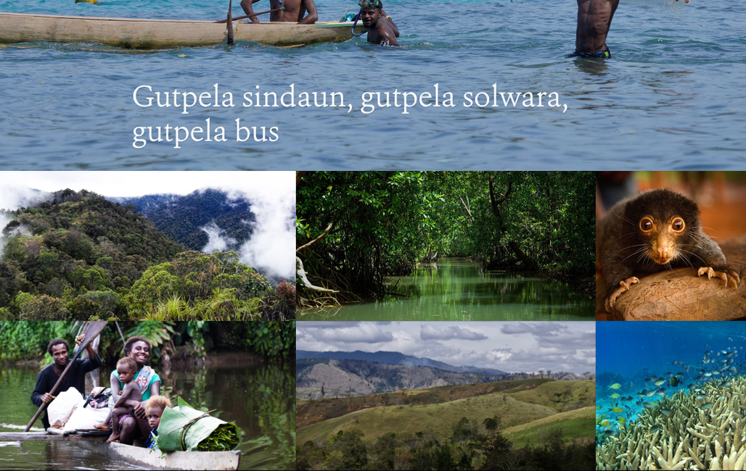
POLICY PILLAR 1
Sustainable Resource Use
Using natural resources in a way that meets the needs of the present generation without compromising the ability of future generations to meet their own needs.
It ensures long-term availability of resources while minimising negative environmental, social and economic impacts.
PNG's forests, reefs, rivers and wildlife — the resources being managed
6

Slide 7


POLICY PILLAR 1 · KEY PRINCIPLES
Principles of Sustainable Resource Use
Conservation
Manage resources so they are available for future generations — preventing overexploitation or depletion.
Biodiversity preservation
Recognise that ecosystems are interconnected; maintain healthy, diverse plant and animal populations.
Minimising waste and pollution
Use resources efficiently; reduce extraction, promote recycling and reuse, limit environmental impact.
7

Slide 8



POLICY PILLAR 1 · KEY PRINCIPLES
Principles of Sustainable Resource Use (cont.)
Renewable resource management
Forests, fisheries and water must be managed so they regenerate and remain continuously available.
Socio-economic considerations
Consider community well-being, share benefits equitably, and support livelihoods that depend on natural resources.
Long-term planning & adaptive management
Use scientific knowledge, monitoring and evaluation — and adjust practices as conditions change.
8

Slide 9
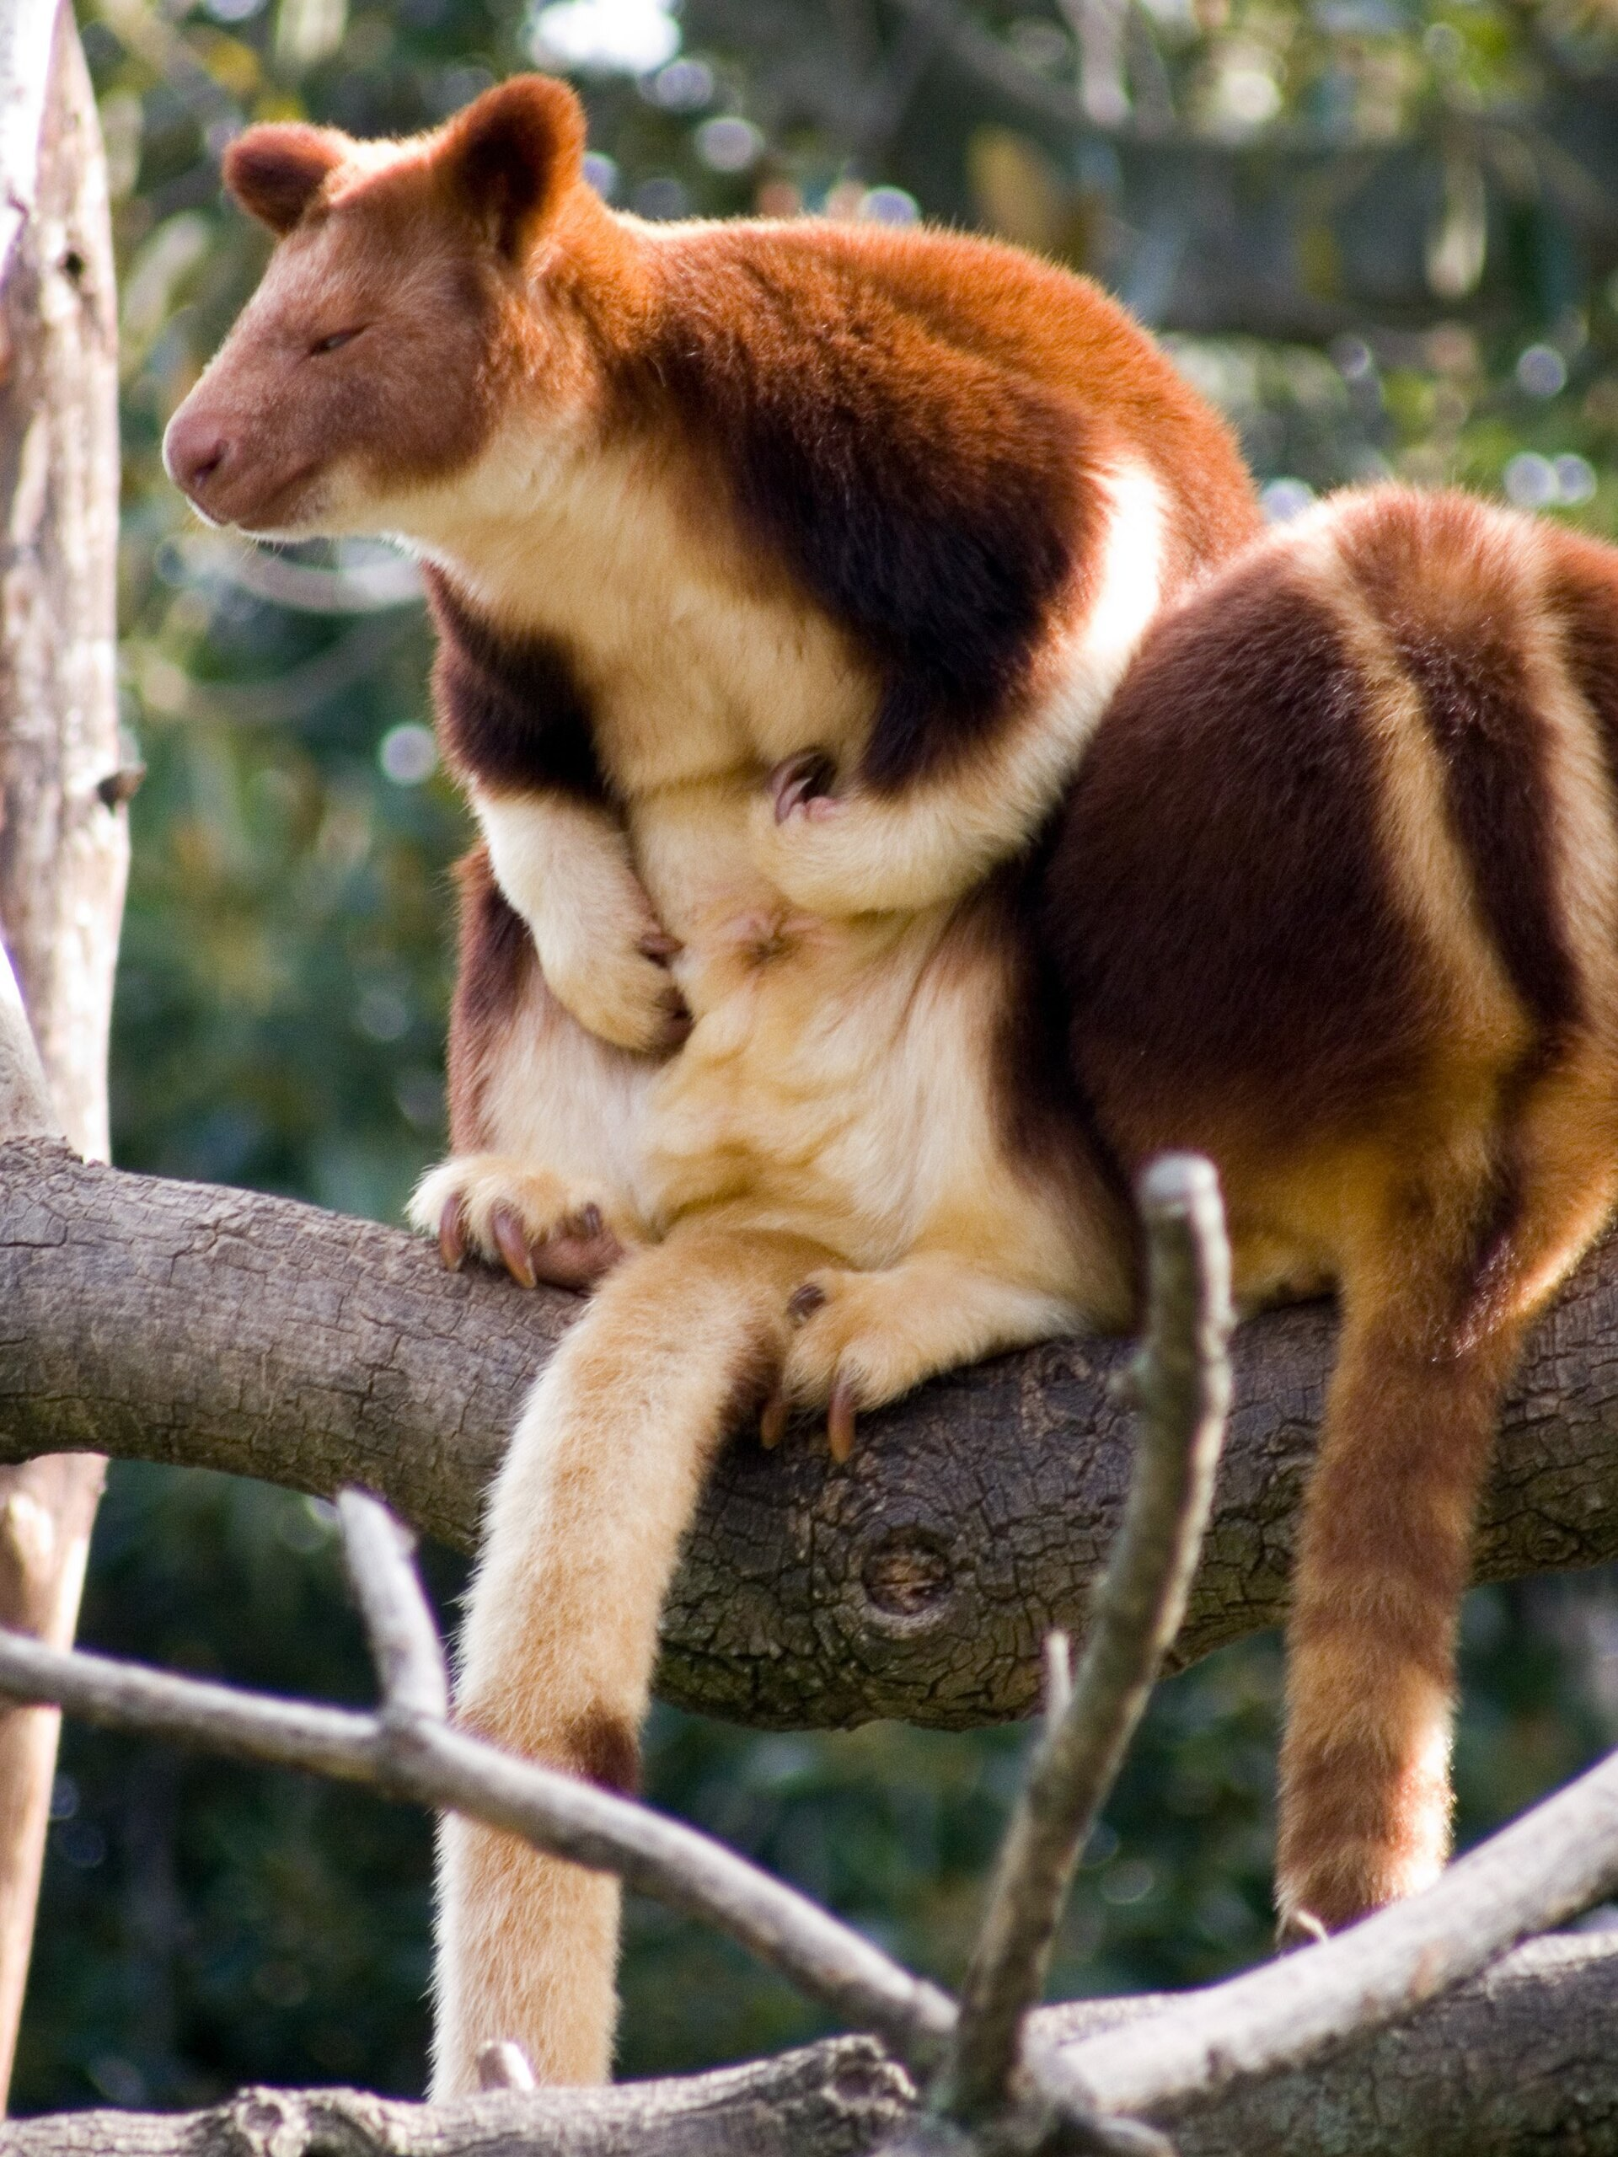
POLICY PILLAR 2
Conservation
The protection, management and sustainable use of natural resources, ecosystems and biodiversity.
It aims to preserve the diversity and integrity of living organisms and their habitats, ensuring their long-term survival and functioning.
Biodiversity conservation. Biodiversity is the variety of life on Earth — genetic, species and ecosystem diversity. Conservation safeguards it by protecting species from extinction and preserving their habitats.
Tree-kangaroos — endemic species at the centre of PNG conservation
9

Slide 10

POLICY PILLAR 2 · KEY PRINCIPLES
Principles of Conservation
Habitat protection
Endangered species protection
Preserve and restore forests, wetlands, coral reefs and grasslands critical to species survival.
Prevent decline through habitat restoration, captive breeding and tackling poaching and illegal trade.
Sustainable resource use
Ecosystem services
Manage forests, fisheries and water so human needs are balanced with ecosystem health.
Protect the clean air and water, pollination, climate regulation and soil fertility that ecosystems provide.
10

Slide 11

WHY CONSERVATION MATTERS
Conservation Is a Shared Effort
Education and awareness turn policy into everyday practice — fostering stewardship in communities.
Scientific research
Policy development
Community engagement
Collaboration
Understanding species, habitats and threats
Turning knowledge into rules and plans
Landowners as active conservation partners
Government, NGOs, researchers and communities
11

Slide 12
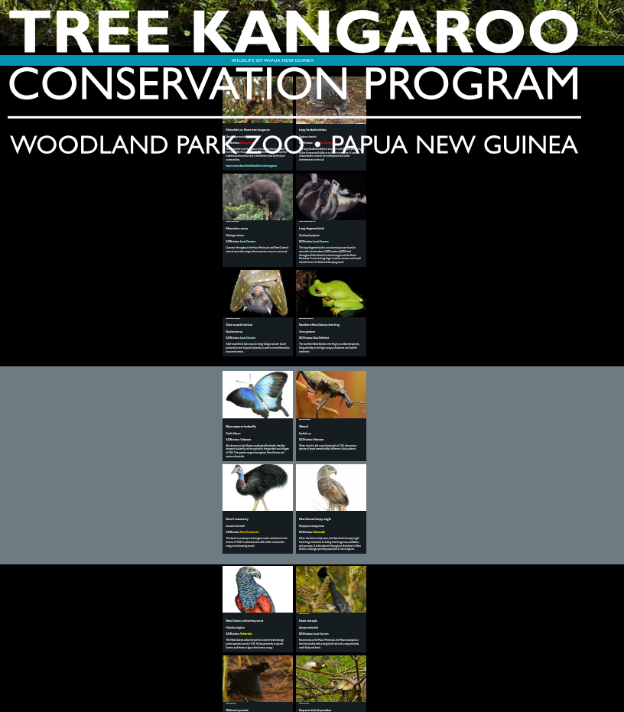
POLICY PILLAR 3
Protection of Endangered Species
Actions taken to prevent extinction and promote recovery of species at risk of disappearing from the Earth.
Endangered species face a high risk of extinction in the wild, typically due to:
habitat loss
poaching and illegal trade
climate change
pollution
invasive species
Tree Kangaroo Conservation Program — Woodland Park Zoo & PNG
12

Slide 13

POLICY PILLAR 3 · KEY PRINCIPLES
Protecting Endangered Species
Legal frameworks
Laws prohibit hunting, capturing, trading or harming endangered species, and set penalties for breaches.
Habitat conservation
Identify and preserve critical habitat; restore degraded areas and manage protected areas.
Captive breeding & reintroduction
Where populations are critically low, breed in captivity and return animals to the wild.
13

Slide 14


POLICY PILLAR 3 · KEY PRINCIPLES
Protecting Endangered Species (cont.)
Research & monitoring
Anti-poaching & enforcement
Track population trends and habitat needs so management can adapt in time.
Strengthen enforcement agencies and offer alternative livelihoods to communities.
International collaboration
Public awareness & education
Species cross borders — CITES regulates global trade in endangered species.
Campaigns and community programmes build understanding and responsibility.
14

Slide 15
02
Laws Governing Wildlife Management
The legislation that turns policy into enforceable protection
15

Slide 16
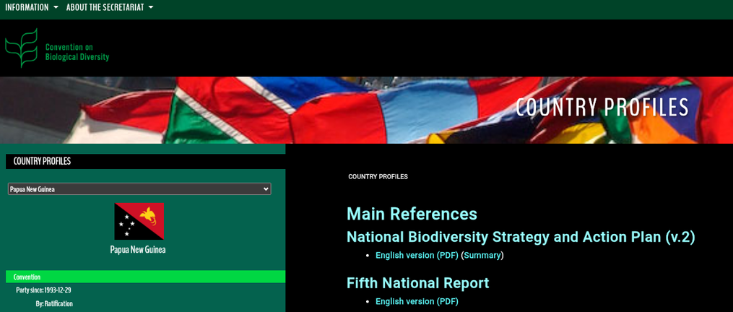
THE LEGAL BACKBONE
Key Legislation in PNG
Fauna (Protection and Control) Act 1966
Core wildlife law — protected fauna, sanctuaries, WMAs
Conservation Areas Act 1978
Conservation areas for sites of biological importance
National Parks Act 1982
National parks for conservation and public enjoyment
cbd.int/countries/?country=pg
International Trade (Flora & Fauna) Act 1979
Together these laws provide the framework for wildlife management, regulate hunting and trade, and set penalties for illegal activities.
Implements PNG's CITES obligations
Protected Areas Act 2023
New national protected-area system
16
Notes:
NOTE: the original slide listed a 'Wildlife Protection Act'. PNG has no statute of that name — the core wildlife law is the Fauna (Protection and Control) Act 1966. Conservation Areas Act 1978 and National Parks Act 1982 are correct.

Slide 17
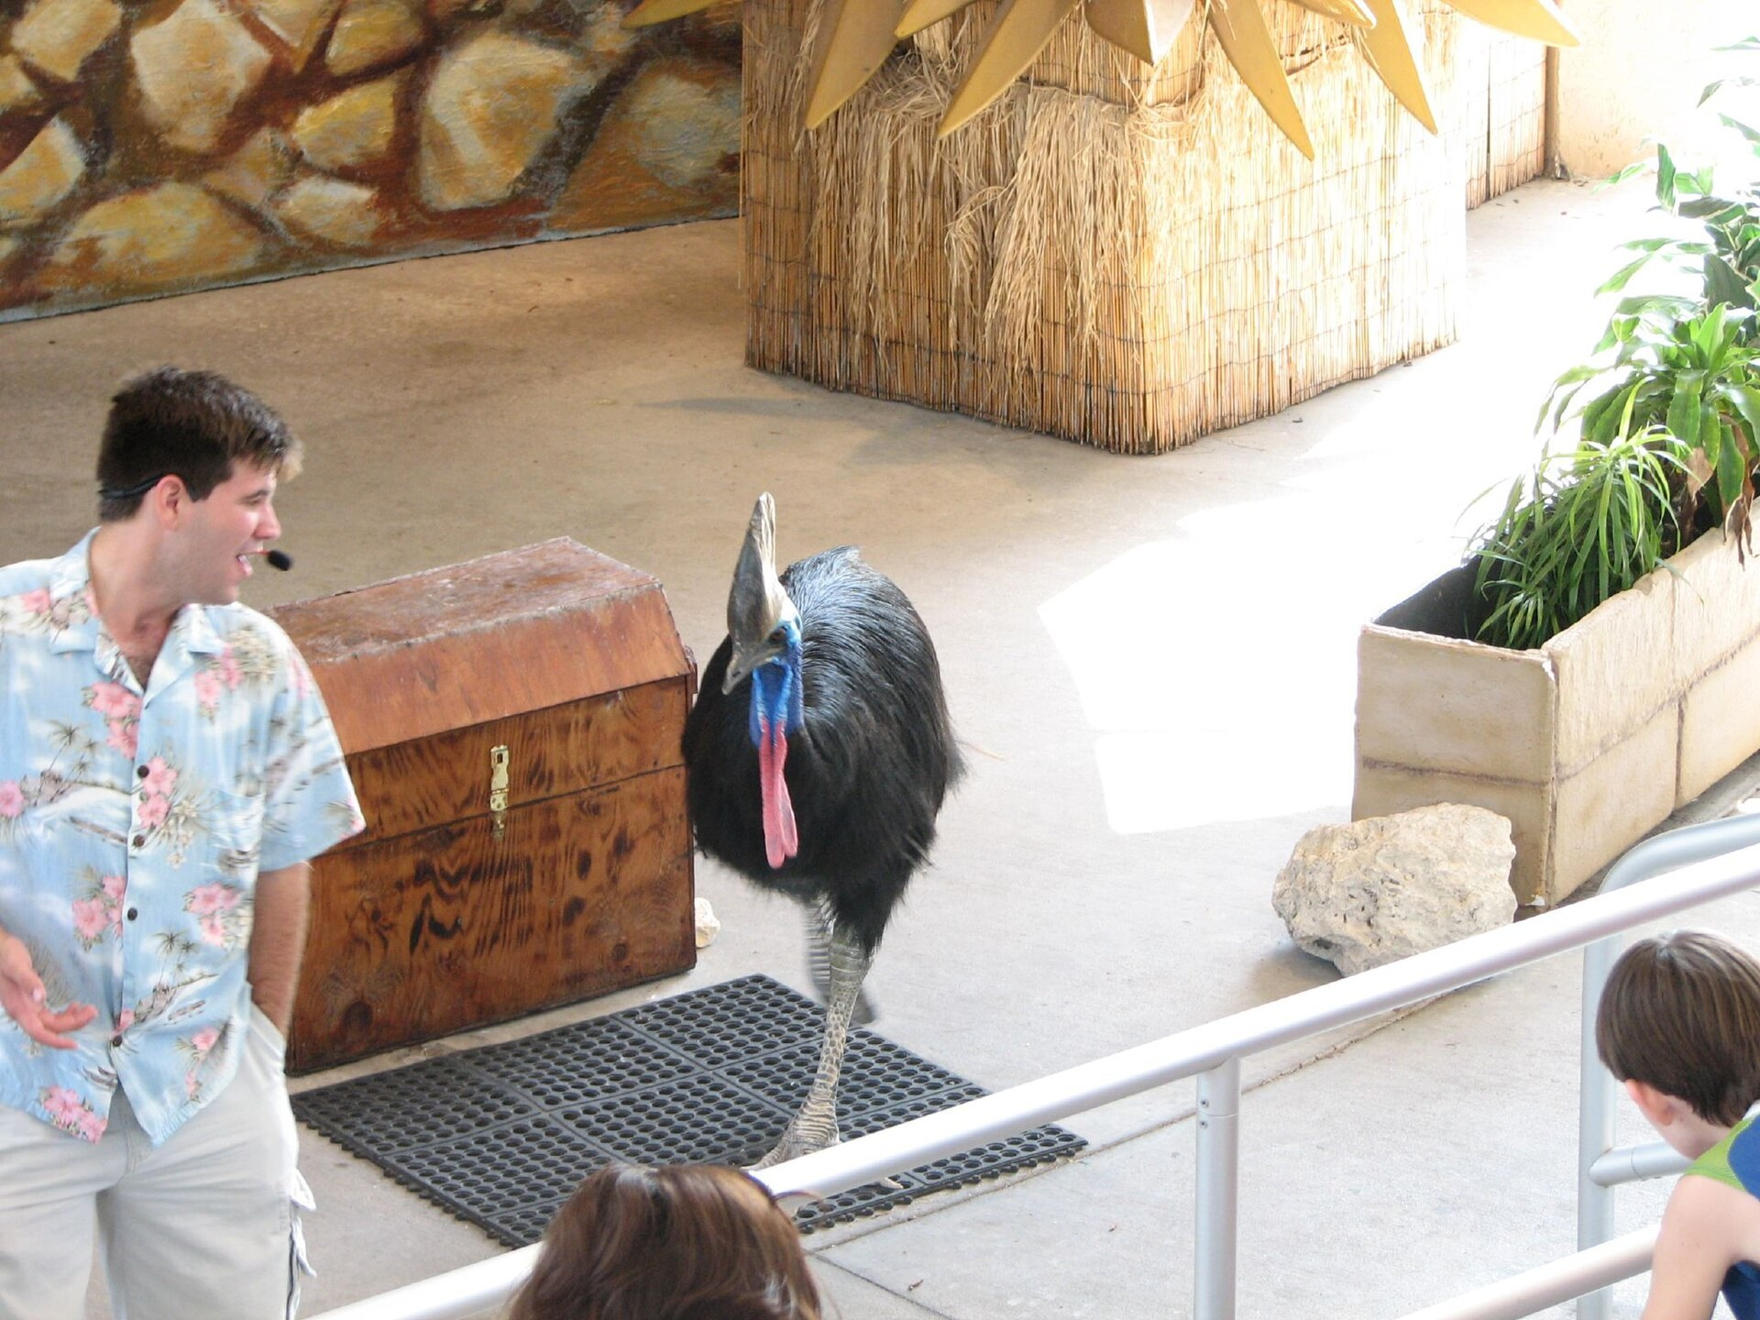

THE CORE WILDLIFE LAW
Fauna (Protection and Control) Act 1966
Declares protected fauna by notice in the National Gazette
Makes all protected animals the property of the State
Creates sanctuaries and Wildlife Management Areas
Requires permits to take, keep, trade or export wildlife
Appoints Rangers and a Conservator of Fauna to enforce it
Sets penalties for illegal hunting, capture and trade
Amended in 2014 and 2015 — the Act now sits under CEPA, whose Managing Director is the Conservator of Fauna.
Cassowaries are among PNG's protected fauna
17

Slide 18




THE NEWEST LAW
Protected Areas Act 2023
Passed by Parliament in February 2024 after two decades of drafting.
'30 by 30' target
Works with landowners
Biodiversity & Climate Fund
Alternative livelihoods
Protect 30% of PNG's land and sea by 2030
Legal process to declare protected areas on customary land
Long-term fund communities can access
Support for forest-dependent communities
18

Slide 19
03
Wildlife Conservation Areas in PNG
WMAs · National Parks · Conservation Areas
19

Slide 20
PROTECTING PNG'S UNIQUE FLORA AND FAUNA
Wildlife Conservation Areas in PNG
PNG has a diverse range of wildlife conservation areas — wildlife management areas (WMA), national parks, conservation areas and more.
These areas play a crucial role in protecting and conserving PNG's unique flora and fauna.
They provide habitat for threatened species, support research and education, and offer recreational opportunities for visitors.
PNG's protected landscapes and seascapes
20

Slide 21
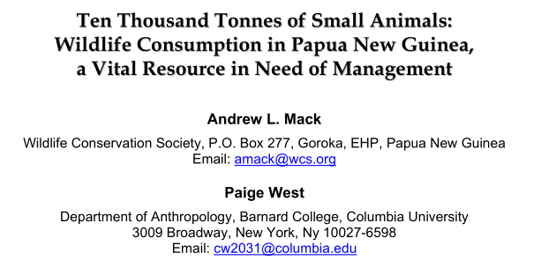
THE PNG MODEL
Wildlife Management Areas (WMA)
Designated regions where wildlife resources are managed sustainably for the benefit of local communities and conservation.
WMAs involve collaboration between:
government agencies
local communities
other stakeholders
They balance the economic needs of communities with the conservation of biodiversity.
Mack & West — Wildlife consumption in PNG, a vital resource in need of management
WMAs are a legal structure through which communities exercise greater control over their own wildlife resources.
21

Slide 22
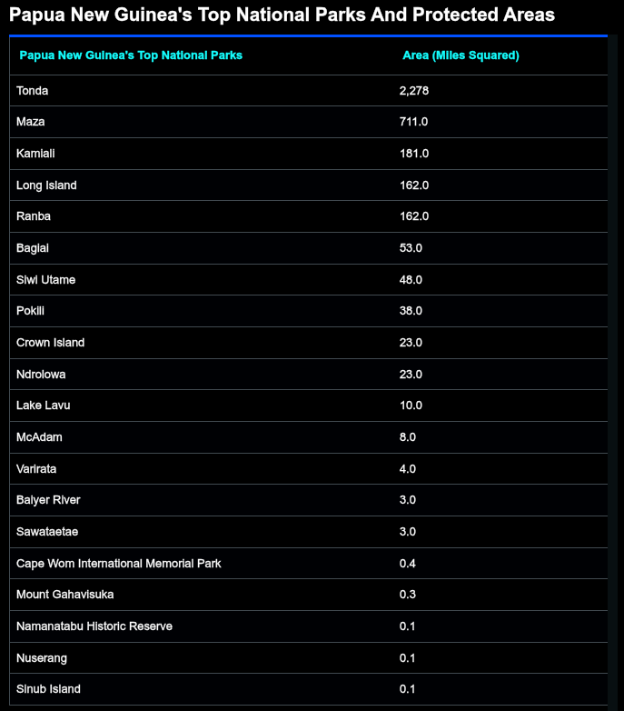
STATE-PROTECTED LANDS
National Parks & Protected Areas
National parks conserve outstanding natural and cultural heritage.
They preserve unique ecosystems, promote environmental education and support scientific research.
Well-known examples include Varirata, McAdam, Mount Gahavisuka and Namanatabu.
Note: the largest entries in this table — Tonda and Maza — are Wildlife Management Areas rather than national parks.
PNG's top national parks and protected areas, by area
22
Notes:
Tonda and Maza in the table are Wildlife Management Areas, not national parks. Actual national parks include Varirata, McAdam, Mount Gahavisuka.

Slide 23
CONSERVATION-FIRST AREAS
Conservation Areas
Designated for the protection and management of natural resources, including wildlife.
They encompass diverse ecosystems — rainforests, wetlands and coral reefs.
They are critical habitat for endemic species and anchor national conservation efforts.
58
Well-known examples
Kokoda Track
Central / Oro
conservation areas in Papua New Guinea
Sepik River Basin
East Sepik
Managed by government, local communities and NGOs to protect unique biodiversity and cultural heritage.
YUS Conservation Area
Huon Peninsula
YUS was PNG's first Conservation Area, created by landowners for the Matschie's tree-kangaroo.
23

Slide 24
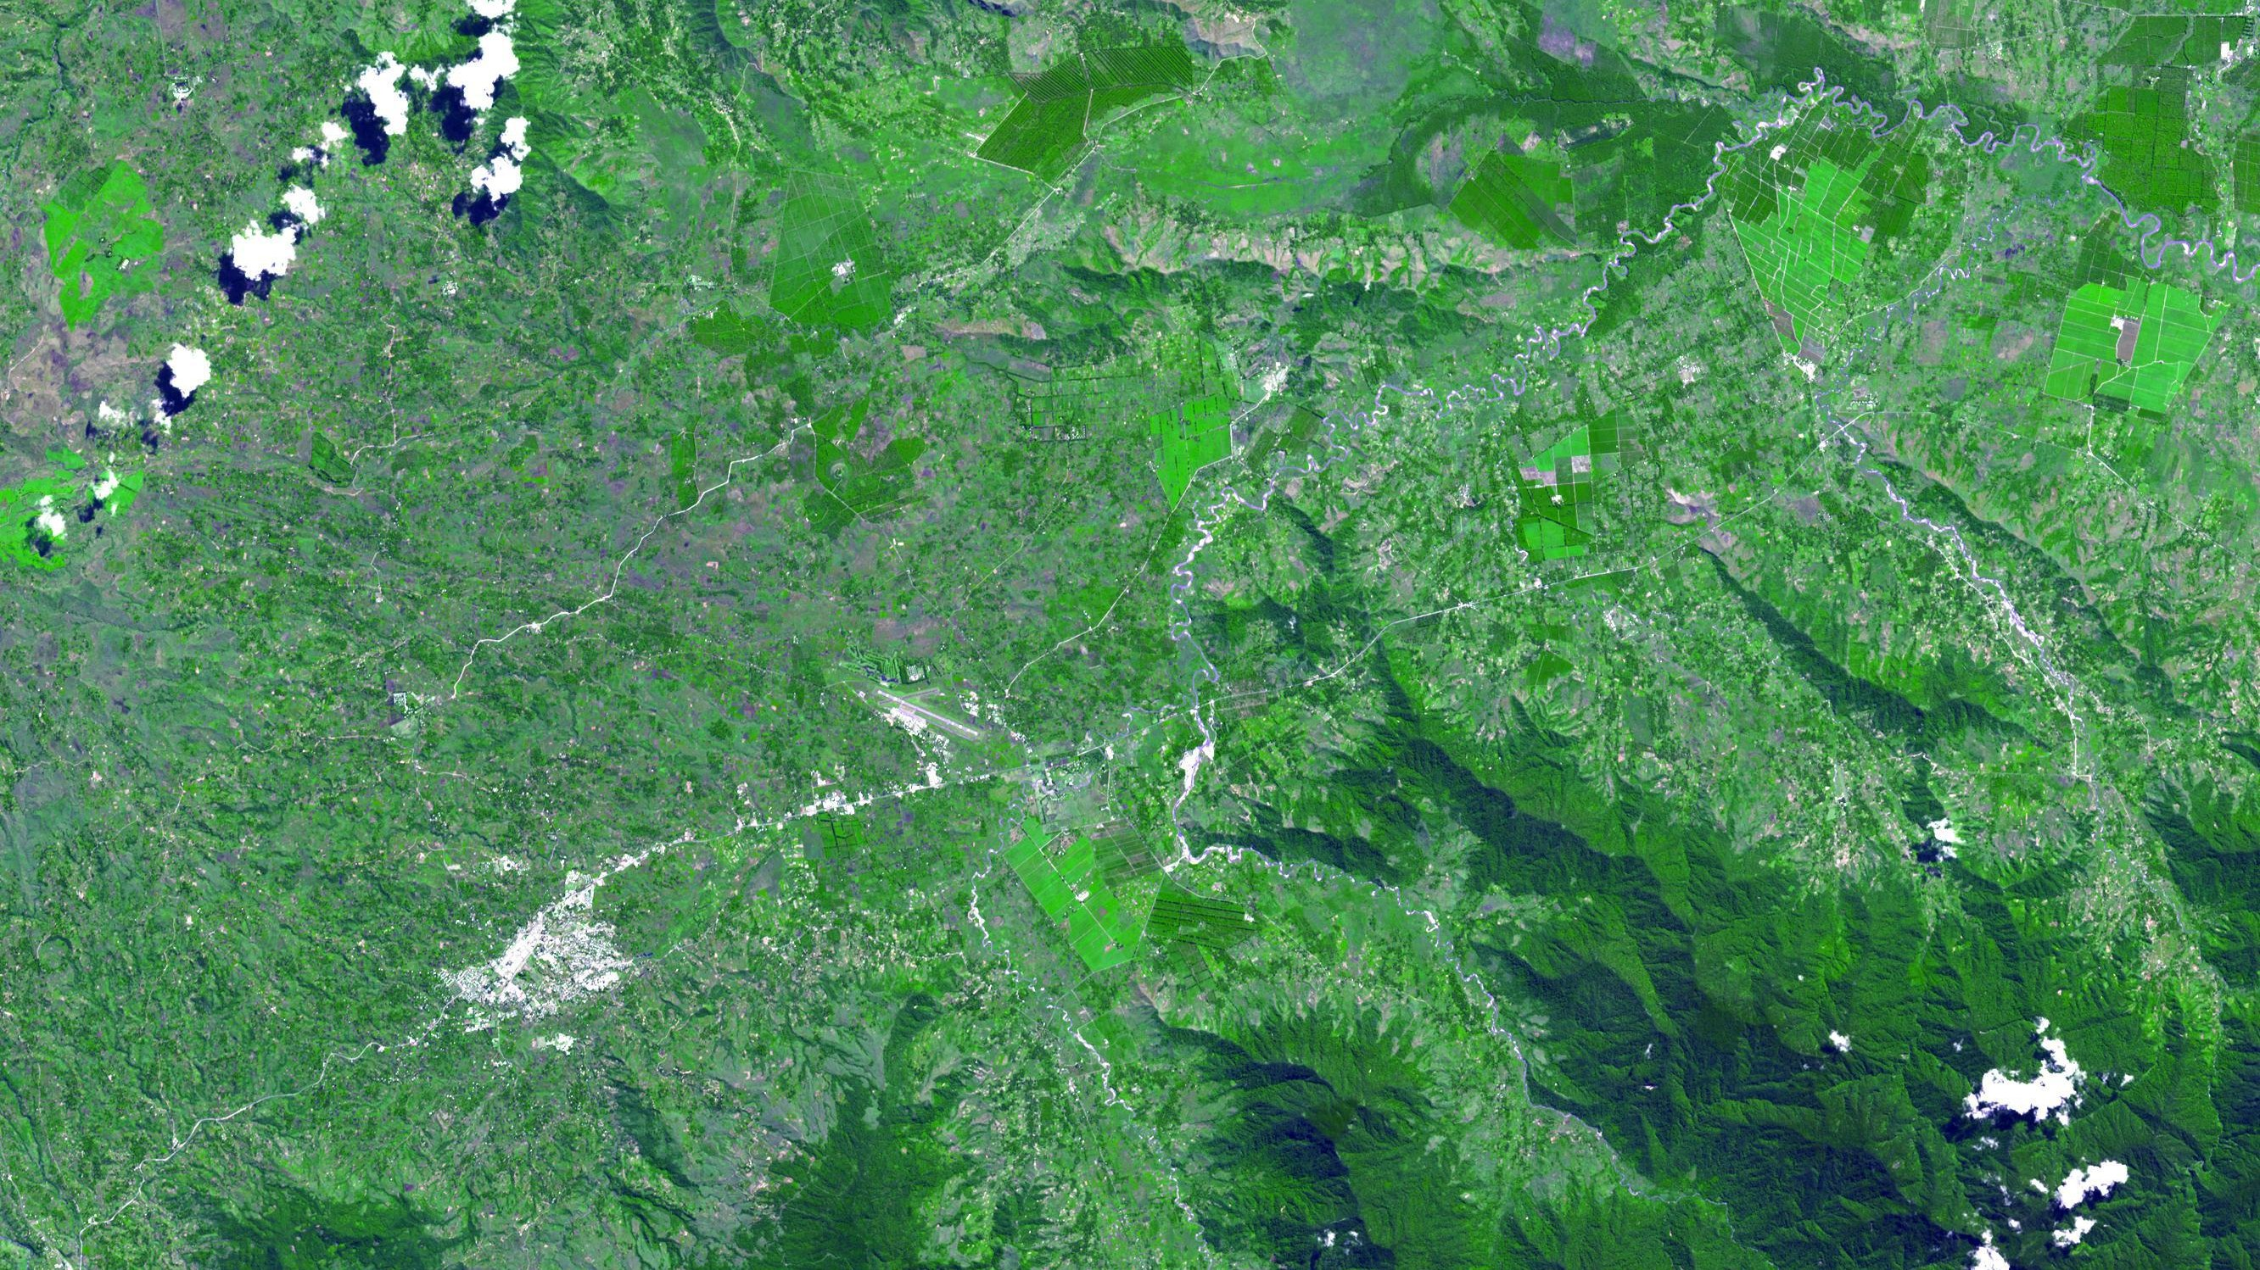
04
World Heritage Sites & Others
PNG's place in the global heritage and conservation system
24

Slide 25
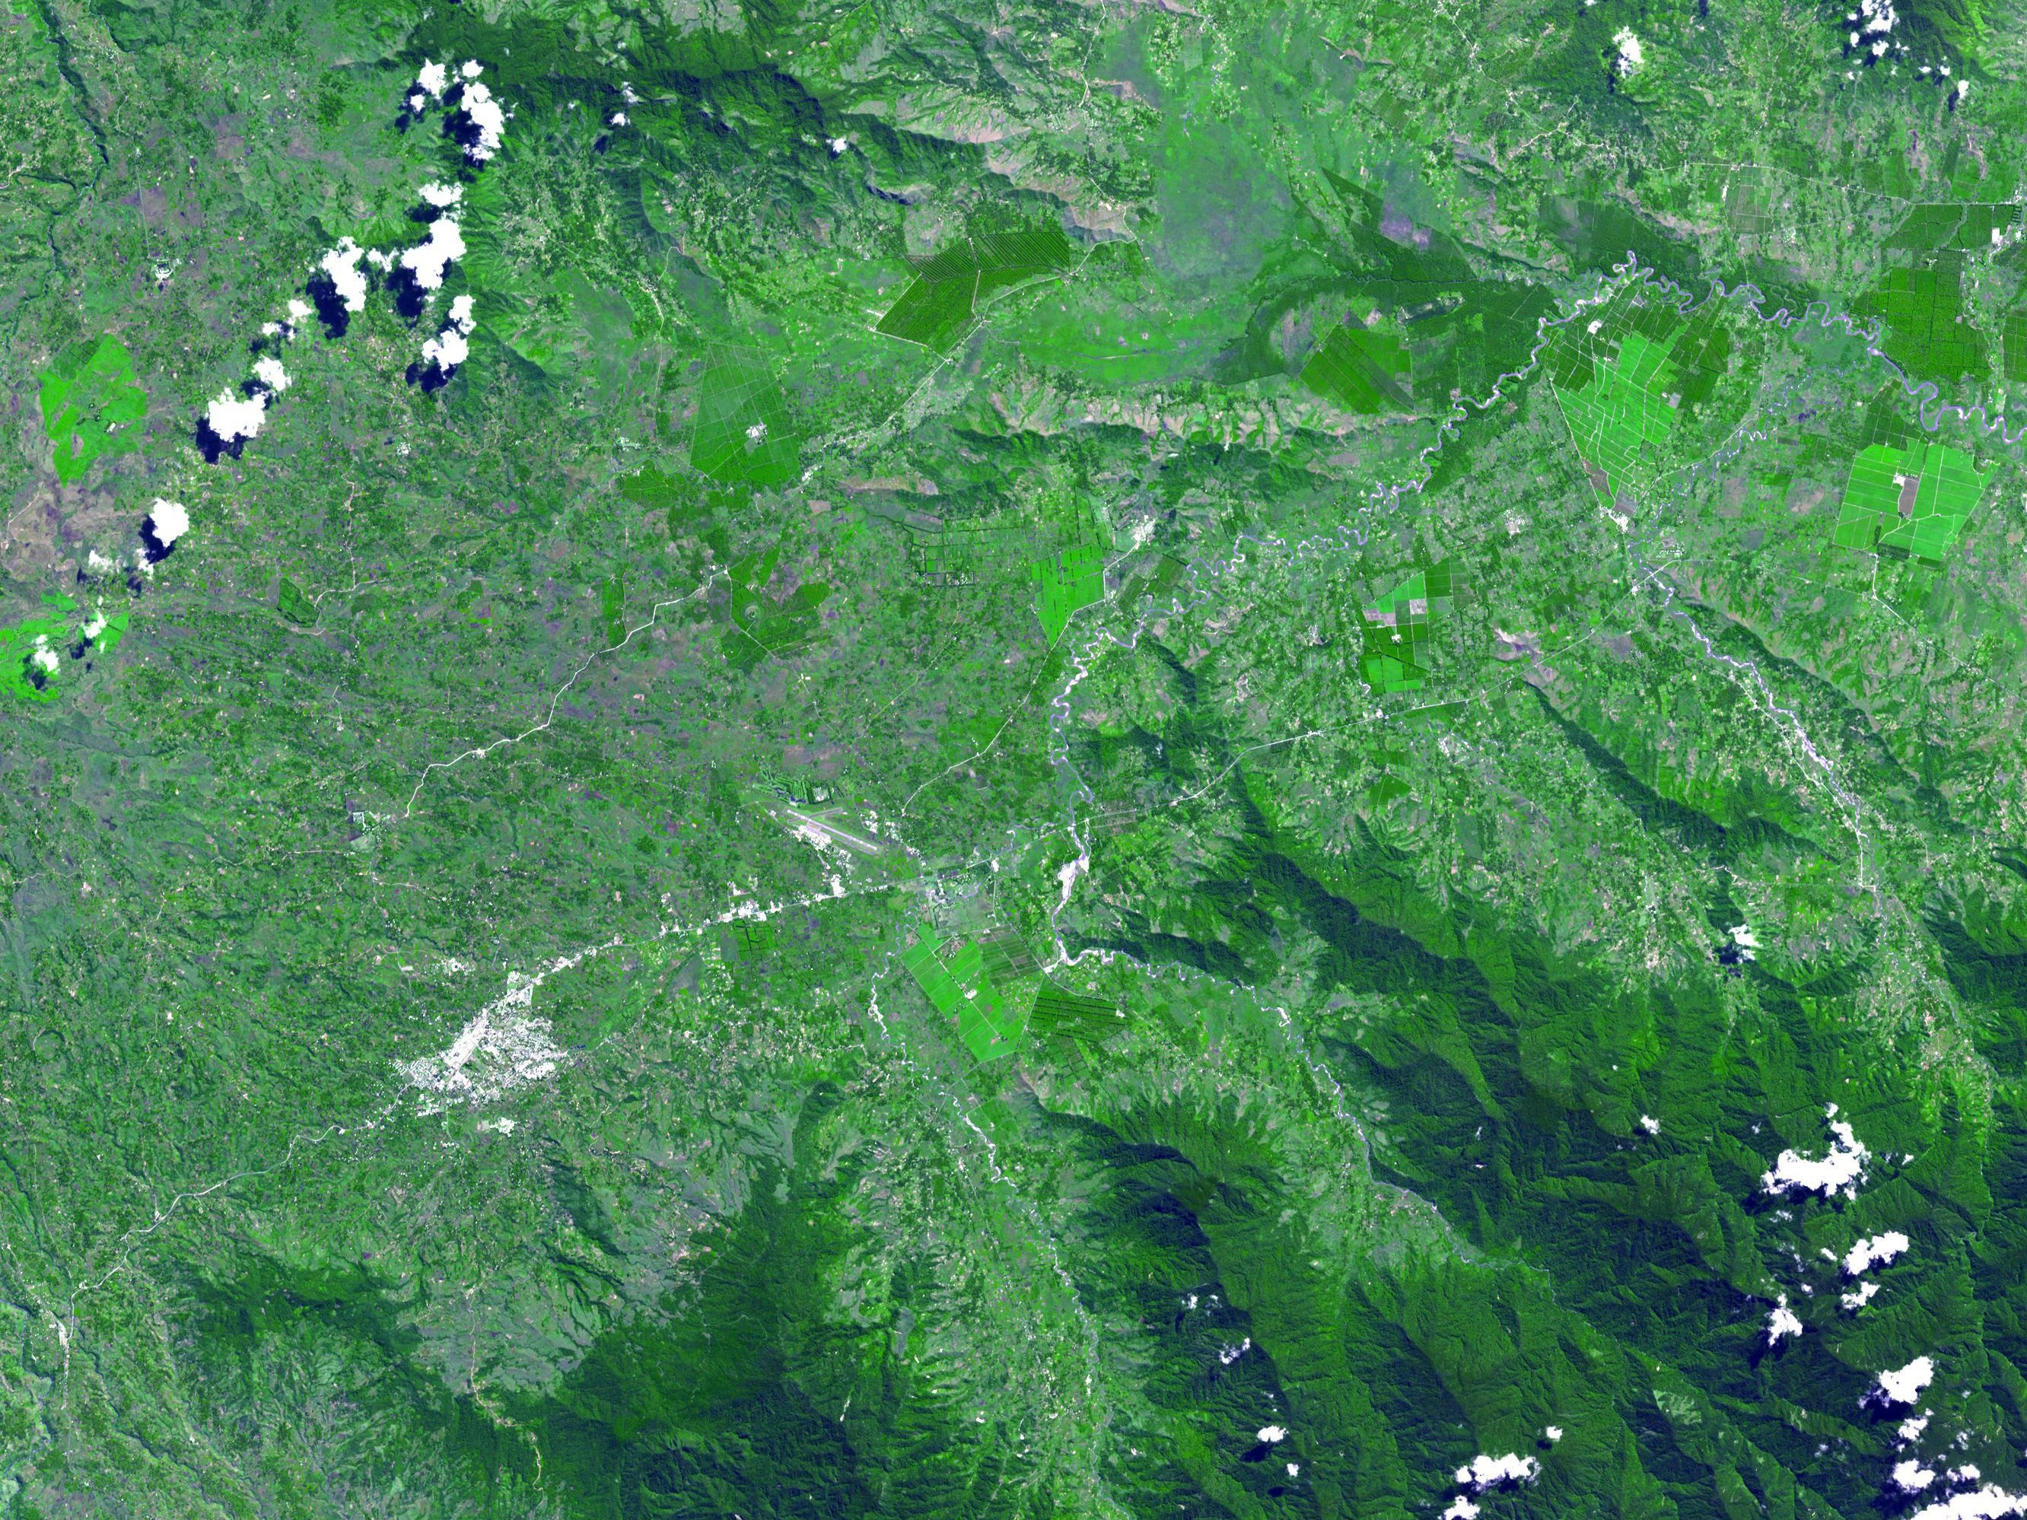

PNG'S ONLY INSCRIBED SITE
Kuk Early Agricultural Site
Inscribed by UNESCO in 2008
A 116-hectare swamp in the Wahgi Valley, ~1,550 m above sea level — one of the few places on Earth where people independently invented agriculture.
~7,000–10,000 years of near-continuous wetland cultivation
Taro, banana and sugarcane domesticated by Highland peoples
The Melpa-speaking Kawelka people are custodians today
Kuk Swamp, Western Highlands
25
Notes:
Kuk (2008) is PNG's ONLY inscribed World Heritage Site. Parliament House is not a World Heritage Site — the seven other candidates are on the tentative list.

Slide 26
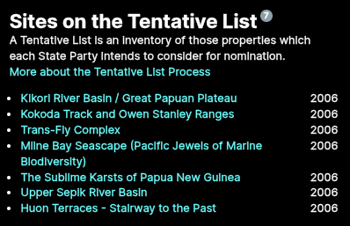
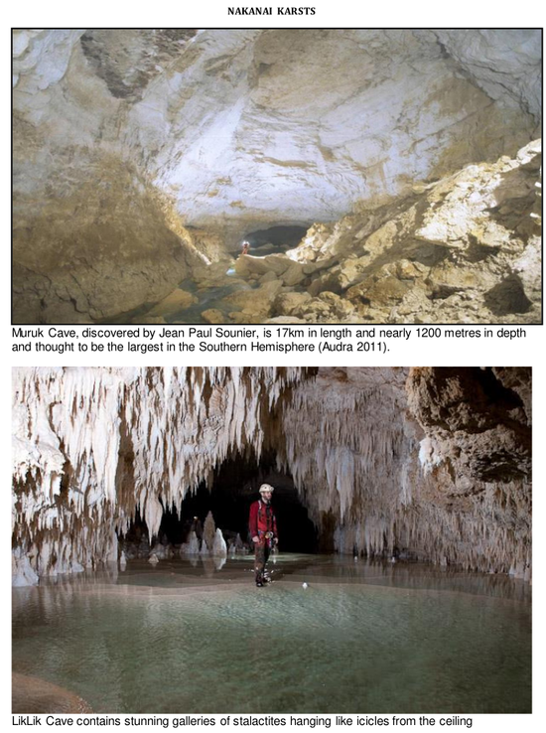
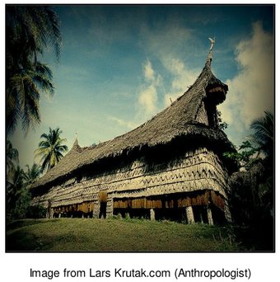
WHAT COMES NEXT
PNG's World Heritage Tentative List
Kuk is PNG's only inscribed World Heritage Site — but seven further sites sit on the tentative list.
Several are of direct wildlife and habitat significance:
Kikori River Basin / Great Papuan Plateau
Kokoda Track and Owen Stanley Ranges
Trans-Fly Complex
Milne Bay Seascape (Pacific Jewels of Marine Biodiversity)
The Sublime Karsts of Papua New Guinea
Upper Sepik River Basin
UNESCO tentative list — sites PNG intends to nominate
26

Slide 27
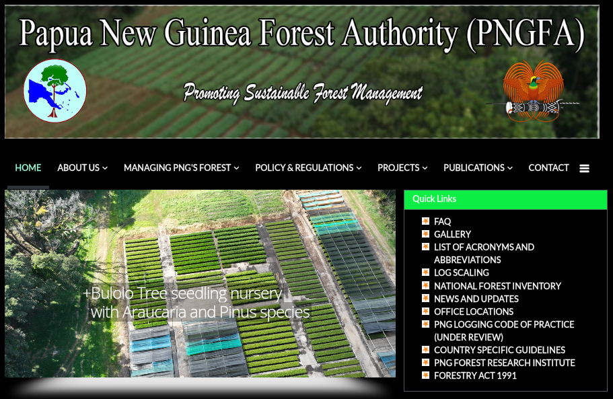
TWO SIDES OF ONE COIN
Forestry and Wildlife Management
The relationship between forestry and wildlife management in PNG is intricate and interconnected.
Forests provide essential habitat, and sustainable forestry can contribute directly to biodiversity conservation.
However, unsustainable logging threatens wildlife populations and their habitats.
Integrating wildlife considerations into forestry practice is crucial for ecological balance and sustainable resource use.
PNG Forest Authority — promoting sustainable forest management
27

Slide 28
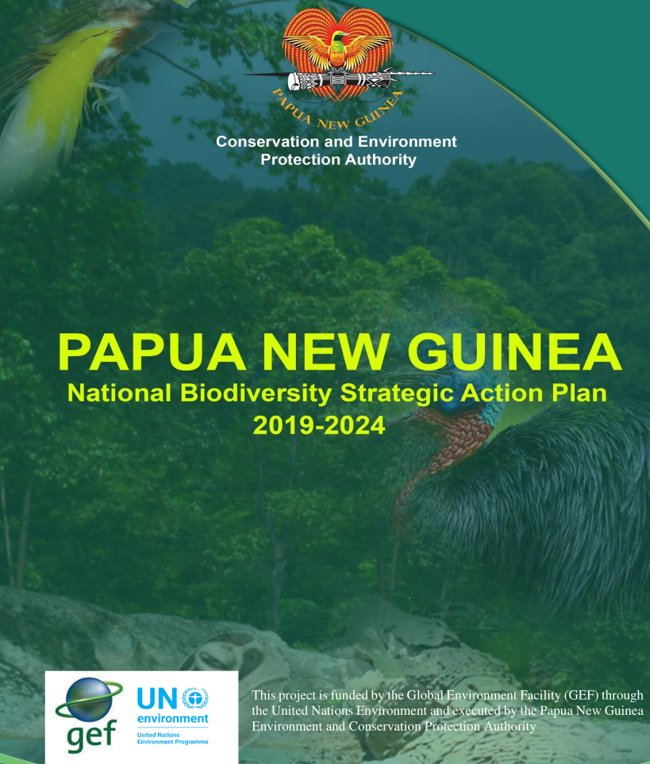
BRINGING IT TOGETHER
Conclusion
PNG has implemented wildlife management policies and laws to protect its rich biodiversity.
WMAs, national parks and conservation areas have been instrumental in conserving unique species and ecosystems.
By recognising the link between forestry and wildlife management, PNG aims to achieve sustainable resource use while safeguarding its natural heritage.
PNG National Biodiversity Strategic Action Plan 2019–2024
28

Slide 29
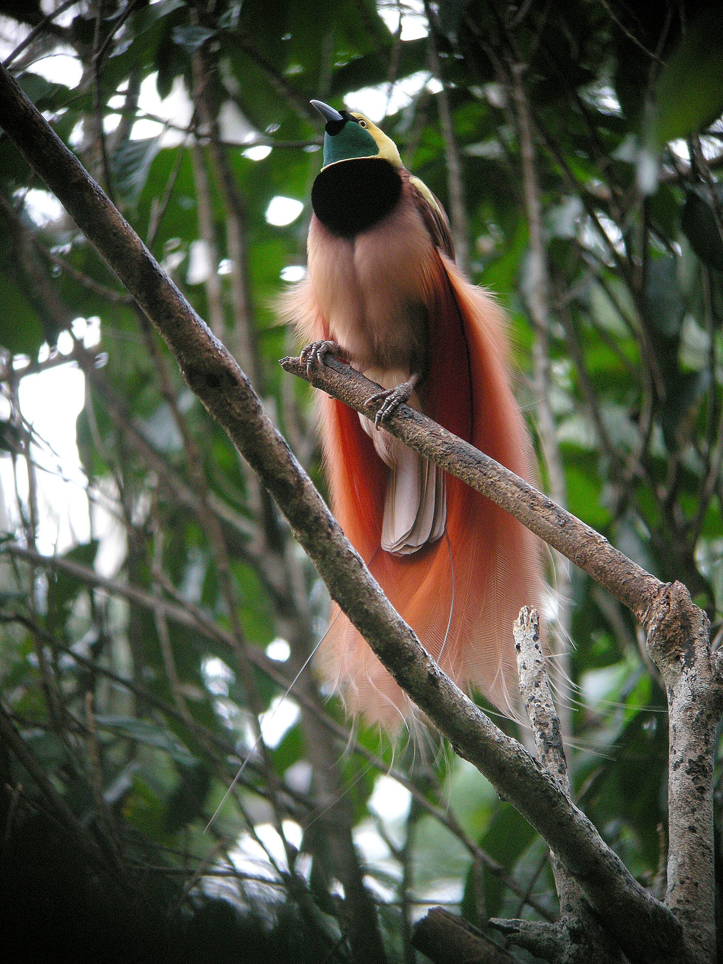
OVER TO YOU
Discussion Questions
Why is community-based management through WMAs especially suited to PNG's customary land ownership?
Q1
How does a national park differ in purpose from a conservation area?
Q2
What does the Protected Areas Act 2023 add that the older laws did not provide?
Q3
As a forester, how would you reduce harm to wildlife when planning a logging operation?
Q4
Raggiana bird-of-paradise — PNG's national bird
29

