Slide 1




STRATEGIC GUIDE
Boosting Sales and Building Market Goodwill
In any business, sales and goodwill are inextricably linked. The profits from increased sales arrive alongside customer trust, loyalty, and long-term brand strength. When both flourish together, your company becomes more competitive, gains better recognition, and achieves greater profitability.

Slide 2

The Foundation: Know Your Customers Deeply
A successful sale begins with a thorough understanding of the customers most likely to purchase your product. Without this foundation, even the most brilliant marketing efforts will fall flat.
Deep customer knowledge enables you to refine product design, sharpen positioning, and create promotions that truly resonate. This isn't about guesswork—it's about systematic insight gathering that drives real results.
Deploy Simple Surveys
Investigate Pain Points
Use feedback forms to capture customer sentiment and preferences regularly
Examine the problems customers encounter and their buying habits more closely
Track Common Enquiries
Research Competitors
List the questions customers ask most frequently to identify knowledge gaps
Discover what customers expect by analysing competitor offerings and positioning

Slide 3





Enhance Perceived Value
Customers consistently choose products that deliver clear, demonstrable value. It's not merely about features—it's about the perception of quality, uniqueness, and the overall experience your product provides.
Elevate Quality
Upgrade product quality and packaging to exceed customer expectations
Highlight Uniqueness
Emphasise specific features that competitors aren't offering to stand out
Support Vigorously
Provide robust customer assistance alongside attractive offers and bonuses
Deliver Consistently
Maintain the same high standard across every product and interaction
When confidence is built through consistent value delivery, your product rises in the hearts and minds of your customers, creating a lasting competitive advantage.

Slide 4

Create a Distinct Brand Identity
Goodwill flourishes when people trust and recognise your brand instantly. A distinct identity isn't just visual—it's the entire experience customers associate with your company.
Strong branding builds the foundation for trust, which directly enhances both immediate sales and enduring market goodwil. Every touchpoint should reinforce who you are and what you stand for.
01
02
Memorable Logo
Unified Visual Language
Create a simple, recognisable logo that customers remember instantly
Establish a consistent colour scheme and voice across all channels
03
04
Compelling Story
Trust Signals
Craft a brand narrative that explains why your product exists and matters
Display reviews, testimonials, and case studies prominently to build credibility

Slide 5





Elevate the Customer Experience
A happy customer is the strongest advertising tool. Their recommendations carry more weight than any paid campaign ever could.
Timely Response
Acknowledge and respond to all enquiries promptly and professionally
Respectful Treatment
Handle every customer with professionalism and genuine care
Simple Process
Ensure clear communication and an uncomplicated purchasing journey
Continuous Support
Offer assistance before, during, and after every sale
Happy customers become repeat buyers and enthusiastic brand ambassadors who actively promote your business within their networks, creating a virtuous cycle of growth.

Slide 6

Smart Promotional Strategies
Effective promotion extends far beyond discounts—it's about gaining visibility, building influence, and creating compelling reasons for customers to choose you. Strategic promotions drive rapid sales growth whilst maintaining your brand's positive reputation.
Limited-Time Offers
Create urgency to motivate immediate purchasing decisions
Targeted Social Ads
Focus on specific customer segments for maximum impact
Influencer Partnerships
Collaborate with trusted voices to expand your reach
Seasonal Marketing
Risk-Free Trials
Capitalise on celebrations, events, and special occasions when customers are primed to purchase
Offer free samples, trials, or money-back guarantees to reduce purchase hesitation

Slide 7


Harness the Power of Social Proof
Customers place significantly more trust in other customers than in advertisements. Social proof transforms sceptical prospects into confident buyers by demonstrating that others have succeeded with your product.
Customer Reviews
Transformation Stories
User-Generated Content
Display authentic feedback and ratings prominently on your website and product pages
Showcase before-and-after results that demonstrate tangible outcomes
Feature customer photos, videos, and testimonials across your channels
Expert Endorsements
Data-Driven Results
Leverage recommendations from recognised authorities and influencers
Present research reports and case studies demonstrating measurable outcomes
Key Insight: The more proof you provide, the easier it becomes for customers to trust your brand and make confident purchasing decisions.

Slide 8
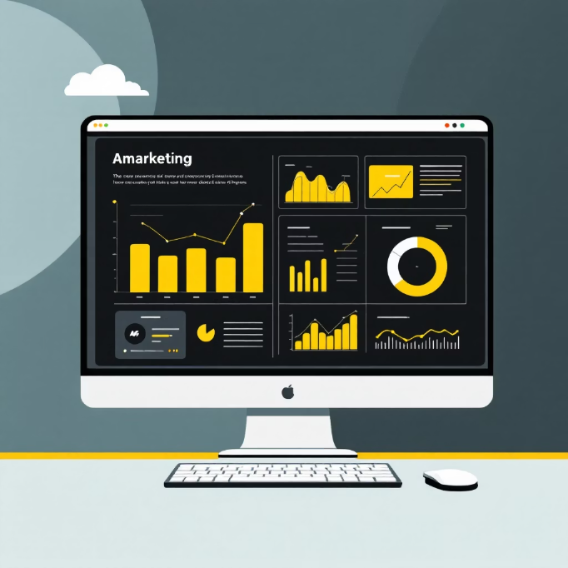
Digital Marketing Excellence
Digital platforms deliver exceptional results when used strategically and consistently. A powerful digital presence simultaneously enhances brand reputation and increases product visibility across multiple touchpoints.
The key is selecting the right channels for your audience and maintaining a cohesive, value-driven approach across all platforms.
Social Media Marketing
Share valuable, engaging content that educates and entertains your audience regularly
Search Engine Optimisation
Improve your website's rankings to capture high-intent customers actively searching
Email Marketing
Nurture leads and encourage repeat purchases from existing customers through personalised campaigns
Content Marketing
Develop blogs, videos, reels, and comprehensive guides that establish thought leadership
Paid Advertising
Use Google Ads and Meta Ads to expand reach to precisely targeted audience segments

Slide 9




Build Lasting Customer Relationships
Long-term relationships are the wellspring of genuine market goodwill. When customers perceive their worth within your company, they not only remain loyal—they become vocal advocates who actively promote your products.
Loyalty Programmes
Returning Customer Perks
Personalised Communication
Milestone Recognition
Reward repeat customers with points, discounts, and exclusive benefits
Acknowledge birthdays, anniversaries, and other personal occasions
Offer special discounts that acknowledge and appreciate continued patronage
Send tailored emails and recommendations based on purchase history
In B2B contexts, regular client meetings and strategic check-ins demonstrate commitment and uncover new opportunities for collaboration and growth.

Slide 10

Maintain Consistency and Monitor Progress
Inconsistency is the greatest enemy of goodwill. A consistent business becomes a trusted business.
Ensuring Consistency
Key Performance Indicators
Conduct regular quality control audits across all products and services
Track sales reports over time to identify trends and patterns
Implement Standard Operating Procedures (SOPs) for all critical processes
Monitor lead-to-customer conversion rates closely
Train personnel thoroughly and hold them accountable to standards
Gather regular customer satisfaction feedback through surveys
Maintain punctual delivery times without exception
Analyse customer repurchase rates and lifetime value
Communicate clearly and consistently with all stakeholders
Assess market perception through reviews and social listening
Final Thoughts
Whilst realising product sales matters tremendously, generating market goodwill guarantees your business's long-term survival. When customers trust your brand, recommend it enthusiastically, and return repeatedly, you've built a powerful engine for sustainable success.
Combine value-driven products, strong branding, intelligent marketing, excellent customer service, and continuous improvement—and you can always expect steady growth in both sales and goodwill.

