Slide 1

311 Service Request Dade County 2023

Slide 2
Background and Methodology
Purpose:
Understand the community service needs to enhance service delivery and community satisfaction
Identify potential improvements for resource allocation and future service delivery enhancements.
Data Collection and Methodology:
Sourced datasets from Miami Dade County’s 311 open data hub
Executed union operation to merge distinct dataset and consolidate view
Scope of Analysis:
Explored 311 service requests data (2020 and 2021)
Focused on closed or completed tickets for service request patterns

Slide 3
Key Objectives
Identify predominant issue types:
Type of requests submitted by the community (example of issue types: bulky trash requests, noise complaints, potholes)
Examine geographical distribution:
Location and concentrations of service requests across different neighborhood by zip code
Examine Method Usage:
What prevalent communication channels are used (i.e. phone, web, walk-in, mail, etc.)
Formulate Business Recommendations:
Derive actionable insights from the analysis to propose business strategies for service delivery improvements

Slide 4
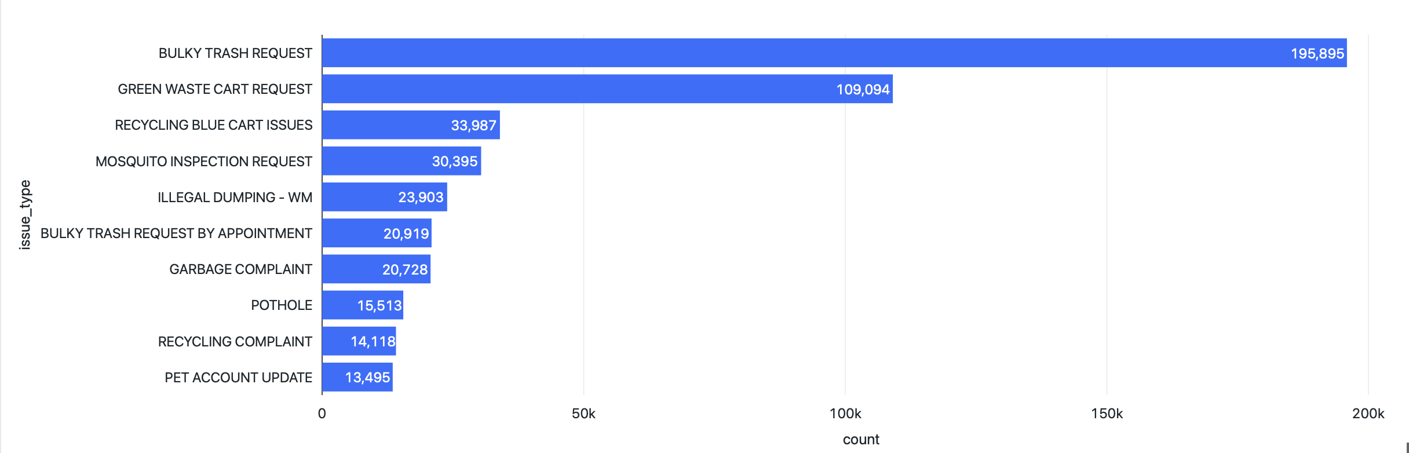


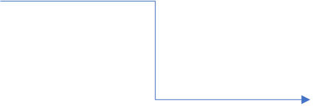



1. What is the most common “Issue_Type” reason?

Slide 5
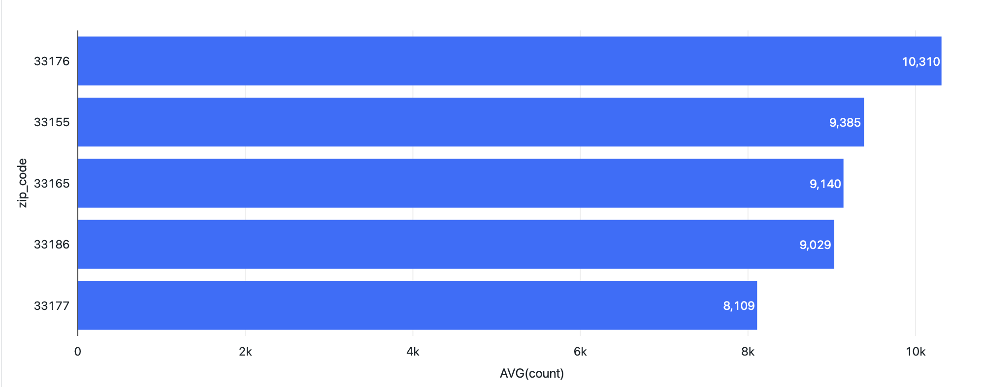
2. Which are the top 5 Zip Codes with most "Bulky trash requests"?
Kendall
Miami
Westchester
Kendall
South Miami Heights

Slide 6
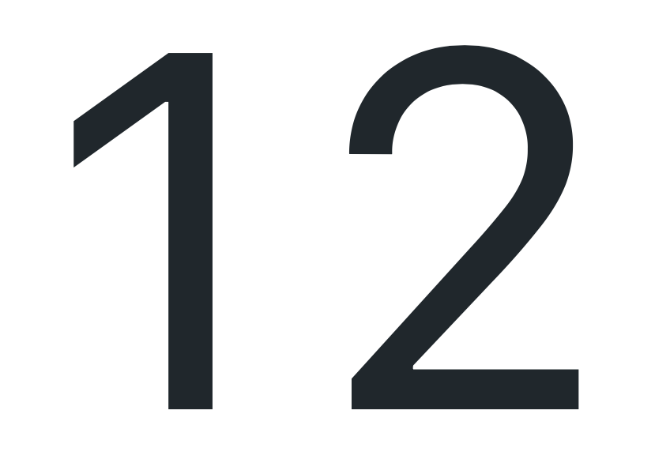
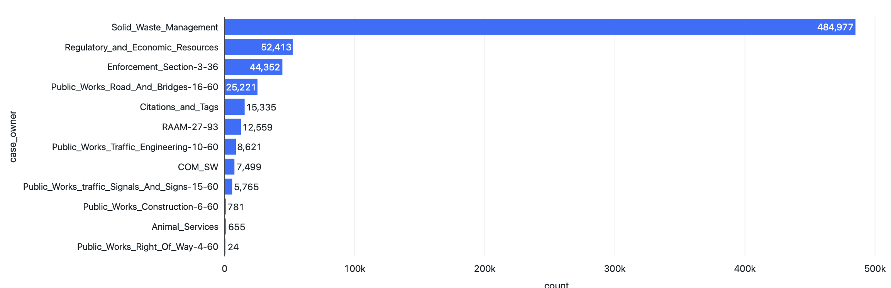
4. How many different departments are there?
5. Which department is handling the most service request calls?

Slide 7
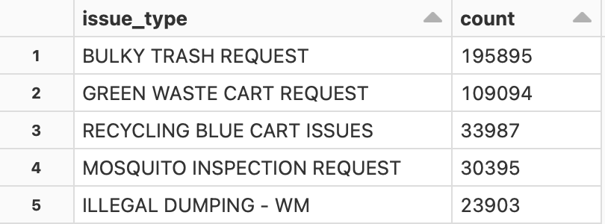
6. What are the most common “issue_type” within the ‘”solid_waste_management” department?

Slide 8
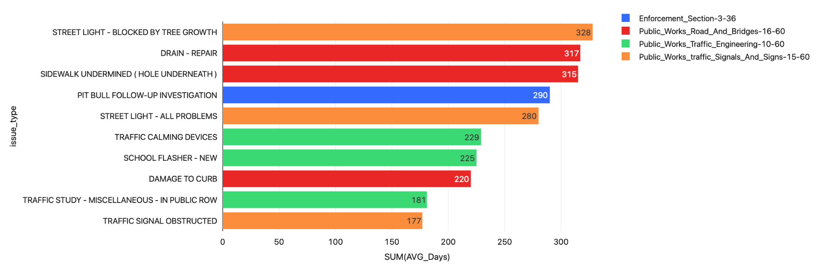
7. What type of ticket takes longer to resolve on average?

Slide 9
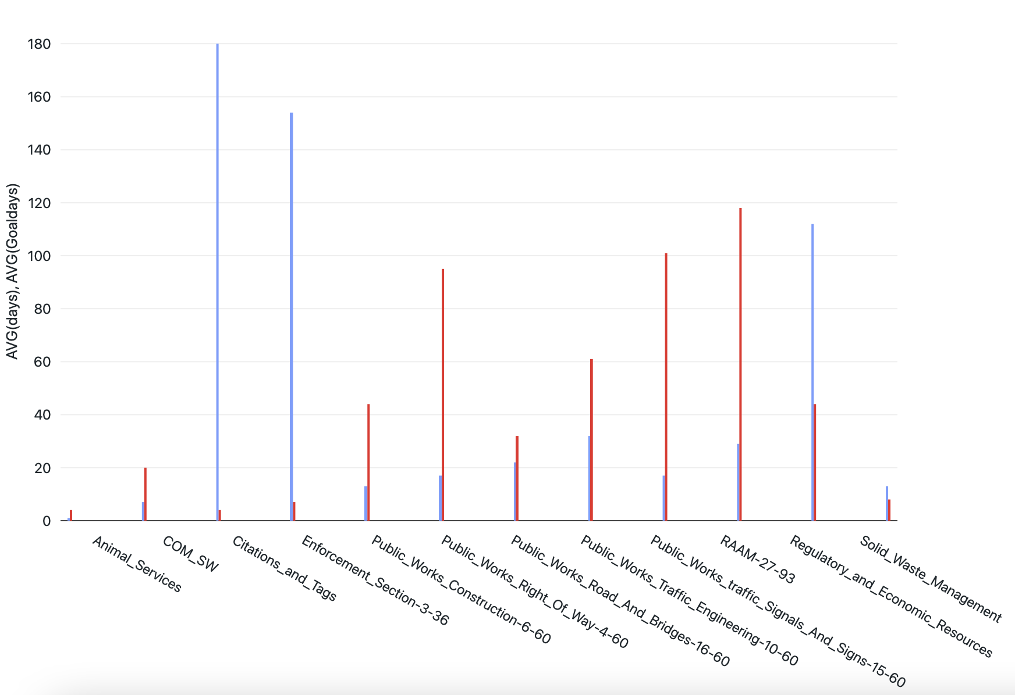
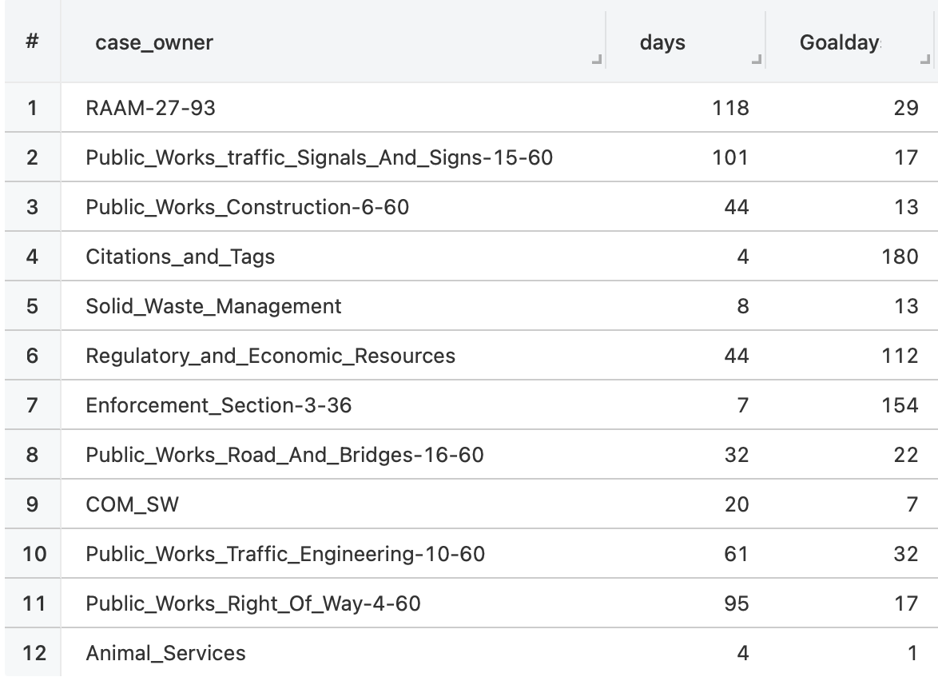

8. Performance by departments
AVG Goal days
AVG days

Slide 10
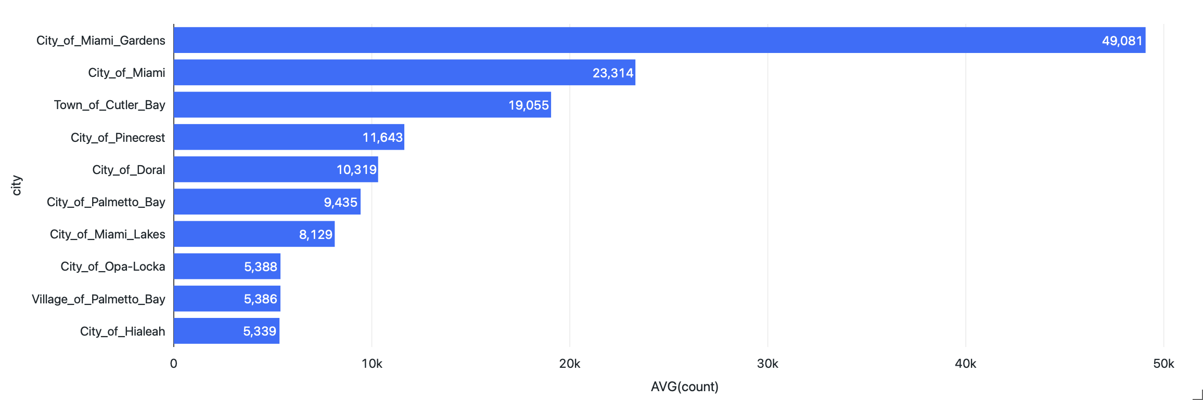
9. Which city has the highest number of tickets?

Slide 11
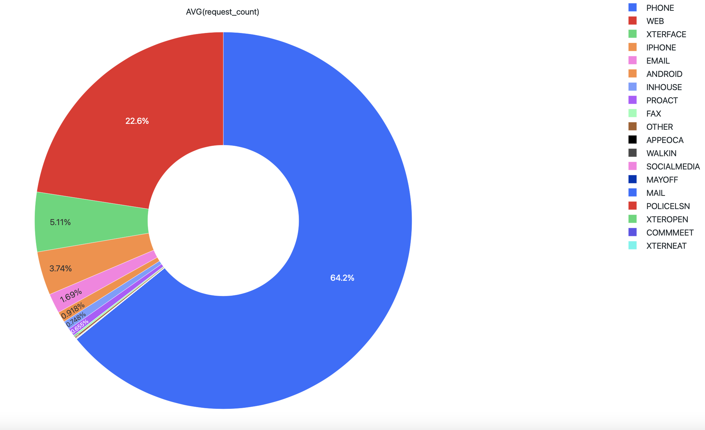
10. Top 5 methods used for requests.

Slide 12
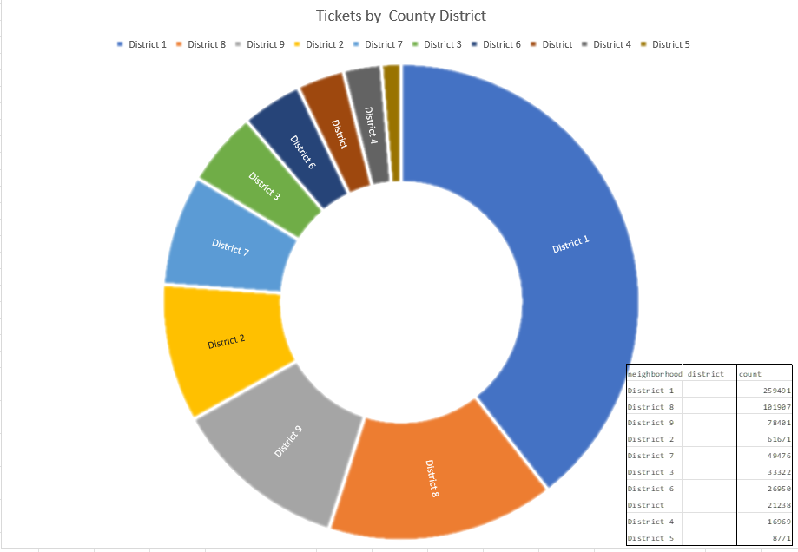
11. Total Request Service Tickets by District

Slide 13
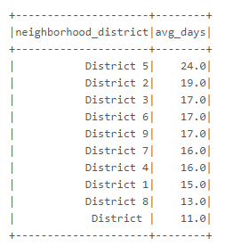
12. Average number of days to close a service ticket by County District
(https://www.miamidade.gov/elections/library/reports/2022-july-miami-dade-precincts-with-zip-codes.pdf)

Slide 14
Correlation & Conclusion
Based on the dataset analysis, we arrive to the following findings:
Using spearman correlation analysis, there is not a significant correlation between the actual number of days it takes to closed a service ticket request and the estimated number of days each department assigns to their department tickets. The coefficient of our analysis was 0.392120 which is far below the threshold of at least 0.70 to be considered correlated
Large part of the county’s resources are allocated to the solid waste management department. For a county population of 2.7MM habitants it is reasonable to assume that waste management receives the bulk of the request and therefore budget cuts are not expected to impact this department. In fact, this division still receives FEMA reimbursement for cleanup associated with Hurricane Irma. (https://www.miamidade.gov/performance/library/business-plans/FY-2022-23-solid-waste.pdf)
Recommendations:
From a efficiency standpoint, Citations & Tags division is a high performing team. County commissioners should look deeper into the department operational team and applied their best practices to enhance the performance of other departments within the county. One particular division that needs immediate attention is Right-of-Way Aesthetic & Assets Management Division (RAAM 27-93) as currently is the most underperforming division in the county.

