Slide 1
Development Plans for your Direct Reports

Slide 2
Executive Summary
Development plans are a mandate for 2012
I will be asking you to insure that each of your direct reports has a development objective in Success Factors by 29 Jun 2012.

Slide 3
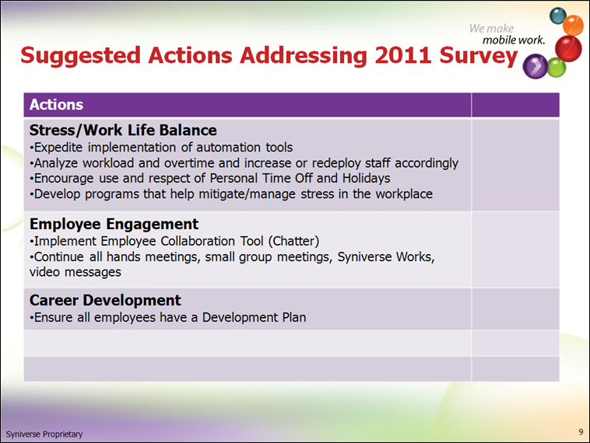
Notes:
One of the actions stemming from the 2011 Employee Satisfaction survey and approved by Jeff Gordon’s executive team is to ensure that all employees have a Development plan for 2012.

Slide 4
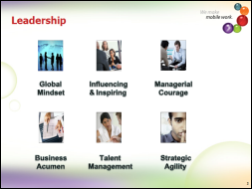
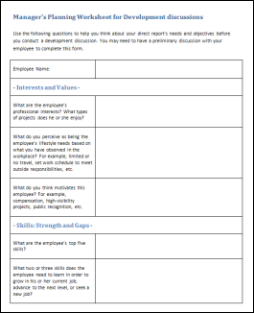
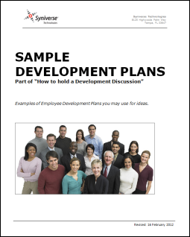
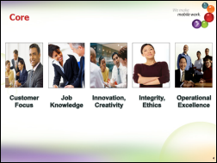
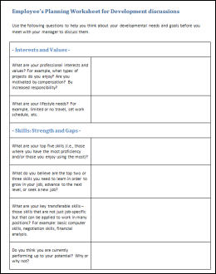
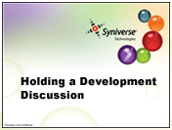

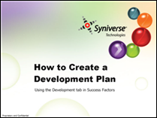
Resources

Slide 5



What is a Development Plan?
A development plan is a small written goal that details someone’s growth in a given area.
A development plan leads towards career development.
Career development is doing something that helps one learn a new skill or helps that person get better at something that can help their career.

Slide 6

Another way of expressing it
New skills, understanding, abilities, insight, knowledge, awareness, appreciation, etc.
Development
Plan
Career Development

Slide 7
Career Development sometimes goes by other names
Professional development
Career Progression
Developmental Objective

Slide 8
Development Plan
1 Development objective in Success Factors
=

Slide 9


1 Development objective in Success Factors
=
1 Development objective in Success Factors
=

Slide 10
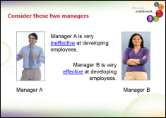
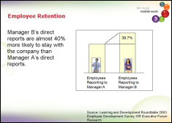
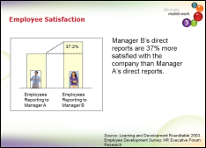
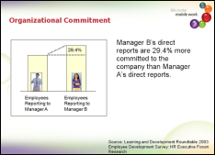
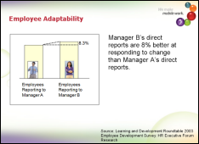
Research shows that developed employees are more productive than employees not being developed
See the elearning entitled, ‘The Necessity for Career Development.’

Slide 11
Two ways to create a development plan
Your direct report creates a development plan for themself.
And you can discuss with them later
You create one for your direct report
Discuss with them prior

Slide 12
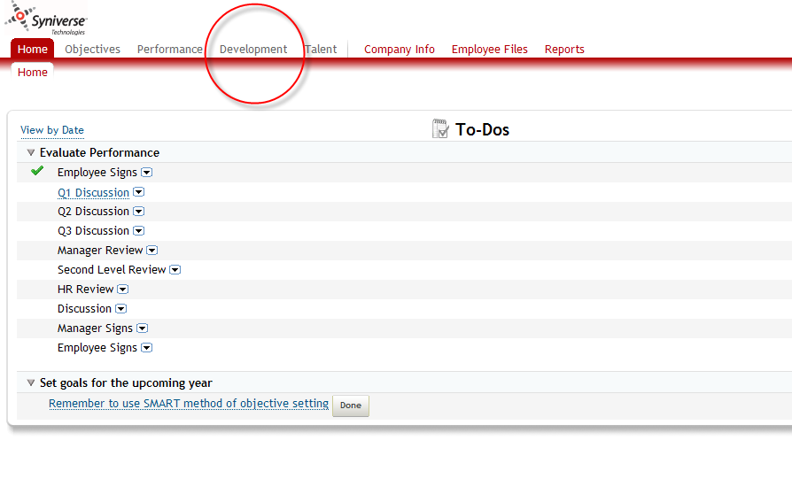

Slide 13
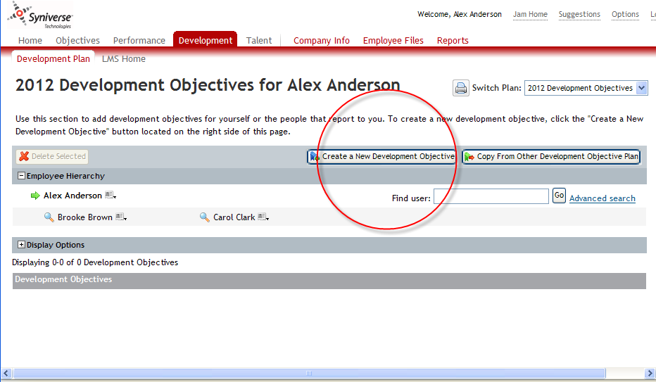

Slide 14
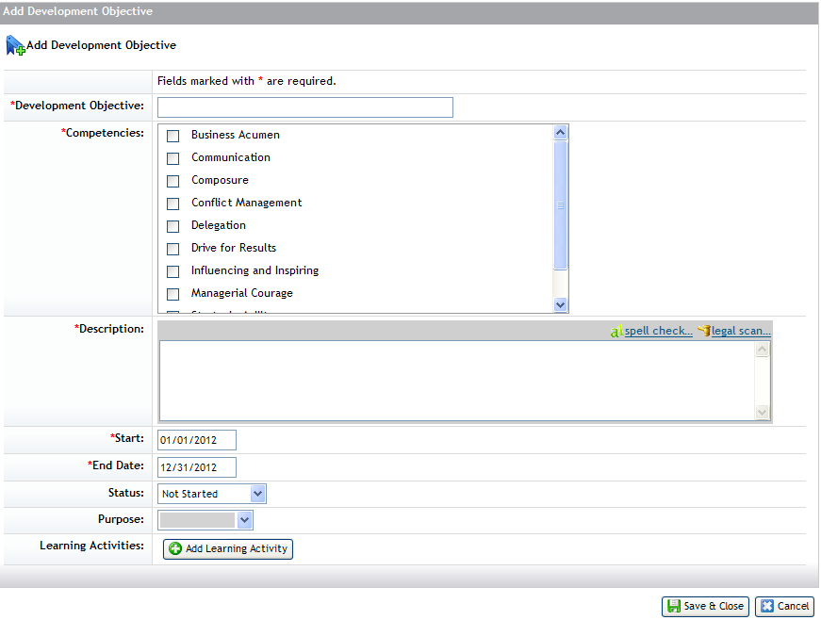

Slide 15
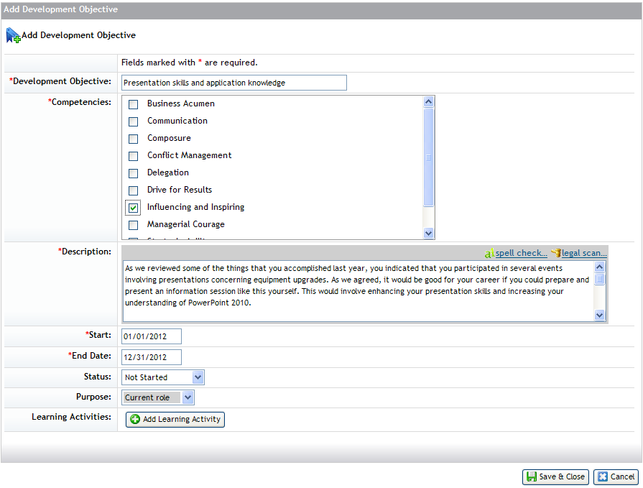

Slide 16
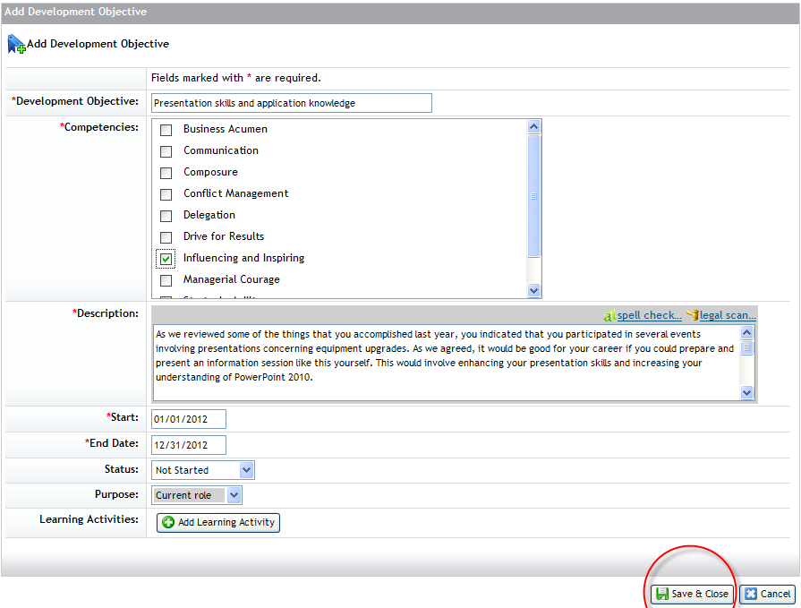

Slide 17
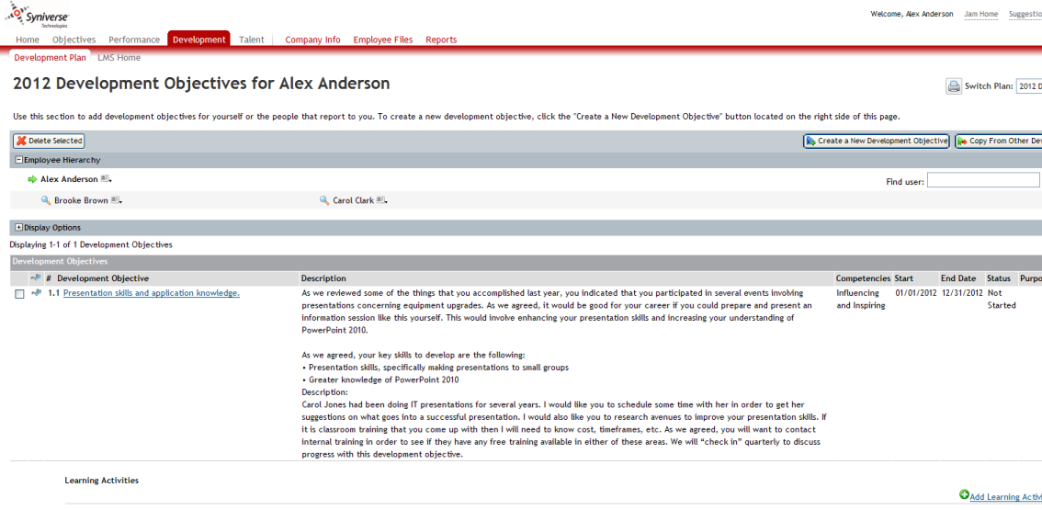

Slide 18

Follow up
During the quarterly objective meeting

Slide 19

Caveat
An employee can refuse a development plan.
If that is the case simply make a note in that employees development plan that the employee does not wish a development plan in that year.

Slide 20
Resources
SKR:
Manager/Employee Worksheets and Sample Development plans
http://skrcollab.syniverse.com/gm/folder-1.11.115876
Geo Learning Resources:
Holding a Development Discussion
https://gm1.geolearning.com/geonext/syniverse/coursesummary.CourseCatalog.geo?id=22506129390
The Necessity for Career Development
https://gm1.geolearning.com/geonext/syniverse/coursesummary.CourseCatalog.geo?id=22506129391
Employee Development in Success Factors
https://gm1.geolearning.com/geonext/syniverse/coursesummary.CourseCatalog.geo?id=22506129389

Slide 21
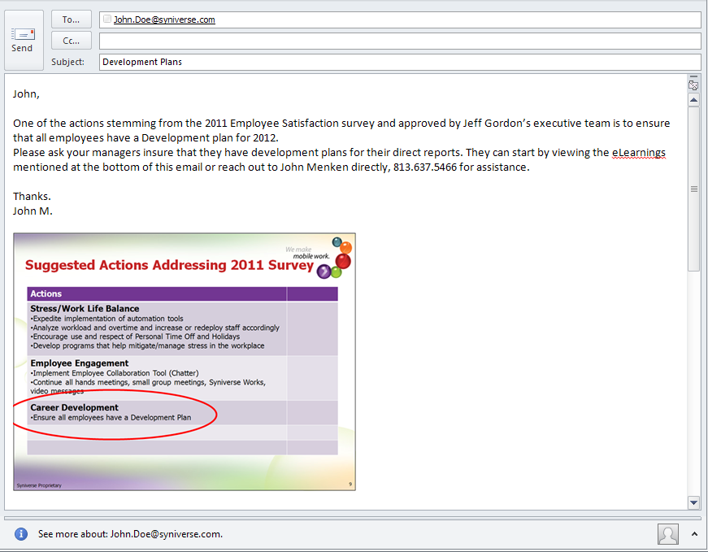
Email for your direct reports

Slide 22
Resources
John Menken, 813.637.5466, john.menken@syniverse.com
This presentation
Contains links to sample development plans, worksheets, and eLearnings
Email that you can forward
Worksheets, eLearnings, sample development plans, etc.

Slide 23
When is it due?
June 29th, 2012.
As soon as possible

Slide 24
End

Slide 25
Extra Slides

Slide 26
Syniverse 2012 Competencies

Slide 27






Leadership
Global Mindset
Influencing & Inspiring
Managerial Courage
Business Acumen
Talent Management
Strategic
Agility

Slide 28



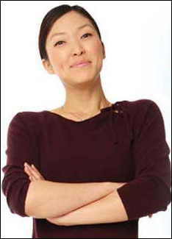

Core
Customer Focus
Job Knowledge
Innovation, Creativity
Integrity, Ethics
Operational Excellence

Slide 29
Leadership
Global Mindset
The ability to understand the impact of changes in global economies and collaborate and work across different functions and geographies. Grasps the intricacies of the different local markets in which we operate. Recognizes global socio-political and economic dynamics and their future impact on people, resources, and processes of the organization. Works respectfully in multicultural environments and realizes that cultural diversity makes Syniverse stronger and better able to compete globally.
Influencing & Inspiring
Influences others to accomplish objectives and directs his/her group in a positive, proactive way, applying leadership attributes, beliefs, values, ethics, character, knowledge, and skills; makes followers want to achieve high goals and expend discretionary effort. Communicates in a clear, concise, consistent and timely manner.
Managerial Courage
Tactfully dispenses direct and actionable feedback; is open and direct with others without being intimidating; deals head-on with people problems and prickly situations. Successfully mediates conflict between individuals and groups; Is cool under pressure and does not become defensive or irritated; is considered mature and can be counted on to hold things together during tough times; can handle stress; is not knocked off balance by the unexpected; doesn't show frustration when resisted or blocked and is a settling influence in a crisis.

Slide 30
Leadership (continued)
Business Acumen
Possesses a keen understanding of what it takes for the business to make money. This includes financial literacy with business literacy recognizing how strategies and decisions impact the business. Possesses a deep understanding of markets, competitors, and customers. Understands and utilizes economic, financial, industry and competitive data to accurately diagnose business strengths and weaknesses, identify key issues, and develop and implement strategies/plans.
Talent Management
Attracts and integrates highly skilled workers and develops and retains current workers to meet current and future business objectives. Sets clear goals and expectations for staff; follows progress against goals; provides regular feedback; addresses performance issues promptly; fosters learning and development; provides public recognition of staff accomplishments. Is a good judge of talent; accurately projects what people are likely to do across a variety of situations; hires the best people available from inside or outside; assembles and builds talented teams and grows people in their jobs. Deploys retention strategies for key individuals. Engages employees.
Strategic Agility
Sees ahead clearly, anticipates future consequences and trends accurately, has broad knowledge and perspective; is future oriented, articulately paints credible pictures and visions of possibilities and likelihoods, and creates competitive and breakthrough strategies and plans. Ability to continuously adjust and adapt strategic direction as a function of strategic ambitions and changing circumstances and create not just new products, services and solutions but also new business models and innovative ways to create value for the company.

Slide 31
Core
Customer Focus
Builds customer confidence, is committed to increasing customer satisfaction, sets achievable customer expectations, assumes responsibility for solving customer problems, ensures commitments to customers are met, and solicits opinions and ideas from customers. Responds to internal customers as well.
Job Knowledge
Understands duties and responsibilities and has necessary job knowledge. Has necessary technical skills, understands company mission/values, keeps job knowledge current and is in command of critical issues.
Innovation/Creativity
Generates new ideas, challenges the status quo, takes risks, supports change, encourages innovation and solves problems creatively.
Integrity/Ethics
Deals with others in a straightforward and honest manner, is accountable for actions, maintains confidentiality, supports company values and conveys good news and bad.

Slide 32
Core (continued)
Operational Excellence
Consistent, dependable, efficient and meets commitments. Produces high quality work and focuses on continuous improvement. Pursues everything with energy, drive, and a need to finish. Does not give up before finishing, even in the face of resistance or setbacks; steadfastly pushes self and others for results. Holds self and others accountable for measurable high-quality, timely, and cost-effective outcomes. Accepts responsibility for mistakes and is a group player who understands responsibilities towards his/her team.

Slide 33
End

