Slide 1
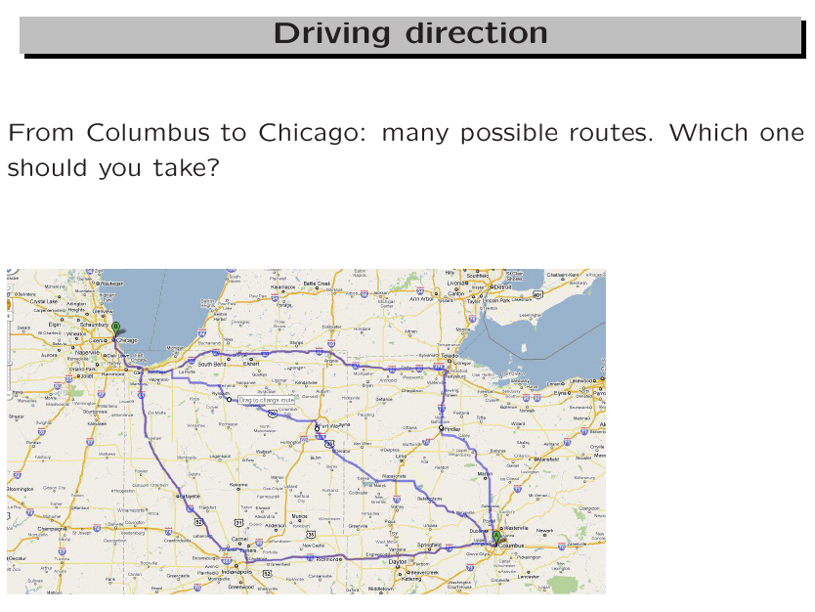

Slide 2
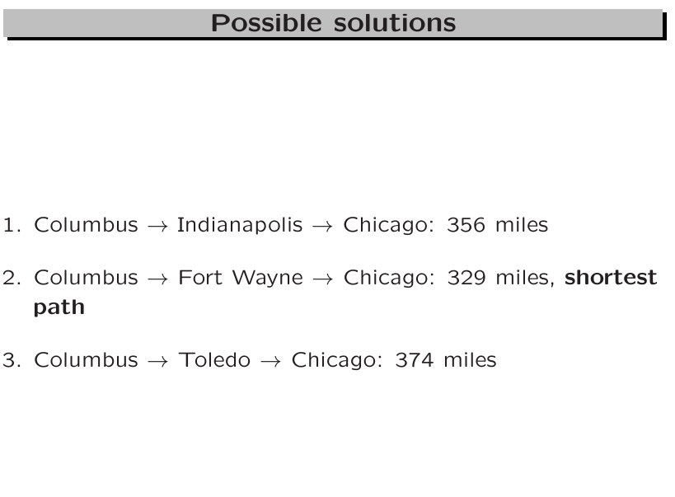

Slide 3
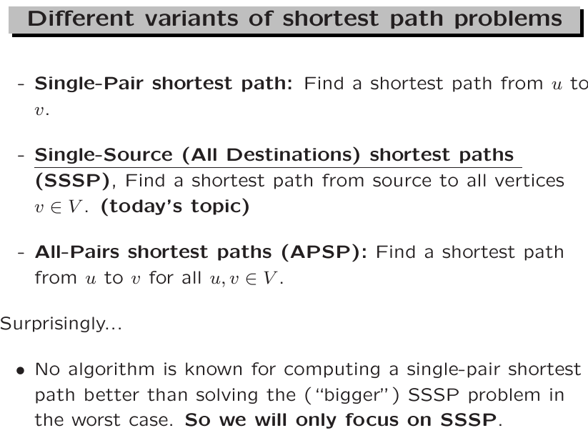

Slide 4
Shortest Path Problem
Weight of the graph
  Nonnegative real number assigned to the edges connecting to vertices
Weighted graphs
  When a graph uses the weight to represent the distance between two places
Data Structures Using C++ 2E

Slide 5
Shortest Path Problem
Weight of the path P
  Given G as a weighted graph with vertices u and v in G and P as a path in G from u to v
    Sum of the weights of all the edges on the path
Shortest path: path with the smallest weight
Data Structures Using C++ 2E

Slide 6
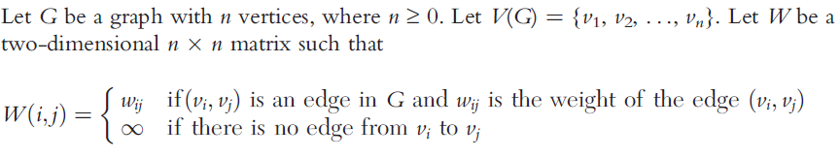
Shortest Paths solution: Dijkstra’s algorithm
A greedy solution (based on local information to make optimal decisions)
class weightedGraphType
  Extend definition of class graphType
  Adds function createWeightedGraph to create graph and weight matrix associated with the graph

Slide 7
Dijkstra’s algorithm: single-source all-destination shortest paths solution
Basic idea:
  Given a graph G = (V, E) and a vertex, say vertex, as the source
  Keep two sets:
    S: the sets of vertices whose shortest distances from vertex have been determined and V-S: the set of undetermined vertices.
    For each vertex u in V-S, keep an array element dist[u] to store the best estimate of the shortest distance from vertex to u through S
  Iterations:…

Slide 8
Dijkstra’s algorithm: single-source all-destination shortest paths solution
Basic idea:
  Iterations: pick the undetermined vertex v with smallest dist[] value, include v to S, and update the dist[] values for the affected neighbors.

Slide 9
Dijkstra’s algorithm: from Columbus to..
Toledo
Celeveland
145
143
120
150
72
Columbus
55
Zsville
25
Cam
51
Whel
Dayton
50
54
107
73
Marietta
13
Cincy
156
Athens
38
Pksbg
75
Lexington

Slide 10
Dist[v]: the best estimate of the shortest distance of v away from the source (Columbus)
145
143
Toledo
Celeveland
145
143
120
150
0
55
INF
INF
72
72
55
Zsville
25
Cam
51
Columbus
Whel
Dayton
50
INF
54
107
73
Marietta
73
13
107
Cincy
156
Athens
38
Pksbg
INF
75
INF
Lexington

Slide 11
Green cities: whose shortest distances have been determined. The source (Columbus) is the first city to be included. Red cities: shortest distances to be determined.
145
143
Toledo
Celeveland
145
143
120
150
0
55
INF
INF
72
72
55
Zsville
25
Cam
51
Columbus
Whel
Dayton
50
INF
54
107
73
Marietta
73
13
107
Cincy
156
Athens
38
Pksbg
INF
75
INF
Lexington

Slide 12
Green cities: Zanesville is added.
Red cities: Dist[Cambridge] is updated from infinity to 80.
145
143
Toledo
Celeveland
145
143
120
150
0
55
INF->80
INF
72
72
55
Zsville
25
Cam
51
Columbus
Whel
Dayton
50
INF
54
107
73
Marietta
73
13
107
Cincy
156
Athens
38
Pksbg
INF
75
INF
Lexington

Slide 13
Green cities: Dayton is added.
Red cities: no Dist[] updated
145
143
Toledo
Celeveland
145
143
120
150
0
55
80
INF
72
72
55
Zsville
25
Cam
51
Columbus
Whel
Dayton
50
INF
54
107
73
Marietta
73
13
107
Cincy
156
Athens
38
Pksbg
INF
75
INF
Lexington

Slide 14
Green cities: Athens is added.
Red cities: Dist[Parkersburg] is updated from infinity to 111.
145
143
Toledo
Celeveland
145
143
120
150
0
55
80
INF
72
72
55
Zsville
25
Cam
51
Columbus
Whel
Dayton
50
INF
54
107
73
Marietta
73
13
107
Cincy
156
Athens
38
Pksbg
INF-> 111
75
INF
Lexington

Slide 15
Green cities: Cambridge is added.
Red cities: Dist[Marietta] is updated from infinity to 130.
Dist[Wheeling] is updated to 131.
145
Toledo
Celeveland
143
145
143
120
150
0
55
80
INF-> 131
72
72
55
Zsville
25
Cam
51
Columbus
Whel
Dayton
50
INF-> 130
54
107
73
Marietta
73
13
107
Cincy
156
Athens
38
Pksbg
111
75
INF
Lexington

Slide 16
Green cities: Cincy is added.
Red cities: Dist[Lexington] is updated from infinity to 183.
145
143
Toledo
Celeveland
145
143
120
150
0
55
80
131
72
72
55
Zsville
25
Cam
51
Columbus
Whel
Dayton
50
130
54
107
73
Marietta
73
13
107
Cincy
156
Athens
38
Pksbg
111
75
INF-> 183
Lexington

Slide 17
Green cities: Parkersburg is added.
Red cities: Dist[Marietta] is updated from 130 to 124.
145
143
Toledo
Celeveland
145
143
120
150
0
55
80
131
72
72
55
Zsville
25
Cam
51
Columbus
Whel
Dayton
50
130-> 124
54
107
73
Marietta
73
13
107
Cincy
156
Athens
38
Pksbg
111
75
183
Lexington

Slide 18
Green cities: Marietta is added.
Red cities: No Dist[] needs to be updated.
145
143
Toledo
Celeveland
145
143
120
150
0
55
80
131
72
72
55
Zsville
25
Cam
51
Columbus
Whel
Dayton
50
124
54
107
73
Marietta
73
13
107
Cincy
156
Athens
38
Pksbg
111
75
183
Lexington

Slide 19
From Marietta to Columbus
Marietta is added into the set of Green Cities in this round.
We can prove the current estimate dist[Marietta], 124 miles, is indeed the shortest distance from Columbus to Marietta, which means no further update would be needed.
However, how to get the shortest path from Columbus to Marietta?
Data Structures Using C++ 2E

Slide 20
Dijkstra’s algorithm: detailed implementation in the textbook
The dist[] array is called smallestWeight in the textbook.
General algorithm
  Initialize array smallestWeight
    smallestWeight[u] = weights[vertex, u]
  Set smallestWeight[vertex] = zero
  Find vertex v closest to vertex where shortest path is not determined
  Mark v as the (next) vertex for which the smallest weight is found
Data Structures Using C++ 2E

Slide 21
Dijkstra’s algorithm (cont’d.)
General algorithm (cont’d.)
  5. For each undetermined neighbor vertex w,
    If weight of the path to w via v smaller than its current weight smallestWeight[w]
      Update weight of w to the weight of v + weight of edge (v, w)
Data Structures Using C++ 2E

Slide 22
Shortest Path (cont’d.)
See code on pages 704-705
  C++ function shortestPath implements previous algorithm
    smallestWeight[] is the Dist[] array we mentioned.
  To find the actual paths, a back-tracing step is needed.
    Use an additional array pred[]to record the predecessor of each vertex v
Data Structures Using C++ 2E

Slide 23
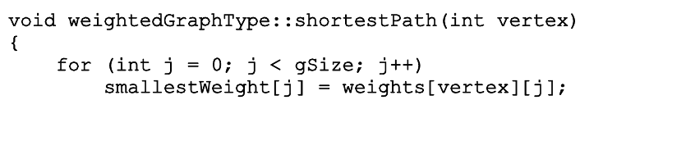
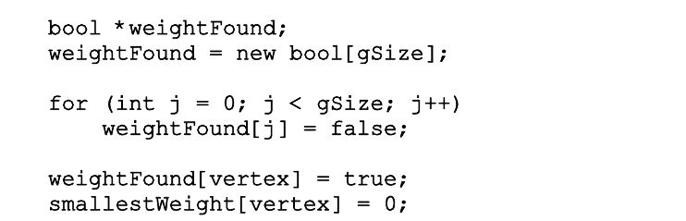
Initialize the weights away from the source
Everyone is undetermined
The source is the first determined

Slide 24
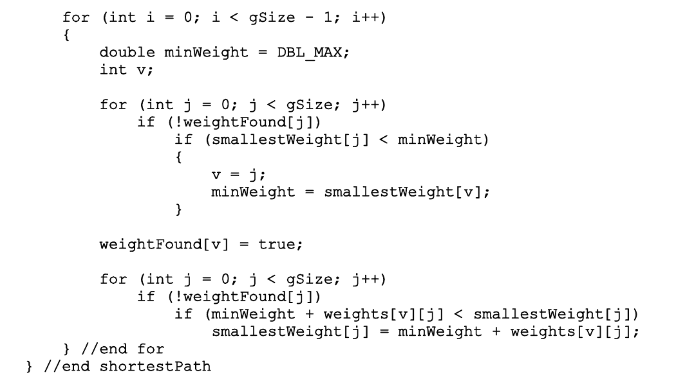
Loop. Each time remove one node from the undetermined set
Linear search to find the undetermined vertex with the smallest distance.
Update the neighbors’ distances, if necessary.

Slide 25
Complexity
Initialization: linear time, O(n)
Loop, each time remove one vertices from V – S. n times
  Linear search to find a vertex v in V – S, with the minimum dist[] value. Complexity: O(n)
  Update v’s neighbors’ dist[] values: need to go through v’s linked list. The length varies.
  Overall, all vertices on the adjacency list will be checked once. Complexity: O(|E|).

Slide 26
Complexity
Overall complexity: O(n) + O(n*n) + O(|E|)

Slide 27
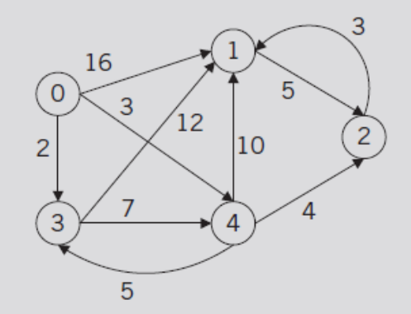
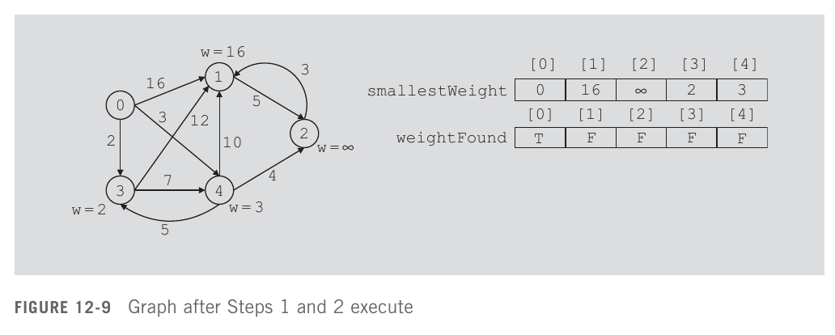
Dijkstra’s algorithm: textbook example
FIGURE 12-8 Weighted graph G

Slide 28
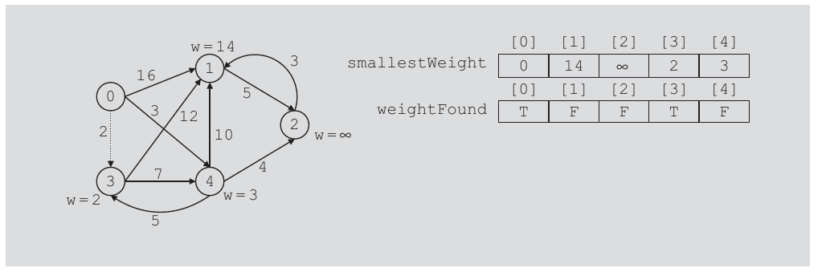
Shortest Path (cont’d.)
FIGURE 12-10 Graph after the first iteration of Steps 3 to 5

Slide 29
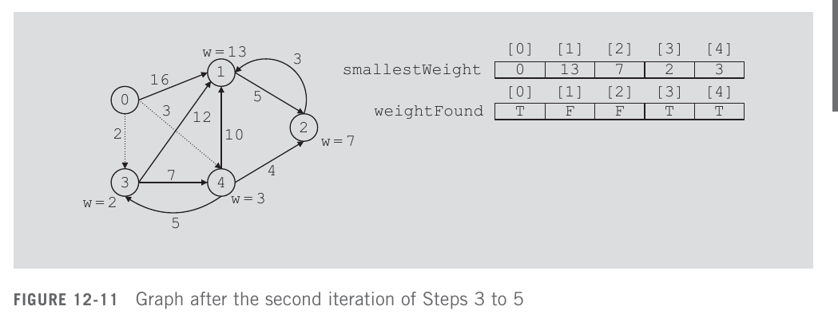
Shortest Path (cont’d.)

Slide 30
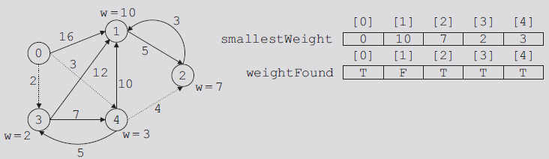
Shortest Path (cont’d.)
FIGURE 12-12 Graph after the third iteration of Steps 3 to 5
Data Structures Using C++ 2E

Slide 31
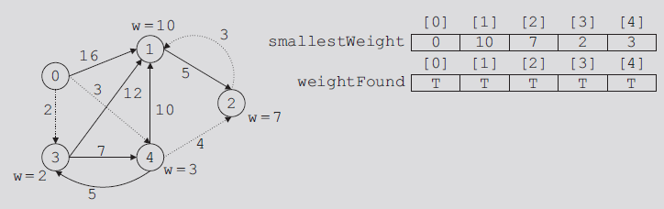
Shortest Path (cont’d.)
FIGURE 12-13 Graph after the fourth iteration of Steps 3 through 5
Data Structures Using C++ 2E

Slide 32
Heap implementation of the Dijkstra’s algorithm
Project 5 assignment

Slide 33
Maintain V-S (undetermined cities)
In Dijkstra’s algorithm. in each iteration, we need to
  find a vertex v in the set V-S that has the minimum dist[] value among V-S vertices.
  Then include v to set S (or remove it from V – S)
  Update its neighbors if necessary.

Slide 34
Use a min-heap to maintain V-S
The set V – S can be maintained using an array, as we just saw.
V – S can also be maintained as a min-heap, then
  Removing v is essentially a Delete-Min operation.
  Update a neighbor’s dist[] value would be an Decrease-Key operation

Slide 35
Min-heap implementation
Delete-Min would be faster, becoming O(log n)
  Previously, linear search, O(n)
But ”update neighbors” part will be slower. Changing a neighbor’s dist[] value is essentially a call for Decrease-Key() on a heap node, which takes O(log n) time.

Slide 36
Min-heap implementation: complexity
Delete-Min() will be called n times
  Each call takes O(log n)
When v is removed from V – S (undetermined cities) and included to S (determined cities), its neighbors will be checked.
  If using adjacency list, the linked list corresponding to v will be scanned.

Slide 37
Min-heap implementation: complexity
The overall number of edges to be checked is |E| (if directed graph) or 2|E| (if undirected graph)
  Decrease-Key() takes O(log n) time.
Overall complexity: O(n) + O(n log n) + O(|E| log n)
Is this faster than the array implementation? It depends.

