Slide 1
Databricks for Big Data and AI
Jimmy Chen
Jinghan Ma

Slide 2
Table of Content
Bottlenecks in Traditional Solution
What is Databricks
Components of Databricks
Databricks Delta
Databricks ML Frameworks
Alternate Options

Slide 3
Bottlenecks in Traditional Solution
Python with related package
Apache Spark
Easy to setup & use
Hard to scale infrastructure
Multiple packages need to be leveraged
Python interpreter negate the possibility of true multi-threading
Will have performance issue in ETL & model training when data grows
Native in-memory & parallel computing solution
Single platform for data integration, ETL and Machine Leaning
Hard to setup infrastructure
Complex config to scale

Slide 4
Databricks – The Treatment of Pain
Powered by Apache Spark
Unified Analytics Platform in clouds (MS Azure & AWS)
Simple infrastructure management
Highly reliable and performant data pipelines
Productive data science at scale

Slide 5
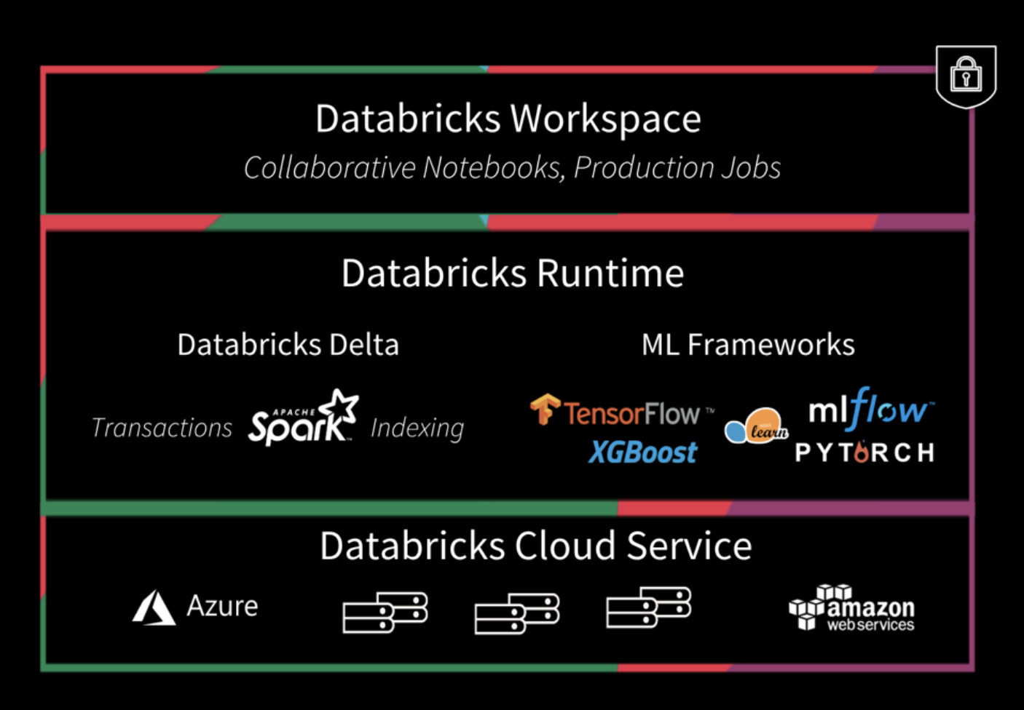
Databricks Components

Slide 6
Databricks Components
Databricks UI
Concise interface that could help user to access fundamental Databricks entities and manage scalable, monitorable & limitable infrastructure by simple clicks
Databricks Delta
Reliable and Performant pipelines
For Streaming & Batch data
Databricks ML Frameworks
1
2

Slide 7
Databricks Delta
High performance, reliable, low latent data pipeline for Batch & Streaming data
Data Engineer related component
Open-source Parquet columnar file format
Performance Tuning with indexing and Partitioning
ANSI SQL style query, ACID compliance and Schema Validation
Support real-time streaming ingest of data

Slide 8
Databricks ML Frameworks

Slide 9
Alternate Options
Although Databricks is a powerful tool, we DO have alternate options
AWS Glue & AWS SageMaker
Glue for Data Integration
SageMaker for Machine Learning
For the next step, we will compare all the options and make decision based on our requirement

Slide 10
Appendix
Azure Databricks
https://docs.azuredatabricks.net/index.html
AWS Databricks
https://databricks.com/aws

Slide 11
Title Layout
Subtitle

Slide 12
Title and Content Layout with List
Add your first bullet point here
Add your second bullet point here
Add your third bullet point here

Slide 13
Title and Content Layout with Chart

Slide 14
Title and Content Layout with Table
First bullet point here
Second bullet point here
Third bullet point here
Class | Group A | Group B
Class 1 | 82 | 95
Class 2 | 76 | 88
Class 3 | 84 | 90

Slide 15
Title and Content Layout with SmartArt
Group A
Task 1
Task 2
Group B
Task 1
Task 2
Group C
Task 1
First bullet point here
Second bullet point here
Third bullet point here

Slide 16
Add a Slide Title - 1

Slide 17
Add a Slide Title - 2

Slide 18
Add a Slide Title - 3

Slide 19
Add a Slide Title - 4

Slide 20
Add a Slide Title - 5

