Slide 1
THE ELITES – MILESTONE II
Designing and Implementing the Lexical Analyzer
Busto, Peter Richard
Cardenas, Patrick Joseph
Monceller, Aivan Reigh

Slide 2
Designing the Scanner
The token types and corresponding token patterns
DIRECTIVE -> "<.+?>”
INCLUDE -> "include”
VOID -> "void”
WHILE -> "while”
NUMBER -> "[0-9]+”
ASTERISK -> "\*“
…..

Slide 3
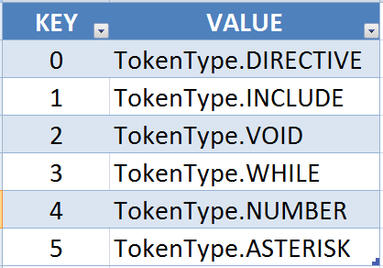
Designing the Scanner
Each of the token types are stored in the Tokens collection.

Slide 4
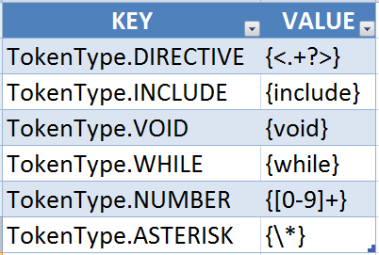
Designing the Scanner
Each of the token patterns are stored in the Patterns collection.

Slide 5
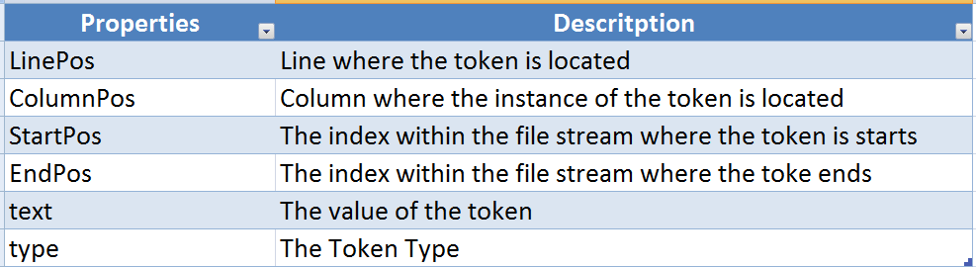
Designing the Scanner
The Token data structure properties:

Slide 6
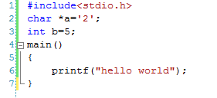
Implementing The Scanner
Test Program
Converted to string by Scanner
"#include<stdio.h>\r\nchar *a='2';\r\nint b=5;\r\nmain()\r\n{\r\n\tprintf(\"hello world\");\r\n}"

Slide 7
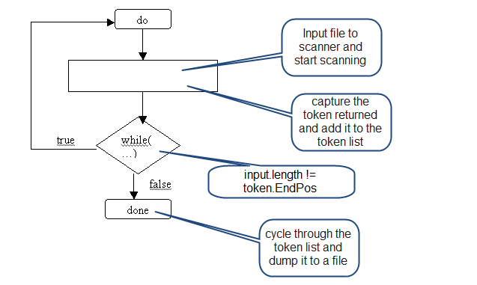
Implementing The Scanner The Process
Level 1 Diagram

Slide 8
Implementing The Scanner The Process
Assuming the first token is scanned – the TokenType.SHARP
"#include<stdio.h>\r\nchar *a='2';\r\nint b=5;\r\nmain()\r\n{\r\n\tprintf(\"hello world\");\r\n}"
"include<stdio.h>\r\nchar *a='2';\r\nint b=5;\r\nmain()\r\n{\r\n\tprintf(\"hello world\");\r\n}"

Slide 9
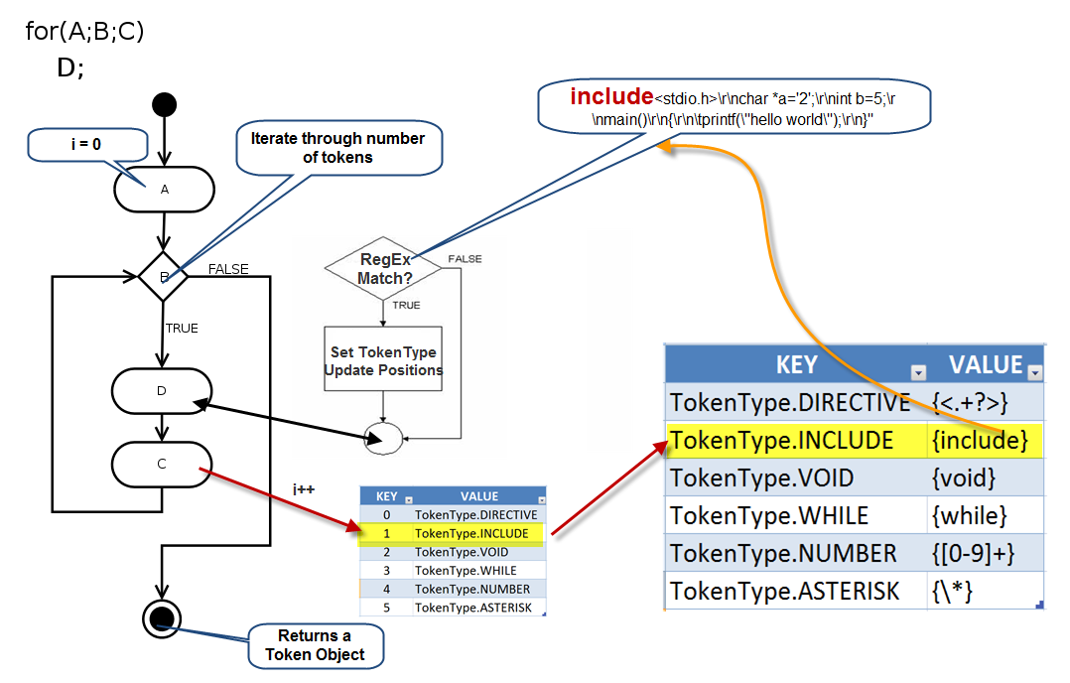
Implementing The Scanner The Process
Level 2 Diagram

