Slide 1
The Elites
Designing and Implementing the Parser

Slide 2
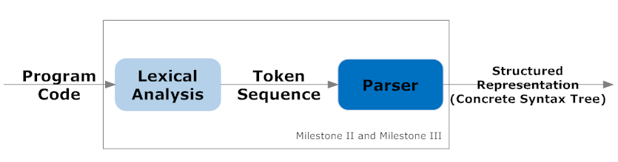
Design Overview
Lexical Analysis
Identify atomic language constructs
Each type of construct is represented by a token
(e.g. 3 → NUMBER, if → IF, a → IDENTIFIIER)
Syntax Analysis (Parser)
Checks if the token sequence is correct with respect to the language specification.

Slide 3
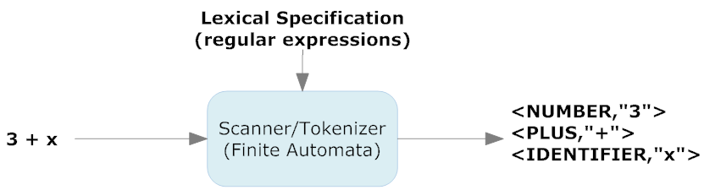
Lexical Analysis Overview
Input program representation: Character sequence
Output program representation: Token sequence
Analysis specification: Regular expressions
Implementation: Finite Automata

Slide 4
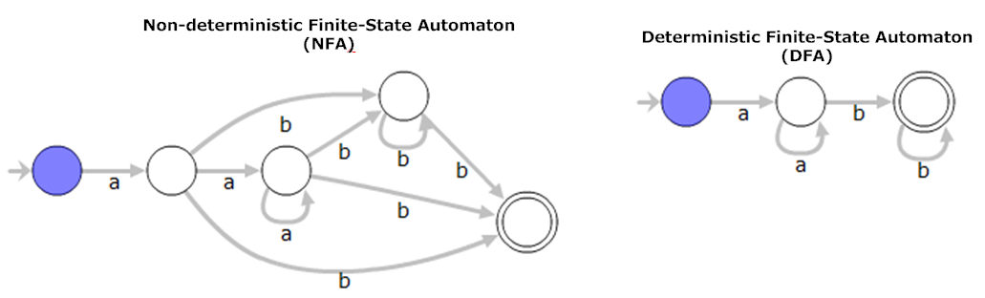
Lexical Analysis Overview Regular Expressions Automata Theory Applied
Regular Expression: a+b*b
First, there should be (1) or more a’s,
Followed by (0) or more b’s.
Lastly, A (1) b is required at the end of the string.
Notes:
FSA - is a model of behavior composed of a finite number of states, transitions between those states, and actions.
Differences
1. The transition function for NFA is multi valued where as for DFA it is single valued. 2. Checking membership is easy with DFA where as it is difficult for NFA 3. Construction of NFA is very easy where as for DFA it is difficult 4. Space required for DFA is more where for NFA it is less 5. Backtracking is allowed in DFA, but it is not possible in every case in NFA. 6. For every input and output we can construct DFA machine, but it is not possible to construct an NFA machine for every input and output. 7. There is only 1 final state in NFA but there can be more then 1 final state in DFA.

Slide 5
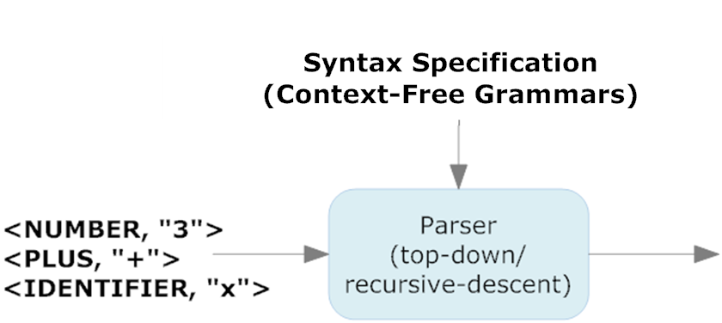
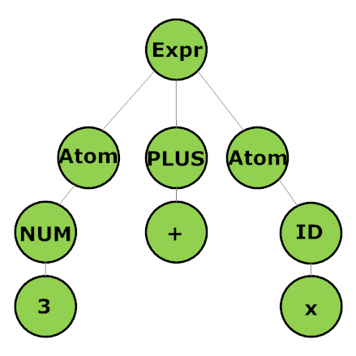
Syntax Analysis Overview
Concrete Syntax Tree
Input program representation: Token Sequence
Output program representation: CST
Analysis specification: CFG (EBNF)
Implementation: Top-down / Recursive Descent
Notes:
Goal of Grammar:
To derive syntactical structure from order and type of tokens.
Syntax vs. Semantics
Syntax: the structure of a set of tokens (Local Property)
Semantics: the meaning of a set of tokens (Global Property)

Slide 6
Syntax Analysis Overview Rpresenting Syntax Strucure
Production Rules
Concrete Syntax Tree
Expr -> Atom (ArithmeticOperator Atom)*;
ArithmeticOperator -> PLUS | MINUS | ASTERISK | FSLASH | PERCENT;
Atom -> NUMBER | ((Pointer|REFOPER)? IDENTIFIER VarArray?) | LPAREN Expr RPAREN;
Grammar is in EBNF (Extended Backus-Naur Form)

Slide 7
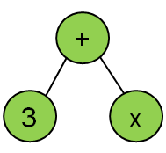
CST vs AST Concrete Syntax Tree vs Abstract Syntax Tree
Concrete Syntax Tree
Abstract Syntax Tree
We can reconstruct the original source code from a concrete syntax tree.
Abstract syntax tree takes a CST and simplify it to the essential nodes.
Notes:
CST
We can reconstruct the original source code from the concrete syntax tree
There is a syntax directed translation
AST
Take the concrete syntax tree and simplify it to the essential nodes
Elimination of left-recursion, changing the grammar to remove shift/reduce conflicts
We have to eliminate left-recursion to use the recursive descent parser (LL(1) Parser)
Either we are using a CFG/PEG the parser’s output is a Concrete Syntax Tree because there is a syntax directed translation
However, a CST will later be converted into an AST for it to be useful for semantic processing and code generation.

Slide 8
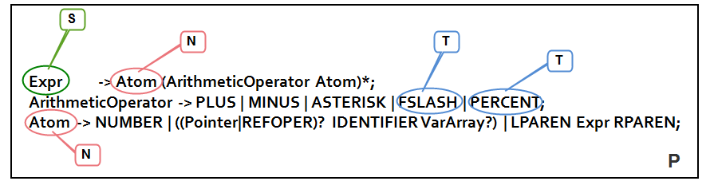
Grammar Formal Definition
A grammar, G, is a structure <N,T,P,S>
N → is a set of non-terminals
T → is a set of terminals
P →is a set of productions
S → is a special non-terminal called the start symbol of the grammar.
Notes:
Goal of Grammar:
To derive syntactical structure from order and type of tokens.
Metasyntax – Syntax used to describe syntax. The best known example is BNF and its variants such as EBNF.
CFG -a formal way to describe formal languages ( a set of words, i.e. finite strings of letters, symbols, or tokens).

Slide 9
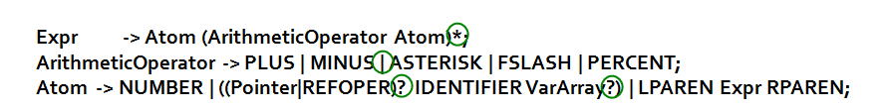
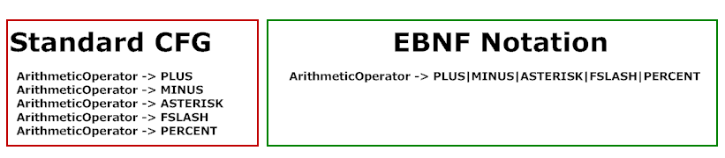
Context-Free Grammar Extended Backus-Naur Form
Extended Backus-Naur Form
a metasyntax notation used to express context-free grammars
is generally for human consumption. It is easier to read than a standard CFG
can be used for hand-built parsers
Allows the following symbols to be used in production rules
* - the symbol or sub-rule can occur 0 or more times
+ - the symbol or sub-rule can occur 1 or more times
? - the symbol or sub-rule can occur 0 or 1 time.
| - this defines a choice between 2 sub rules.
( ... ) - allows definition of a sub-rule.
Notes:
BNF Variants
Backus-Naur form
Extended Backus-Naur form
Wirth Syntax Notation
Augmented Backus-Naur form

Slide 10
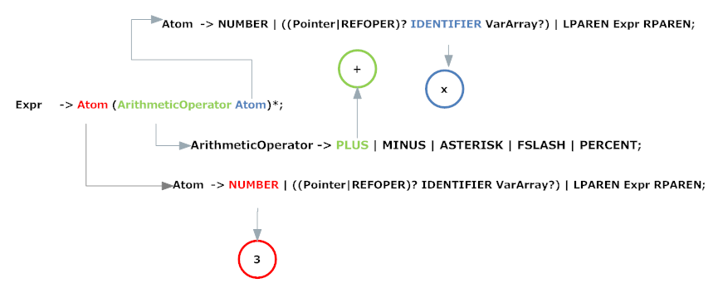
Implementing the Parser Top-down Methods
Using the left - most derivation we can show that → 3+x is in the language
This is a top-down approach since we start from the start symbol Expr and work our way down to the tokens 3+x

Slide 11
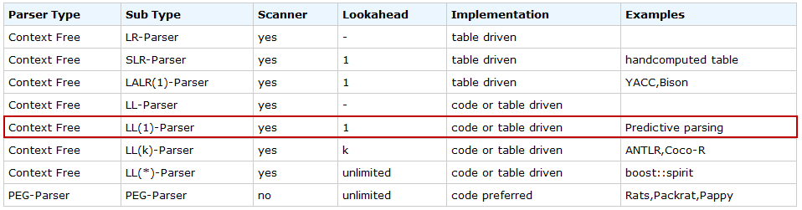
Implementing the Parser Top-down Methods
AGENDA
Recursive descent parser
Code-driven parsing
Take a grammar written in EBNF check if it is indeed LL(1) suitable for recursive descent parser

Slide 12
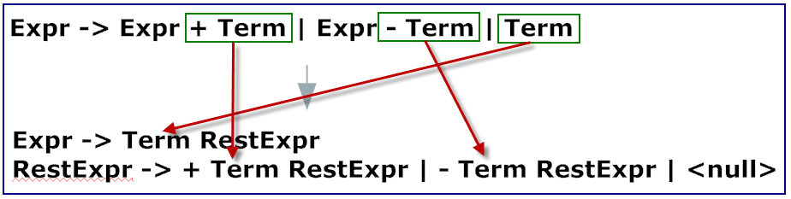
Implementing the Parser LL(1) Grammar
The number in the parenthesis tells the maximum number of terminals you may have to look at a time to choose the right production
Eliminate left recursion
Rules like this are left recursive because the Expr function would first call the Expr function in a recursive descent parser.
Without a base case first, we are stuck in infinite recursion (a bad thing).
The usual way to eliminate left recursion is to introduce a new non-terminal to handle all but the first part of the production
Notes:
Without a base case first, we are stuck in infinite recursion (a bad thing).

Slide 13
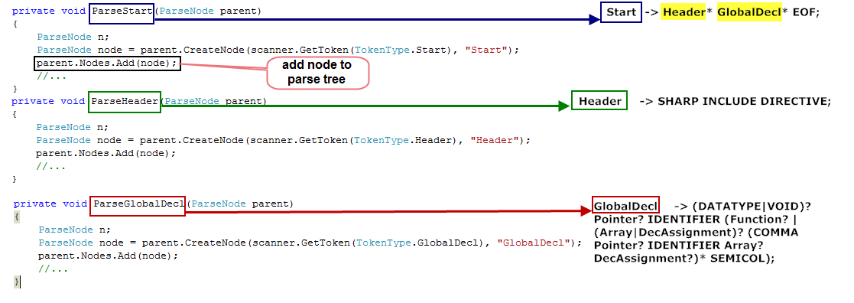
Implementing the Parser (1) Creating the Recursive Descent Parser
Construct a function for each non-terminal. Each of these function should return a node in the CST

Slide 14
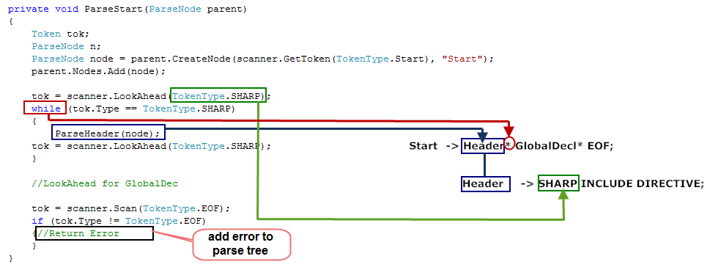
Implementing the Parser (2) Creating the Recursive Descent Parser
Each non-terminal function should call a function to get the next token as needed. The parser which is based on an LL(1) grammar, should never have to get more than one token at a time.

Slide 15
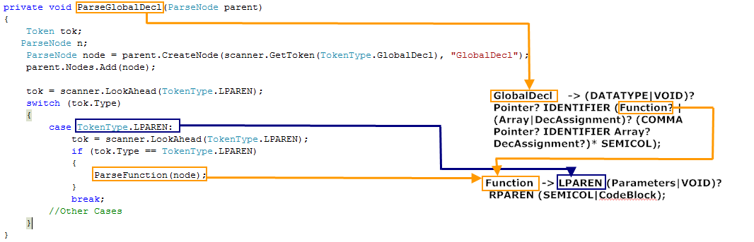
Implementing the Parser (3) Creating the Recursive Descent Parser
The body of each non-terminal function should be a series of if statements that choose which production right-hand side to expand depending on the value of the next token.

Slide 16
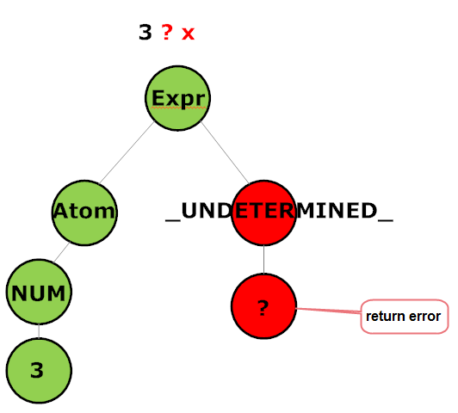
Implementing the Parser Parser Output Representation
The output of the parser is a parse tree (Concrete Syntax Tree) which contains all the nodes in the grammar and errors encountered (usually for _UNDETERMINED_ token types)

