Slide 1
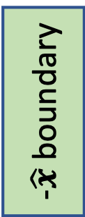
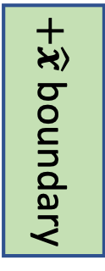



$+\hat{y}$ boundary
$+\hat{z}$ boundary
$-\hat{x}$ boundary
Sub-domain
$+\hat{x}$ boundary
$-\hat{y}$ boundary

