Slide 1
CS12430 Group Project
NewJ

Slide 2
Division of tasks
GUI aspects
  Everything the user actually interacts with
Model/Controller aspects
  The internal workings of the application
Decided Phoebe would implement the GUI and Joe would implement the Model

Slide 3
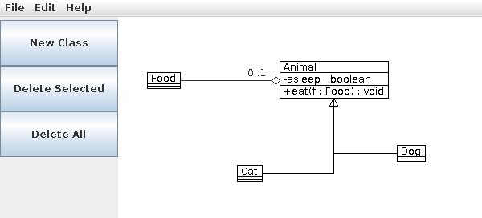
GUI
Basic look of entire program first
Basic button panel and menus second – print lines to show working
Diagram panel next

Slide 4
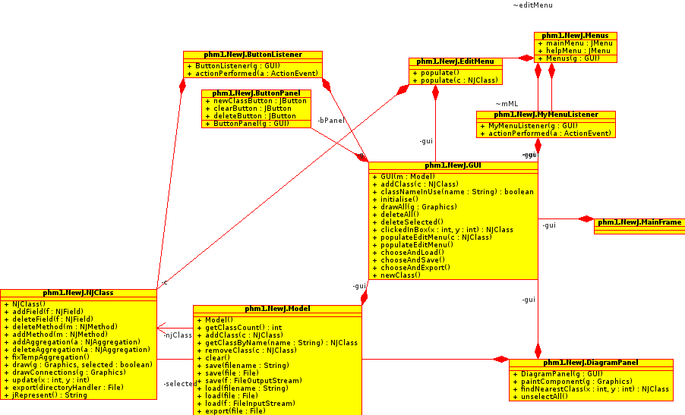
GUI

Slide 5
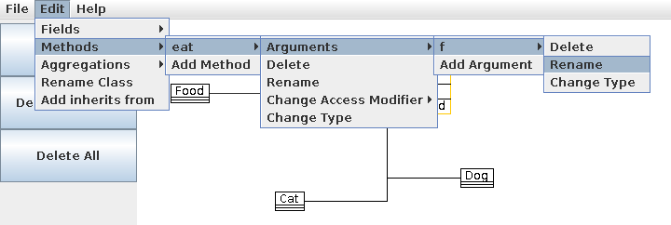
GUI – Edit Menu
Manipulation of UML classes
  Add fields, methods (with arguments), aggregations, inheritance
Populates menu dynamically on selection
Anonymous listener classes

Slide 6
Model
NJObject, NJClass, NJAttribute, etc.
  Abstraction
Saving and Loading
  XML – more human readable
  JFileChooser
Exporting to Java
  public String jRepresent();

Slide 7
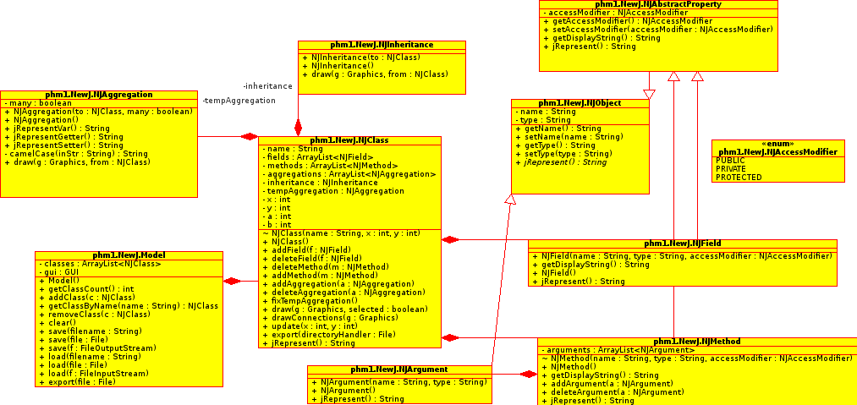
Model

Slide 8
Demonstration

Slide 9
Potential improvements
Undo
UI improvements
  Right click → popup menu → properties window
Validation/sanitisation of names (class, method, field)

