Slide 1
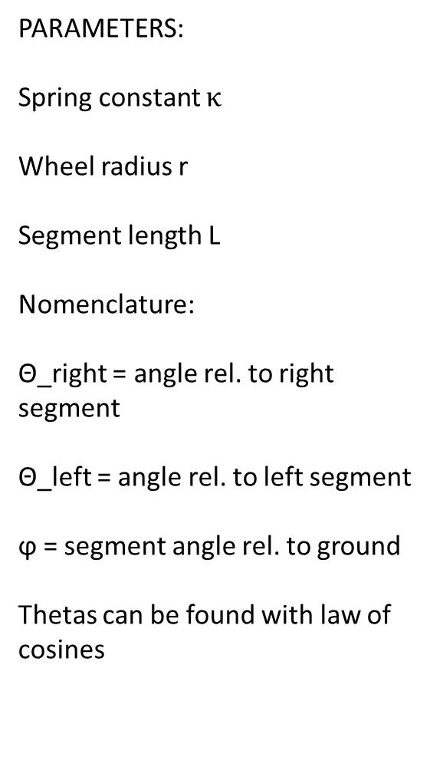

L
PARAMETERS:
Spring constant $κ$
Wheel radius r
Segment length L
Nomenclature:
Θ_right = angle rel. to right segment
Θ_left = angle rel. to left segment
ϕ = segment angle rel. to ground
Thetas can be found with law of cosines
P_{i} = (x_{i},y_{i})
P_{i-1}
$$κ$$
P_{i+1}
r
Θ_right
ϕ
Θ_left

Slide 2


F_{n} = ½ ($L∗κ ∗$(Θ_right + Θ_left )) * cos(ϕ)
½($L∗κ ∗$(Θ_right + Θ_left ))
mg

Slide 3


Θ_right
ϕ
Θ_left
$κ$* Θ_right
τ
$κ$* Θ_left
mg

Slide 4

L
P_{i} = (x_{i},y_{i})
P_{i-1}
$$κ$$
r

