Slide 1
EAST BAY PERMACULTURE GUILD · HACK FOR SOCIAL IMPACT 2026
Roots
Volunteers who come back.
Reasons that make every hour count, AI that knows your people, and money that funds more volunteer days.
Built on Garden Steward · Demo uses fictional volunteers
Notes:
Hi, we’re Roots. We built this for the East Bay Permaculture Guild. Their big problem is not finding volunteers. It is getting them to come back. In four minutes we’ll show how Roots gives each person a reason to return, uses AI to know them and reach them, and finds money that funds more volunteer days.

Slide 2
THE GUILD’S CHALLENGE
People come once. Then life gets in the way.
8 of 35
“…welcome new members, understand how they want to participate, and turn event details into outreach ready for volunteer review.”
people in our demo community came once and have not been back. A garden needs the same hands every month.
Affordable, easy to maintain, and personal.
Quote: the Guild’s written challenge. Demo figures use fictional volunteers.
Notes:
Hi, we’re Roots. The East Bay Permaculture Guild doesn’t struggle to find volunteers. It struggles to get them back. In our demo community, 8 of 35 people came once and never returned. The Guild asked for simple tools to welcome people, understand how they want to take part, and turn events into outreach. Under all of it is one problem: consistency.

Slide 3
Roots gives people three reasons to stay.
1 · HOURS THAT COUNT
2 · A PERSONAL NUDGE
3 · MONEY FOR THE GARDEN
12
AI + you
$25/hr
volunteers could gain a benefit by coming back: school hours, FFA, college credit, CalFresh.
A Garden Steward sign-up learns what people want. Roots drafts each SMS; a coordinator sends it.
from Microsoft for 3 regulars’ hours, plus a $2.5k–$10k grant that closes 2 November.
Benefits → return visits → logged hours → funding → more volunteer days.
Notes:
Roots gives people three reasons to stay. First, hours that count: 12 volunteers could gain something by coming back, like school service hours, FFA placement hours, college credit or the CalFresh work rule. Second, a personal nudge: a new sign-up in Garden Steward learns what people want, Roots drafts a personal SMS, and a coordinator sends it. Third, money for the garden: Microsoft gives $25 for every hour an employee volunteers, and three regulars work there; the CalAgPlate grant fits 20 students and closes on 2 November. Each part feeds the next.

Slide 4
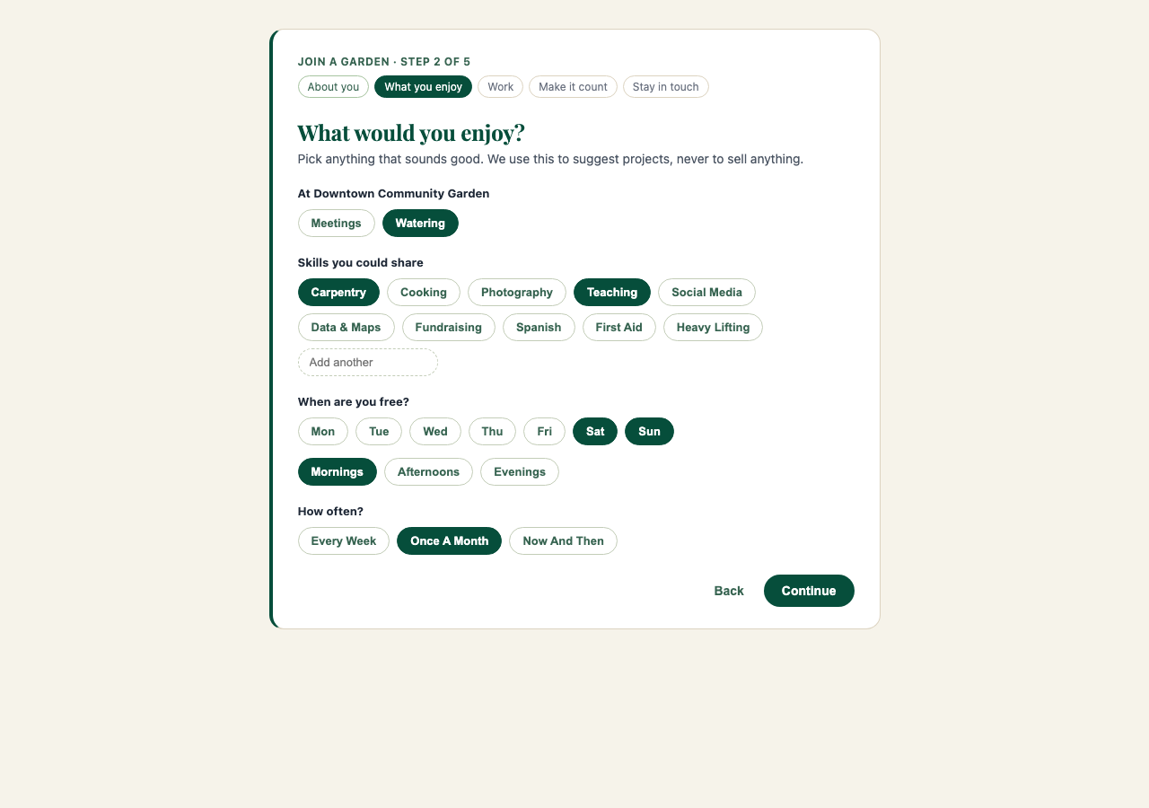
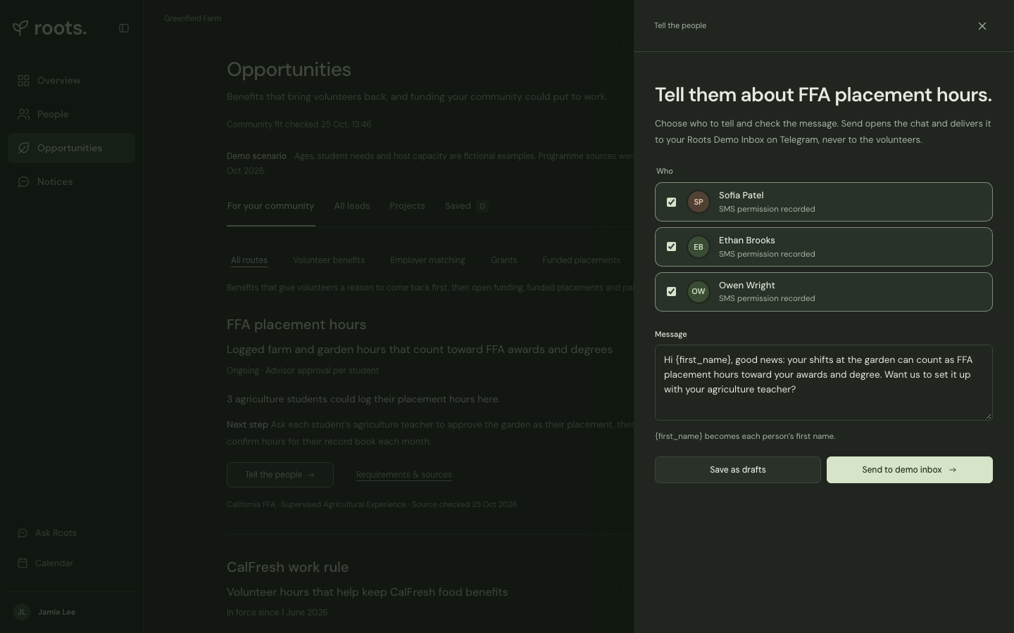
Know them. Reach them.
Sign-up in Garden Steward: interests, availability, work, and whether their hours could count.
Tell the people: Roots writes the SMS. Nothing goes out until a person sends it.
Demo uses fictional people. SMS is not connected yet; demo messages go to a Telegram demo inbox.
Notes:
Here’s how it works. People sign up in Garden Steward, the Guild’s own platform. It asks what they enjoy, when they’re free, where they work, and whether their hours could count. Then Roots notices who could benefit and writes a personal SMS. A coordinator checks it and presses send. In the demo, it lands in a Telegram demo inbox standing in for the volunteer’s phone. Now the live demo.

Slide 5
ROOTS
Every hour should count for something.
Let’s pilot it at the Guild’s next monthly work day.
Built into Garden Steward · a person approves every message · costs cents
Notes:
Every hour should count for something, for the volunteer and for the garden. It lives in the Guild’s own tools, a person approves every message, and the AI costs cents. Our ask: let’s pilot Roots at the Guild’s next monthly work day. Thank you.

