Slide 1

INVESTOR PITCH
KAILA
The On-Demand Services Marketplace for the Philippines
Kung wala kay kaila, naa mi.
Pilot proof in Gingoog City. National expansion story for the Philippines.
John Mark Agustin E. Acido
94jmaea94@gmail.com
Pilot City: Gingoog City

Slide 2
PROBLEM
Finding trusted local help is still informal, slow, and hard to verify.
Customers
Service Providers
Hard to find trusted workers quickly No standardized pricing or offer comparison No clear guarantees, ratings, or work history Communication scattered across referrals, Facebook, and Messenger
Depend heavily on referrals Inconsistent job flow and income Limited digital presence Difficult to acquire customers outside their network
KAILA Investor Pitch Package
02

Slide 3
SOLUTION
KAILA turns informal referrals into a structured request, match, pay, and review workflow.
1
2
3
4
5
Request
->
Match
->
Work
->
Payment
->
Review
Customer opens KAILA and posts the service need.
Relevant local providers receive the request.
Provider performs the agreed service.
Payment is completed or recorded.
Both sides build visible reputation.
KAILA Investor Pitch Package
03

Slide 4
MARKET OPPORTUNITY
Philippines is the upside market; Gingoog City is the proof market.
TAM
SAM
SOM
Philippine local services spend
Digitally reachable early categories
3-year realistic capture
Est. PHP 250B+ annual addressable household and small-business service activity.
Est. PHP 25B-50B across repair, maintenance, cleaning, digital services, and skilled work.
Est. PHP 20M-60M GMV from disciplined city-by-city expansion after Gingoog validation.
Sizing is an explicit planning estimate using PSA household/service spend categories, DTI MSME data, and KAILA category assumptions.
KAILA Investor Pitch Package
04

Slide 5
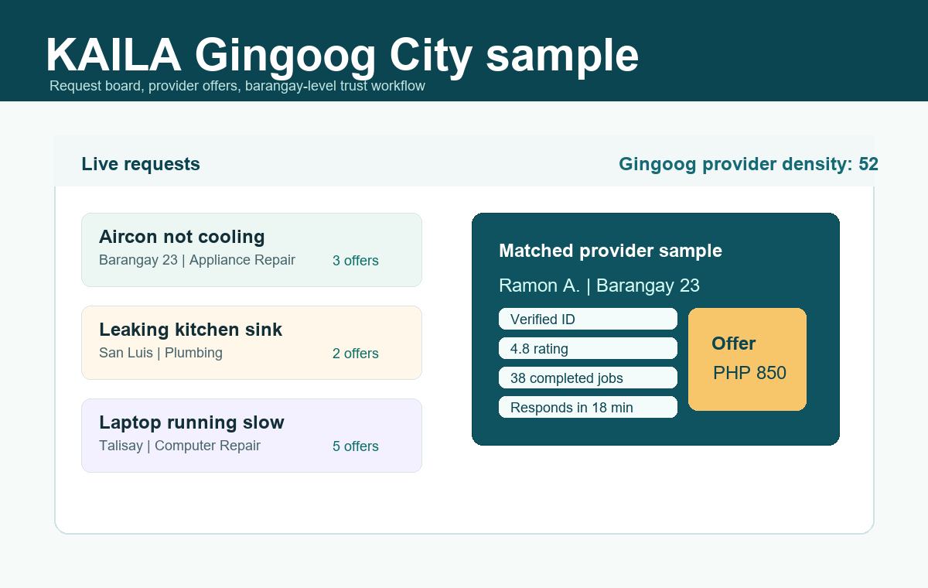
PRODUCT DEMO
Early mockups show the core marketplace workflow before full app build.
Request board for client needs and provider offers
Provider directory with categories, areas, and trust signals
Admin-style dashboard for pilot operations and manual matching
Mobile-first experience planned for clients and providers
KAILA Investor Pitch Package
05

Slide 6
BUSINESS MODEL
KAILA monetizes after the marketplace proves real provider value.
Revenue Stream
Description
Service fee
% commission per completed transaction after trust is proven
Featured listings
Provider promotion and profile boosts
Subscription
Premium provider accounts with better visibility
Ads
Local business promotions and category sponsorships
KAILA Investor Pitch Package
06

Slide 7
WHY NOW
The behavior is already digital; the trust system is missing.
97.5M internet users
142M mobile connections
DataReportal reported 83.8% internet penetration in the Philippines in January 2025.
Mobile connectivity is larger than the population, making mobile-first matching practical.
57.4% digital payment volume
MSME-heavy economy
BSP reported digital retail payments reached 57.4% of transaction volume in 2024.
DTI reports MSMEs make up 99.66% of Philippine business establishments.
KAILA Investor Pitch Package
07

Slide 8
COMPETITION
KAILA wins by combining local focus, search, verification, ratings, and structured workflows.
Feature
Facebook
Generic Marketplace
KAILA
Searchability
No
Yes
Yes
Ratings
No
Yes
Yes
Verification
No
Partial
Yes
Local focus
Partial
Partial
Yes
Request-to-offer workflow
No
Partial
Yes
Pilot operations support
No
No
Yes
KAILA Investor Pitch Package
08

Slide 9
GO-TO-MARKET
Start narrow in Gingoog City, prove density, then replicate the playbook.
Demand Side
Supply Side
Gingoog Pilot
Facebook groups Barangay partnerships Local ads and referrals Small business outreach
Skilled workers Freelancers Tradespeople Repair shops and service microbusinesses
Recruit providers first Run concierge matching Measure response and completion Convert proof into MVP scope
KAILA Investor Pitch Package
09

Slide 10
TRACTION
Current stage: founder-grade package, prototype mockups, and Gingoog validation plan.
50
Target providers
100
Client survey responses
30
Real service requests
15+
Completed or strongly matched jobs
5-8
Starting service categories
30-45
Active pilot days
If actual interviews, waitlist, survey results, or pilot jobs are added, this becomes the strongest investor proof slide.
KAILA Investor Pitch Package
10

Slide 11
FINANCIAL PROJECTIONS
3-year model: realistic ramp from concierge pilot to paid marketplace.
Metric
Year 1
Year 2
Year 3
Active providers
150
600
1,800
Completed jobs
900
7,200
32,400
GMV
PHP 0.9M
PHP 8.6M
PHP 48.6M
Revenue
PHP 0.2M
PHP 1.7M
PHP 7.3M
Expenses
PHP 1.8M
PHP 3.6M
PHP 7.2M
Profit / Loss
(PHP 1.6M)
(PHP 1.9M)
PHP 0.1M
Assumptions are included in the investor package workbook and should be updated after the Gingoog pilot.
KAILA Investor Pitch Package
11

Slide 12
FUNDING ASK
Raising PHP 2,000,000 to validate Gingoog City and build the first focused MVP.
40%
Development
35%
Marketing
PHP 800,000
PHP 700,000
15%
Operations
10%
Legal/Admin
PHP 300,000
PHP 200,000
Scenario options in the package show lean, base, and accelerated funding paths.
KAILA Investor Pitch Package
12

Slide 13
TEAM
Founder-led by a technical builder with validation-first discipline.
John Mark Agustin E. Acido
Next strategic hires / co-founders
Product and technology lead
Web development and prototype execution
Founder-grade business documentation and MVP planning
Local pilot design for Gingoog City
Operations lead
Provider acquisition lead
Marketing/community lead
KAILA Investor Pitch Package
13

Slide 14
VISION
Become the leading on-demand services platform for Philippine cities.
Start with one disciplined pilot in Gingoog City.
Prove matching, trust, ratings, and provider value manually.
Build the MVP around the proven workflow.
Expand city-by-city with a repeatable local operations playbook.
KAILA Investor Pitch Package
14

Slide 15
INVESTOR PACKAGE
What investors can review next
Investor pitch deck
Market sizing and assumptions memo
Starter 3-year financial model
Business plan outline
Due diligence data room checklist
The immediate next milestone is the Gingoog City validation sprint.
KAILA Investor Pitch Package
15

