Slide 1

Applying Iterative Design Principles to a Live Product
Jason Magnuson
July 19, 2021

Slide 2
Step 1
Select KPIs
&
Evaluate Previous Multivariate Experiment Results

Slide 3
Select KPIs for Flyber Analyses
KPIs
Acquisition: Number of Users/Day
Retention: Number of Users with Repeat Sessions
Task Success: Conversion Rate (Count event(Open_App)/ Count event(Begin_ride)
How would you calculate these KPI(s) using the available event data logs?
List other KPIs that might be important to Flyber but are not calculable based on available data
Customer Satisfaction (ex: NPS)
Financial Metrics (ex: Customer Lifetime Value, Customer Acquisition Cost, Revenue/Ride)

Slide 4
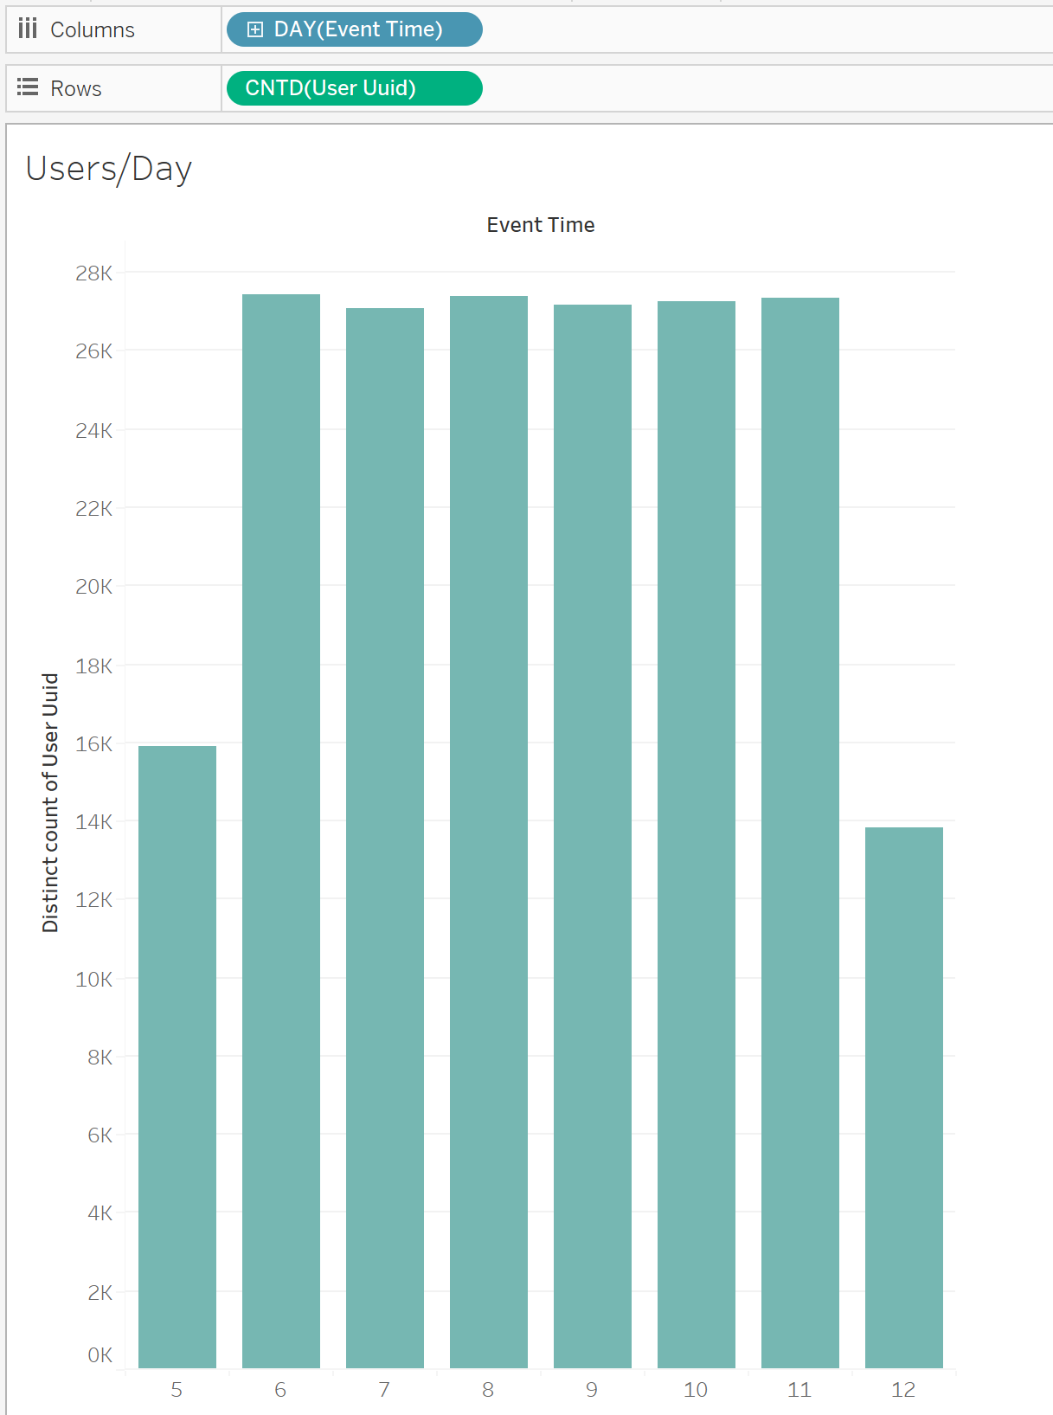
KPIs

Slide 5
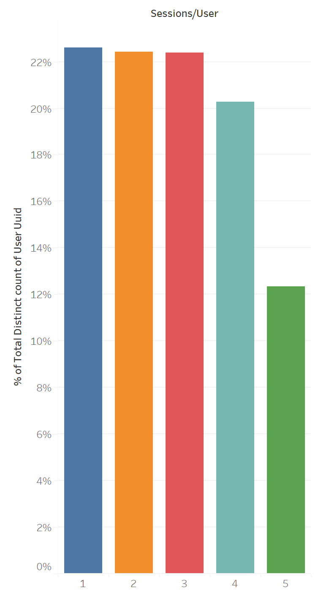
KPIs
77.4% of Users with Repeat Sessions w/in 5 day period

Slide 6
KPIs
Our Conversion Rate (calculated by dividing the count of trip events by the count of Opened App events) is unexpectedly low. We will present additional analysis against this KPI in the coming slides.
Open App | Begin Ride | Conversion Rate
56390 | 154 | 0.27%

Slide 7
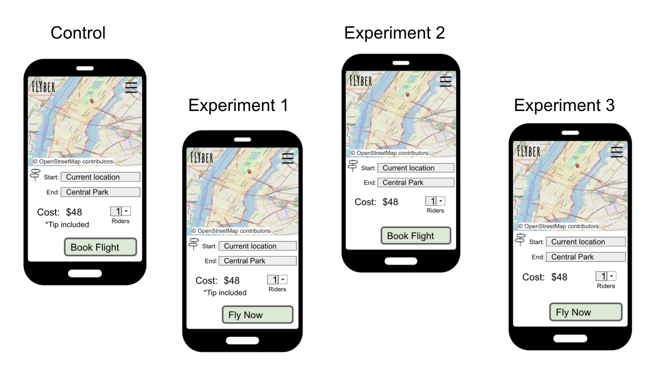
Describe the First Multivariate Experiment
Control: Current UX. ‘Tip Included’ text included underneath flight cost. Booking button reads, ‘Book Flight’.
Experiment 1 Variable: Booking button text changed to ‘Fly Now”
Experiment 2 Variable: ‘Tip Included’ text removed.
Experiment 3 Variable: ‘Tip Included’ text removed and Booking button text changed to ‘Fly Now’

Slide 8
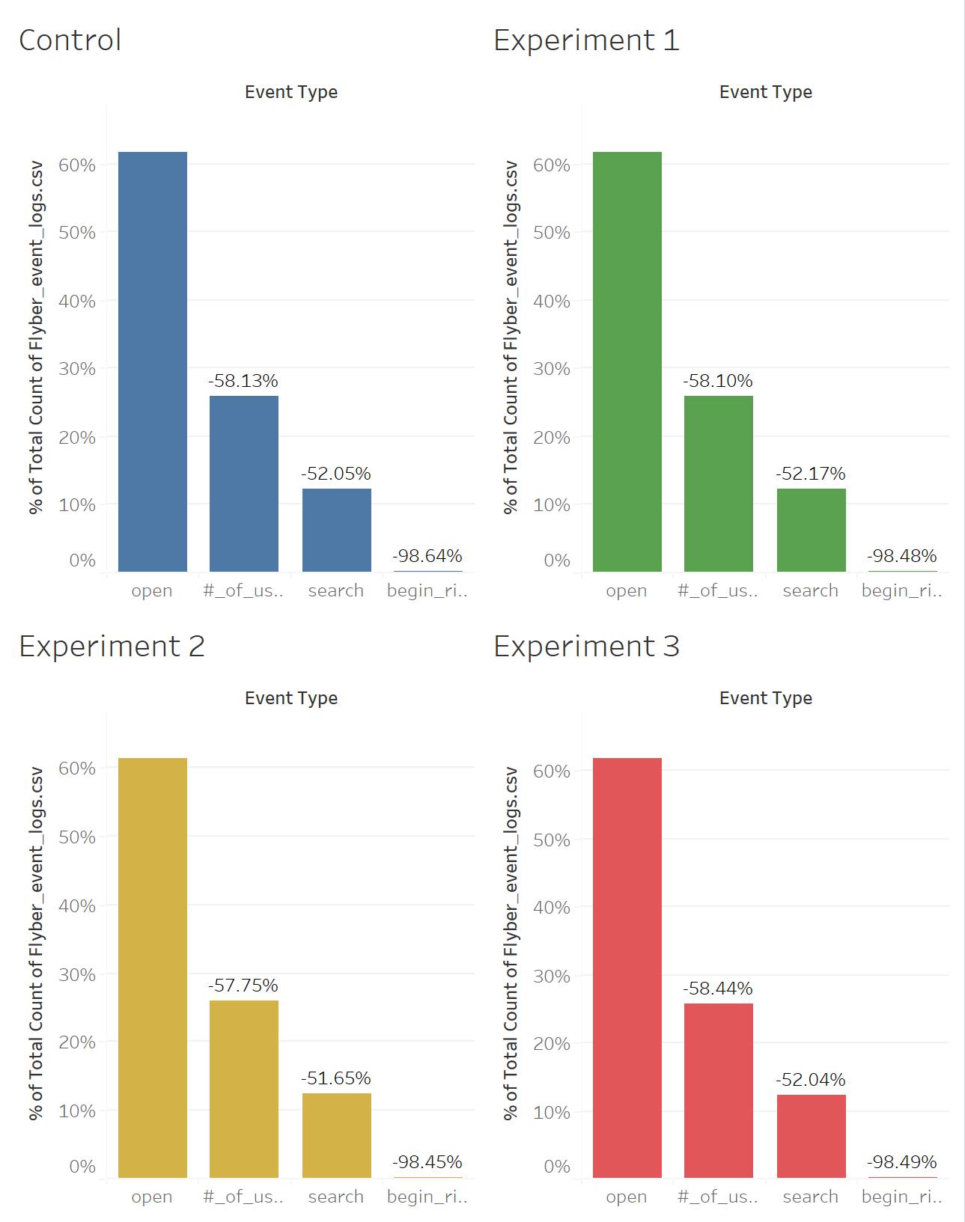
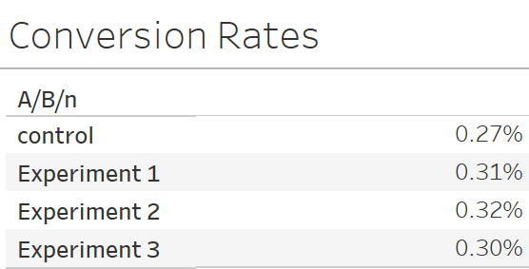
Review Multivariate Test Results: Visualization

Slide 9
Review Multivariate Test Results: Significance Test
Determine if there was a significant difference between the experiments and control states.
Explain how you would perform a t-test to determine if the experimental results had a greater impact on the booking conversion rate than the control state
We perform a t-test by performing the following steps:
State the Null Hypothesis:
Customers will not convert differently in the experiment groups vs the control groups
State the Alternate Hypothesis:
Customers will convert differently in the experiment groups vs the control groups.
Next we identify the P Value using a 95% Confidence threshold.
Now we would perform the test by identifying the # of Users, the # of Conversions, and the Confidence Interval
Notes:
List the test results (p value) for each experiment compared to the control
Using the statistical significance calculator of your choice, determine which experiments, if any, had a significant result at the 95% level. Include your calculations as part of your explanation
Based on your statistical significance calculations, recommend if any of the experiments should be expanded

Slide 10
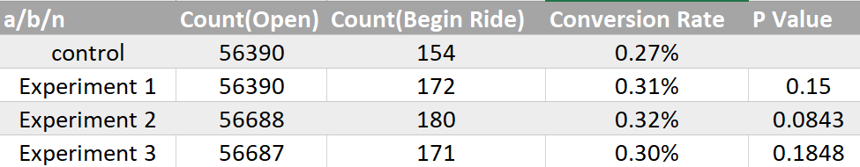
Review Multivariate Test Results: Significance Test
Determine if there was a significant difference between the experiments and control states.
Based on the above results, I calculated using a Two-Tailed t-test via
A/B Testing Calculator for Statistical Significance | SurveyMonkey
The two tailed test is required, given we must identify whether the changes tested provide a statistically significant impact in either the positive or negative direction compared to the control.
We would NOT PROCEED in rolling out these variants as is to Production. While these changes did appear to have a marginal improvement in booking, we will revisit the color, shape, and fontsize for our Booking Button to see if additional changes lead to statistically significant improvements.
Notes:
List the test results (p value) for each experiment compared to the control
Using the statistical significance calculator of your choice, determine which experiments, if any, had a significant result at the 95% level. Include your calculations as part of your explanation
Based on your statistical significance calculations, recommend if any of the experiments should be expanded

Slide 11
Step 2
Funnel & Cohort Analyses

Slide 12
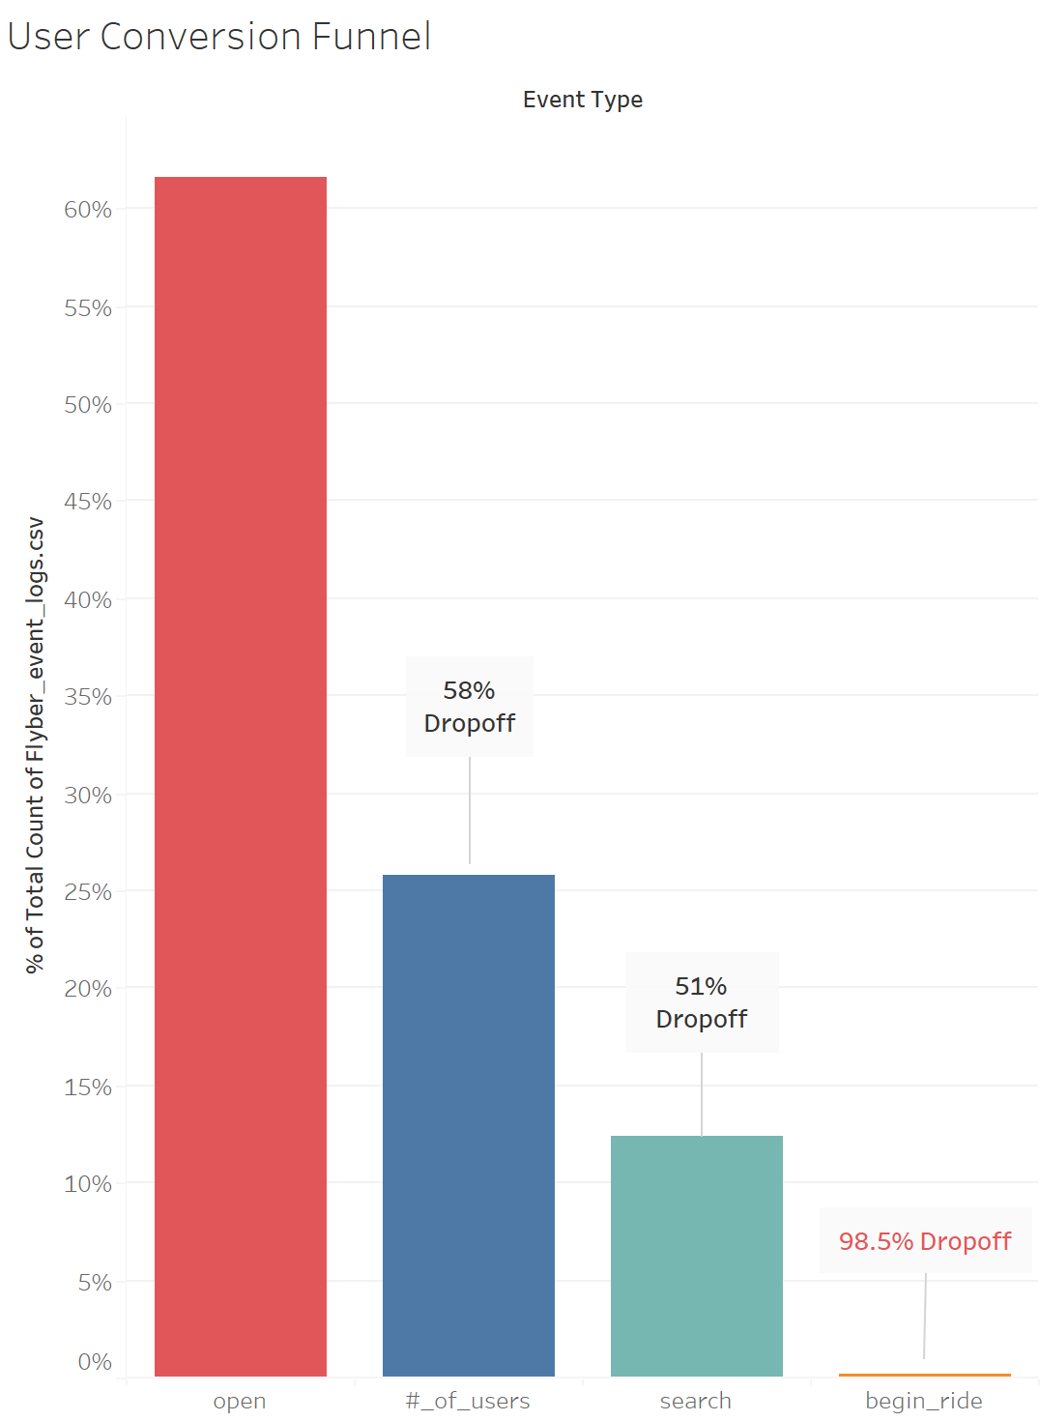
User Funnel
Identifying the different stages the user funnel
User conversion steps
Open App
Enter # of Users
Hit Search
Click Button to Begin Ride

Slide 13
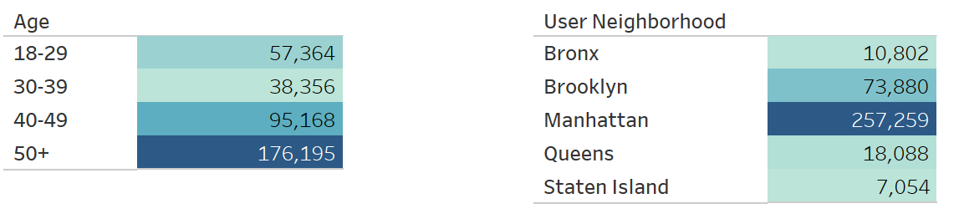
User Segments
We have data to segment users by Age Bracket and by Neighborhood
Age 50+ and Manhattan Residents are the highest segments in each Demographic

Slide 14
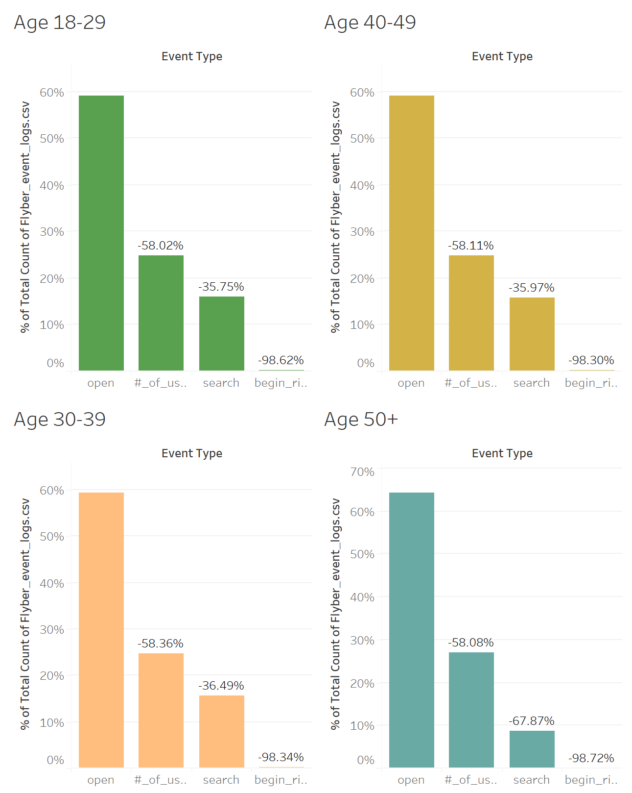
Segment Analysis of Funnel - AGE

Slide 15
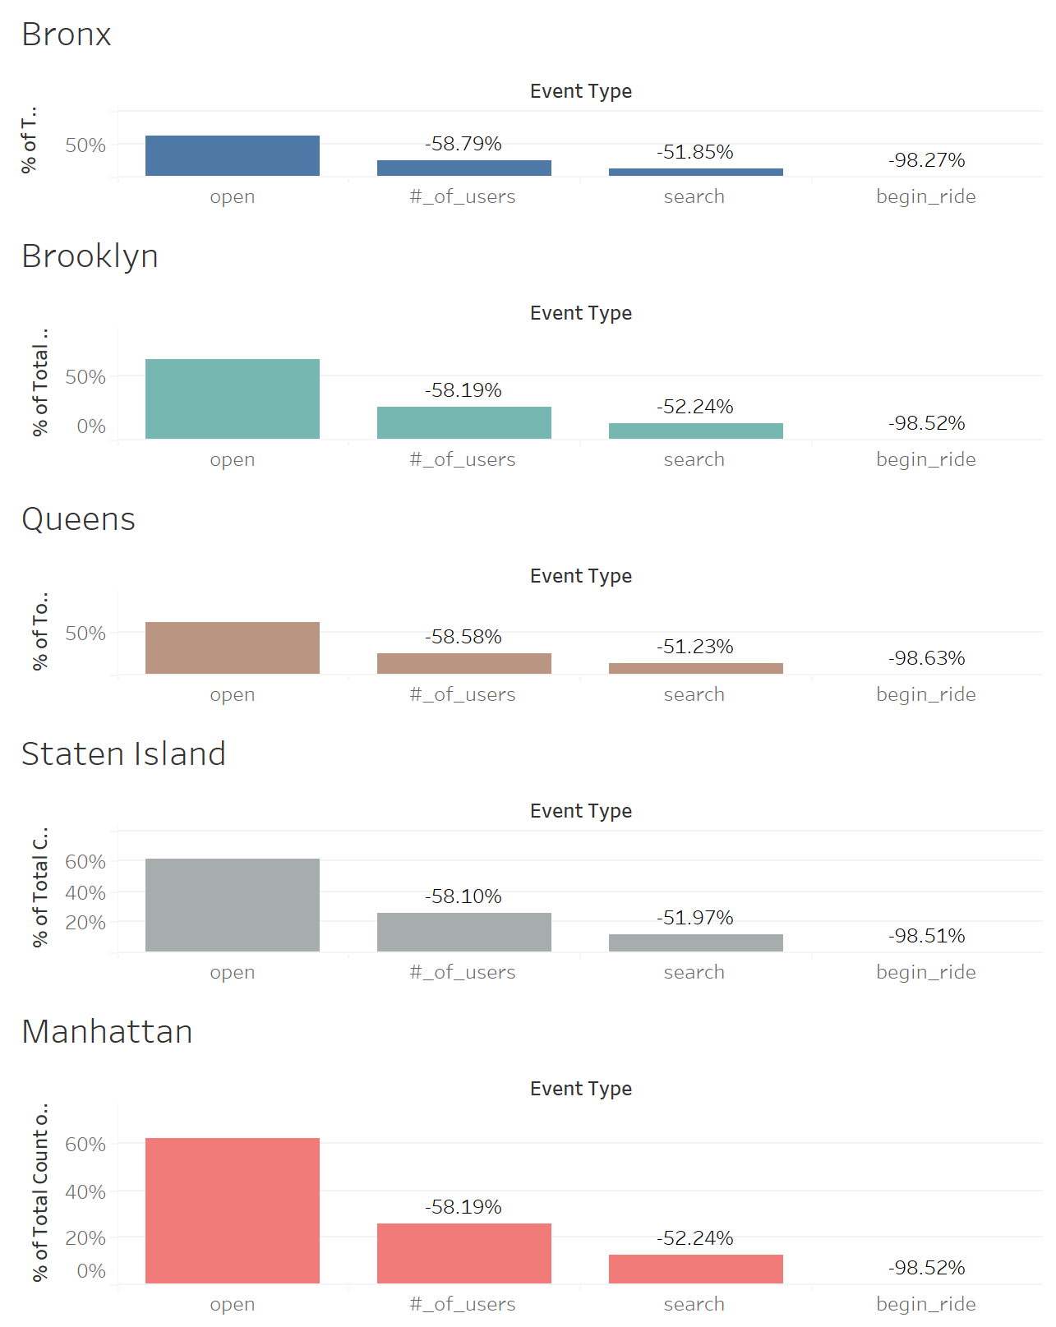
Segment Analysis of Funnel - Neighborhood

Slide 16
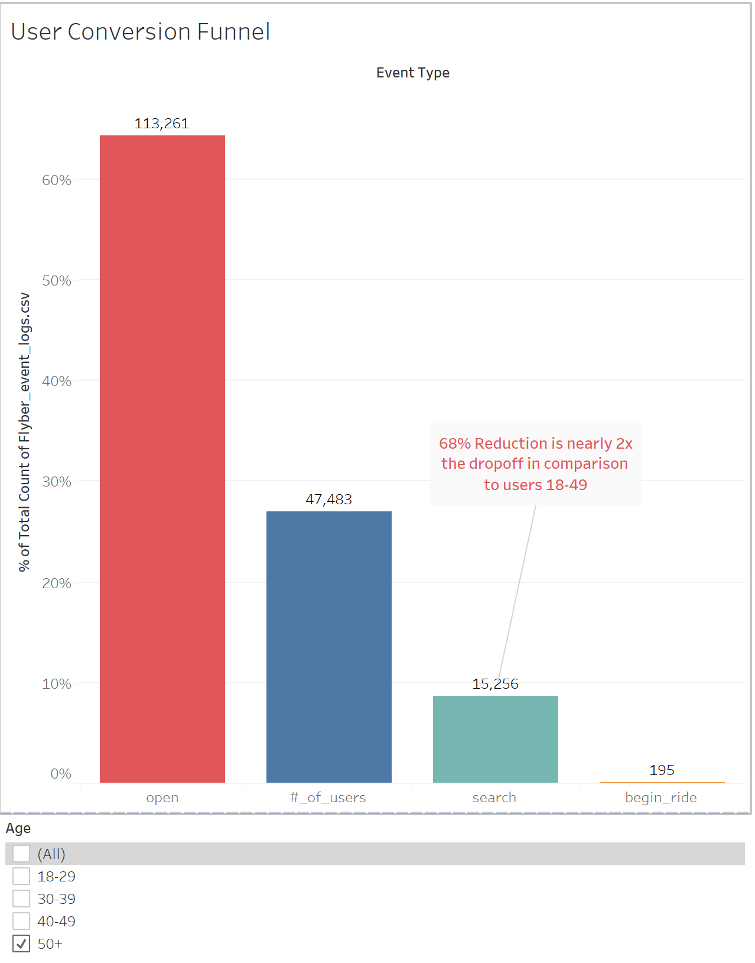
Segment Analysis of Funnel
Age 50+ contains a significant dropoff between # of Users & Search.
Recommend consulting with UX to identify variations to reduce this dropoff.

Slide 17
Step 3
Hypothesis & Next Steps

Slide 18
User Interviews
We believe we are losing trips to 50+ demographic Because our user interface is too difficult for this cohort, And that by providing increased booking options for users 50+ we will see a reduction in the conversion pipeline between # of Users and Search.
“Before Flyber, I'd call a taxi service on the phone.” - Sapphire Dupont, 60
“I just hail a taxi or tell my phone to call a cab to go to a certain address (I'm always on the phone, so I just use voice commands with my phone most of the time)” - Kierran Blackburn, 55
“I have a personal car service on call. My assistant books Flyber whenever I'd be travelling during peak NYC traffic hours. Time is money and Flyber saves me time! But I let my assistant actually book the Flyber because the first few times I tried booking, the instructions were too small.” – Louis Jones, 70

Slide 19
Suggested Features & Experimentation Plan
We believe we are losing trips to 50+ demographic Because our user interface is too difficult for this cohort, And that by providing increased visual options for users 50+ we will see a reduction in the conversion pipeline between # of Users and Search.
Feature 1: Create a ‘Call to Book’ button, connecting to an automated agent to finalize booking.
Feature 2: Change default text sizes for ages 50+ to larger font size.
As this cohort is our largest user demographic, we will perform a multi-variate test to analyze the impact of these changes.
For Feature 1, we will test 2 different flavors of the Call to Book button, compared against our existing control
For Feature 2, we will conduct 2 different default font sizes, for a total of 4 different test variations.

Slide 20
Additional Metrics to be Captured
For each experiment, we will capture the following (in addition to data gathered from prior experiment event logs (Age, existing events, etc)):
Device Type
Event (call_to_book)
Event (default_text_modified)
We will also add duration to each event, to capture whether the intended changes reduce the time taken to book a Flyber. This may lead to other enhancements targeted to reducing booking time for other cohorts, if we establish a statistically significant correlation between time/event and conversion rate.

Slide 21
Appendix
Raw Data

Slide 22
Additional Info
You could include supporting or additional information that can support your previous slides but isn’t necessary for every person to see that looks at your slides.

