Slide 1
Data Science Capstone
Identifying Colorado Cities with high Outdoor Recreation amenities for Real Estate Investment

Slide 2
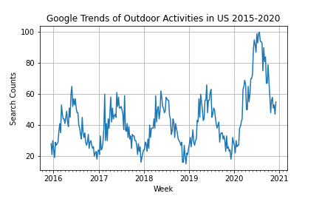
Opportunity Statement
COVID 19 caused an explosive growth in Outdoor Recreation and interest in smaller cities/towns with outdoor amenities
This, coupled with pivot to remote work, may lead to higher migration to small cities.

Slide 3
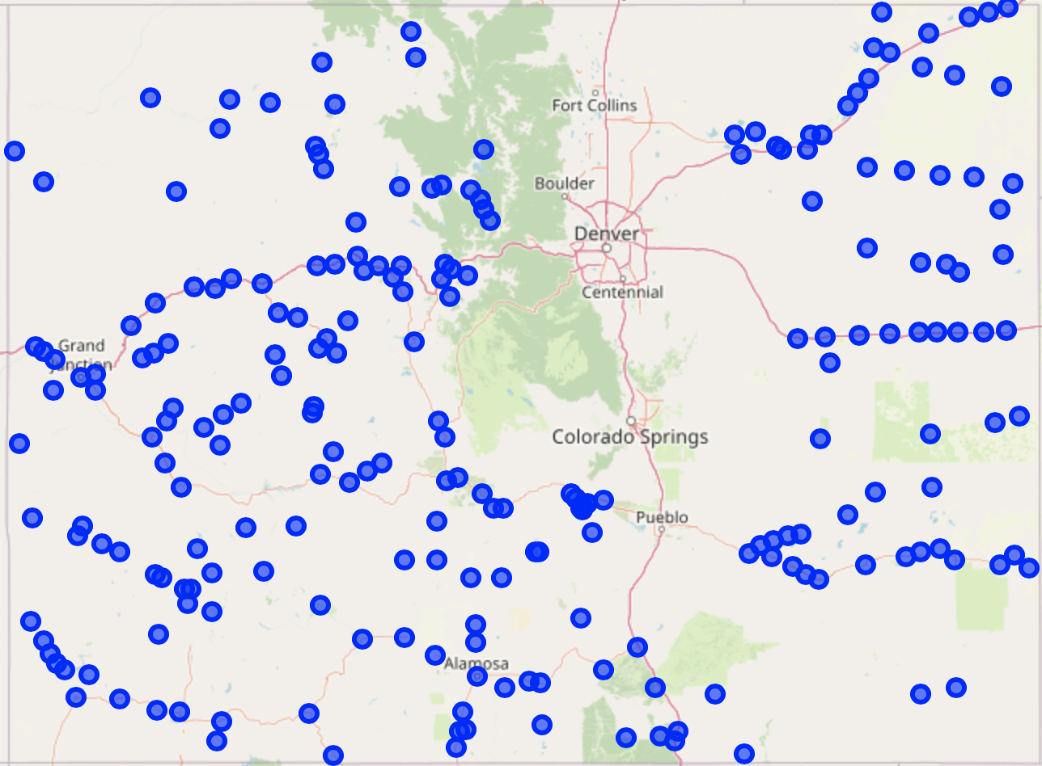
Project Scope: Small Cities in Colorado with Zilllow Home Value Data
Given the focus on small cities near nature, we are excluding the main metro areas east of the mountain ranges

Slide 4
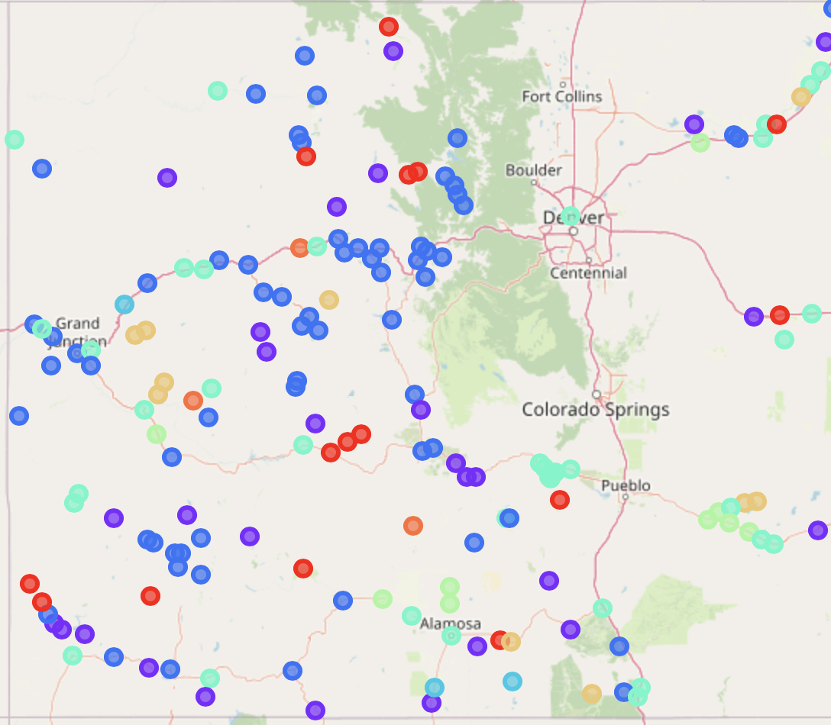
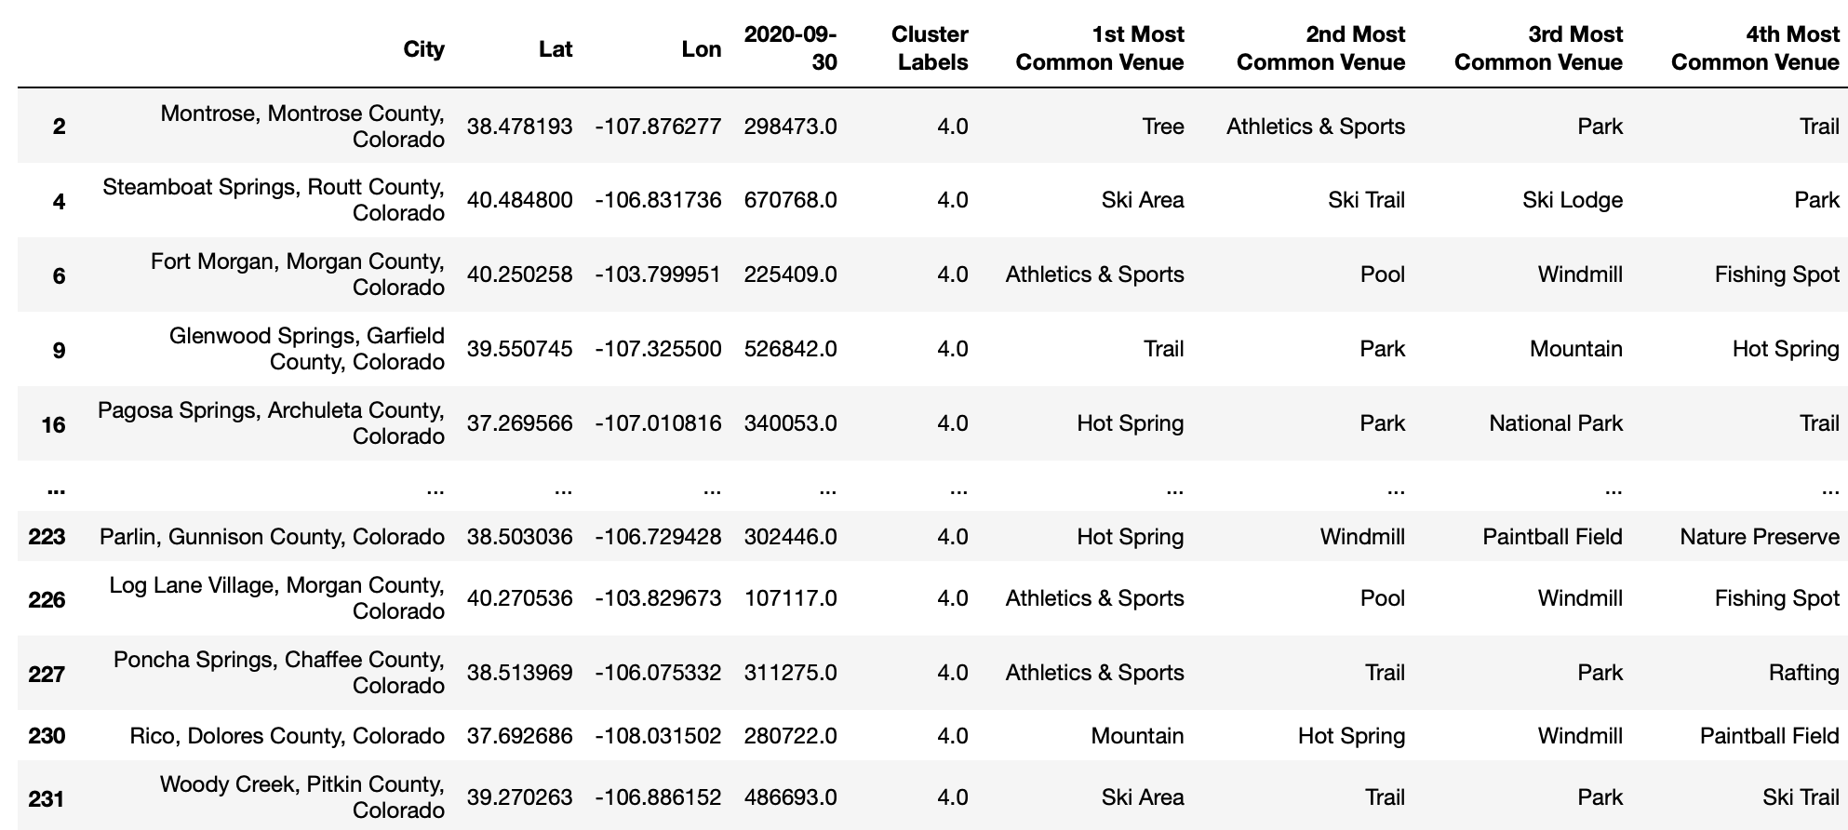
Foursquare API returns Outdoor Venues, then clustered cities using Kmeans Clustering algorithm

Slide 5
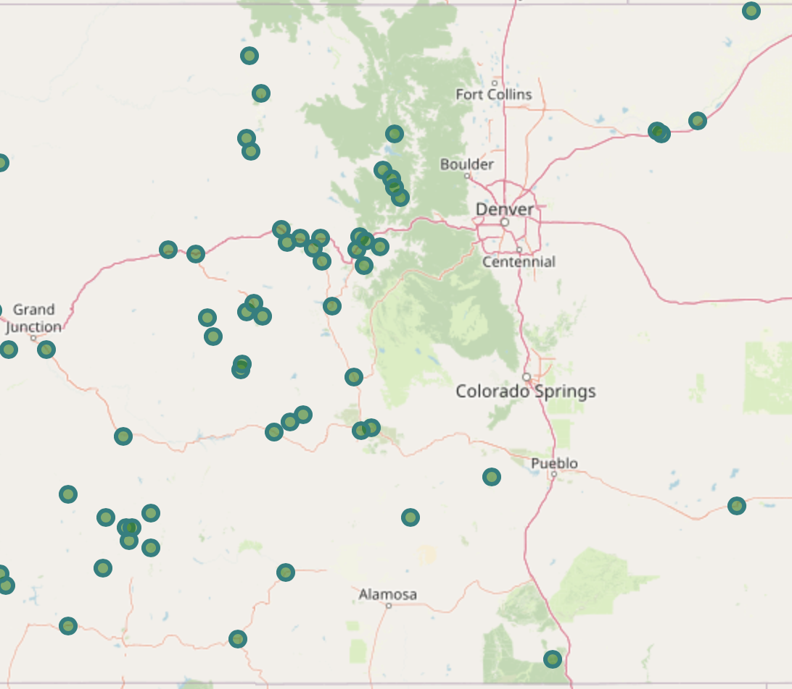
Cluster 4 returns most interesting results - Includes the famous ski resort towns wide list of more affordable, lesser known cities

Slide 6
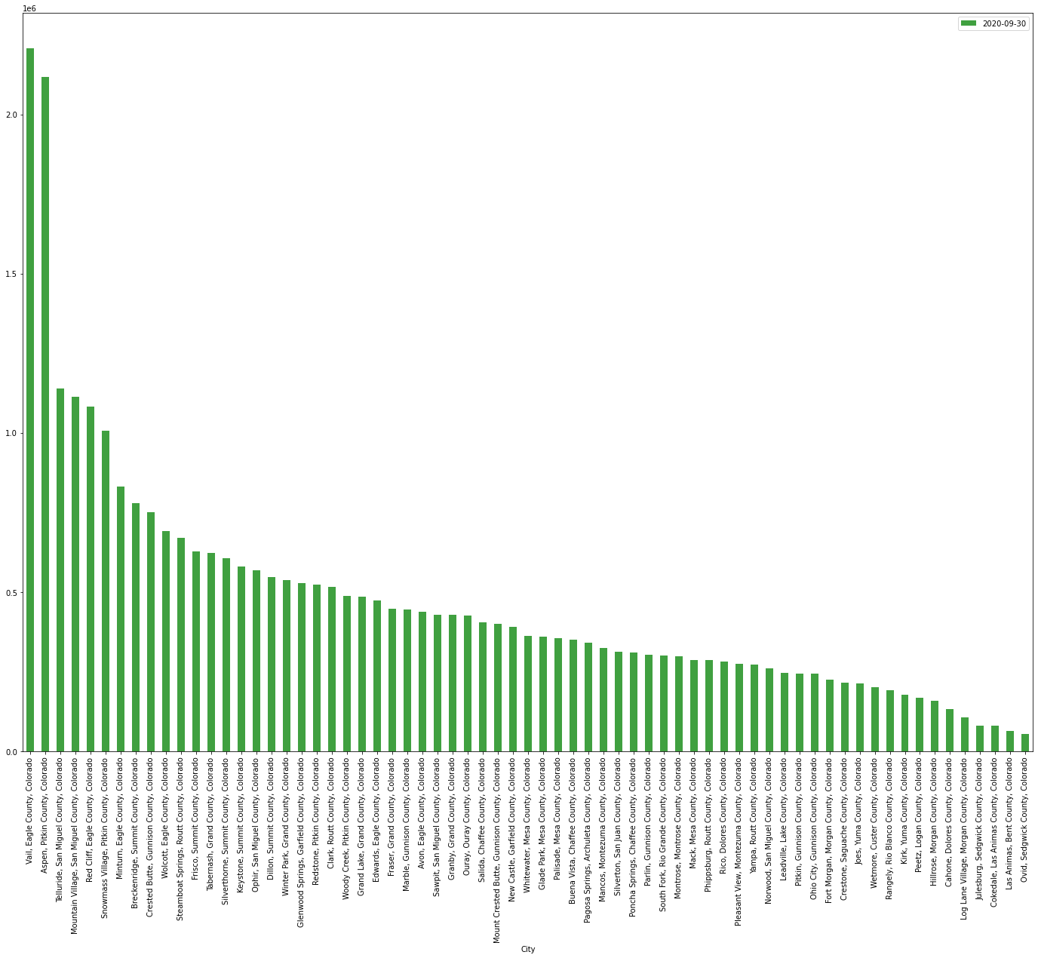
Cluster 4 Home Values Sorted

Slide 7
Conclusions
Based on Linear Regression, the homes at the high end of market in cluster 4 look to have the highest price appreciation.
However, homes within cluster 4 at a lower price point contain robust outdoor amenities and merit additional research for long term housing investments.

